Slide 1
Jupiter’s unearthly jets: quo vadis?
Oxford/Leverhulme 2 September 2015
Stephen I. Thomson & Michael E. McIntyre,
Dept of Applied Mathematics & Theoretical Physics,
University of Cambridge, UK
1. Update on: our new idealized model of Jupiter’s jets – daring to
depart from beta-turbulence orthodoxies – strange new territory plus:
2. Strong suggestions for real planet. Model results
(a) themselves reinforce case that deep jets exist;
(b) suggest new constraint on real planet’s values;
(c) Suggest fruitful way forward for GCM work.
For more detail, websearch ”lucidity principles”
then back to my home page at ”unearthly”, ”Encyclopedia”, ”Haurwitz”.

Slide 2
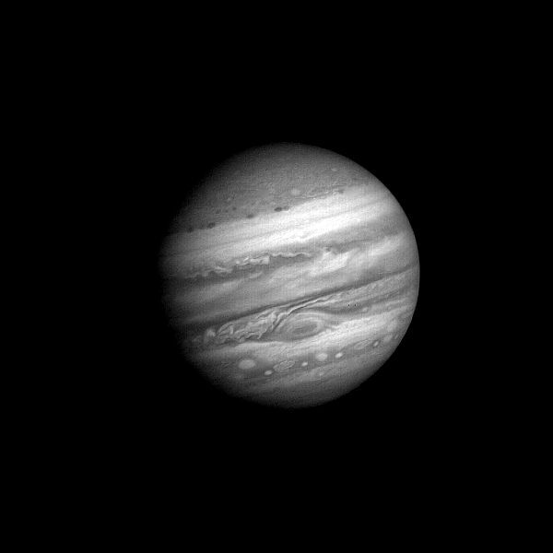
1979: Voyager 1 approaching (60 Jupiter days)
folded
filamentary
region
For more detail, websearch ”lucidity principles”
then back to my home page at ”unearthly”, ”Encyclopedia”, ”Haurwitz”.

Slide 3
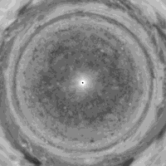
North-polar view of Jupiter assembled from Cassini images from Porco et al.
2003, movie S1, showing the jets’ unearthly “straightness”
For more detail, websearch ”lucidity principles”
then back to my home page at ”unearthly”, ”Encyclopedia”, ”Haurwitz”.

Slide 4
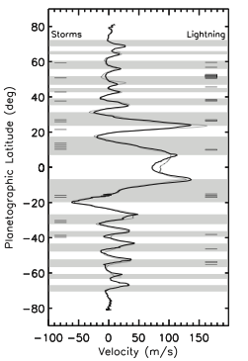
Zonal mean cloud winds
Extremely steady! 21-year time interval between
Voyager (light curve) and Cassini (dark curve).
(And GRS has persisted for centuries.)
[

Slide 5
Zonal mean cloud winds
Extremely steady! 21-year time interval between
Voyager (light curve) and Cassini (dark curve).
(And GRS has persisted for centuries.)
Jets extremely straight, especially the prograde jets
– unearthly !! Unlike weather-layer-only models.
[

Slide 6
Zonal mean cloud winds
Extremely steady! 21-year time interval between
Voyager (light curve) and Cassini (dark curve).
(And GRS has persisted for centuries.)
Jets extremely straight, especially the prograde jets
– unearthly !! Unlike weather-layer-only models.
Weather layer coupled to deep dry-convection layer
offers best hope of fluid-dynamical understanding
(Ingersoll-Cuong 1981, Dowling-Ingersoll 1989,…)
[

Slide 7
Zonal mean cloud winds
Extremely steady! 21-year time interval between
Voyager (light curve) and Cassini (dark curve).
(And GRS has persisted for centuries.)
Jets extremely straight, especially the prograde jets
– unearthly !! Unlike weather-layer-only models.
Weather layer coupled to deep dry-convection layer
offers best hope of fluid-dynamical understanding
(Ingersoll-Cuong 1981, Dowling-Ingersoll 1989,…)
[
(rejecting an old
false dichotomy)

Slide 8
Zonal mean cloud winds
Extremely steady! 21-year time interval between
Voyager (light curve) and Cassini (dark curve).
(And GRS has persisted for centuries.)
Jets extremely straight, especially the prograde jets
– unearthly !! Unlike weather-layer-only models.
Weather layer coupled to deep dry-convection layer
offers best hope of fluid-dynamical understanding
(Ingersoll-Cuong 1981, Dowling-Ingersoll 1989,…)
(And NB: there is only one GRS.)
[
(rejecting an old
false dichotomy)

Slide 9
Zonal mean cloud winds
Extremely steady! 21-year time interval between
Voyager (light curve) and Cassini (dark curve).
(And GRS has persisted for centuries.)
Jets extremely straight, especially the prograde jets
– unearthly !! Unlike weather-layer-only models.
Weather layer coupled to deep dry-convection layer
offers best hope of fluid-dynamical understanding
(Ingersoll-Cuong 1981, Dowling-Ingersoll 1989,…)
(And NB: there is only one GRS.)
[
(rejecting an old
false dichotomy)
↓tangent cylinder?↓

Slide 10
Zonal mean cloud winds
Extremely steady! 21-year time interval between
Voyager (light curve) and Cassini (dark curve).
(And GRS has persisted for centuries.)
Jets extremely straight, especially the prograde jets
– unearthly !! Unlike weather-layer-only models.
Weather layer coupled to deep dry-convection layer
offers best hope of fluid-dynamical understanding
(Ingersoll-Cuong 1981, Dowling-Ingersoll 1989,…)
(And NB: there is only one GRS.)
[
(rejecting an old
false dichotomy)
↓tangent cylinder?↓
Moist convection may be the dominant coupling:
stronger in ‘belts’ (cyclonic, shaded) than in ‘zones’
(anticyclonic, unshaded). R.h. bars show lightning.

Slide 11
Zonal mean cloud winds
Extremely steady! 21-year time interval between
Voyager (light curve) and Cassini (dark curve).
(And GRS has persisted for centuries.)
Jets extremely straight, especially the prograde jets
– unearthly !! Unlike weather-layer-only models.
Weather layer coupled to deep dry-convection layer
offers best hope of fluid-dynamical understanding
(Ingersoll-Cuong 1981, Dowling-Ingersoll 1989,…)
(And NB: there is only one GRS.)
[
(rejecting an old
false dichotomy)
↓tangent cylinder?↓
Moist convection may be the dominant coupling:
stronger in ‘belts’ (cyclonic, shaded) than in ‘zones’
(anticyclonic, unshaded). R.h. bars show lightning.
Large-scale (Rayleigh-like) friction not credible
for the real planet. (No shallow solid surface.)

Slide 12
Zonal mean cloud winds
Extremely steady! 21-year time interval between
Voyager (light curve) and Cassini (dark curve).
(And GRS has persisted for centuries.)
Jets extremely straight, especially the prograde jets
– unearthly !! Unlike weather-layer-only models.
Weather layer coupled to deep dry-convection layer
offers best hope of fluid-dynamical understanding
(Ingersoll-Cuong 1981, Dowling-Ingersoll 1989,…)
(And NB: there is only one GRS.)
[
(rejecting an old
false dichotomy)
↓tangent cylinder?↓
Moist convection may be the dominant coupling:
stronger in ‘belts’ (cyclonic, shaded) than in ‘zones’
(anticyclonic, unshaded). R.h. bars show lightning.
Large-scale (Rayleigh-like) friction not credible
for the real planet. (No shallow solid surface.)
Perfectly-unbiased forcing not credible.

Slide 13
Zonal mean cloud winds
Extremely steady! 21-year time interval between
Voyager (light curve) and Cassini (dark curve).
(And GRS has persisted for centuries.)
Jets extremely straight, especially the prograde jets
– unearthly !! Unlike weather-layer-only models.
Weather layer coupled to deep dry-convection layer
offers best hope of fluid-dynamical understanding
(Ingersoll-Cuong 1981, Dowling-Ingersoll 1989,…)
(And NB: there is only one GRS.)
[
(rejecting an old
false dichotomy)
↓tangent cylinder?↓
Moist convection may be the dominant coupling:
stronger in ‘belts’ (cyclonic, shaded) than in ‘zones’
(anticyclonic, unshaded). R.h. bars show lightning.
Large-scale (Rayleigh-like) friction not credible
for the real planet. (No shallow solid surface.)
Perfectly-unbiased forcing not credible.
Real moist convection is strongly 3-dimensional.
(Consider Jupiter’s folded filamentary regions, and
cf. terrestrial supercell thunderstorms, tornadoes, etc.)

Slide 14
Zonal mean cloud winds
Extremely steady! 21-year time interval between
Voyager (light curve) and Cassini (dark curve).
(And GRS has persisted for centuries.)
Jets extremely straight, especially the prograde jets
– unearthly !! Unlike weather-layer-only models.
Weather layer coupled to deep dry-convection layer
offers best hope of fluid-dynamical understanding
(Ingersoll-Cuong 1981, Dowling-Ingersoll 1989,…)
(And NB: there is only one GRS.)
[
(rejecting an old
false dichotomy)
↓tangent cylinder?↓
Moist convection may be the dominant coupling:
stronger in ‘belts’ (cyclonic, shaded) than in ‘zones’
(anticyclonic, unshaded). R.h. bars show lightning.
Large-scale (Rayleigh-like) friction not credible
for the real planet. (No shallow solid surface.)
Perfectly-unbiased forcing not credible.
Real moist convection is strongly 3-dimensional.
(Consider Jupiter’s folded filamentary regions, and
cf. terrestrial supercell thunderstorms, tornadoes, etc.)
Is there a relevant idealized model??

Slide 15
Zonal mean cloud winds
Extremely steady! 21-year time interval between
Voyager (light curve) and Cassini (dark curve).
(And GRS has persisted for centuries.)
Jets extremely straight, especially the prograde jets
– unearthly !! Unlike weather-layer-only models.
Weather layer coupled to deep dry-convection layer
offers best hope of fluid-dynamical understanding
(Ingersoll-Cuong 1981, Dowling-Ingersoll 1989,…)
(And NB: there is only one GRS.)
[
(rejecting an old
false dichotomy)
↓tangent cylinder?↓
Moist convection may be the dominant coupling:
stronger in ‘belts’ (cyclonic, shaded) than in ‘zones’
(anticyclonic, unshaded). R.h. bars show lightning.
Large-scale (Rayleigh-like) friction not credible
for the real planet. (No shallow solid surface.)
Perfectly-unbiased forcing not credible.
Real moist convection is strongly 3-dimensional.
(Consider Jupiter’s folded filamentary regions, and
cf. terrestrial supercell thunderstorms, tornadoes, etc.)
Is there a relevant idealized model?? A tall order,
but we thought it worth a try.

Slide 16
Zonal mean cloud winds
Extremely steady! 21-year time interval between
Voyager (light curve) and Cassini (dark curve).
(And GRS has persisted for centuries.)
Jets extremely straight, especially the prograde jets
– unearthly !! Unlike weather-layer-only models.
Weather layer coupled to deep dry-convection layer
offers best hope of fluid-dynamical understanding
(Ingersoll-Cuong 1981, Dowling-Ingersoll 1989,…)
(And NB: there is only one GRS.)
[
(rejecting an old
false dichotomy)
↓tangent cylinder?↓
Moist convection may be the dominant coupling:
stronger in ‘belts’ (cyclonic, shaded) than in ‘zones’
(anticyclonic, unshaded). R.h. bars show lightning.
[
Large-scale (Rayleigh-like) friction not credible
for the real planet. (No shallow solid surface.)
Perfectly-unbiased forcing not credible.
Real moist convection is strongly 3-dimensional.
(Consider Jupiter’s folded filamentary regions, and
cf. terrestrial supercell thunderstorms, tornadoes, etc.)
Is there a relevant idealized model?? A tall order,
but we thought it worth a try. Focus on middle latitudes:

Slide 17

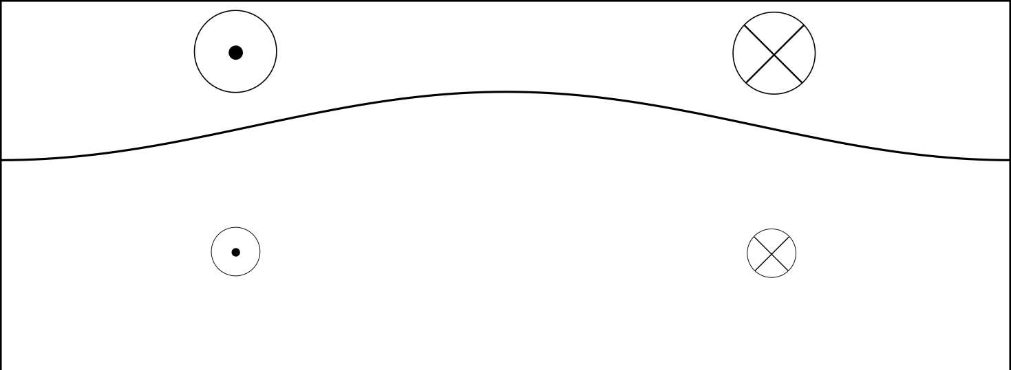

Start by taking Dowling-Ingersoll ‘89 seriously,
weather
layer (1)
dry-
convec’n
layer (2)
(massive)
deep jets
are fixed.
(northward)

Slide 18
Start by taking Dowling-Ingersoll ‘89 seriously,
weather
layer (1)
cold
dry-
convec’n
layer (2)
(massive)
deep jets
are fixed.
(northward)

Slide 19
Start by taking Dowling-Ingersoll ‘89 seriously, as
supported also by Sugiyama et al. 2014, Icarus 229.
A2-stable mid-latitude jet system,
cf. Dowling 1993, Stamp-Dowling 1993:
weather
layer (1)
cold
dry-
convec’n
layer (2)
(massive)
deep jets
are fixed.
(northward)

Slide 20
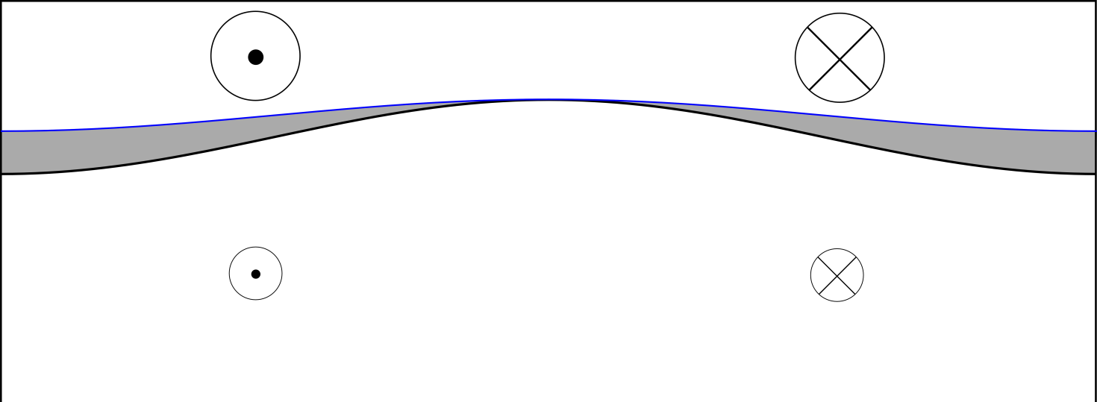
Start by taking Dowling-Ingersoll ‘89 seriously, as
supported also by Sugiyama et al. 2014, Icarus 229.
A2-stable mid-latitude jet system,
cf. Dowling 1993, Stamp-Dowling 1993:
weather
layer (1)
cold
stably
stratified
dry-
convec’n
layer (2)
(massive)
deep jets
are fixed.
(northward)

Slide 21
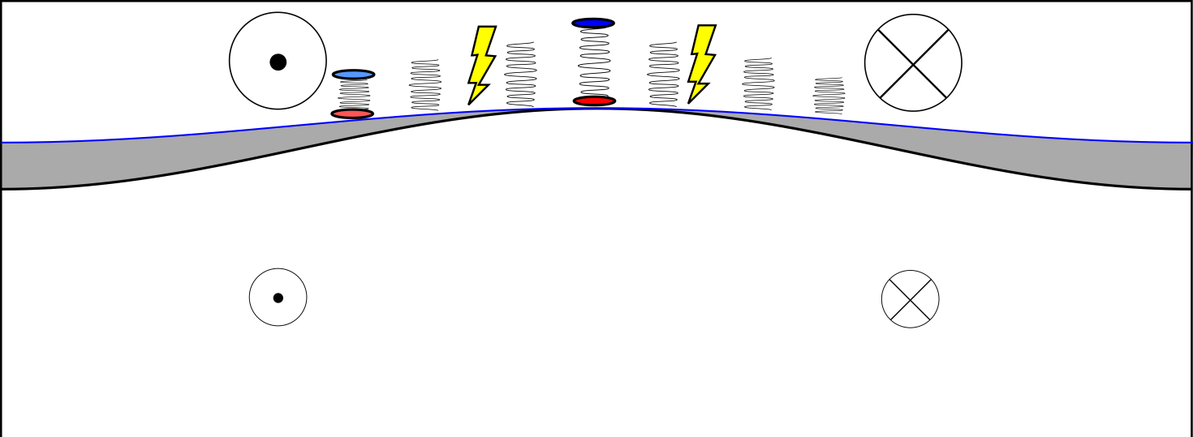
Start by taking Dowling-Ingersoll ‘89 seriously, as
supported also by Sugiyama et al. 2014, Icarus 229.
A2-stable mid-latitude jet system,
cf. Dowling 1993, Stamp-Dowling 1993:
weather
layer (1)
cold
stably
stratified
dry-
convec’n
layer (2)
(massive)
deep jets
are fixed.
(northward)

Slide 22
Start by taking Dowling-Ingersoll ‘89 seriously, as
supported also by Sugiyama et al. 2014, Icarus 229.
A2-stable mid-latitude jet system,
cf. Dowling 1993, Stamp-Dowling 1993:
Water
lifting
condens’n
level
weather
layer (1)
cold
stably
stratified
dry-
convec’n
layer (2)
(massive)
deep jets
are fixed.
(northward)

Slide 23
Start by taking Dowling-Ingersoll ‘89 seriously, as
supported also by Sugiyama et al. 2014, Icarus 229.
A2-stable mid-latitude jet system,
cf. Dowling 1993, Stamp-Dowling 1993:
weather
layer (1)
cold
stably
stratified
dry-
convec’n
layer (2)
(massive)
deep jets
are fixed.
(northward)
Idealize the forcing as injected vortex pairs –
cf. oceanographers’ “heatons” or “hetons” –
but with anticyclonic bias. (Recall the extreme cases
studied by Li et al. 2006, Showman 2007.)
Very artificial – but artifice unavoidable in any such model!

Slide 24

Start by taking Dowling-Ingersoll ‘89 seriously, as
supported also by Sugiyama et al. 2014, Icarus 229.
A2-stable mid-latitude jet system,
cf. Dowling 1993, Stamp-Dowling 1993:
weather
layer (1)
cold
stably
stratified
dry-
convec’n
layer (2)
(massive)
deep jets
are fixed.
(northward)
Idealize the forcing as injected vortex pairs –
cf. oceanographers’ “heatons” or “hetons” –
but with anticyclonic bias. (Recall the extreme cases
studied by Li et al. 2006, Showman 2007.)
Very artificial – but artifice unavoidable in any such model!
Stronger wherever base colder.

Slide 25
Start by taking Dowling-Ingersoll ‘89 seriously, as
supported also by Sugiyama et al. 2014, Icarus 229.
A2-stable mid-latitude jet system,
cf. Dowling 1993, Stamp-Dowling 1993:
“Large” will mean
by comparison
with
weather
layer (1)
cold
stably
stratified
dry-
convec’n
layer (2)
(massive)
deep jets
are fixed.
(northward)
Idealize the forcing as injected vortex pairs –
cf. oceanographers’ “heatons” or “hetons” –
but with anticyclonic bias. (Recall the extreme cases
studied by Li et al. 2006, Showman 2007.)
Very artificial – but artifice unavoidable in any such model!
Stronger wherever base colder.

Slide 26

Standard 1½-layer
quasi-geostrophic
beta-plane model:
, where:

Slide 27
Standard 1½-layer
quasi-geostrophic
beta-plane model:
, where:
PV inversion: given q₁, solve for ψ₁.

Slide 28


Standard 1½-layer
quasi-geostrophic
beta-plane model:
, where:
PV inversion: given q₁, solve for ψ₁.
doubly periodic,

Slide 29
Standard 1½-layer
quasi-geostrophic
beta-plane model:
, where:
PV inversion: given q₁, solve for ψ₁.
cf. exact impermeability theorem
doubly periodic,

Slide 30
Standard 1½-layer
quasi-geostrophic
beta-plane model:
, where:
PV inversion: given q₁, solve for ψ₁.
cf. exact impermeability theorem
doubly periodic,
X
quasi-hyperdiffusive.
Ignore from here on.

Slide 31
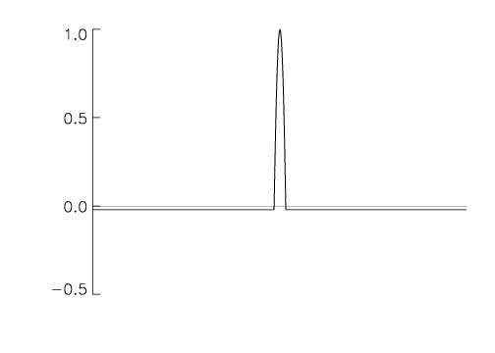
Standard 1½-layer
quasi-geostrophic
beta-plane model:
, where:
PV inversion: given q₁, solve for ψ₁.
cf. exact impermeability theorem
doubly periodic,
X
randomly-injected E-W pairs of
small vortices, with anticyclonic PV-bias,
and stronger wherever base colder, & v.v.
quasi-hyperdiffusive.
Ignore from here on.

Slide 32
Standard 1½-layer
quasi-geostrophic
beta-plane model:
, where:
PV inversion: given q₁, solve for ψ₁.
cf. exact impermeability theorem
doubly periodic,
X
randomly-injected E-W pairs of
small vortices, with anticyclonic PV-bias,
and stronger wherever base colder, & v.v.
quasi-hyperdiffusive.
Ignore from here on.

Slide 33
Standard 1½-layer
quasi-geostrophic
beta-plane model:
, where:
PV inversion: given q₁, solve for ψ₁.
cf. exact impermeability theorem
doubly periodic,
X
randomly-injected E-W pairs of
small vortices, with anticyclonic PV-bias,
and stronger wherever base colder, & v.v.
Note domain-wide “complementary forcing”
quasi-hyperdiffusive.
Ignore from here on.

Slide 34
Standard 1½-layer
quasi-geostrophic
beta-plane model:
, where:
PV inversion: given q₁, solve for ψ₁.
cf. exact impermeability theorem
doubly periodic,
X
NB, not
spectrally
narrow
quasi-hyperdiffusive.
Ignore from here on.
randomly-injected E-W pairs of
small vortices, with anticyclonic PV-bias,
and stronger wherever base colder, & v.v.
Note domain-wide “complementary forcing”

Slide 35
Standard 1½-layer
quasi-geostrophic
beta-plane model:
, where:
PV inversion: given q₁, solve for ψ₁.
cf. exact impermeability theorem
doubly periodic,
X
NB, not
spectrally
narrow
quasi-hyperdiffusive.
Ignore from here on.
randomly-injected E-W pairs of
small vortices, with anticyclonic PV-bias,
and stronger wherever base colder, & v.v.
Note domain-wide “complementary forcing”
Key point: PV-bias plus base-temperature dependence can
replace large-scale friction!

Slide 36

Standard 1½-layer
quasi-geostrophic
beta-plane model:
, where:
PV inversion: given q₁, solve for ψ₁.
cf. exact impermeability theorem
doubly periodic,
X
NB, not
spectrally
narrow
quasi-hyperdiffusive.
Ignore from here on.
randomly-injected E-W pairs of
small vortices, with anticyclonic PV-bias,
and stronger wherever base colder, & v.v.
Note domain-wide “complementary forcing”
Key point: PV-bias plus base-temperature dependence can
replace large-scale friction! Statistical steadiness possible!!

Slide 37

Standard 1½-layer
quasi-geostrophic
beta-plane model:
, where:
PV inversion: given q₁, solve for ψ₁.
cf. exact impermeability theorem
doubly periodic,
X
NB, not
spectrally
narrow
quasi-hyperdiffusive.
Ignore from here on.
randomly-injected E-W pairs of
small vortices, with anticyclonic PV-bias,
and stronger wherever base colder, & v.v.
Note domain-wide “complementary forcing”
Key point: PV-bias plus base-temperature dependence can
replace large-scale friction! Statistical steadiness possible!!
Can have
either sign

Slide 38
Standard 1½-layer
quasi-geostrophic
beta-plane model:
, where:
PV inversion: given q₁, solve for ψ₁.
cf. exact impermeability theorem
doubly periodic,
X
NB, not
spectrally
narrow
quasi-hyperdiffusive.
Ignore from here on.
randomly-injected E-W pairs of
small vortices, with anticyclonic PV-bias,
and stronger wherever base colder, & v.v.
Note domain-wide “complementary forcing”
Key point: PV-bias plus base-temperature dependence can
replace large-scale friction! Statistical steadiness possible!!
No need for radiative damping either.
Can have
either sign

Slide 39
Standard 1½-layer
quasi-geostrophic
beta-plane model:
, where:
PV inversion: given q₁, solve for ψ₁.
cf. exact impermeability theorem
doubly periodic,
X
NB, not
spectrally
narrow
quasi-hyperdiffusive.
Ignore from here on.
randomly-injected E-W pairs of
small vortices, with anticyclonic PV-bias,
and stronger wherever base colder, & v.v.
Note domain-wide “complementary forcing”
Key point: PV-bias plus base-temperature dependence can
replace large-scale friction! Statistical steadiness possible!!
No need for radiative damping either.
(Realistic radiative damping timescales? Is concept relevant at all?)
Can have
either sign

Slide 40

In particular, in the zonally-averaged PV equation
acts qualitatively like a Rayleigh drag toward the deep-jet
velocity profile.

Slide 41
In particular, in the zonally-averaged PV equation
acts qualitatively like a Rayleigh drag toward the deep-jet
velocity profile.
also acts quasi-frictionally on large cyclones, though not
so much on large anticyclones. (Is there a clue here about
the large anticyclones on the real planet?) Call this “cyclone
attrition”

Slide 42
In particular, in the zonally-averaged PV equation
acts qualitatively like a Rayleigh drag toward the deep-jet
velocity profile.
also acts quasi-frictionally on large cyclones, though not
so much on large anticyclones. (Is there a clue here about
the large anticyclones on the real planet?) Call this “cyclone
attrition” – in competition with various cyclone-boosting effects…

Slide 43
In particular, in the zonally-averaged PV equation
acts qualitatively like a Rayleigh drag toward the deep-jet
velocity profile.
also acts quasi-frictionally on large cyclones, though not
so much on large anticyclones. (Is there a clue here about
the large anticyclones on the real planet?) Call this “cyclone
attrition” – in competition with various cyclone-boosting effects…
The drag toward deep-jet velocity profiles is quite powerful in
most cases that look at all realistic (timescale 10’s of Earth years).
There is no tendency to create ever-stronger jets, such as found in
typical frictionless beta-turbulence models.

Slide 44

In particular, in the zonally-averaged PV equation
acts qualitatively like a Rayleigh drag toward the deep-jet
velocity profile.
also acts quasi-frictionally on large cyclones, though not
so much on large anticyclones. (Is there a clue here about
the large anticyclones on the real planet?) Call this “cyclone
attrition” – in competition with various cyclone-boosting effects…
The drag toward deep-jet velocity profiles is quite powerful in
most cases that look at all realistic (timescale 10’s of Earth years).
There is no tendency to create ever-stronger jets, such as found in
typical frictionless beta-turbulence models.
To translate PV picture into momentum picture, use the Taylor
identity

Slide 45

In particular, in the zonally-averaged PV equation
acts qualitatively like a Rayleigh drag toward the deep-jet
velocity profile.
also acts quasi-frictionally on large cyclones, though not
so much on large anticyclones. (Is there a clue here about
the large anticyclones on the real planet?) Call this “cyclone
attrition” – in competition with various cyclone-boosting effects…
The drag toward deep-jet velocity profiles is quite powerful in
most cases that look at all realistic (timescale 10’s of Earth years).
There is no tendency to create ever-stronger jets, such as found in
typical frictionless beta-turbulence models.
To translate PV picture into momentum picture, use the Taylor
identity
What happens is sensitive to & hence to the strength of :

Slide 46

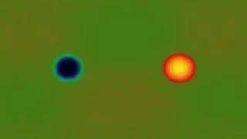

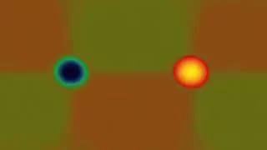
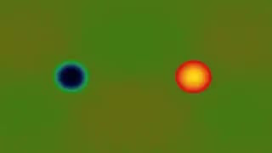
Forcing strengths ,
cf. Shigeo Kida (1981):
Strong injections
= 16:
in units of background shear
Recall
Semi-strong injec’ns
= 8:
Weak injections
= 2:
(as required for passive
Kelvin shearing,
CE2/SSST-type models)

Slide 47
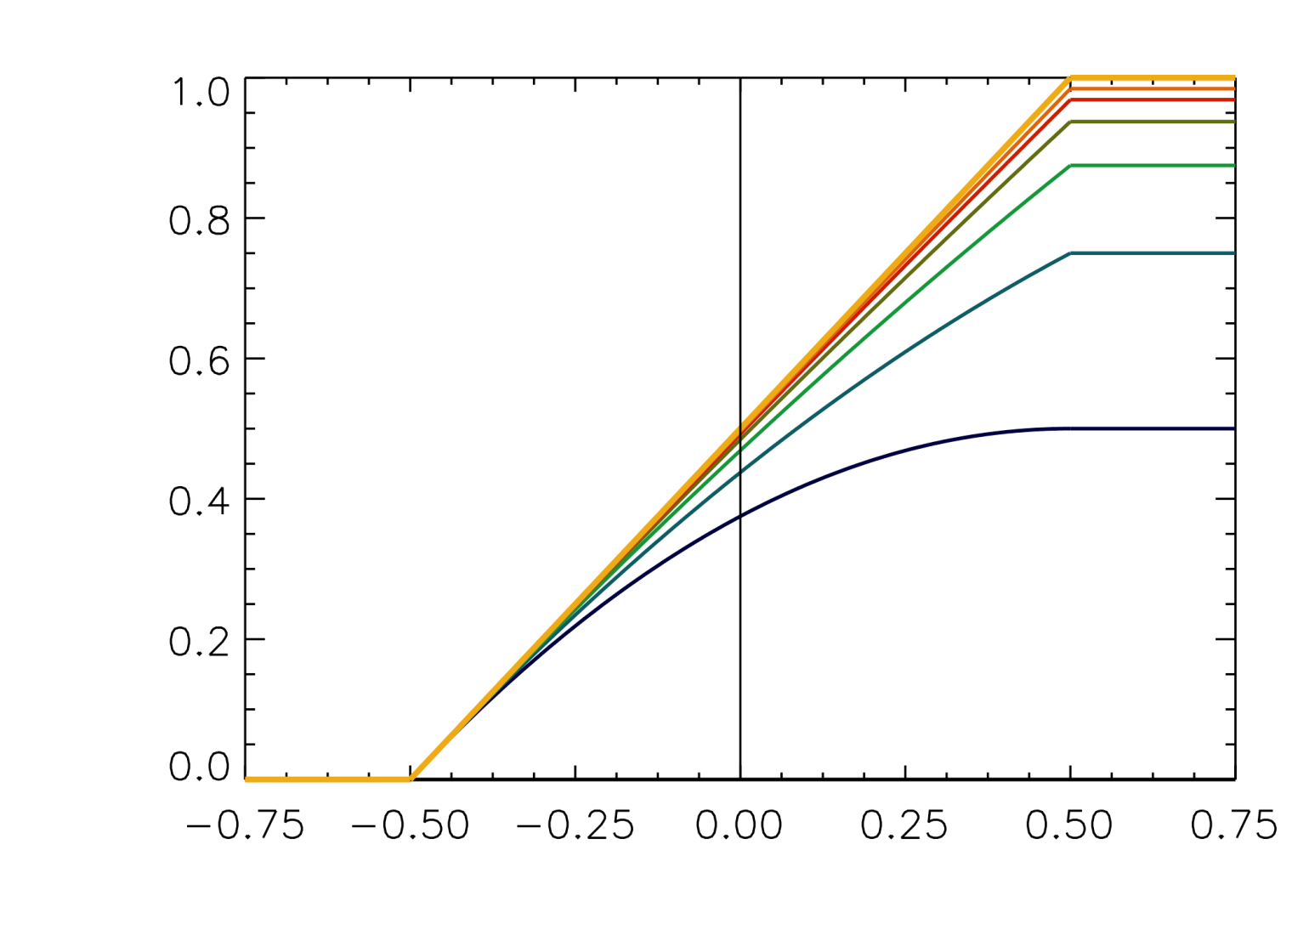


Final (July ’14) version of injection-pair algorithm, with “saturation”:
biases:
0
1/64
1/32
1/16
1/8
1/4
1/2
1/1 (anticyclone
only, as in
Li et al. ’06,
Showman ’07)
anticyclone
strength
cyclone
strengths
An additional “saturation” constraint further limits injection strengths by
prohibiting from exceeding .
With this setup, bias 1/32 is enough to ensure large-cyclone attrition.
Illustrate for strength = 16 and = 0 (pure Dowling-Ingersoll):

Slide 48
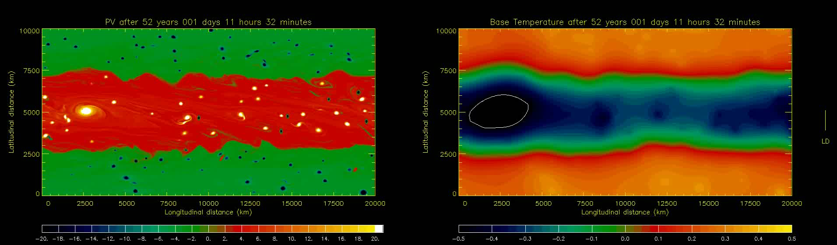
Bias 1/32, = 16, = 0 (pure Dowling-Ingersoll), 2:1 domain aspect ratio:
NB: quasi-realistic base-temperature structure;
white contour shows where = +0.5 threshold reached.

Slide 49
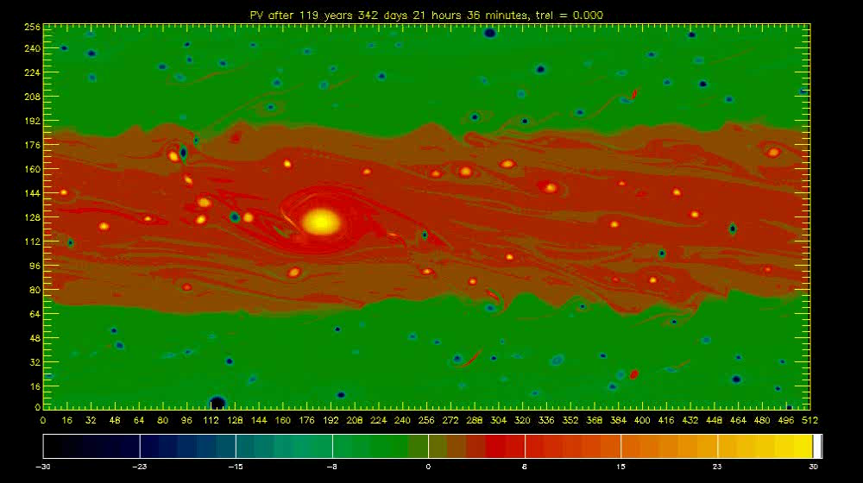
Bias 1/16, = 16, = 0 (pure Dowling-Ingersoll), 2:1 domain:
LD

Slide 50
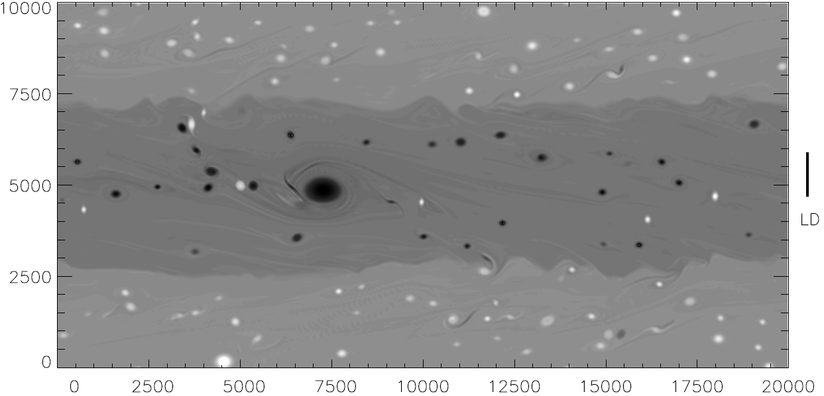
Bias 1/16, = 16, = 0 (pure Dowling-Ingersoll), 2:1 domain:
km
km
(same in grayscale: note sharp edges)

Slide 51
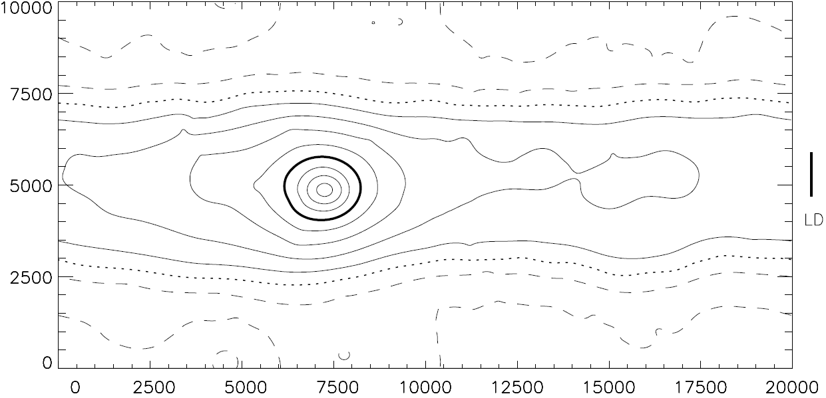
Corresponding field:
km
WARM
COLD
WARM
km

Slide 52
Corresponding field:
km
WARM
COLD
WARM
km
Some zonal-mean profiles for different biases ( = 0 still):

Slide 53
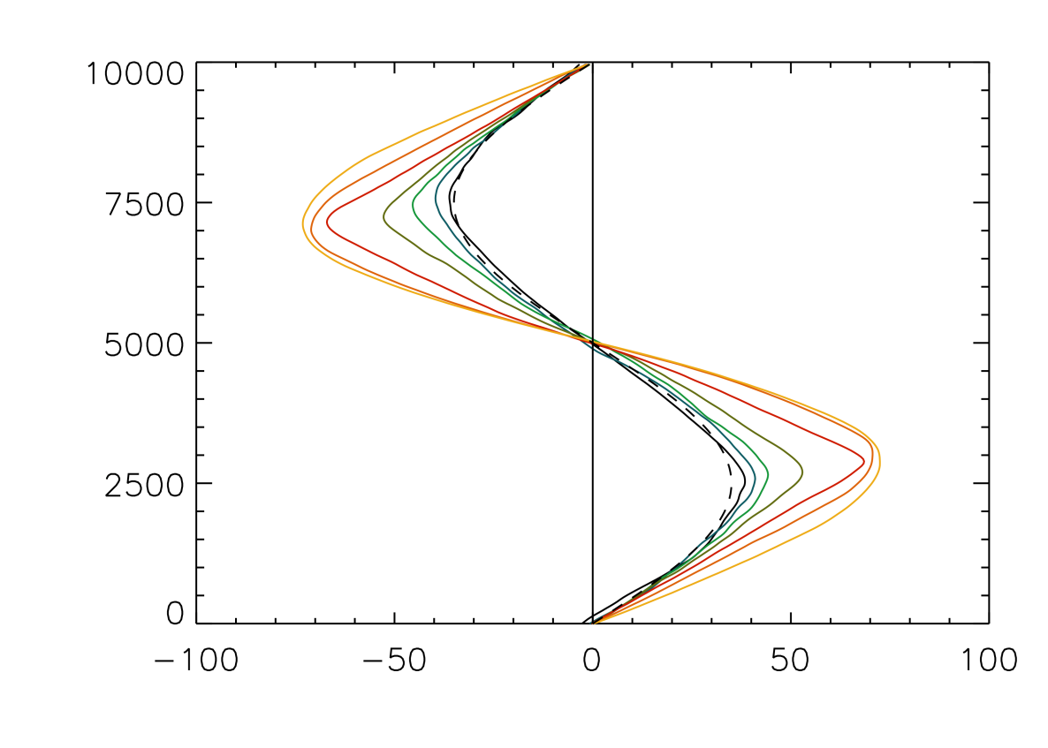
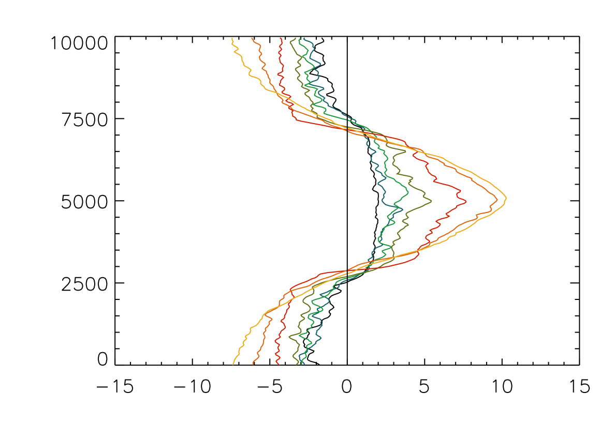

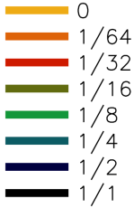
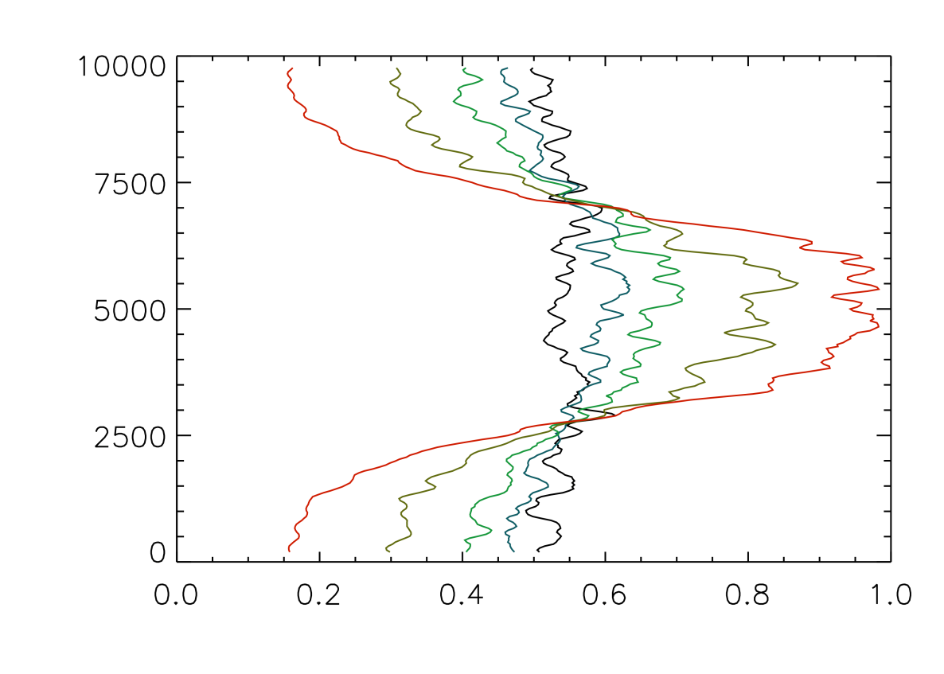
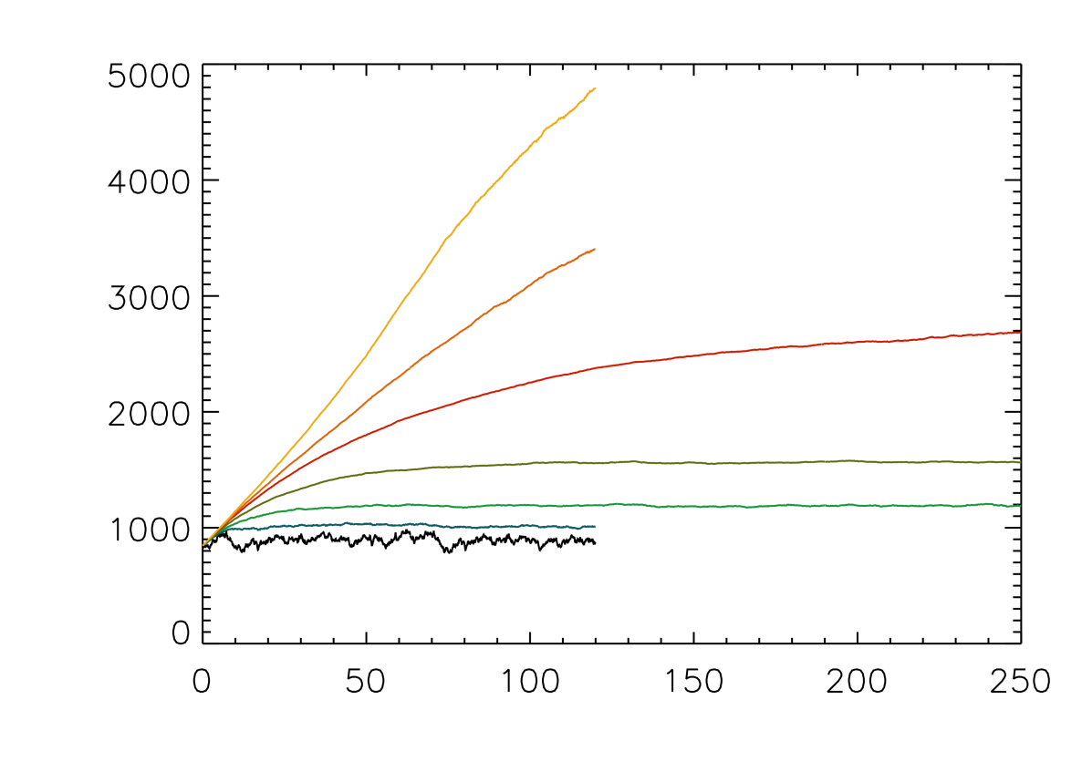
biases:
/km
deep jet,
à la
Stamp-Dowling
m/s
Total energy
Not quite
settled yet
Strength-
weighted
injections
/km
Statistically steady
time / Earth years

Slide 54
Main points about model results so far:
▪ Jupiter model has no large-scale friction and no radiative damping.
▪ Yet PV bias and zeta-dependence allow statistically-steady states.
▪ Model can produce realistic belt-zone (zeta) structure, with vortex activity
strengthening and sharpening the upper jets relative to the deep jets.
▪ Strengthening is due to monopole migration.
▪ Sharpening is due to PV mixing.
▪ No significant upscale energy cascade!
For more detail, websearch ”lucidity principles”
then back to my home page at ”unearthly”, ”Encyclopedia”, ”Haurwitz”.

Slide 55
Main points about model results so far:
▪ Jupiter model has no large-scale friction and no radiative damping.
▪ Yet PV bias and zeta-dependence allow statistically-steady states.
▪ Model can produce realistic belt-zone (zeta) structure, with vortex activity
strengthening and sharpening the upper jets relative to the deep jets.
▪ Strengthening is due to monopole migration.
▪ Sharpening is due to PV mixing.
▪ No significant upscale energy cascade!
(Unmixing!!)
For more detail, websearch ”lucidity principles”
then back to my home page at ”unearthly”, ”Encyclopedia”, ”Haurwitz”.

Slide 56
Main points about model results so far:
▪ Jupiter model has no large-scale friction and no radiative damping.
▪ Yet PV bias and zeta-dependence allow statistically-steady states.
▪ Model can produce realistic belt-zone (zeta) structure, with vortex activity
strengthening and sharpening the upper jets relative to the deep jets.
▪ Strengthening is due to monopole migration.
▪ Sharpening is due to PV mixing.
▪ No significant upscale energy cascade!
(Unmixing!!)
(And KE conv. has
credible magnitude)
For more detail, websearch ”lucidity principles”
then back to my home page at ”unearthly”, ”Encyclopedia”, ”Haurwitz”.

Slide 57
Main points about model results so far:
▪ Jupiter model has no large-scale friction and no radiative damping.
▪ Yet PV bias and zeta-dependence allow statistically-steady states.
▪ Model can produce realistic belt-zone (zeta) structure, with vortex activity
strengthening and sharpening the upper jets relative to the deep jets.
▪ Strengthening is due to monopole migration.
▪ Sharpening is due to PV mixing.
▪ No significant upscale energy cascade!
(Unmixing!!)
(And KE conv. has
credible magnitude)
▪ Model has not so far produced a realistic-looking large anticyclone (GRS)
For more detail, websearch ”lucidity principles”
then back to my home page at ”unearthly”, ”Encyclopedia”, ”Haurwitz”.

Slide 58
Main points about model results so far:
▪ Jupiter model has no large-scale friction and no radiative damping.
▪ Yet PV bias and zeta-dependence allow statistically-steady states.
▪ Model can produce realistic belt-zone (zeta) structure, with vortex activity
strengthening and sharpening the upper jets relative to the deep jets.
▪ Strengthening is due to monopole migration.
▪ Sharpening is due to PV mixing.
▪ No significant upscale energy cascade!
(Unmixing!!)
(And KE conv. has
credible magnitude)
▪ Model has not so far produced a realistic-looking large anticyclone (GRS)
▪ Passive Kelvin (“SSST”, “CE2”) weak & produces unrealistic zeta despite
favourable forcing-anisotropy (Srinivasan & Young 2014).
(Plasma results robustly suggest the opposite: Kelvin mech. probably dominant.)
For more detail, websearch ”lucidity principles”
then back to my home page at ”unearthly”, ”Encyclopedia”, ”Haurwitz”.

Slide 59

Quo vadis? (with this model? with understanding the real planet?)
Main points from slide 1: the model results
(a) themselves reinforce case that deep jets exist:
If pure-DI resembles reality, then jet straightness is in itself
evidence for the existence of deep jets – otherwise long-wave unstable.
(b) suggest new constraint on real planet’s values:
Even with deep jets, the real planet’s weather-layer jets cannot remain
straight (free of coherent long-wave undulations) unless is below
some threshold – probably km in middle latitudes.
(c) suggest fruitful way forward for GCM work:
Best way forward may be to use flexible lower boundary and
prescribed deep jets. (Avoids huge uncertainty over deep boundary conditions.)
For more detail, websearch ”lucidity principles”
then back to my home page at ”unearthly”, ”Encyclopedia”, ”Haurwitz”.

Slide 62
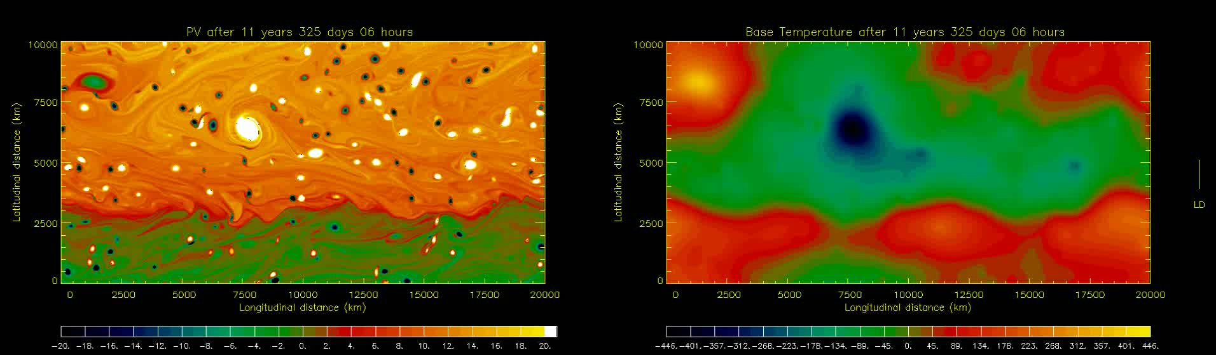
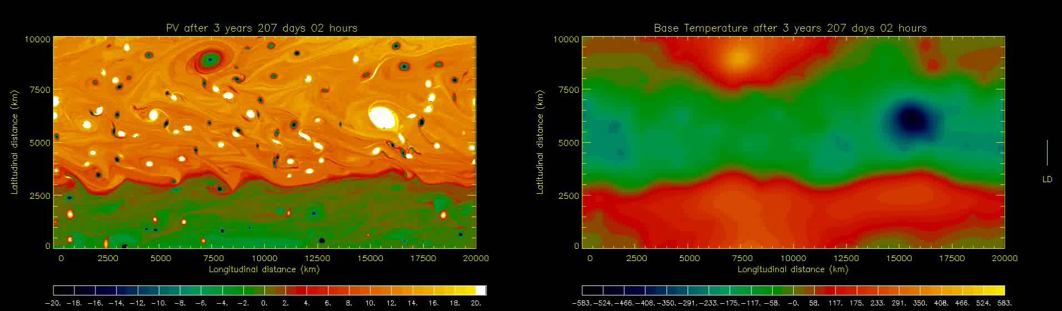
Early mature, bias 1/16:
Early mature, bias 1/64:
Bias 1/64 is too weak to stop the large cyclone from growing further:

Slide 63
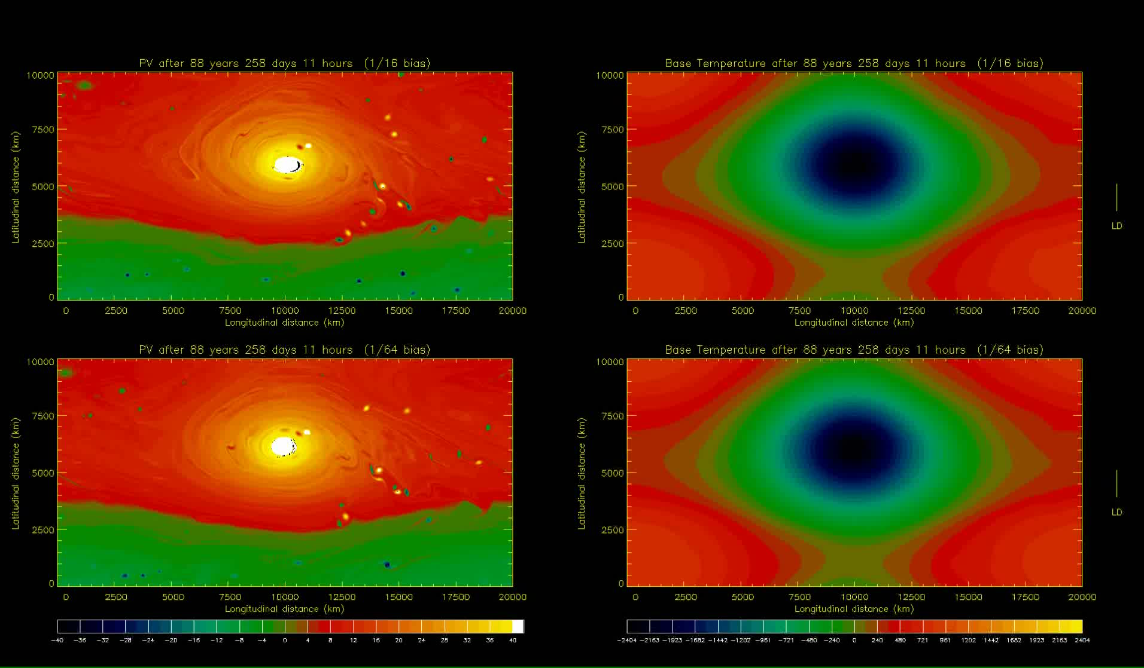
Skipping forward, ~ 80 Earth-years later:
Bias was 1/64, now 1/16:
Bias 1/64 continues:
Bias 1/64 is too weak to stop the large cyclone from growing further.

Slide 65
Toy tokamak? Very preliminary – with hopes of collaboration with Steve Tobias
and others (?) E.g. I don’t yet know enough about plasma numerical magnitudes...)

Slide 66
Toy tokamak? Very preliminary – with hopes of collaboration with Steve Tobias
and others (?) E.g. I don’t yet know enough about plasma numerical magnitudes...)
Recall “extended Hasegawa-Mima”, ‘model 2’ in Rosenbluth Lecture.
(For historical justice, we should call it the
“extended Charney-Obukhov-Hasegawa-Mima model”,
ECOHAM – oh, dear):

Slide 67



Toy tokamak? Very preliminary – with hopes of collaboration with Steve Tobias
and others (?) E.g. I don’t yet know enough about plasma numerical magnitudes...)
Recall “extended Hasegawa-Mima”, ‘model 2’ in Rosenbluth Lecture.
(For historical justice, we should call it the
“extended Charney-Obukhov-Hasegawa-Mima model”,
ECOHAM – oh, dear):
with

Slide 68
Toy tokamak? Very preliminary – with hopes of collaboration with Steve Tobias
and others (?) E.g. I don’t yet know enough about plasma numerical magnitudes...)
Recall “extended Hasegawa-Mima”, ‘model 2’ in Rosenbluth Lecture.
(For historical justice, we should call it the
“extended Charney-Obukhov-Hasegawa-Mima model”,
ECOHAM – oh, dear):
Prime is crucial! (Tilde, if you prefer
– departure from zonal average.)
with

Slide 69
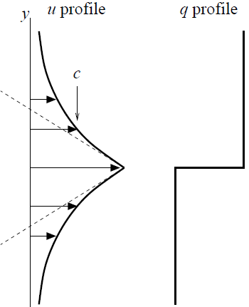

Toy tokamak? Very preliminary – with hopes of collaboration with Steve Tobias
and others (?) E.g. I don’t yet know enough about plasma numerical magnitudes...)
Recall “extended Hasegawa-Mima”, ‘model 2’ in Rosenbluth Lecture.
(For historical justice, we should call it the
“extended Charney-Obukhov-Hasegawa-Mima model”,
ECOHAM – oh, dear):
Prime is crucial! (Tilde, if you prefer
– departure from zonal average.)
Implication: strong jet with given
PV contrast has far greater velocity
contrast:
with
Rosenbluth
Lecture, Fig. 1.8

Slide 70
Add self-excitation term as crude model – this is cheating! – of resistive
drift-wave instability à la Hasegawa-Wakatani

Slide 71
Add self-excitation term as crude model – this is cheating! – of resistive
drift-wave instability à la Hasegawa-Wakatani (note, Jeffrey Parker has
done this properly, personal communication Tuesday):

Slide 72


Add self-excitation term as crude model – this is cheating! – of resistive
drift-wave instability à la Hasegawa-Wakatani (note, Jeffrey Parker has
done this properly, personal communication Tuesday):
constant nominal growth rate
constant Rayleigh frictions (more cheating)
with >>

Slide 73
Add self-excitation term as crude model – this is cheating! – of resistive
drift-wave instability à la Hasegawa-Wakatani (note, Jeffrey Parker has
done this properly, personal communication Tuesday):
constant nominal growth rate
constant Rayleigh frictions (more cheating)
with >>
(in short-
hand)

Slide 74
Add self-excitation term as crude model – this is cheating! – of resistive
drift-wave instability à la Hasegawa-Wakatani (note, Jeffrey Parker has
done this properly, personal communication Tuesday):
constant nominal growth rate
constant Rayleigh frictions (more cheating)
with >>
(in short-
hand)
is chosen much smaller than the domain size (square box now) –
less Jupiter-like and more tokamak-like – such that

Slide 75
Add self-excitation term as crude model – this is cheating! – of resistive
drift-wave instability à la Hasegawa-Wakatani (note, Jeffrey Parker has
done this properly, personal communication Tuesday):
constant nominal growth rate
constant Rayleigh frictions (more cheating)
with >>
(in short-
hand)
is chosen much smaller than the domain size (square box now) –
less Jupiter-like and more tokamak-like – such that
Get predator-prey-like situation, with hyper-staircasing of the
profile. (My Rosenbluth speculation was WRONG!!) Not weakly
forced/dissipating, PV-mixing-dominated, à la Scott-Dritschel JFM 2012.

Slide 76
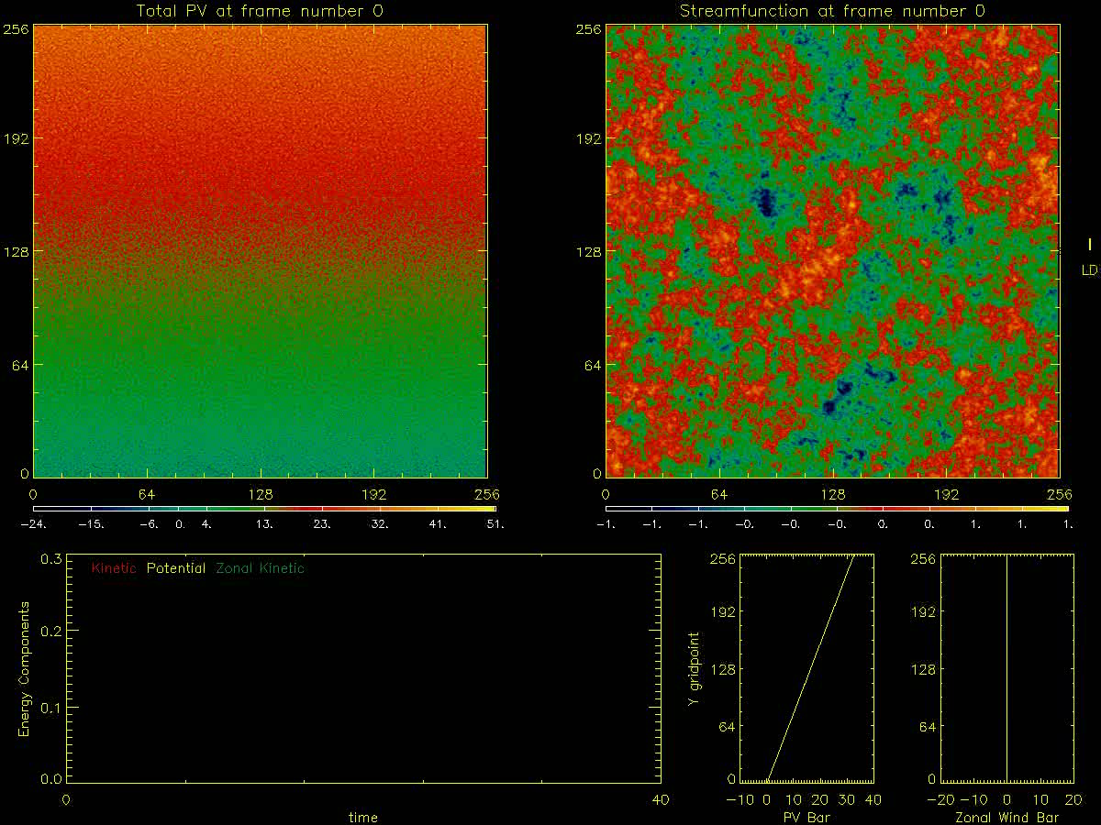
q
q
ψ
ψ
q bar
u bar
E
E

Slide 77
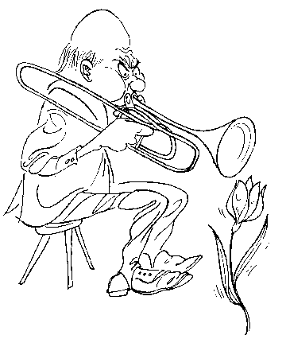
“Erasmus Darwin held that every so often you should
try a damn-fool experiment. He played the trombone to his tulips.
This… result… was negative. But other… impudent ideas have succeeded…“
– J. E. Littlewood: A Mathematician’s Miscellany, ed. Béla Bollobás

Slide 78
“Erasmus Darwin held that every so often you should
try a damn-fool experiment. He played the trombone to his tulips.
This… result… was negative. But other… impudent ideas have succeeded…“
– J. E. Littlewood: A Mathematician’s Miscellany, ed. Béla Bollobás
Set = 0, otherwise same problem:

Slide 79
“Erasmus Darwin held that every so often you should
try a damn-fool experiment. He played the trombone to his tulips.
This… result… was negative. But other… impudent ideas have succeeded…“
– J. E. Littlewood: A Mathematician’s Miscellany, ed. Béla Bollobás
Set = 0, otherwise same problem:

Slide 80
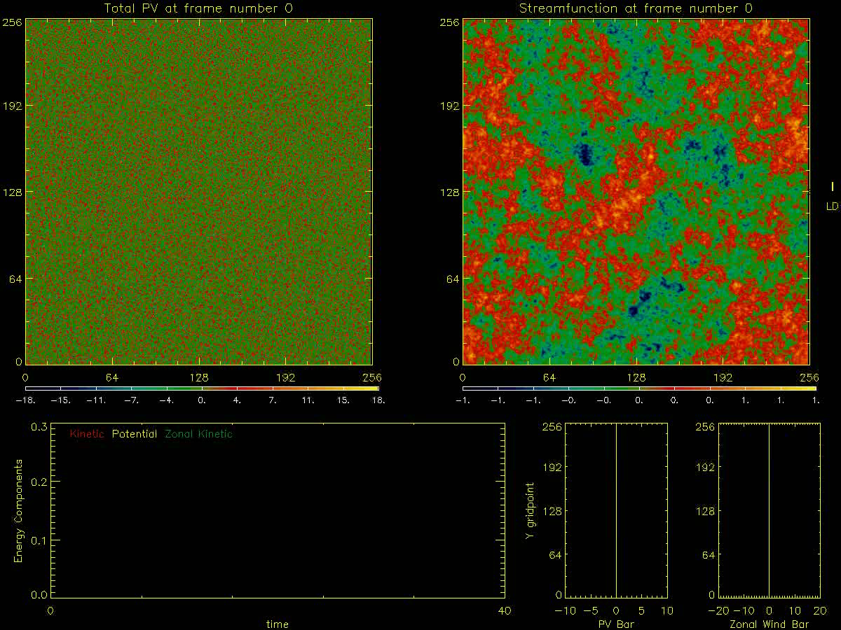
q
q
ψ
ψ
q bar
u bar
E
E

Slide 82

Jet dynamics – a complex conceptual landscape wth a 2-level hierarchy of ideas:
Horse & cart?
PV Phillips effect Taylor identity:
1. Generic ideas: PV invertibility – div (eddy momentum flux)
Nonlinear, forced/free/self-excited
2. Particular mechanisms:
(i) Rhines effect. Re weak jets generated by strong small-scale forcing – strong
enough to create active small-scale vortices that merge or cluster, producing an
inverse cascade that is arrested or slowed when eddy velocities ~ plane Rossby-
wave phase speeds. Wave-turbulence interaction is spatially homogeneous.
(ii) Repeated excit’n of passive Kelvin sheared disturbances by weak small-scale
forcing. (Kelvin 1887, Farrell-Ioannou, Marston, Srinivasan-Young: CE2, SSST)
(iii) Inhomogeneous PV mixing: re strong jets self-sharpened by Rossby-wave
breaking. Wave-turbulence interaction spatially inhomogeneous.
(iv) Vortex merging and cannibalism, ↔ inverse cascade (sort of)
(v) Monopole vortex migration (significant on Jupiter? Ingersoll et al. 2000)
(vi) Quasi-random-walk vortex migration (significant on Jupiter?)
(vii) PV-biased forcing: critical in the idealized Jupiter weather-layer model
being studied by Stephen Thomson and myself.
3. Additional point: DIMBO effect ...

Slide 83
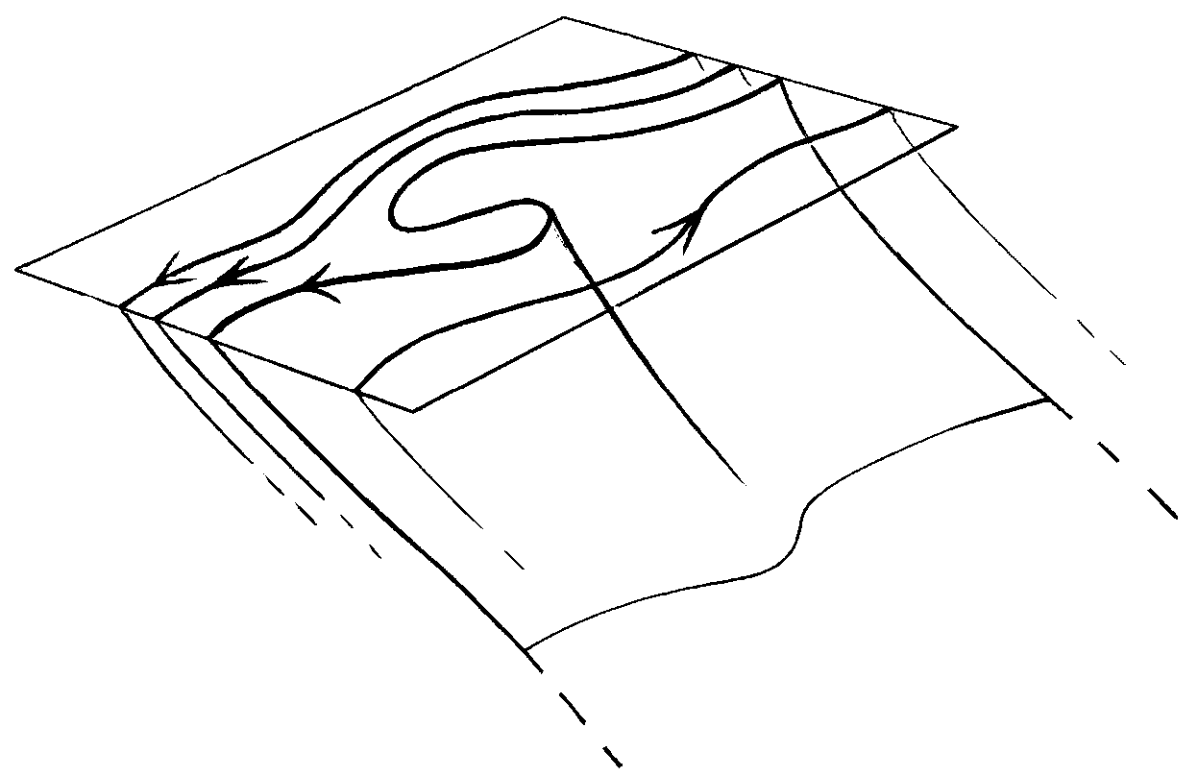
DIMBO = DIapycnal Mixing via Baroclinic Overturning
sea surface, ignoring
mixed layer
← L (mesoscale) →
isopycnal
surface
(to Antarctica)
DIMBO layer:
mesoscale eddies
mix diapycnally as well
as isopycnally
Underneath:
mesoscale eddies
mix only isopycnally.
Diapycnal transport is
solely by inertia-gravity-wave
breaking, cabbeling, DD, spiralling
How deep is the DIMBO layer? Scale analysis and semigeostrophic PV inversion suggest
the “obvious” answer fL/N. Could ~ kilometre or two. Must often exceed mixed-layer depth.
Numerical experiments underway (John Taylor, Raff Ferrari, personal communication)
– watch this space!

Slide 84
DIMBO = DIapycnal Mixing via Baroclinic Overturning
sea surface, ignoring
mixed layer
← L (mesoscale) →
isopycnal
surface
(to Antarctica)
DIMBO layer:
mesoscale eddies
mix diapycnally as well
as isopycnally
Statically unstable:
must convect.
Underneath:
mesoscale eddies
mix only isopycnally.
Diapycnal transport is
solely by inertia-gravity-wave
breaking, cabbeling, DD, spiralling
How deep is the DIMBO layer? Scale analysis and semigeostrophic PV inversion suggest
the “obvious” answer fL/N. Could ~ kilometre or two. Must often exceed mixed-layer depth.
Numerical experiments underway (John Taylor, Raff Ferrari, personal communication)
– watch this space!

