Slide 1
Jets: a roller-coaster ride from Earth to Jupiter and back, or:
Leverhulm Wave-Turbulence Meeting, Cambridge, 14 July 2014
The multiplicity of ‘turbulence’ problems, or:
Is homogeneous turbulence theory a dangerous idea?
Michael E. McIntyre,
Dept of Applied Mathematics & Theoretical Physics,
University of Cambridge, UK
1: Very brief look at standard jet mechanisms and the case of
earthly strong jets, following Rosenbluth and Haurwitz lectures
2. Hot off the press: results from a new idealized model of Jupiter’s jets
– strange new territory!!
3. Even hotter (not to say hasty and preliminary) surprises from the
extended Hasegawa-Mima equation including a ‘damn fool experiment’
(but Jeff Parker has got further with this...)
For more detail, websearch ”lucidity principles”
then back to my home page at ”Encyclopedia”, ”Rosenbluth”, ”Haurwitz”.

Slide 2
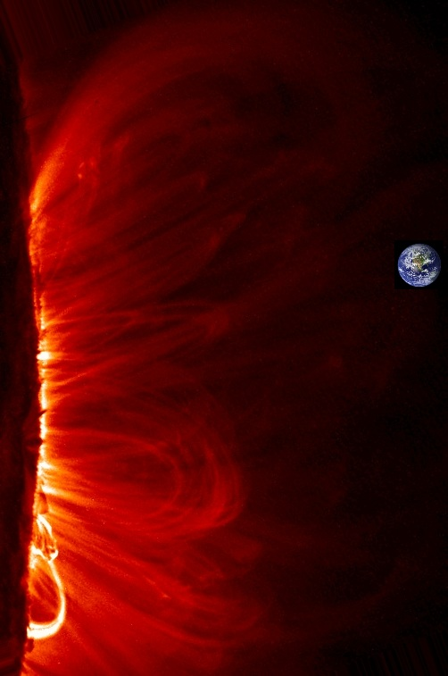
Our life support system
For more detail, websearch ”lucidity principles”
then back to my home page at ”Encyclopedia”, ”Rosenbluth”, ”Haurwitz”.

Slide 3
Our life support system
fluid dynamics on a grand scale…
For more detail, websearch ”lucidity principles”
then back to my home page at ”Encyclopedia”, ”Rosenbluth”, ”Haurwitz”.

Slide 4
Our life support system
fluid dynamics on a grand scale…
And rotation and stable stratification are
important in many cases, including the Sun’s
interior…
For more detail, websearch ”lucidity principles”
then back to my home page at ”Encyclopedia”, ”Rosenbluth”, ”Haurwitz”.

Slide 5
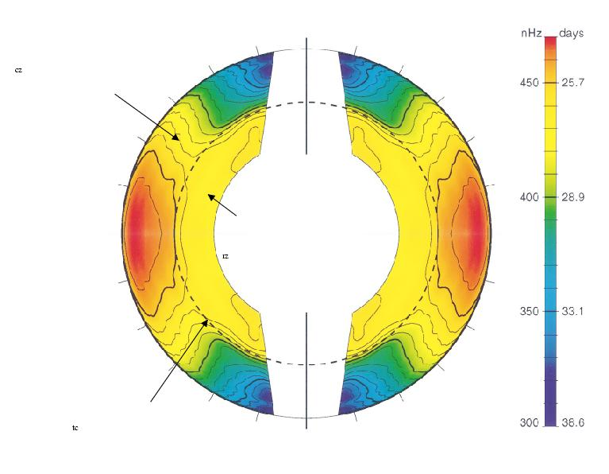
2πΩ/nHz
convection
zone
radiative interior –
no significant evidence
for departures from
solid rotation
(Princeton, May 2011)
For more detail, websearch ”lucidity principles”
then back to my home page at ”Encyclopedia”, ”Rosenbluth” , ”Haurwitz”.
Schou et al ’98

Slide 6
2πΩ/nHz
convection
zone
Wood & McI
(2011),
J. Fluid
Mech. 677
radiative interior –
no significant evidence
for departures from
solid rotation
(Princeton, May 2011)
For more detail, websearch ”lucidity principles”
then back to my home page at ”Encyclopedia”, ”Rosenbluth” , ”Haurwitz”.
tachocline
Schou et al ’98

Slide 7
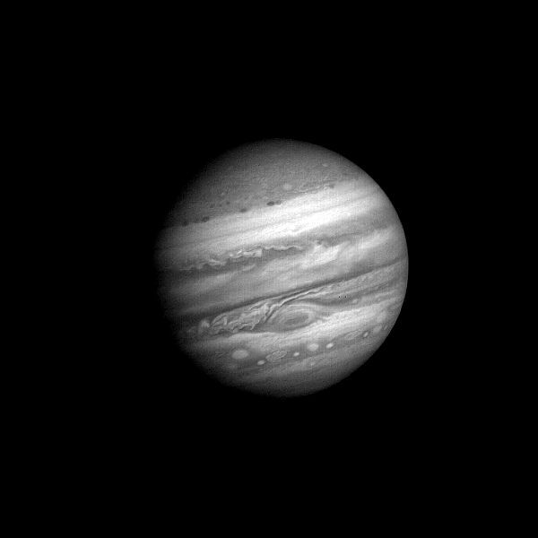
1979: Voyager 1 approaching (60 Jupiter days) – unearthly!
folded
filamentary
region
For more detail, websearch ”lucidity principles”
then back to my home page at ”Encyclopedia”, ”Rosenbluth” , ”Haurwitz”.

Slide 8
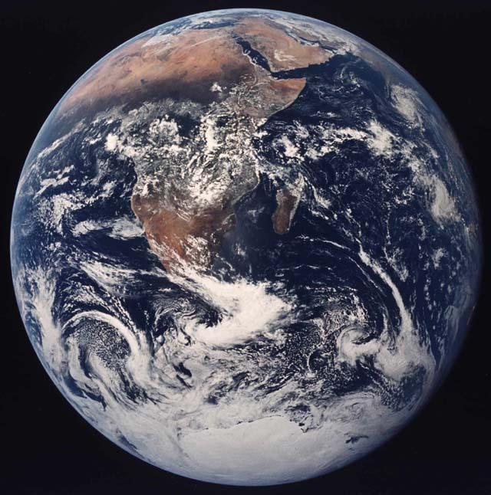
Today it hardly needs saying, following an
aphorism of V.I. Arnol’d, that
Rotating, stratified
fluid dynamics
cannot be
understood without
potential vorticity,
PV
For more detail, websearch ”lucidity principles”
then back to my home page at ”Encyclopedia”, ”Rosenbluth” , ”Haurwitz”.

Slide 9
Today it hardly needs saying, following an
aphorism of V.I. Arnol’d, that
Rotating, stratified
fluid dynamics
cannot be
understood without
potential vorticity,
PV
Tokamaks too?
For more detail, websearch ”lucidity principles”
then back to my home page at ”Encyclopedia”, ”Rosenbluth” , ”Haurwitz”.

Slide 10
Today it hardly needs saying, following an
aphorism of V.I. Arnol’d, that
Rotating, stratified
fluid dynamics
cannot be
understood without
potential vorticity,
PV
Tokamaks too?
Here’s the most
beautiful definition
of the exact PV:
For more detail, websearch ”lucidity principles”
then back to my home page at ”Encyclopedia”, ”Rosenbluth” , ”Haurwitz”.

Slide 11
In both single-layer and multi-layer systems,
we can define the exact PV as the suitably normalized Kelvin circulation
of an infinitesimal material circuit Γ lying in a stratification surface.
For more detail, websearch ”lucidity principles”
then back to my home page at ”Encyclopedia”, ”Rosenbluth”, ”Haurwitz”.

Slide 12
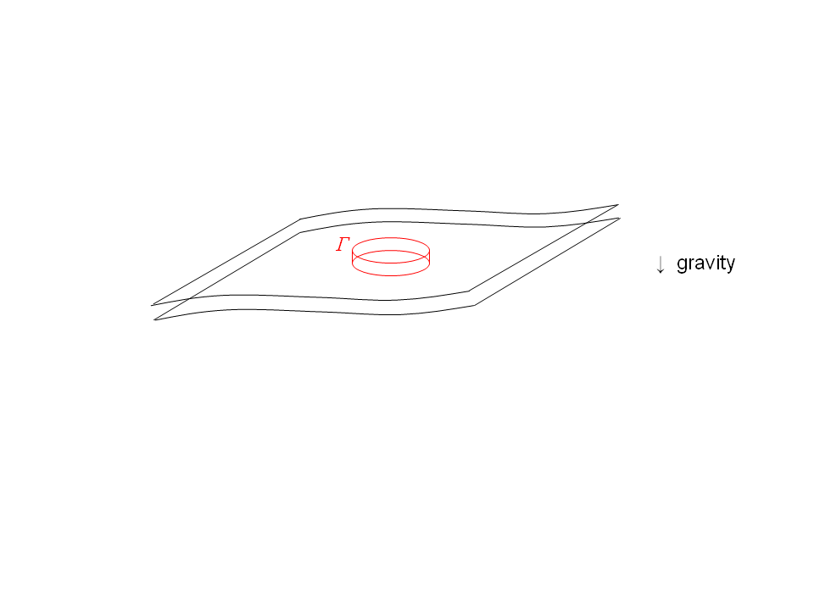

In both single-layer and multi-layer systems,
we can define the exact PV as the suitably normalized Kelvin circulation
of an infinitesimal material circuit Γ lying in a stratification surface.
“Suitably normalized”: multiply by mass of pillbox
between adjacent stratification surfaces:
For more detail, websearch ”lucidity principles”
then back to my home page at ”Encyclopedia”, ”Rosenbluth”, ”Haurwitz”.

Slide 13
In both single-layer and multi-layer systems,
we can define the exact PV as the suitably normalized Kelvin circulation
of an infinitesimal material circuit Γ lying in a stratification surface.
“Suitably normalized”: multiply by mass of pillbox
between adjacent stratification surfaces:
Kelvin
circulation is
For more detail, websearch ”lucidity principles”
then back to my home page at ”Encyclopedia”, ”Rosenbluth”, ”Haurwitz”.

Slide 14
In both single-layer and multi-layer systems,
we can define the exact PV as the suitably normalized Kelvin circulation
of an infinitesimal material circuit Γ lying in a stratification surface.
“Suitably normalized”: multiply by mass of pillbox
between adjacent stratification surfaces:
Kelvin
circulation is
Corollary:
exact PV =
For more detail, websearch ”lucidity principles”
then back to my home page at ”Encyclopedia”, ”Rosenbluth”, ”Haurwitz”.

Slide 15
In both single-layer and multi-layer systems,
we can define the exact PV as the suitably normalized Kelvin circulation
of an infinitesimal material circuit Γ lying in a stratification surface.
“Suitably normalized”: multiply by mass of pillbox
between adjacent stratification surfaces:
Kelvin
circulation is
Corollary:
exact PV =
Note: (1) the PV is a material invariant for frictionless, adiabatic
fluid motion, under any scenario of stretching or tilting
of fluid elements and stratification surfaces.
So the PV is mixable along stratification surfaces (though not across!)
For more detail, websearch ”lucidity principles”
then back to my home page at ”Encyclopedia”, ”Rosenbluth”, ”Haurwitz”.

Slide 16
In both single-layer and multi-layer systems,
we can define the exact PV as the suitably normalized Kelvin circulation
of an infinitesimal material circuit Γ lying in a stratification surface.
“Suitably normalized”: multiply by mass of pillbox
between adjacent stratification surfaces:
Kelvin
circulation is
Corollary:
exact PV =
Note: (1) the PV is a material invariant for frictionless, adiabatic
fluid motion, under any scenario of stretching or tilting
of fluid elements and stratification surfaces.
So the PV is mixable along stratification surfaces (though not across!)
For more detail, websearch ”lucidity principles”
then back to my home page at ”Encyclopedia”, ”Rosenbluth”, ”Haurwitz”.

Slide 17
In both single-layer and multi-layer systems,
we can define the exact PV as the suitably normalized Kelvin circulation
of an infinitesimal material circuit Γ lying in a stratification surface.
“Suitably normalized”: multiply by mass of pillbox
between adjacent stratification surfaces:
Kelvin
circulation is
Corollary:
exact PV =
Note: (1) the PV is a material invariant for frictionless, adiabatic
fluid motion, under any scenario of stretching or tilting
of fluid elements and stratification surfaces.
So the PV is mixable along stratification surfaces (though not across!)
impermeability
theorem etc
For more detail, websearch ”lucidity principles”
then back to my home page at ”Encyclopedia”, ”Rosenbluth”, ”Haurwitz”.

Slide 18
In both single-layer and multi-layer systems,
we can define the exact PV as the suitably normalized Kelvin circulation
of an infinitesimal material circuit Γ lying in a stratification surface.
“Suitably normalized”: multiply by mass of pillbox
between adjacent stratification surfaces:
Kelvin
circulation is
Corollary:
exact PV =
Note: (1) the PV is a material invariant for frictionless, adiabatic
fluid motion, under any scenario of stretching or tilting
of fluid elements and stratification surfaces.
So the PV is mixable along stratification surfaces (though not across!)
And (2) the PV is invertible: the PV field has nearly all the dynamical
information. (Invertibility depends on the flow being balanced.)
impermeability
theorem etc

Slide 19
In both single-layer and multi-layer systems,
we can define the exact PV as the suitably normalized Kelvin circulation
of an infinitesimal material circuit Γ lying in a stratification surface.
“Suitably normalized”: multiply by mass of pillbox
between adjacent stratification surfaces:
Kelvin
circulation is
Corollary:
exact PV =
Note: (1) the PV is a material invariant for frictionless, adiabatic
fluid motion, under any scenario of stretching or tilting
of fluid elements and stratification surfaces.
So the PV is mixable along stratification surfaces (though not across!)
And (2) the PV is invertible: the PV field has nearly all the dynamical
information. (Invertibility depends on the flow being balanced.)
impermeability
theorem etc
Note scale effect: small-scale PV anomalies → weak velocities.

Slide 20
In both single-layer and multi-layer systems,
we can define the exact PV as the suitably normalized Kelvin circulation
of an infinitesimal material circuit Γ lying in a stratification surface.
“Suitably normalized”: multiply by mass of pillbox
between adjacent stratification surfaces:
Kelvin
circulation is
Corollary:
exact PV =
Note: (1) the PV is a material invariant for frictionless, adiabatic
fluid motion, under any scenario of stretching or tilting
of fluid elements and stratification surfaces.
So the PV is mixable along stratification surfaces (though not across!)
And (2) the PV is invertible: the PV field has nearly all the dynamical
information. (Invertibility depends on the flow being balanced.)
impermeability
theorem etc
What do real PV fields look like? Here’s an example (nostalgic for me):

Slide 21
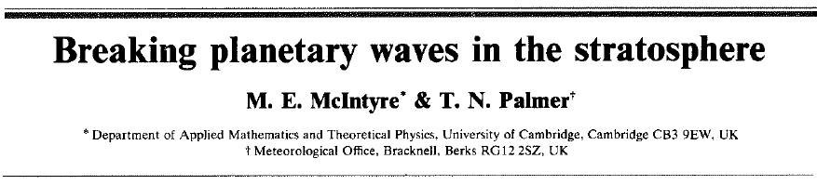
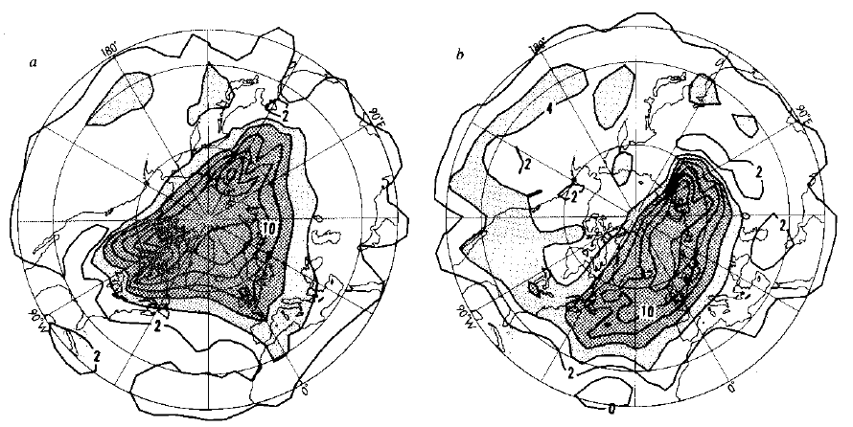
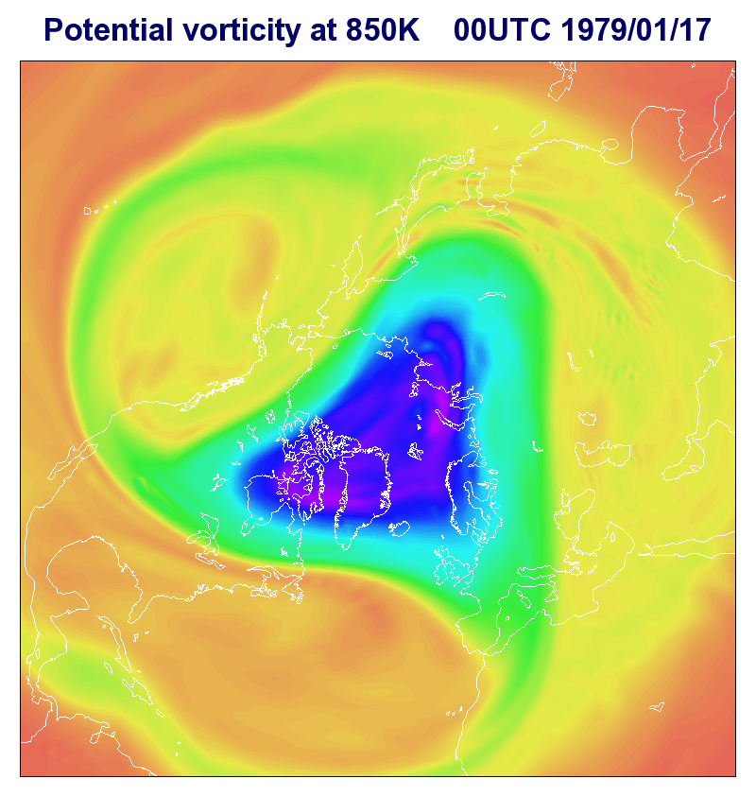
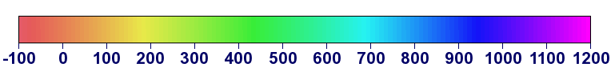
Courtesy Dr A J Simmons,
European Centre for Medium
Range Weather Forecasts:
McIntyre and Palmer (1983), revisited
PV on the 850K stratification surface:
Initial state
PVU

Slide 22
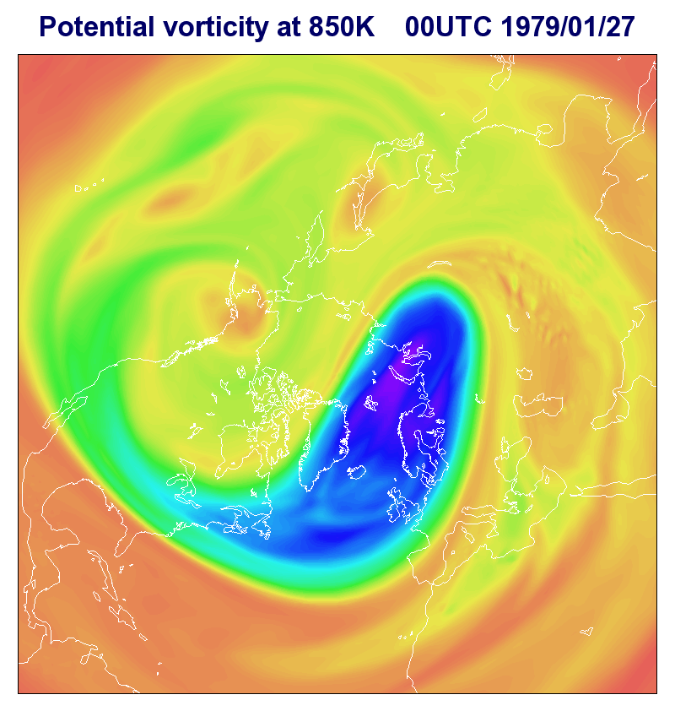
Courtesy Dr A J Simmons,
European Centre for Medium
Range Weather Forecasts:
McIntyre and Palmer (1983), revisited
PV on the 850K stratification surface:
Final state
PVU

Slide 23
Courtesy Dr A J Simmons,
European Centre for Medium
Range Weather Forecasts:
McIntyre and Palmer (1983), revisited
PV on the 850K stratification surface:
turbulent
here
Final state
PVU

Slide 24
Courtesy Dr A J Simmons,
European Centre for Medium
Range Weather Forecasts:
McIntyre and Palmer (1983), revisited
PV on the 850K stratification surface:
turbulent
here
wavelike
here
Final state
PVU

Slide 25
Courtesy Dr A J Simmons,
European Centre for Medium
Range Weather Forecasts:
PV at 850K,
mid-Jan. 1979
Inhomogeneous!
Quasi-elastic
“eddy-transport
barrier”
For more detail, websearch ”lucidity principles”
then back to my home page at ”Encyclopedia”, ”Rosenbluth”, ”Haurwitz”.

Slide 26
Yes, it’s turbulent – strongly nonlinear – but also highly inhomogeneous,
well outside the scope of homogeneous turbulence theory and its
extensions.
For more detail, websearch ”lucidity principles”
then back to my home page at ”Encyclopedia”, ”Rosenbluth”, ”Haurwitz”.

Slide 27
Yes, it’s turbulent – strongly nonlinear – but also highly inhomogeneous,
well outside the scope of homogeneous turbulence theory and its
extensions. In particular,
- the structure is completely missed by power spectra
(e.g. Armi and Flament 1985, J. Geophys. Res.)
For more detail, websearch ”lucidity principles”
then back to my home page at ”Encyclopedia”, ”Rosenbluth”, ”Haurwitz”.

Slide 28
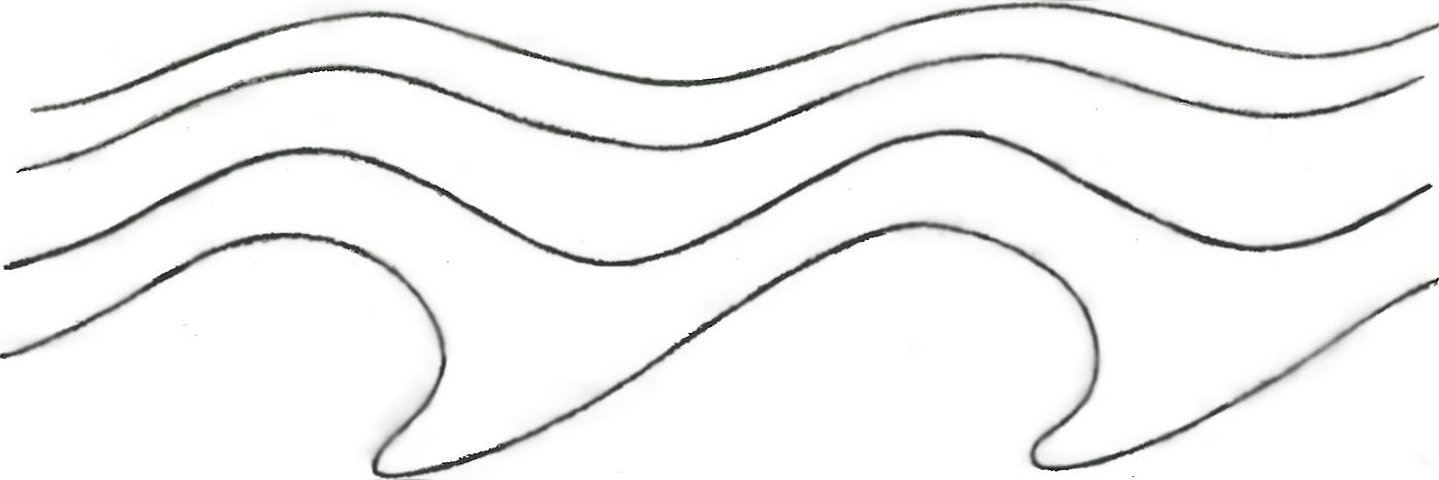
Yes, it’s turbulent – strongly nonlinear – but also highly inhomogeneous,
well outside the scope of homogeneous turbulence theory and its
extensions. In particular,
- the structure is completely missed by power spectra
(e.g. Armi and Flament 1985, J. Geophys. Res.)
- the structure has wavelike and turbulent regions that fit together
in a “wave-turbulence jigsaw”:
latitude
↑
PV contours undulate reversibly:
PV contours deform irreversibly:
→ longitude
For more detail, websearch ”lucidity principles”
then back to my home page at ”Encyclopedia”, ”Rosenbluth”, ”Haurwitz”.

Slide 29
Yes, it’s turbulent – strongly nonlinear – but also highly inhomogeneous,
well outside the scope of homogeneous turbulence theory and its
extensions. In particular,
- the structure is completely missed by power spectra
(e.g. Armi and Flament 1985, J. Geophys. Res.)
Quasi-
elastic
“barrier”
- the structure has wavelike and turbulent regions that fit together
in a “wave-turbulence jigsaw”:
latitude
↑
PV contours undulate reversibly:
PV contours deform irreversibly:
→ longitude
For more detail, websearch ”lucidity principles”
then back to my home page at ”Encyclopedia”, ”Rosenbluth”, ”Haurwitz”.

Slide 30
Yes, it’s turbulent – strongly nonlinear – but also highly inhomogeneous,
well outside the scope of homogeneous turbulence theory and its
extensions. In particular,
- the structure is completely missed by power spectra
(e.g. Armi and Flament 1985, J. Geophys. Res.)
Quasi-
elastic
“barrier”
- the structure has wavelike and turbulent regions that fit together
in a “wave-turbulence jigsaw”:
latitude
↑
PV contours undulate reversibly:
PV contours deform irreversibly:
(wave breaking → inhomogeneous PV mixing via scale effect)
→ longitude
For more detail, websearch ”lucidity principles”
then back to my home page at ”Encyclopedia”, ”Rosenbluth”, ”Haurwitz”.

Slide 31
Yes, it’s turbulent – strongly nonlinear – but also highly inhomogeneous,
well outside the scope of homogeneous turbulence theory and its
extensions. In particular,
- the structure is completely missed by power spectra
(e.g. Armi and Flament 1985, J. Geophys. Res.)
Quasi-
elastic
“barrier”
- the structure has wavelike and turbulent regions that fit together
in a “wave-turbulence jigsaw”:
latitude
↑
PV contours undulate reversibly:
PV contours deform irreversibly:
(wave breaking → inhomogeneous PV mixing via scale effect)
→ longitude
NB: it’s impossible to make sense of the dynamics, even gross
angular-momentum budgets – including Starr’s “negative viscosity”
(anti-friction) – without recognizing this inhomogeneous jigsaw structure.

Slide 32
Yes, it’s turbulent – strongly nonlinear – but also highly inhomogeneous,
well outside the scope of homogeneous turbulence theory and its
extensions. In particular,
- the structure is completely missed by power spectra
(e.g. Armi and Flament 1985, J. Geophys. Res.)
Quasi-
elastic
“barrier”
- the structure has wavelike and turbulent regions that fit together
in a “wave-turbulence jigsaw”:
latitude
↑
PV contours undulate reversibly:
PV contours deform irreversibly:
(wave breaking → inhomogeneous PV mixing via scale effect)
→ longitude
NB: it’s impossible to make sense of the dynamics, even gross
angular-momentum budgets – including Starr’s “negative viscosity”
(anti-friction) – without recognizing this inhomogeneous jigsaw structure.
The simplest fully self-consistent model of the structure is the
Stewartson-Warn-Warn (1978) nonlinear critical-layer theory.
And the essence of it was first recognized by Dickinson (1969).

Slide 33
The wave-turbulence jigsaw structure is often associated with
jet-self-sharpening scenarios. (Negative viscosity or
anti-friction again.)
For more detail, websearch ”lucidity principles”
then back to my home page at ”Encyclopedia”, ”Rosenbluth”, ”Haurwitz”.

Slide 34
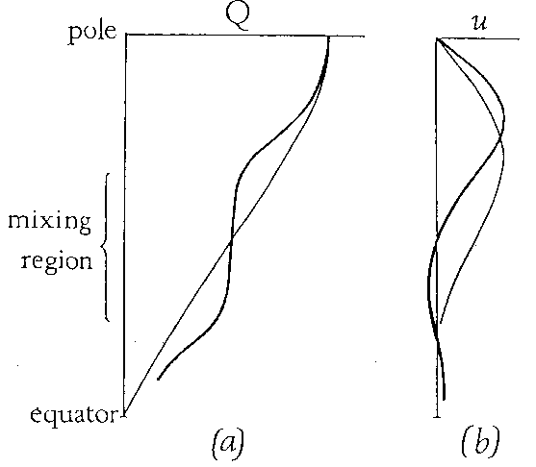
The wave-turbulence jigsaw structure is often associated with
jet-self-sharpening scenarios. (Negative viscosity or
anti-friction again.) The polar-night jet was the first
example for which this whole picture became clear:
___
PV
wavelike:
(quasi-linear)
turbulent:
(strongly nonlinear)
(Fig 5 from
my 1982
review,
J. Met. Soc.
Japan 60)
For more detail, websearch ”lucidity principles”
then back to my home page at ”Encyclopedia”, ”Rosenbluth”, ”Haurwitz”.

Slide 35
The wave-turbulence jigsaw structure is often associated with
jet-self-sharpening scenarios. (Negative viscosity or
anti-friction again.) The polar-night jet was the first
example for which this whole picture became clear:
___
PV
wavelike:
(quasi-linear)
turbulent:
(strongly nonlinear)
cf. movie!
(Fig 5 from
my 1982
review,
J. Met. Soc.
Japan 60)
For more detail, websearch ”lucidity principles”
then back to my home page at ”Encyclopedia”, ”Rosenbluth”, ”Haurwitz”.

Slide 36
The wave-turbulence jigsaw structure is often associated with
jet-self-sharpening scenarios. (Negative viscosity or
anti-friction again.) The polar-night jet was the first
example for which this whole picture became clear:
___
PV
wavelike:
(quasi-linear)
turbulent:
(strongly nonlinear)
cf. movie!
The inhomogeneity of PV mixing means that
PV contours must bunch up on the borders of the
PV mixing regions..
(Fig 5 from
my 1982
review,
J. Met. Soc.
Japan 60)
For more detail, websearch ”lucidity principles”
then back to my home page at ”Encyclopedia”, ”Rosenbluth”, ”Haurwitz”.

Slide 37
The wave-turbulence jigsaw structure is often associated with
jet-self-sharpening scenarios. (Negative viscosity or
anti-friction again.) The polar-night jet was the first
example for which this whole picture became clear:
___
PV
wavelike:
(quasi-linear)
turbulent:
(strongly nonlinear)
cf. movie!
The inhomogeneity of PV mixing means that
PV contours must bunch up on the borders of the
PV mixing regions. Then PV inversion automatically gives
sharp, strong jets (tighter “barriers” thanks to shear).
(Fig 5 from
my 1982
review,
J. Met. Soc.
Japan 60)
For more detail, websearch ”lucidity principles”
then back to my home page at ”Encyclopedia”, ”Rosenbluth”, ”Haurwitz”.

Slide 38
The wave-turbulence jigsaw structure is often associated with
jet-self-sharpening scenarios. (Negative viscosity or
anti-friction again.) The polar-night jet was the first
example for which this whole picture became clear:
___
PV
wavelike:
(quasi-linear)
turbulent:
(strongly nonlinear)
cf. movie!
The inhomogeneity of PV mixing means that
PV contours must bunch up on the borders of the
PV mixing regions. Then PV inversion automatically gives
sharp, strong jets (tighter “barriers” thanks to shear).
(Fig 5 from
my 1982
review,
J. Met. Soc.
Japan 60)
Historical note: the PV-mixing idea was not new even in 1982,
if you count the limiting case (nondivergent barotropic dynamics).

Slide 39
The wave-turbulence jigsaw structure is often associated with
jet-self-sharpening scenarios. (Negative viscosity or
anti-friction again.) The polar-night jet was the first
example for which this whole picture became clear:
___
PV
wavelike:
(quasi-linear)
turbulent:
(strongly nonlinear)
cf. movie!
The inhomogeneity of PV mixing means that
PV contours must bunch up on the borders of the
PV mixing regions. Then PV inversion automatically gives
sharp, strong jets (tighter “barriers” thanks to shear).
(Fig 5 from
my 1982
review,
J. Met. Soc.
Japan 60)
Historical note: the PV-mixing idea was not new even in 1982,
if you count the limiting case (nondivergent barotropic dynamics).
The idea goes back to the work of G. I. Taylor and others on turbulence –
thinking about momentum transport versus vorticity transport.

Slide 40
The wave-turbulence jigsaw structure is often associated with
jet-self-sharpening scenarios. (Negative viscosity or
anti-friction again.) The polar-night jet was the first
example for which this whole picture became clear:
___
PV
wavelike:
(quasi-linear)
turbulent:
(strongly nonlinear)
cf. movie!
The inhomogeneity of PV mixing means that
PV contours must bunch up on the borders of the
PV mixing regions. Then PV inversion automatically gives
sharp, strong jets (tighter “barriers” thanks to shear).
(Fig 5 from
my 1982
review,
J. Met. Soc.
Japan 60)
Historical note: the PV-mixing idea was not new even in 1982,
if you count the limiting case (nondivergent barotropic dynamics).
The idea goes back to the work of G. I. Taylor and others on turbulence –
thinking about momentum transport versus vorticity transport. Taylor
had already found an important clue in 1915, showing that one pattern
of vorticity transport can imply a different pattern of momentum transport:

Slide 41
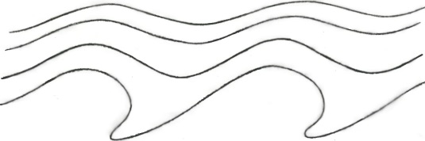
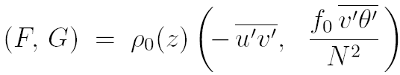
Taylor identity (G.I. Taylor 1915, Phil. Trans. Roy. Soc.)
– nonlinearly relates eddy fluxes of PV to
momentum-flux divergences:
Barotropic (any L_{D}): (+ form stress if topog)
3D baroclinic:
where
(“Eliassen-Palm flux”)
(Taylor-Charney-Stern-
Bretherton-Eady-Green identity)

Slide 42
Taylor identity (G.I. Taylor 1915, Phil. Trans. Roy. Soc.)
– nonlinearly relates eddy fluxes of PV to
momentum-flux divergences:
Barotropic (any L_{D}): (+ form stress if topog)
3D baroclinic:
where
(“Eliassen-Palm flux”)
quasi-geostrophic PV
(Taylor-Charney-Stern-
Bretherton-Eady-Green identity)

Slide 43
Taylor identity (G.I. Taylor 1915, Phil. Trans. Roy. Soc.)
– nonlinearly relates eddy fluxes of PV to
momentum-flux divergences:
Barotropic (any L_{D}): (+ form stress if topog)
3D baroclinic:
where
(“Eliassen-Palm flux”)
quasi-geostrophic PV
(Taylor-Charney-Stern-
Bretherton-Eady-Green identity)

Slide 44
Taylor identity (G.I. Taylor 1915, Phil. Trans. Roy. Soc.)
– nonlinearly relates eddy fluxes of PV to
momentum-flux divergences:
Barotropic (any L_{D}): (+ form stress if topog)
3D baroclinic:
where
(“Eliassen-Palm flux”)
quasi-geostrophic PV
(Taylor-Charney-Stern-
Bretherton-Eady-Green identity)
form stress
(here θ′ = buoyancy-acceleration fluct’n)

Slide 45
Taylor identity (G.I. Taylor 1915, Phil. Trans. Roy. Soc.)
– nonlinearly relates eddy fluxes of PV to
momentum-flux divergences:
Barotropic (any L_{D}): (+ form stress if topog)
3D baroclinic:
where
(“Eliassen-Palm flux”)
quasi-geostrophic PV
(Taylor-Charney-Stern-
Bretherton-Eady-Green identity)
form stress
(here θ′ = buoyancy-acceleration fluct’n)
NB: nonlinear relation: valid at any amplitude!! And valid
regardless of whether motion is free, forced, or self-excited.

Slide 46


Taylor identity (G.I. Taylor 1915, Phil. Trans. Roy. Soc.)
– nonlinearly relates eddy fluxes of PV to
momentum-flux divergences:
Barotropic (any L_{D}): (+ form stress if topog)
3D baroclinic:
where
(“Eliassen-Palm flux”)
quasi-geostrophic PV
(Taylor-Charney-Stern-
Bretherton-Eady-Green identity)
form stress
Corollary:
(here θ′ = buoyancy-acceleration fluct’n)
= 0 for isolated domain – once thought to prove PV mixing impossible
– but actually argues only against homogeneous PV mixing.

Slide 47
Taylor identity (G.I. Taylor 1915, Phil. Trans. Roy. Soc.)
– nonlinearly relates eddy fluxes of PV to
momentum-flux divergences:
Barotropic (any L_{D}): (+ form stress if topog)
3D baroclinic:
where
(“Eliassen-Palm flux”)
quasi-geostrophic PV
(Taylor-Charney-Stern-
Bretherton-Eady-Green identity)
form stress
Corollary:
(here θ′ = buoyancy-acceleration fluct’n)
= 0 for isolated domain – once thought to prove PV mixing impossible
– but actually argues only against homogeneous PV mixing.
Here are 3 more reasons ” “ “ “ :

Slide 48
Three more reasons (beyond quasi-geostrophic ) why PV mixing
on stratification surfaces is usually inhomogeneous:

Slide 49
Three more reasons (beyond quasi-geostrophic ) why PV mixing
on stratification surfaces is usually inhomogeneous:
1. Stagnation effect: For spanning the globe, easy to prove that
homogeneous mixing has an absurd consequence. We have
where P = exact PV,
positive
on each . Homogeneous mixing (e.g., constant-diffusivity models)
→ P = 0 everywhere on : inverts to absolute stagnation!

Slide 50
Three more reasons (beyond quasi-geostrophic ) why PV mixing
on stratification surfaces is usually inhomogeneous:
1. Stagnation effect: For spanning the globe, easy to prove that
homogeneous mixing has an absurd consequence. We have
where P = exact PV,
positive
on each . Homogeneous mixing (e.g., constant-diffusivity models)
→ P = 0 everywhere on : inverts to absolute stagnation!
2. Waveguide effect: Strong jets (PV contours bunched up) are Rossby
waveguides: dispersion relations favour wave breaking in jet flanks.

Slide 51
Three more reasons (beyond quasi-geostrophic ) why PV mixing
on stratification surfaces is usually inhomogeneous:
1. Stagnation effect: For spanning the globe, easy to prove that
homogeneous mixing has an absurd consequence. We have
where P = exact PV,
positive
on each . Homogeneous mixing (e.g., constant-diffusivity models)
→ P = 0 everywhere on : inverts to absolute stagnation!
2. Waveguide effect: Strong jets (PV contours bunched up) are Rossby
waveguides: dispersion relations favour wave breaking in jet flanks.
(Dispersion relations differ from those of homogeneous beta-turbulence theory)

Slide 52
Three more reasons (beyond quasi-geostrophic ) why PV mixing
on stratification surfaces is usually inhomogeneous:
1. Stagnation effect: For spanning the globe, easy to prove that
homogeneous mixing has an absurd consequence. We have
where P = exact PV,
positive
on each . Homogeneous mixing (e.g., constant-diffusivity models)
→ P = 0 everywhere on : inverts to absolute stagnation!
2. Waveguide effect: Strong jets (PV contours bunched up) are Rossby
waveguides: dispersion relations favour wave breaking in jet flanks.
(Dispersion relations differ from those of homogeneous beta-turbulence theory)
3. PV Phillips effect: a generic positive-feedback effect:

Slide 53
O. M. Phillips (1972 Deep Sea Res).
“staircase” on my home page

Slide 54
O. M. Phillips (1972 Deep Sea Res)
“staircase” on my home page

Slide 55
O. M. Phillips (1972 Deep Sea Res). NB: Don’t need to assume Fickian diffusion.
“staircase” on my home page

Slide 56
O. M. Phillips (1972 Deep Sea Res). NB: Don’t need to assume Fickian diffusion.
“staircase” on my home page

Slide 57
O. M. Phillips (1972 Deep Sea Res). NB: Don’t need to assume Fickian diffusion.
a positive feedback
tending to make the mixing
spatially inhomogeneous.
“staircase” on my home page

Slide 58
O. M. Phillips (1972 Deep Sea Res). NB: Don’t need to assume Fickian diffusion.
a positive feedback
tending to make the mixing
spatially inhomogeneous.
The more inhomogeneous, the stronger
the feedback, bringing in the shear effects
(Juckes & M, Nature 1987).
“staircase” on my home page

Slide 59
Waveguide effect:
Simplest quasi-geostrophic strong-jet model (Rosenbluth Lecture & refs.).
PV contours infinitely bunched up to make a perfect Rossby waveguide:

Slide 60
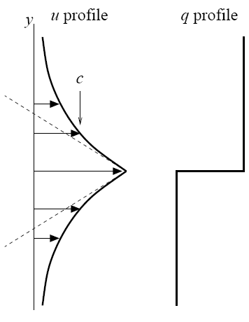
Waveguide effect:
Simplest quasi-geostrophic strong-jet model (Rosenbluth Lecture & refs.).
PV contours infinitely bunched up to make a perfect Rossby waveguide:
u_{j}
(slope jump is
proportional to PV
jump)

Slide 61

Waveguide effect:
Simplest quasi-geostrophic strong-jet model (Rosenbluth Lecture & refs.).
PV contours infinitely bunched up to make a perfect Rossby waveguide:
Dispersion relation differs from homogeneous:
u_{j}
(slope jump is
proportional to PV
jump)

Slide 62
Waveguide effect:
Simplest quasi-geostrophic strong-jet model (Rosenbluth Lecture & refs.).
PV contours infinitely bunched up to make a perfect Rossby waveguide:
Dispersion relation differs from homogeneous:
u_{j}
Phase speed c lies within the
range of the jet velocity profile.
(slope jump is
proportional to PV
jump)

Slide 63

Waveguide effect:
Simplest quasi-geostrophic strong-jet model (Rosenbluth Lecture & refs.).
PV contours infinitely bunched up to make a perfect Rossby waveguide:
Dispersion relation differs from homogeneous:
u_{j}
Phase speed c lies within the
range of the jet velocity profile.
So simple kinematics favours Rossby-wave
breaking on the jet flanks.
(slope jump is
proportional to PV
jump)

Slide 64
Waveguide effect:
Simplest quasi-geostrophic strong-jet model (Rosenbluth Lecture & refs.).
PV contours infinitely bunched up to make a perfect Rossby waveguide:
Dispersion relation differs from homogeneous:
u_{j}
Phase speed c lies within the
range of the jet velocity profile.
So simple kinematics favours Rossby-wave
breaking on the jet flanks. This is the key
message from the Rossby-wave critical-layer
theory – another way of seeing the feedback
from shear.
(slope jump is
proportional to PV
jump)

Slide 65
Waveguide effect:
Simplest quasi-geostrophic strong-jet model (Rosenbluth Lecture & refs.).
PV contours infinitely bunched up to make a perfect Rossby waveguide:
Dispersion relation differs from homogeneous:
u_{j}
Phase speed c lies within the
range of the jet velocity profile.
So simple kinematics favours Rossby-wave
breaking on the jet flanks. This is the key
message from the Rossby-wave critical-layer
theory – another way of seeing the feedback
from shear. Illustrates how a strong jet
sharpens itself when its Rossby waves are excited naturally.
(slope jump is
proportional to PV
jump)

Slide 66
Waveguide effect:
Simplest quasi-geostrophic strong-jet model (Rosenbluth Lecture & refs.).
PV contours infinitely bunched up to make a perfect Rossby waveguide:
Dispersion relation differs from homogeneous:
u_{j}
Phase speed c lies within the
range of the jet velocity profile.
So simple kinematics favours Rossby-wave
breaking on the jet flanks. This is the key
message from the Rossby-wave critical-layer
theory – another way of seeing the feedback
from shear. Illustrates how a strong jet
sharpens itself when its Rossby waves are excited naturally.
Again note the jigsaw-like character of this scenario,
involving quasi-linear wave propagation and strongly
nonlinear turbulence in close symbiosis.
(slope jump is
proportional to PV
jump)

Slide 67
Waveguide effect:
Simplest quasi-geostrophic strong-jet model (Rosenbluth Lecture & refs.).
PV contours infinitely bunched up to make a perfect Rossby waveguide:
Dispersion relation differs from homogeneous:
u_{j}
Phase speed c lies within the
range of the jet velocity profile.
So simple kinematics favours Rossby-wave
breaking on the jet flanks. This is the key
message from the Rossby-wave critical-layer
theory – another way of seeing the feedback
from shear. Illustrates how a strong jet
sharpens itself when its Rossby waves are excited naturally.
Again note the jigsaw-like character of this scenario,
involving quasi-linear wave propagation and strongly
nonlinear turbulence in close symbiosis.
(slope jump is
proportional to PV
jump)
Strong support comes from numerical and laboratory experiments, e.g.,

Slide 68
Scott and Dritschel (2012, J. Fluid Mech. 711, 576) – forced-dissipative
but clarifying how to reach the more “natural” low-excitation, low-dissipation
parameter regimes.

Slide 69
Scott and Dritschel (2012, J. Fluid Mech. 711, 576) – forced-dissipative
but clarifying how to reach the more “natural” low-excitation, low-dissipation
parameter regimes. Also
Esler, G., 2008, J. Fluid Mech. 599, 241 and Phys. Fluids 20, 116602:

Slide 70
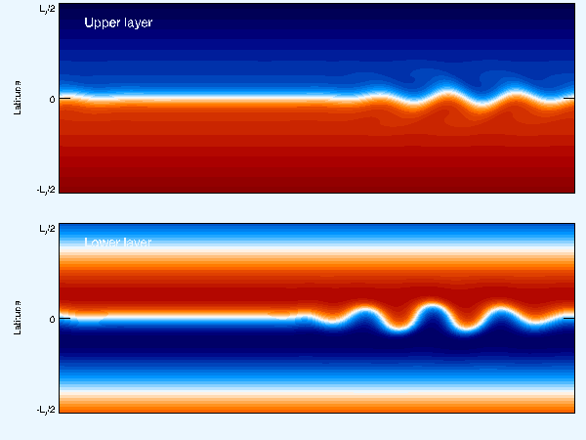
Scott and Dritschel (2012, J. Fluid Mech. 711, 576) – forced-dissipative
but clarifying how to reach the more “natural” low-excitation, low-dissipation
parameter regimes. Also
Esler, G., 2008, J. Fluid Mech. 599, 241 and Phys. Fluids 20, 116602:
Here the Taylor identity is satisfied via a form stress exerted from below:
Next is a classic lab experiment conveying the same message:

Slide 71
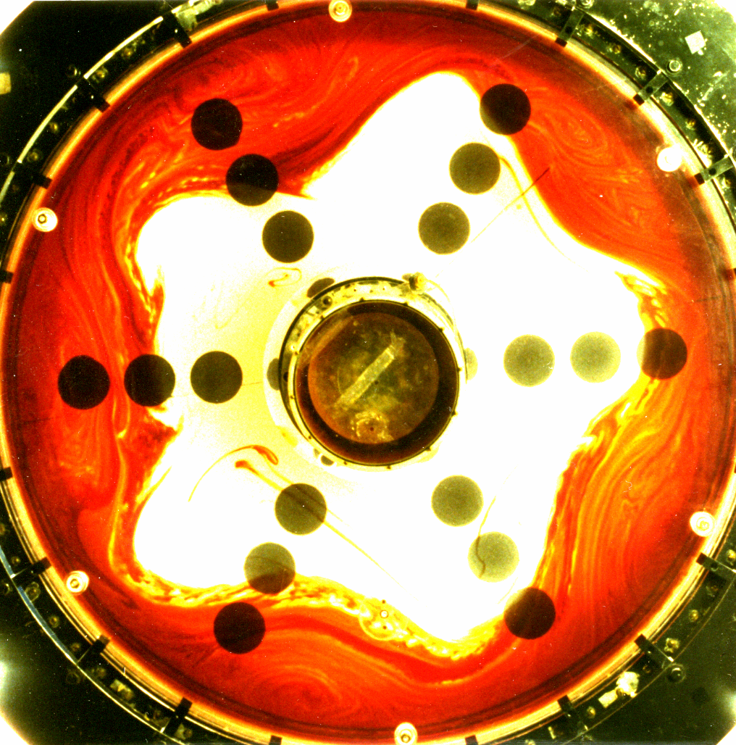
Sommeria,
Myers, and
Swinney,
Nature 1989
86.4 cm dia.;
3 revs/sec (!)

Slide 72
Sommeria,
Myers, and
Swinney,
Nature 1989
86.4 cm dia.;
3 revs/sec (!)
PV map and
dye map
near-identical.

Slide 73
Sommeria,
Myers, and
Swinney,
Nature 1989
86.4 cm dia.;
3 revs/sec (!)
PV map and
dye map
near-identical.
Strong jet,
very tight
eddy-transport
barrier.

Slide 74
Sommeria,
Myers, and
Swinney,
Nature 1989
86.4 cm dia.;
3 revs/sec (!)
PV map and
dye map
near-identical.
Strong jet,
very tight
eddy-transport
barrier.
Dye put in
> 500 revs.
earlier.

Slide 75
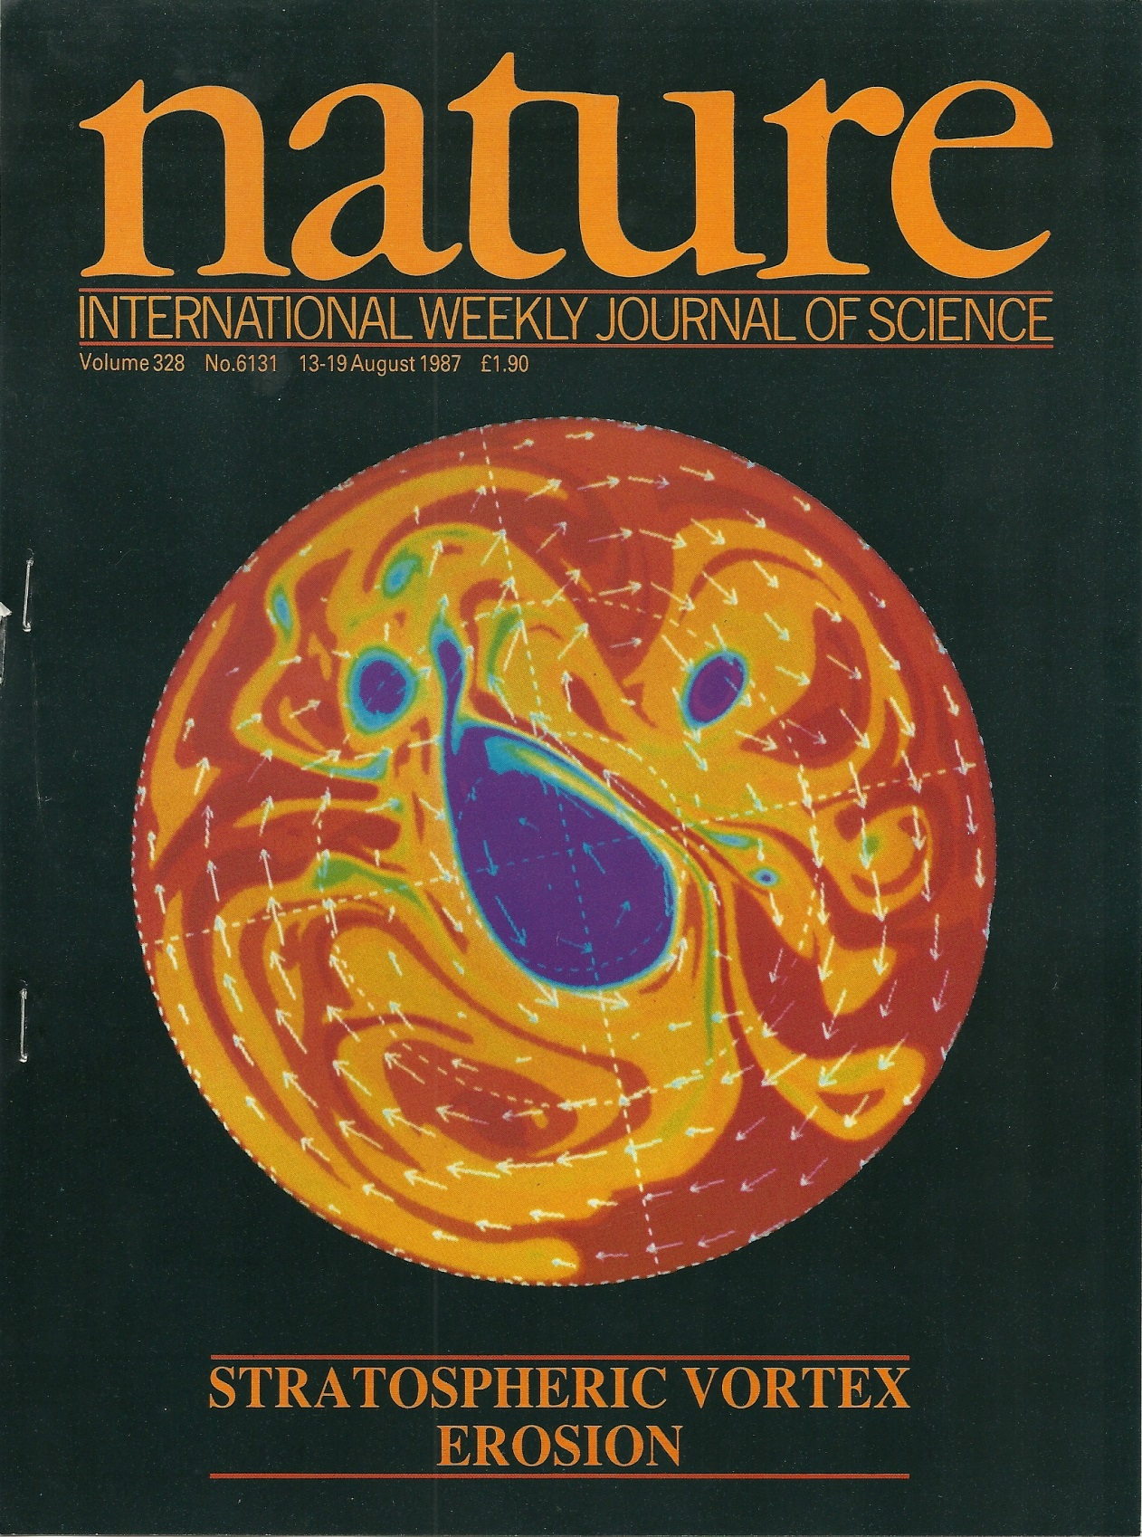
PV in a 2-D idealized “stratosphere”
(Juckes & McI 1987):

Slide 76
PV in a 2-D idealized “stratosphere”
(Juckes & McI 1987):
Polar-night jet strengthened and
sharpened by PV mixing, mainly
on its equatorward flank, this time,
again forming a strong jet and a
very tight eddy-transport barrier.

Slide 77
PV in a 2-D idealized “stratosphere”
(Juckes & McI 1987):
Polar-night jet strengthened and
sharpened by PV mixing, mainly
on its equatorward flank, this time,
again forming a strong jet and a
very tight eddy-transport barrier.
NB: “inverse cascades”
have no significant role
in any of these examples
– despite the variety of ways
in which the flows were excited.

Slide 78
PV in a 2-D idealized “stratosphere”
(Juckes & McI 1987):
Polar-night jet strengthened and
sharpened by PV mixing, mainly
on its equatorward flank, this time,
again forming a strong jet and a
very tight eddy-transport barrier.
NB: “inverse cascades”
have no significant role
in any of these examples
– despite the variety of ways
in which the flows were excited.
Many other examples (e.g. nice
observational work in Huw Davies’
group. So here’s the bottom line:

Slide 79
Inhomogeneous PV mixing is so robust and so typical – mixing works so
much better than it ought (in part because of the PV-inversion scale effect –
and the arguments against homogeneous PV mixing are so powerful –
that we can reasonably talk about a paradigm shift
provided that we emphasize the word “inhomogeneous”.

Slide 80
Inhomogeneous PV mixing is so robust and so typical – mixing works so
much better than it ought (in part because of the PV-inversion scale effect –
and the arguments against homogeneous PV mixing are so powerful –
that we can reasonably talk about a paradigm shift
provided that we emphasize the word “inhomogeneous”.
And this inhomogeneous PV-mixing paradigm is one of the few
simple handles we have on the strongly nonlinear fluid behaviour.

Slide 81
Inhomogeneous PV mixing is so robust and so typical – mixing works so
much better than it ought (in part because of the PV-inversion scale effect –
and the arguments against homogeneous PV mixing are so powerful –
that we can reasonably talk about a paradigm shift
provided that we emphasize the word “inhomogeneous”.
And this inhomogeneous PV-mixing paradigm is one of the few
simple handles we have on the strongly nonlinear fluid behaviour.
It may also give a handle on strong nonlinearity in tokamaks – Rosenbluth Lecture

Slide 82
Inhomogeneous PV mixing is so robust and so typical – mixing works so
much better than it ought (in part because of the PV-inversion scale effect –
and the arguments against homogeneous PV mixing are so powerful –
that we can reasonably talk about a paradigm shift
provided that we emphasize the word “inhomogeneous”.
And this inhomogeneous PV-mixing paradigm is one of the few
simple handles we have on the strongly nonlinear fluid behaviour.
It may also give a handle on strong nonlinearity in tokamaks – Rosenbluth Lecture
(??)
(??)

Slide 83
Inhomogeneous PV mixing is so robust and so typical – mixing works so
much better than it ought (in part because of the PV-inversion scale effect –
and the arguments against homogeneous PV mixing are so powerful –
that we can reasonably talk about a paradigm shift
provided that we emphasize the word “inhomogeneous”.
And this inhomogeneous PV-mixing paradigm is one of the few
simple handles we have on the strongly nonlinear fluid behaviour.
It may also give a handle on strong nonlinearity in tokamaks – Rosenbluth Lecture
(Past obstacles? “Homogeneous” unconsciously assumed?
Mathematical temptation? Constant diffusivity too seductive?)
(??)
(??)

Slide 84
Inhomogeneous PV mixing is so robust and so typical – mixing works so
much better than it ought (in part because of the PV-inversion scale effect –
and the arguments against homogeneous PV mixing are so powerful –
that we can reasonably talk about a paradigm shift
provided that we emphasize the word “inhomogeneous”.
And this inhomogeneous PV-mixing paradigm is one of the few
simple handles we have on the strongly nonlinear fluid behaviour.
It may also give a handle on strong nonlinearity in tokamaks – Rosenbluth Lecture
(Past obstacles? “Homogeneous” unconsciously assumed?
Mathematical temptation? Constant diffusivity too seductive?)
The paradigm is not, of course, the Answer to Everything:
● PV doesn’t always mix (e.g., vortex merging)
● Not all jets are strong jets (e.g., “ghost jets” in the Pacific Ocean)
● And there are, of course, other nonlinear mechanisms
that show up in different thought-experiments:
(??)
(??)

Slide 85

Jet dynamics – a complex conceptual landscape wth a 2-level hierarchy of ideas:
PV Phillips effect Taylor identity:
1. Generic ideas: PV invertibility – div (eddy momentum flux)
Nonlinear, forced/free/self-excited

Slide 86
Jet dynamics – a complex conceptual landscape wth a 2-level hierarchy of ideas:
Horse & cart?
PV Phillips effect Taylor identity:
1. Generic ideas: PV invertibility – div (eddy momentum flux)
Nonlinear, forced/free/self-excited

Slide 87
Jet dynamics – a complex conceptual landscape wth a 2-level hierarchy of ideas:
Horse & cart?
PV Phillips effect Taylor identity:
1. Generic ideas: PV invertibility – div (eddy momentum flux)
Nonlinear, forced/free/self-excited
2. Particular mechanisms:
(i) Rhines effect. Re weak jets generated by strong small-scale forcing – strong
enough to create active small-scale vortices that merge or cluster, producing an
inverse cascade that is arrested or slowed when eddy velocities ~ plane Rossby-
wave phase speeds. Wave-turbulence interaction is spatially homogeneous.

Slide 88
Jet dynamics – a complex conceptual landscape wth a 2-level hierarchy of ideas:
Horse & cart?
PV Phillips effect Taylor identity:
1. Generic ideas: PV invertibility – div (eddy momentum flux)
Nonlinear, forced/free/self-excited
2. Particular mechanisms:
(i) Rhines effect. Re weak jets generated by strong small-scale forcing – strong
enough to create active small-scale vortices that merge or cluster, producing an
inverse cascade that is arrested or slowed when eddy velocities ~ plane Rossby-
wave phase speeds. Wave-turbulence interaction is spatially homogeneous.
(ii) Repeated excit’n of passive Kelvin sheared disturbances by weak small-scale
forcing. (Kelvin 1887, Farrell-Ioannou, Marston, Srinivasan-Young: CE2, SSST)

Slide 89
Jet dynamics – a complex conceptual landscape wth a 2-level hierarchy of ideas:
Horse & cart?
PV Phillips effect Taylor identity:
1. Generic ideas: PV invertibility – div (eddy momentum flux)
Nonlinear, forced/free/self-excited
2. Particular mechanisms:
(i) Rhines effect. Re weak jets generated by strong small-scale forcing – strong
enough to create active small-scale vortices that merge or cluster, producing an
inverse cascade that is arrested or slowed when eddy velocities ~ plane Rossby-
wave phase speeds. Wave-turbulence interaction is spatially homogeneous.
(ii) Repeated excit’n of passive Kelvin sheared disturbances by weak small-scale
forcing. (Kelvin 1887, Farrell-Ioannou, Marston, Srinivasan-Young: CE2, SSST)
(iii) Inhomogeneous PV mixing: Re strong jets self-sharpened by Rossby-wave
breaking. Wave-turbulence interaction spatially inhomogeneous.

Slide 90
Jet dynamics – a complex conceptual landscape wth a 2-level hierarchy of ideas:
Horse & cart?
PV Phillips effect Taylor identity:
1. Generic ideas: PV invertibility – div (eddy momentum flux)
Nonlinear, forced/free/self-excited
2. Particular mechanisms:
(i) Rhines effect. Re weak jets generated by strong small-scale forcing – strong
enough to create active small-scale vortices that merge or cluster, producing an
inverse cascade that is arrested or slowed when eddy velocities ~ plane Rossby-
wave phase speeds. Wave-turbulence interaction is spatially homogeneous.
(ii) Repeated excit’n of passive Kelvin sheared disturbances by weak small-scale
forcing. (Kelvin 1887, Farrell-Ioannou, Marston, Srinivasan-Young: CE2, SSST)
(iii) Inhomogeneous PV mixing: Re strong jets self-sharpened by Rossby-wave
breaking. Wave-turbulence interaction spatially inhomogeneous.
(iv) Vortex merging and cannibalism, ↔ inverse cascade (sort of)

Slide 91
Jet dynamics – a complex conceptual landscape wth a 2-level hierarchy of ideas:
Horse & cart?
PV Phillips effect Taylor identity:
1. Generic ideas: PV invertibility – div (eddy momentum flux)
Nonlinear, forced/free/self-excited
2. Particular mechanisms:
(i) Rhines effect. Re weak jets generated by strong small-scale forcing – strong
enough to create active small-scale vortices that merge or cluster, producing an
inverse cascade that is arrested or slowed when eddy velocities ~ plane Rossby-
wave phase speeds. Wave-turbulence interaction is spatially homogeneous.
(ii) Repeated excit’n of passive Kelvin sheared disturbances by weak small-scale
forcing. (Kelvin 1887, Farrell-Ioannou, Marston, Srinivasan-Young: CE2, SSST)
(iii) Inhomogeneous PV mixing: Re strong jets self-sharpened by Rossby-wave
breaking. Wave-turbulence interaction spatially inhomogeneous.
(iv) Vortex merging and cannibalism, ↔ inverse cascade (sort of)
(v) Monopole vortex migration (significant on Jupiter? Ingersoll et al. 2000)

Slide 92
Jet dynamics – a complex conceptual landscape wth a 2-level hierarchy of ideas:
Horse & cart?
PV Phillips effect Taylor identity:
1. Generic ideas: PV invertibility – div (eddy momentum flux)
Nonlinear, forced/free/self-excited
2. Particular mechanisms:
(i) Rhines effect. Re weak jets generated by strong small-scale forcing – strong
enough to create active small-scale vortices that merge or cluster, producing an
inverse cascade that is arrested or slowed when eddy velocities ~ plane Rossby-
wave phase speeds. Wave-turbulence interaction is spatially homogeneous.
(ii) Repeated excit’n of passive Kelvin sheared disturbances by weak small-scale
forcing. (Kelvin 1887, Farrell-Ioannou, Marston, Srinivasan-Young: CE2, SSST)
(iii) Inhomogeneous PV mixing: Re strong jets self-sharpened by Rossby-wave
breaking. Wave-turbulence interaction spatially inhomogeneous.
(iv) Vortex merging and cannibalism, ↔ inverse cascade (sort of)
(v) Monopole vortex migration (significant on Jupiter? Ingersoll et al. 2000)
(vi) Quasi-random-walk vortex migration (significant on Jupiter?)

Slide 93
Jet dynamics – a complex conceptual landscape wth a 2-level hierarchy of ideas:
Horse & cart?
PV Phillips effect Taylor identity:
1. Generic ideas: PV invertibility – div (eddy momentum flux)
Nonlinear, forced/free/self-excited
2. Particular mechanisms:
(i) Rhines effect. Re weak jets generated by strong small-scale forcing – strong
enough to create active small-scale vortices that merge or cluster, producing an
inverse cascade that is arrested or slowed when eddy velocities ~ plane Rossby-
wave phase speeds. Wave-turbulence interaction is spatially homogeneous.
(ii) Repeated excit’n of passive Kelvin sheared disturbances by weak small-scale
forcing. (Kelvin 1887, Farrell-Ioannou, Marston, Srinivasan-Young: CE2, SSST)
(iii) Inhomogeneous PV mixing: Re strong jets self-sharpened by Rossby-wave
breaking. Wave-turbulence interaction spatially inhomogeneous.
(iv) Vortex merging and cannibalism, ↔ inverse cascade (sort of)
(v) Monopole vortex migration (significant on Jupiter? Ingersoll et al. 2000)
(vi) Quasi-random-walk vortex migration (significant on Jupiter?)
(vii) PV-biased forcing: critical in the idealized Jupiter weather-layer model
being studied by Stephen Thomson and myself.

Slide 94
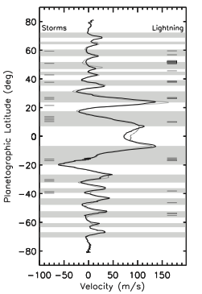
Zonal mean cloud winds
Extremely steady! 21-year time interval between
Voyager (light curve) and Cassini (dark curve).
(And GRS has persisted for centuries.)
[

Slide 95
Zonal mean cloud winds
Extremely steady! 21-year time interval between
Voyager (light curve) and Cassini (dark curve).
(And GRS has persisted for centuries.)
Jets extremely straight, especially the prograde jets
– unearthly !! Unlike weather-layer-only models.
[

Slide 96
Zonal mean cloud winds
Extremely steady! 21-year time interval between
Voyager (light curve) and Cassini (dark curve).
(And GRS has persisted for centuries.)
Jets extremely straight, especially the prograde jets
– unearthly !! Unlike weather-layer-only models.
Weather layer coupled to deep dry-convection layer
offers best hope of fluid-dynamical understanding
(Ingersoll-Cuong 1981, Dowling-Ingersoll 1989,…)
[

Slide 97
Zonal mean cloud winds
Extremely steady! 21-year time interval between
Voyager (light curve) and Cassini (dark curve).
(And GRS has persisted for centuries.)
Jets extremely straight, especially the prograde jets
– unearthly !! Unlike weather-layer-only models.
Weather layer coupled to deep dry-convection layer
offers best hope of fluid-dynamical understanding
(Ingersoll-Cuong 1981, Dowling-Ingersoll 1989,…)
[
(rejecting an old
false dichotomy)

Slide 98
Zonal mean cloud winds
Extremely steady! 21-year time interval between
Voyager (light curve) and Cassini (dark curve).
(And GRS has persisted for centuries.)
Jets extremely straight, especially the prograde jets
– unearthly !! Unlike weather-layer-only models.
Weather layer coupled to deep dry-convection layer
offers best hope of fluid-dynamical understanding
(Ingersoll-Cuong 1981, Dowling-Ingersoll 1989,…)
(And NB: there is only one GRS.)
[
(rejecting an old
false dichotomy)

Slide 99
Zonal mean cloud winds
Extremely steady! 21-year time interval between
Voyager (light curve) and Cassini (dark curve).
(And GRS has persisted for centuries.)
Jets extremely straight, especially the prograde jets
– unearthly !! Unlike weather-layer-only models.
Weather layer coupled to deep dry-convection layer
offers best hope of fluid-dynamical understanding
(Ingersoll-Cuong 1981, Dowling-Ingersoll 1989,…)
(And NB: there is only one GRS.)
[
(rejecting an old
false dichotomy)
↓tangent cylinder?↓

Slide 100
Zonal mean cloud winds
Extremely steady! 21-year time interval between
Voyager (light curve) and Cassini (dark curve).
(And GRS has persisted for centuries.)
Jets extremely straight, especially the prograde jets
– unearthly !! Unlike weather-layer-only models.
Weather layer coupled to deep dry-convection layer
offers best hope of fluid-dynamical understanding
(Ingersoll-Cuong 1981, Dowling-Ingersoll 1989,…)
(And NB: there is only one GRS.)
[
(rejecting an old
false dichotomy)
↓tangent cylinder?↓
Moist convection may be the dominant coupling:
stronger in ‘belts’ (cyclonic, shaded) than in ‘zones’
(anticyclonic, unshaded). R.h. bars show lightning.

Slide 101
Zonal mean cloud winds
Extremely steady! 21-year time interval between
Voyager (light curve) and Cassini (dark curve).
(And GRS has persisted for centuries.)
Jets extremely straight, especially the prograde jets
– unearthly !! Unlike weather-layer-only models.
Weather layer coupled to deep dry-convection layer
offers best hope of fluid-dynamical understanding
(Ingersoll-Cuong 1981, Dowling-Ingersoll 1989,…)
(And NB: there is only one GRS.)
[
(rejecting an old
false dichotomy)
↓tangent cylinder?↓
Moist convection may be the dominant coupling:
stronger in ‘belts’ (cyclonic, shaded) than in ‘zones’
(anticyclonic, unshaded). R.h. bars show lightning.
Large-scale (Rayleigh-like) friction not credible
for the real planet. (No shallow solid surface.)

Slide 102
Zonal mean cloud winds
Extremely steady! 21-year time interval between
Voyager (light curve) and Cassini (dark curve).
(And GRS has persisted for centuries.)
Jets extremely straight, especially the prograde jets
– unearthly !! Unlike weather-layer-only models.
Weather layer coupled to deep dry-convection layer
offers best hope of fluid-dynamical understanding
(Ingersoll-Cuong 1981, Dowling-Ingersoll 1989,…)
(And NB: there is only one GRS.)
[
(rejecting an old
false dichotomy)
↓tangent cylinder?↓
Moist convection may be the dominant coupling:
stronger in ‘belts’ (cyclonic, shaded) than in ‘zones’
(anticyclonic, unshaded). R.h. bars show lightning.
Large-scale (Rayleigh-like) friction not credible
for the real planet. (No shallow solid surface.)
Perfectly-unbiased forcing not credible.

Slide 103
Zonal mean cloud winds
Extremely steady! 21-year time interval between
Voyager (light curve) and Cassini (dark curve).
(And GRS has persisted for centuries.)
Jets extremely straight, especially the prograde jets
– unearthly !! Unlike weather-layer-only models.
Weather layer coupled to deep dry-convection layer
offers best hope of fluid-dynamical understanding
(Ingersoll-Cuong 1981, Dowling-Ingersoll 1989,…)
(And NB: there is only one GRS.)
[
(rejecting an old
false dichotomy)
↓tangent cylinder?↓
Moist convection may be the dominant coupling:
stronger in ‘belts’ (cyclonic, shaded) than in ‘zones’
(anticyclonic, unshaded). R.h. bars show lightning.
Large-scale (Rayleigh-like) friction not credible
for the real planet. (No shallow solid surface.)
Perfectly-unbiased forcing not credible.
Real moist convection is strongly 3-dimensional.
(Consider Jupiter’s folded filamentary regions, and
cf. terrestrial supercell thunderstorms.)

Slide 104
Zonal mean cloud winds
Extremely steady! 21-year time interval between
Voyager (light curve) and Cassini (dark curve).
(And GRS has persisted for centuries.)
Jets extremely straight, especially the prograde jets
– unearthly !! Unlike weather-layer-only models.
Weather layer coupled to deep dry-convection layer
offers best hope of fluid-dynamical understanding
(Ingersoll-Cuong 1981, Dowling-Ingersoll 1989,…)
(And NB: there is only one GRS.)
[
(rejecting an old
false dichotomy)
↓tangent cylinder?↓
Moist convection may be the dominant coupling:
stronger in ‘belts’ (cyclonic, shaded) than in ‘zones’
(anticyclonic, unshaded). R.h. bars show lightning.
Large-scale (Rayleigh-like) friction not credible
for the real planet. (No shallow solid surface.)
Perfectly-unbiased forcing not credible.
Real moist convection is strongly 3-dimensional.
(Consider Jupiter’s folded filamentary regions, and
cf. terrestrial supercell thunderstorms.)
Is there a relevant idealized model?? A tall order,
but worth a try, we think.

Slide 105
Zonal mean cloud winds
Extremely steady! 21-year time interval between
Voyager (light curve) and Cassini (dark curve).
(And GRS has persisted for centuries.)
Jets extremely straight, especially the prograde jets
– unearthly !! Unlike weather-layer-only models.
Weather layer coupled to deep dry-convection layer
offers best hope of fluid-dynamical understanding
(Ingersoll-Cuong 1981, Dowling-Ingersoll 1989,…)
(And NB: there is only one GRS.)
[
(rejecting an old
false dichotomy)
↓tangent cylinder?↓
Moist convection may be the dominant coupling:
stronger in ‘belts’ (cyclonic, shaded) than in ‘zones’
(anticyclonic, unshaded). R.h. bars show lightning.
[
Large-scale (Rayleigh-like) friction not credible
for the real planet. (No shallow solid surface.)
Perfectly-unbiased forcing not credible.
Real moist convection is strongly 3-dimensional.
(Consider Jupiter’s folded filamentary regions, and
cf. terrestrial supercell thunderstorms.)
Is there a relevant idealized model?? A tall order,
but worth a try, we think. Focus on middle latitudes:

Slide 106

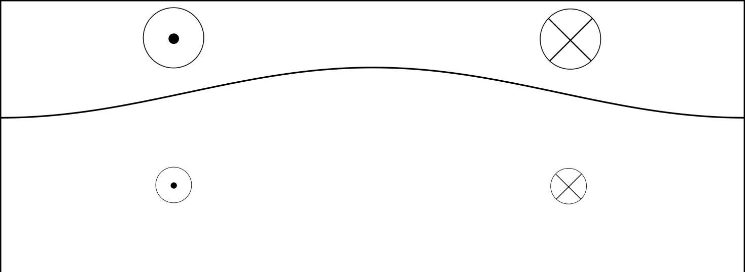

Start by taking Dowling-Ingersoll ‘89 seriously,
weather
layer (1)
cold
dry-
convec’n
layer (2)
(massive)
deep jets
are fixed.
(northward)

Slide 107
Start by taking Dowling-Ingersoll ‘89 seriously, as
supported also by Sugiyama et al. 2014, Icarus 229.
A2-stable mid-latitude jet system,
cf. Dowling 1993, Stamp-Dowling 1993:
weather
layer (1)
cold
dry-
convec’n
layer (2)
(massive)
deep jets
are fixed.
(northward)

Slide 108
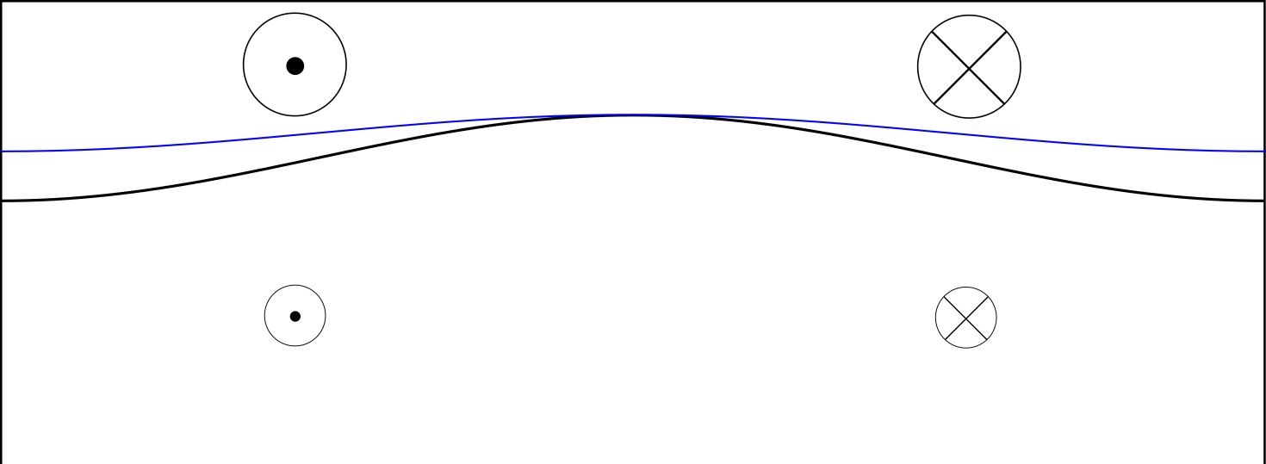
Start by taking Dowling-Ingersoll ‘89 seriously, as
supported also by Sugiyama et al. 2014, Icarus 229.
A2-stable mid-latitude jet system,
cf. Dowling 1993, Stamp-Dowling 1993:
Water
condens’n
level
weather
layer (1)
cold
dry-
convec’n
layer (2)
(massive)
deep jets
are fixed.
(northward)

Slide 109
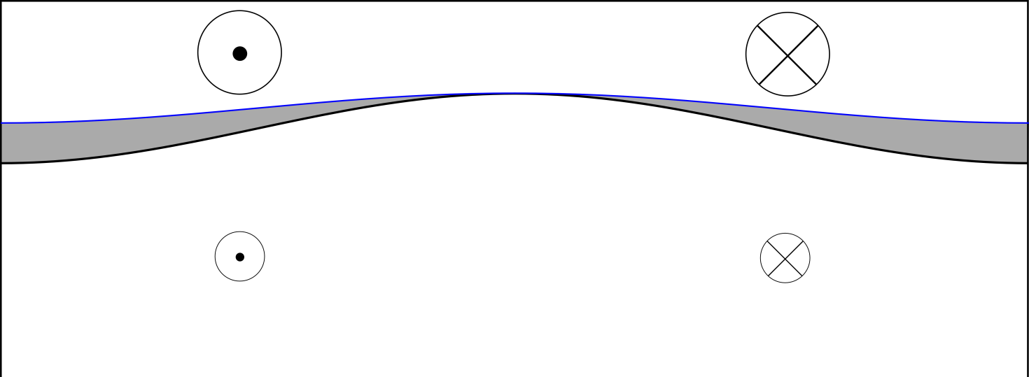
Start by taking Dowling-Ingersoll ‘89 seriously, as
supported also by Sugiyama et al. 2014, Icarus 229.
A2-stable mid-latitude jet system,
cf. Dowling 1993, Stamp-Dowling 1993:
Water
condens’n
level
weather
layer (1)
cold
stably
stratified
dry-
convec’n
layer (2)
(massive)
deep jets
are fixed.
(northward)

Slide 110
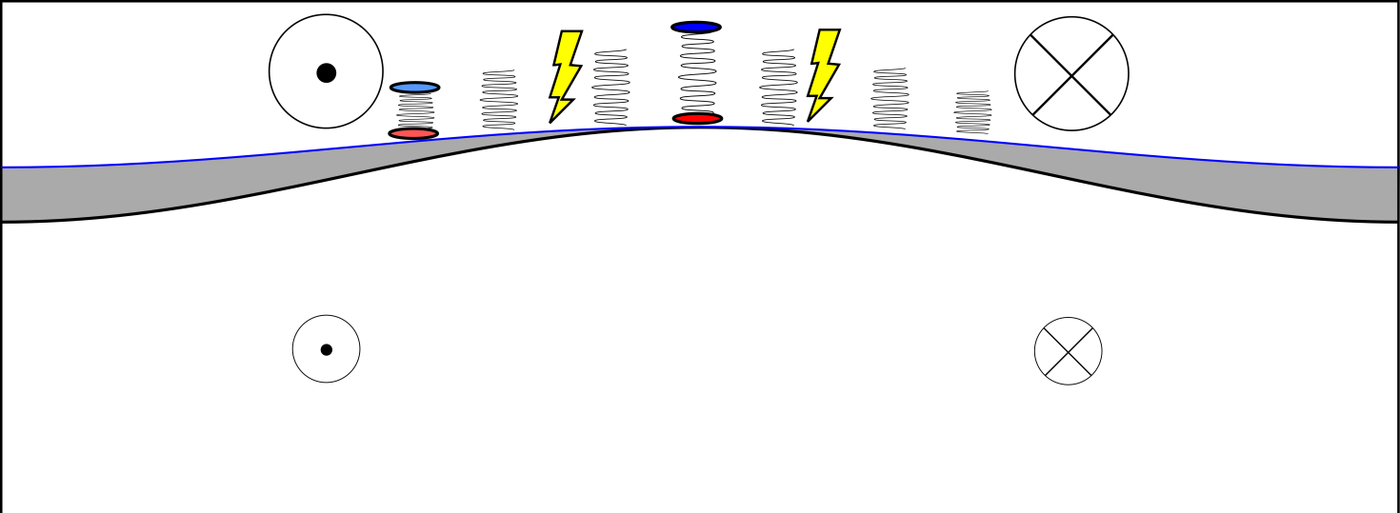
Start by taking Dowling-Ingersoll ‘89 seriously, as
supported also by Sugiyama et al. 2014, Icarus 229.
A2-stable mid-latitude jet system,
cf. Dowling 1993, Stamp-Dowling 1993:
Water
condens’n
level
weather
layer (1)
cold
stably
stratified
dry-
convec’n
layer (2)
(massive)
deep jets
are fixed.
(northward)

Slide 111
Start by taking Dowling-Ingersoll ‘89 seriously, as
supported also by Sugiyama et al. 2014, Icarus 229.
A2-stable mid-latitude jet system,
cf. Dowling 1993, Stamp-Dowling 1993:
Water
condens’n
level
weather
layer (1)
cold
stably
stratified
dry-
convec’n
layer (2)
(massive)
deep jets
are fixed.
(northward)
Idealize the forcing as injected vortex pairs –
cf. oceanographers’ “heatons” or “hetons” –
but with anticyclonic bias. (Recall the extreme cases
studied by Li et al. 2006, Showman 2007.)
Very artificial – but artifice unavoidable in any such model!

Slide 112

Start by taking Dowling-Ingersoll ‘89 seriously, as
supported also by Sugiyama et al. 2014, Icarus 229.
A2-stable mid-latitude jet system,
cf. Dowling 1993, Stamp-Dowling 1993:
Water
condens’n
level
weather
layer (1)
cold
stably
stratified
dry-
convec’n
layer (2)
(massive)
deep jets
are fixed.
(northward)
Idealize the forcing as injected vortex pairs –
cf. oceanographers’ “heatons” or “hetons” –
but with anticyclonic bias. (Recall the extreme cases
studied by Li et al. 2006, Showman 2007.)
Very artificial – but artifice unavoidable in any such model!
Stronger wherever base colder.

Slide 113
Start by taking Dowling-Ingersoll ‘89 seriously, as
supported also by Sugiyama et al. 2014, Icarus 229.
A2-stable mid-latitude jet system,
cf. Dowling 1993, Stamp-Dowling 1993:
“Large” will mean
by comparison
with
Water
condens’n
level
weather
layer (1)
cold
stably
stratified
dry-
convec’n
layer (2)
(massive)
deep jets
are fixed.
(northward)
Idealize the forcing as injected vortex pairs –
cf. oceanographers’ “heatons” or “hetons” –
but with anticyclonic bias. (Recall the extreme cases
studied by Li et al. 2006, Showman 2007.)
Very artificial – but artifice unavoidable in any such model!
Stronger wherever base colder.

Slide 114

Standard 1½-layer
quasi-geostrophic
beta-plane model:
, where:

Slide 115
Standard 1½-layer
quasi-geostrophic
beta-plane model:
, where:
PV inversion: given q₁, solve for ψ₁.

Slide 116


Standard 1½-layer
quasi-geostrophic
beta-plane model:
, where:
PV inversion: given q₁, solve for ψ₁.
doubly periodic,

Slide 117
Standard 1½-layer
quasi-geostrophic
beta-plane model:
, where:
PV inversion: given q₁, solve for ψ₁.
cf. exact impermeability theorem
doubly periodic,

Slide 118
Standard 1½-layer
quasi-geostrophic
beta-plane model:
, where:
PV inversion: given q₁, solve for ψ₁.
cf. exact impermeability theorem
doubly periodic,
X
quasi-hyperdiffusive.
Ignore from here on.

Slide 119
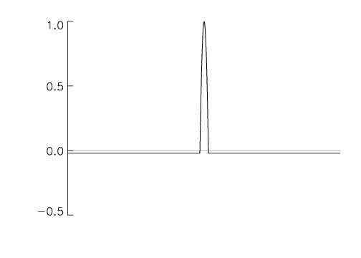
Standard 1½-layer
quasi-geostrophic
beta-plane model:
, where:
PV inversion: given q₁, solve for ψ₁.
cf. exact impermeability theorem
doubly periodic,
X
randomly-injected E-W pairs of
small vortices, with anticyclonic PV-bias,
and stronger wherever base colder, & v.v.
quasi-hyperdiffusive.
Ignore from here on.

Slide 120
Standard 1½-layer
quasi-geostrophic
beta-plane model:
, where:
PV inversion: given q₁, solve for ψ₁.
cf. exact impermeability theorem
doubly periodic,
X
randomly-injected E-W pairs of
small vortices, with anticyclonic PV-bias,
and stronger wherever base colder, & v.v.
quasi-hyperdiffusive.
Ignore from here on.

Slide 121
Standard 1½-layer
quasi-geostrophic
beta-plane model:
, where:
PV inversion: given q₁, solve for ψ₁.
cf. exact impermeability theorem
doubly periodic,
X
randomly-injected E-W pairs of
small vortices, with anticyclonic PV-bias,
and stronger wherever base colder, & v.v.
Note domain-wide “complementary forcing”
quasi-hyperdiffusive.
Ignore from here on.

Slide 122
Standard 1½-layer
quasi-geostrophic
beta-plane model:
, where:
PV inversion: given q₁, solve for ψ₁.
cf. exact impermeability theorem
doubly periodic,
X
NB, not
spectrally
narrow
quasi-hyperdiffusive.
Ignore from here on.
randomly-injected E-W pairs of
small vortices, with anticyclonic PV-bias,
and stronger wherever base colder, & v.v.
Note domain-wide “complementary forcing”

Slide 123
Standard 1½-layer
quasi-geostrophic
beta-plane model:
, where:
PV inversion: given q₁, solve for ψ₁.
cf. exact impermeability theorem
doubly periodic,
X
NB, not
spectrally
narrow
quasi-hyperdiffusive.
Ignore from here on.
randomly-injected E-W pairs of
small vortices, with anticyclonic PV-bias,
and stronger wherever base colder, & v.v.
Note domain-wide “complementary forcing”
Key point: PV-bias plus base-temperature dependence can
replace large-scale friction!

Slide 124

Standard 1½-layer
quasi-geostrophic
beta-plane model:
, where:
PV inversion: given q₁, solve for ψ₁.
cf. exact impermeability theorem
doubly periodic,
X
NB, not
spectrally
narrow
quasi-hyperdiffusive.
Ignore from here on.
randomly-injected E-W pairs of
small vortices, with anticyclonic PV-bias,
and stronger wherever base colder, & v.v.
Note domain-wide “complementary forcing”
Key point: PV-bias plus base-temperature dependence can
replace large-scale friction! Statistical steadiness possible!!

Slide 125

Standard 1½-layer
quasi-geostrophic
beta-plane model:
, where:
PV inversion: given q₁, solve for ψ₁.
cf. exact impermeability theorem
doubly periodic,
X
NB, not
spectrally
narrow
quasi-hyperdiffusive.
Ignore from here on.
randomly-injected E-W pairs of
small vortices, with anticyclonic PV-bias,
and stronger wherever base colder, & v.v.
Note domain-wide “complementary forcing”
Key point: PV-bias plus base-temperature dependence can
replace large-scale friction! Statistical steadiness possible!!
Can have
either sign

Slide 126
Standard 1½-layer
quasi-geostrophic
beta-plane model:
, where:
PV inversion: given q₁, solve for ψ₁.
cf. exact impermeability theorem
doubly periodic,
X
NB, not
spectrally
narrow
quasi-hyperdiffusive.
Ignore from here on.
randomly-injected E-W pairs of
small vortices, with anticyclonic PV-bias,
and stronger wherever base colder, & v.v.
Note domain-wide “complementary forcing”
Key point: PV-bias plus base-temperature dependence can
replace large-scale friction! Statistical steadiness possible!!
No need for radiative damping either.
Can have
either sign

Slide 127
Standard 1½-layer
quasi-geostrophic
beta-plane model:
, where:
PV inversion: given q₁, solve for ψ₁.
cf. exact impermeability theorem
doubly periodic,
X
NB, not
spectrally
narrow
quasi-hyperdiffusive.
Ignore from here on.
randomly-injected E-W pairs of
small vortices, with anticyclonic PV-bias,
and stronger wherever base colder, & v.v.
Note domain-wide “complementary forcing”
Key point: PV-bias plus base-temperature dependence can
replace large-scale friction! Statistical steadiness possible!!
No need for radiative damping either.
(Realistic radiative damping timescales? Or is concept irrelevant?)
Can have
either sign

Slide 128

In particular, in the zonally-averaged PV equation
acts qualitatively like a Rayleigh drag toward the deep-jet
velocity profile.

Slide 129
In particular, in the zonally-averaged PV equation
acts qualitatively like a Rayleigh drag toward the deep-jet
velocity profile.
also acts quasi-frictionally on large cyclones, though not
so much on large anticyclones. (Is there a clue here about
the large anticyclones on the real planet?) Call this ‘cyclone
attrition’.

Slide 130
In particular, in the zonally-averaged PV equation
acts qualitatively like a Rayleigh drag toward the deep-jet
velocity profile.
also acts quasi-frictionally on large cyclones, though not
so much on large anticyclones. (Is there a clue here about
the large anticyclones on the real planet?) Call this ‘cyclone
attrition’.
The drag toward deep-jet velocity profiles is very powerful in
most cases that look at all realistic. There is no tendency to
create ever-stronger jets, such as found in typical frictionless
beta-turbulence models.

Slide 131

In particular, in the zonally-averaged PV equation
acts qualitatively like a Rayleigh drag toward the deep-jet
velocity profile.
also acts quasi-frictionally on large cyclones, though not
so much on large anticyclones. (Is there a clue here about
the large anticyclones on the real planet?) Call this ‘cyclone
attrition’.
The drag toward deep-jet velocity profiles is very powerful in
most cases that look at all realistic. There is no tendency to
create ever-stronger jets, such as found in typical frictionless
beta-turbulence models.
To translate PV picture into momentum picture, use the Taylor
identity

Slide 132

In particular, in the zonally-averaged PV equation
acts qualitatively like a Rayleigh drag toward the deep-jet
velocity profile.
also acts quasi-frictionally on large cyclones, though not
so much on large anticyclones. (Is there a clue here about
the large anticyclones on the real planet?) Call this ‘cyclone
attrition’.
The drag toward deep-jet velocity profiles is very powerful in
most cases that look at all realistic. There is no tendency to
create ever-stronger jets, such as found in typical frictionless
beta-turbulence models.
To translate PV picture into momentum picture, use the Taylor
identity
What happens is sensitive to & hence to the strength of :

Slide 133

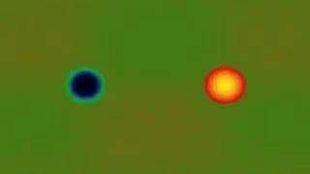

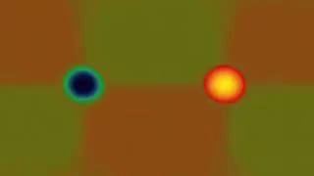
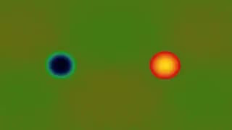
Forcing strengths ,
cf. Shigeo Kida (1981):
Strong injections
= 16:
in units of background shear
Recall
Semi-strong injec’ns
= 8:
Weak injections
= 2:
(as required for passive
Kelvin shearing,
CE2/SSST-type models)

Slide 134
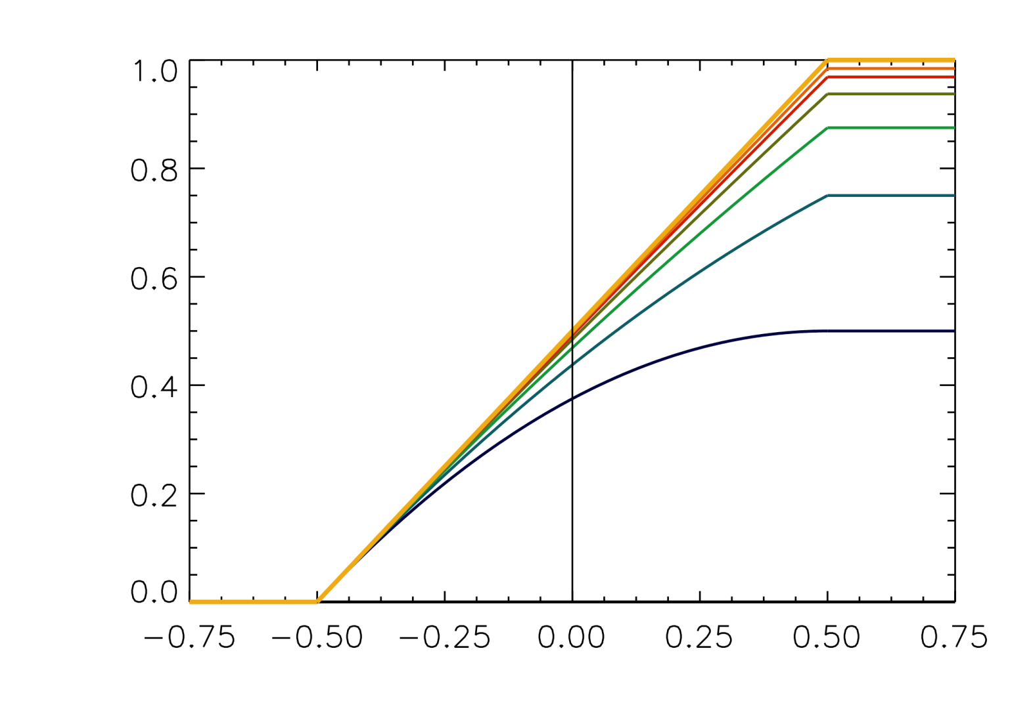


Final (July ’14) version of injection-pair algorithm, with “saturation”:
biases:
0
1/64
1/32
1/16
1/8
1/4
1/2
1/1 (anticyclone
only, as in
Li et al. ’06,
Showman ’07)
anticyclone
strength
cyclone
strengths
An additional “saturation” constraint further limits injection strengths by
prohibiting from exceeding .
With this setup, bias 1/32 is enough to ensure large-cyclone attrition.
Illustrate for strength = 16 and = 0 (pure Dowling-Ingersoll):

Slide 135
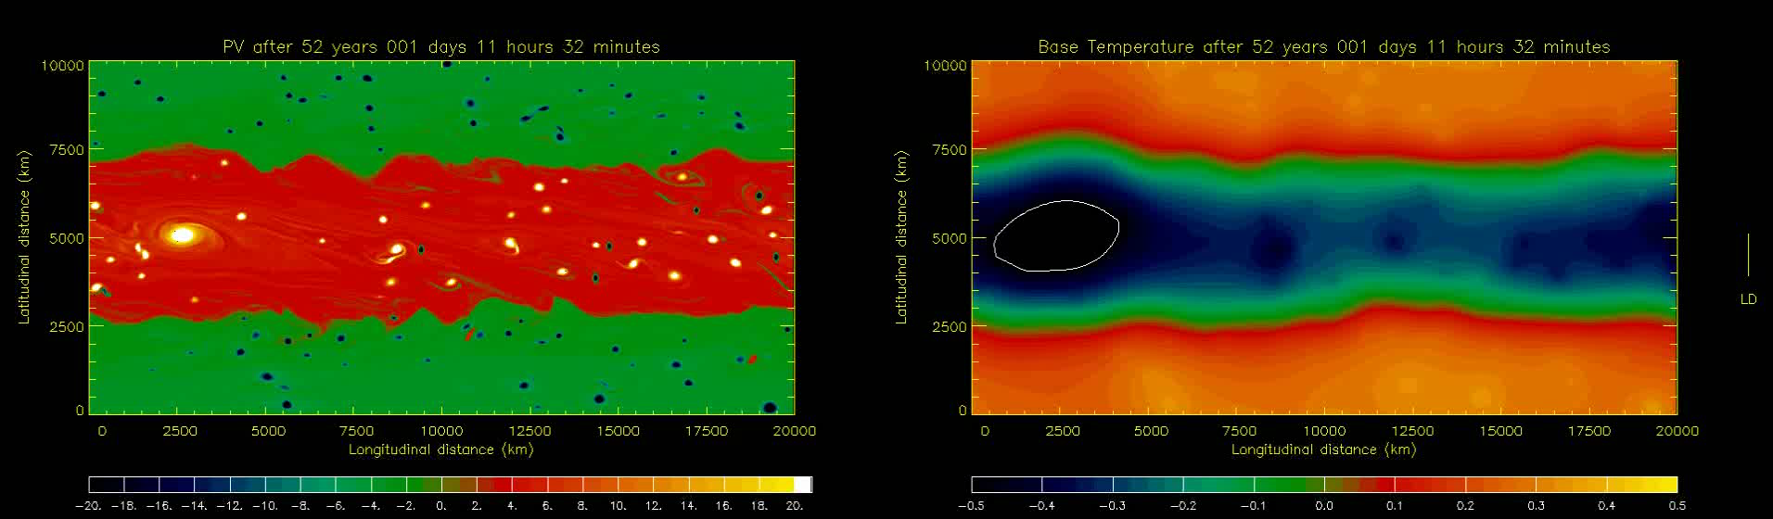
Bias 1/32, = 16, = 0 (pure Dowling-Ingersoll):
NB: quasi-realistic base-temperature structure;
white contour shows where = +0.5 threshold reached.
Some zonal-mean profiles for different biases ( = 0 still):

Slide 136
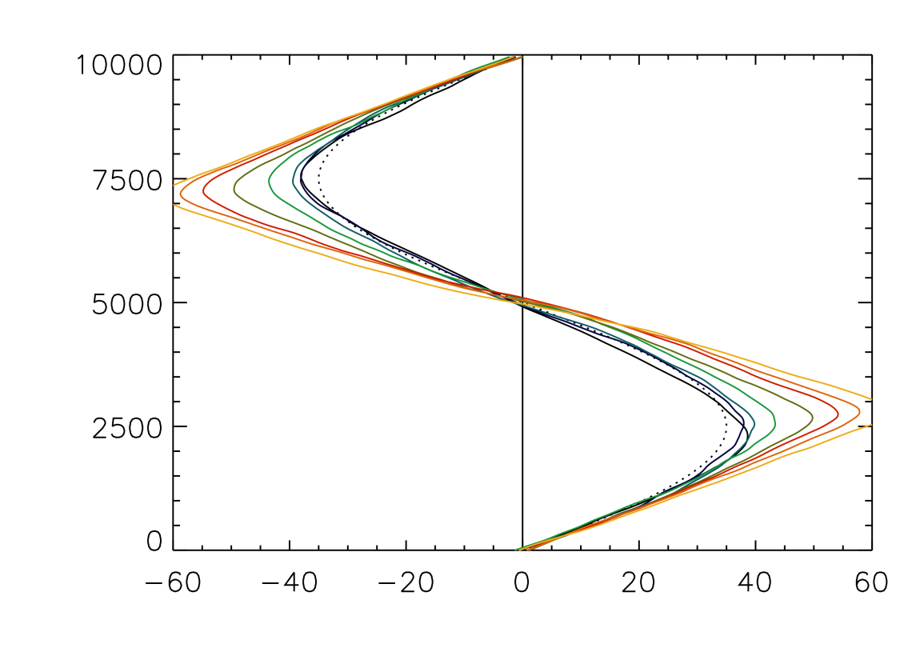
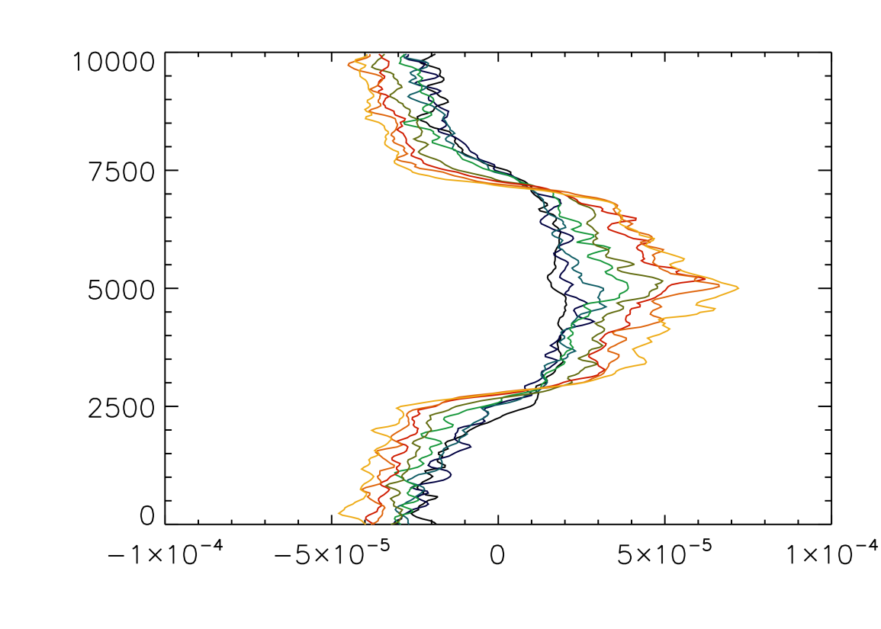

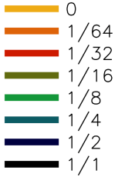
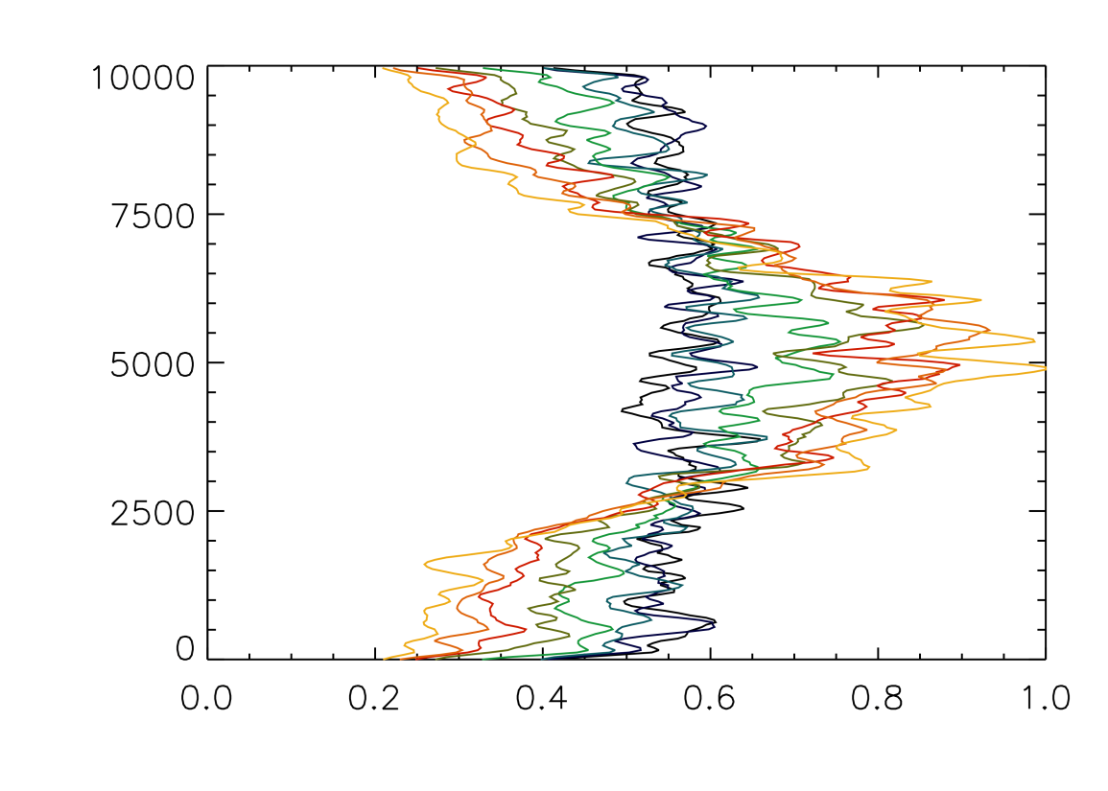
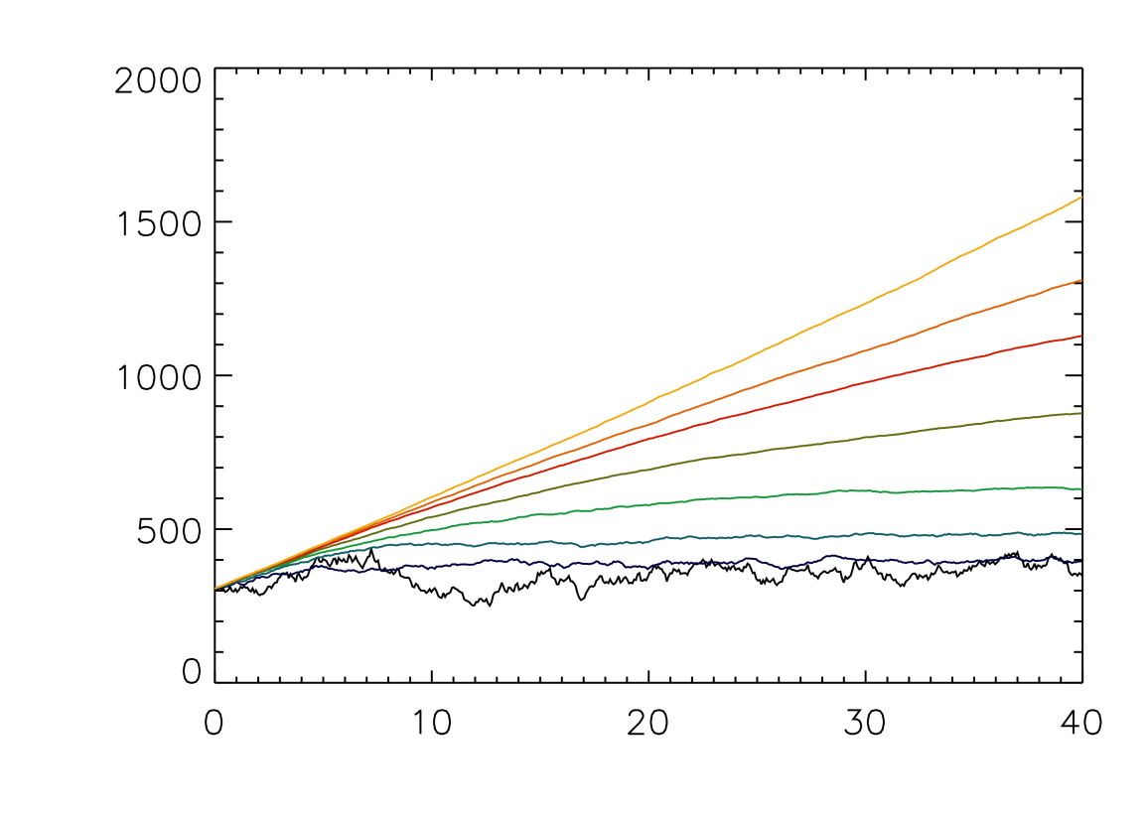
biases:
/km
deep jet,
à la
Stamp-Dowling
m/s
Total energy
Not quite
settled yet
Strength-
weighted
injections
/km
Statistically steady
time / Earth years

Slide 137
Toy tokamak? Very preliminary – with hopes of collaboration with Steve Tobias
and others (?) E.g. I don’t yet know enough about plasma numerical magnitudes...)

Slide 138
Toy tokamak? Very preliminary – with hopes of collaboration with Steve Tobias
and others (?) E.g. I don’t yet know enough about plasma numerical magnitudes...)
Recall “extended Hasegawa-Mima”, ‘model 2’ in Rosenbluth Lecture.
(For historical justice, we should call it the
“extended Charney-Obukhov-Hasegawa-Mima model”,
ECOHAM – oh, dear):

Slide 139



Toy tokamak? Very preliminary – with hopes of collaboration with Steve Tobias
and others (?) E.g. I don’t yet know enough about plasma numerical magnitudes...)
Recall “extended Hasegawa-Mima”, ‘model 2’ in Rosenbluth Lecture.
(For historical justice, we should call it the
“extended Charney-Obukhov-Hasegawa-Mima model”,
ECOHAM – oh, dear):
with

Slide 140
Toy tokamak? Very preliminary – with hopes of collaboration with Steve Tobias
and others (?) E.g. I don’t yet know enough about plasma numerical magnitudes...)
Recall “extended Hasegawa-Mima”, ‘model 2’ in Rosenbluth Lecture.
(For historical justice, we should call it the
“extended Charney-Obukhov-Hasegawa-Mima model”,
ECOHAM – oh, dear):
Prime is crucial! (Tilde, if you prefer
– departure from zonal average.)
with

Slide 141
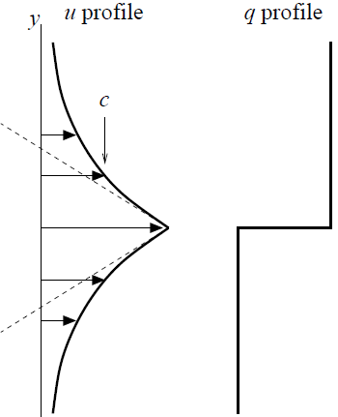

Toy tokamak? Very preliminary – with hopes of collaboration with Steve Tobias
and others (?) E.g. I don’t yet know enough about plasma numerical magnitudes...)
Recall “extended Hasegawa-Mima”, ‘model 2’ in Rosenbluth Lecture.
(For historical justice, we should call it the
“extended Charney-Obukhov-Hasegawa-Mima model”,
ECOHAM – oh, dear):
Prime is crucial! (Tilde, if you prefer
– departure from zonal average.)
Implication: strong jet with given
PV contrast has far greater velocity
contrast:
with
Rosenbluth
Lecture, Fig. 1.8

Slide 142
Add self-excitation term as crude model – this is cheating! – of resistive
drift-wave instability à la Hasegawa-Wakatani

Slide 143
Add self-excitation term as crude model – this is cheating! – of resistive
drift-wave instability à la Hasegawa-Wakatani (note, Jeffrey Parker has
done this properly, personal communication Tuesday):

Slide 144


Add self-excitation term as crude model – this is cheating! – of resistive
drift-wave instability à la Hasegawa-Wakatani (note, Jeffrey Parker has
done this properly, personal communication Tuesday):
constant nominal growth rate
constant Rayleigh frictions (more cheating)
with >>

Slide 145
Add self-excitation term as crude model – this is cheating! – of resistive
drift-wave instability à la Hasegawa-Wakatani (note, Jeffrey Parker has
done this properly, personal communication Tuesday):
constant nominal growth rate
constant Rayleigh frictions (more cheating)
with >>
(in short-
hand)

Slide 146
Add self-excitation term as crude model – this is cheating! – of resistive
drift-wave instability à la Hasegawa-Wakatani (note, Jeffrey Parker has
done this properly, personal communication Tuesday):
constant nominal growth rate
constant Rayleigh frictions (more cheating)
with >>
(in short-
hand)
is chosen much smaller than the domain size (square box now) –
less Jupiter-like and more tokamak-like – such that

Slide 147
Add self-excitation term as crude model – this is cheating! – of resistive
drift-wave instability à la Hasegawa-Wakatani (note, Jeffrey Parker has
done this properly, personal communication Tuesday):
constant nominal growth rate
constant Rayleigh frictions (more cheating)
with >>
(in short-
hand)
is chosen much smaller than the domain size (square box now) –
less Jupiter-like and more tokamak-like – such that
Get predator-prey-like situation, with hyper-staircasing of the
profile. (My Rosenbluth speculation was WRONG!!) Not weakly
forced/dissipating, PV-mixing-dominated, à la Scott-Dritschel JFM 2012.

Slide 148
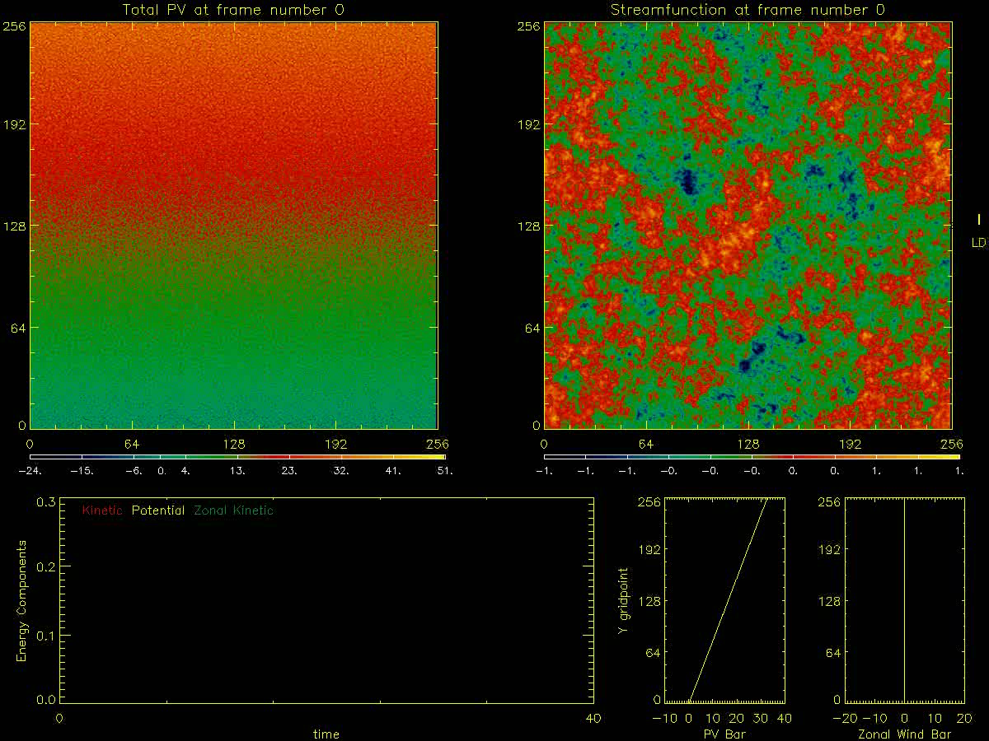
q
q
ψ
ψ
q bar
u bar
E
E

Slide 149
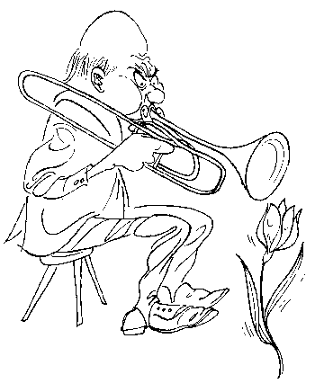
“Erasmus Darwin held that every so often you should
try a damn-fool experiment. He played the trombone to his tulips.
This… result… was negative. But other… impudent ideas have succeeded…“
– J. E. Littlewood: A Mathematician’s Miscellany, ed. Béla Bollobás

Slide 150
“Erasmus Darwin held that every so often you should
try a damn-fool experiment. He played the trombone to his tulips.
This… result… was negative. But other… impudent ideas have succeeded…“
– J. E. Littlewood: A Mathematician’s Miscellany, ed. Béla Bollobás
Set = 0, otherwise same problem:

Slide 151
“Erasmus Darwin held that every so often you should
try a damn-fool experiment. He played the trombone to his tulips.
This… result… was negative. But other… impudent ideas have succeeded…“
– J. E. Littlewood: A Mathematician’s Miscellany, ed. Béla Bollobás
Set = 0, otherwise same problem:

Slide 152
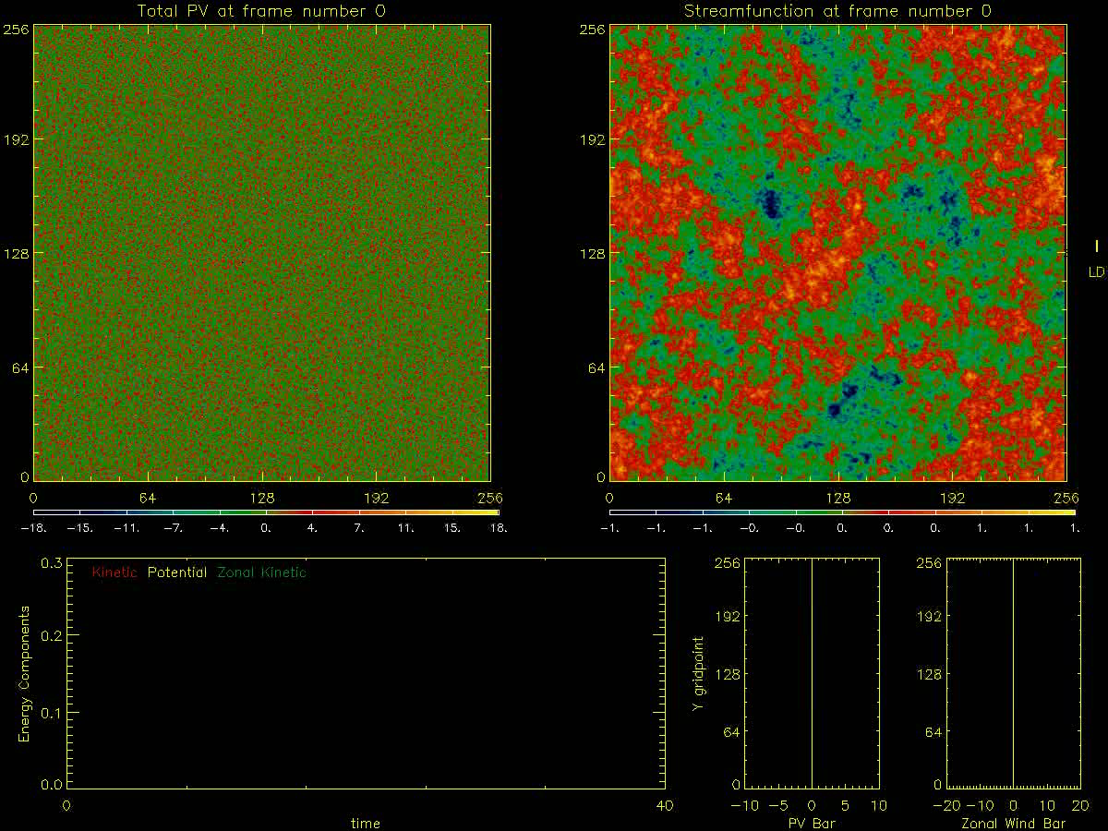
q
q
ψ
ψ
q bar
u bar
E
E

Slide 153

Conclusions re new work (Jupiter and extended Hasegawa-Mima:
▪ Jupiter model has no large-scale friction and no radiative damping.
▪ Despite that, PV bias and zeta-dependence allow statistically-steady
states – but closely tied to the deep jets. Deep jets now essential!!
▪ Other significant mechanisms in our model include monopole migration,
PV mixing (esp. when background beta strong), and cyclone attrition,
as well as vortex merging/cannibalism. (Relevance to GRS etc. ???)
▪ Passive Kelvin (SSST, CE2) almost vanishingly weak despite
favourable forcing-anisotropy (Srinivasan & Young).
▪ EHM results robustly suggest the opposite: Kelvin mech. probably dominant,
thanks to perfectly unbiased self-excitation, but easily killed by shear.
Reason is the enormously stronger and more extensive shear arising from
= 0 zonal-mean PV inversion. (“Killed”: easy extension of Kelvin 1887.)
For more detail, websearch ”lucidity principles”
then back to my home page at ”Encyclopedia”, ”Rosenbluth”, ”Haurwitz”.

