Slide 1
What can music tell us about science and mathematics?
Michael E McIntyre
Dept of Applied Mathematics & Theoretical Physics
University of Cambridge
Websearch e-book ”lucidity principles”

Slide 2
What indeed is music?
What is science?
What is mathematics?
What can music tell us about science and mathematics?
Websearch e-book ”lucidity principles”

Slide 3
What indeed is music?
What is science?
What is mathematics?
What can music tell us about science and mathematics?
How did our ancestors survive?
Websearch e-book ”lucidity principles”

Slide 4
What indeed is music?
What is science?
What is mathematics?
What can music tell us about science and mathematics?
How did our ancestors survive?
How does perception work?
Websearch e-book ”lucidity principles”

Slide 5
An idea to take seriously (with far-reaching implications):
perception works by model-fitting.
Websearch e-book ”lucidity principles”

Slide 6
An idea to take seriously (with far-reaching implications):
perception works by model-fitting.
The unconscious brain actively fits an internal model
to the sensory data coming in from the outside world.
Websearch e-book ”lucidity principles”

Slide 7
An idea to take seriously (with far-reaching implications):
perception works by model-fitting.
The unconscious brain actively fits an internal model
to the sensory data coming in from the outside world.
If the fit is good enough, the internal model becomes
the perceived reality.
Websearch e-book ”lucidity principles”

Slide 8

An idea to take seriously (with far-reaching implications):
perception works by model-fitting.
The unconscious brain actively fits an internal model
to the sensory data coming in from the outside world.
If the fit is good enough, the internal model becomes
the perceived reality.
Example: the “walking lights”:
Websearch e-book ”lucidity principles”

Slide 9
And what is a model?
Websearch e-book ”lucidity principles”

Slide 10
And what is a model?
(in the sense used here
– a very general sense)
Websearch e-book ”lucidity principles”

Slide 11
And what is a model?
Answer: a
partial and approximate representation of reality
(e.g. of a real person really walking)
(in the sense used here
– a very general sense)
Websearch e-book ”lucidity principles”

Slide 12
And what is a model?
Answer: a
partial and approximate representation of reality
(e.g. of a real person really walking)
NB: Science works the same way.
(in the sense used here
– a very general sense)
Websearch e-book ”lucidity principles”

Slide 13
And what is a model?
Answer: a
partial and approximate representation of reality
(e.g. of a real person really walking)
NB: Science works the same way.
(in the sense used here
– a very general sense)
(e.g.
Einstein’s
theory of
gravity)
Websearch e-book ”lucidity principles”

Slide 14
And what is a model?
Answer: a
partial and approximate representation of reality
(e.g. of a real person really walking)
NB: Science works the same way.
(Implication: science is not about Absolute Truth or
Absolute Proof.)
(in the sense used here
– a very general sense)
(e.g.
Einstein’s
theory of
gravity)
Websearch e-book ”lucidity principles”

Slide 15
And what is a model?
Answer: a
partial and approximate representation of reality
(e.g. of a real person really walking)
NB: Science works the same way.
(Implication: science is not about Absolute Truth or
Absolute Proof.)
(For one thing, we must assume that there’s an outside world…)
(in the sense used here
– a very general sense)
(e.g.
Einstein’s
theory of
gravity)
Websearch e-book ”lucidity principles”

Slide 16
Models and model-fitting require mathematics
Websearch e-book ”lucidity principles”

Slide 17
Models and model-fitting require mathematics
(e.g. Euclidean geometry).
Websearch e-book ”lucidity principles”

Slide 18
Models and model-fitting require mathematics
(e.g. Euclidean geometry).
Implication: we all have unconscious mathematics.
Websearch e-book ”lucidity principles”

Slide 19
Models and model-fitting require mathematics
(e.g. Euclidean geometry).
Implication: we all have unconscious mathematics.
Another way to say it is:
We all have an unconscious power of abstraction
Websearch e-book ”lucidity principles”

Slide 20
Models and model-fitting require mathematics
(e.g. Euclidean geometry).
Implication: we all have unconscious mathematics.
Another way to say it is:
We all have an unconscious power of abstraction
– and what is abstraction? Answer:
the ability to handle many possibilities at once
Websearch e-book ”lucidity principles”

Slide 21
Models and model-fitting require mathematics
(e.g. Euclidean geometry).
Implication: we all have unconscious mathematics.
Another way to say it is:
We all have an unconscious power of abstraction
– and what is abstraction? Answer:
the ability to handle many possibilities at once
(even an infinite number of possibilities).
Websearch e-book ”lucidity principles”

Slide 22
All this can be seen as a consequence of biological
natural selection
Websearch e-book ”lucidity principles”

Slide 23
All this can be seen as a consequence of biological
natural selection
along with certain mathematical facts, especially
combinatorial largeness.
Websearch e-book ”lucidity principles”

Slide 24
All this can be seen as a consequence of biological
natural selection
along with certain mathematical facts, especially
combinatorial largeness.
  The unconscious brain must choose the
  model components to fit to the incoming data from a
  combinatorially large number of possibilities.
Websearch e-book ”lucidity principles”

Slide 25
So, internal-model components need to be
as simple as possible:
(Platonic objects – elegance – computational economy)
Websearch e-book ”lucidity principles”
“Platonic” versus “constructivist” –
another of our false dichotomies! Again see Lucidity and Science Part II, p. 296.

Slide 26
So, internal-model components need to be
as simple as possible:
(Platonic objects – elegance – computational economy)
Websearch e-book ”lucidity principles”
“Platonic” versus “constructivist” –
another of our false dichotomies! Again see Lucidity and Science Part II, p. 296.

Slide 27
So, internal-model components need to be
as simple as possible:
(Platonic objects – elegance – computational economy)
Perfectly smooth curves are what we perceive when the data allow it.
Websearch e-book ”lucidity principles”
“Platonic” versus “constructivist” –
another of our false dichotomies! Again see Lucidity and Science Part II, p. 296.

Slide 28

So, internal-model components need to be
as simple as possible:
(Platonic objects – elegance – computational economy)
Perfectly smooth curves are what we perceive when the data allow it.
Websearch e-book ”lucidity principles”
“Platonic” versus “constructivist” –
another of our false dichotomies! Again see Lucidity and Science Part II, p. 296.

Slide 29
So, internal-model components need to be
as simple as possible:
(Platonic objects – elegance – computational economy)
Perfectly smooth curves are what we perceive when the data allow it.
A perfectly straight line is another Platonic object:
Websearch e-book ”lucidity principles”
“Platonic” versus “constructivist” –
another of our false dichotomies! Again see Lucidity and Science Part II, p. 296.

Slide 30

So, internal-model components need to be
as simple as possible:
(Platonic objects – elegance – computational economy)
Perfectly smooth curves are what we perceive when the data allow it.
A perfectly straight line is another Platonic object:
Websearch e-book ”lucidity principles”
“Platonic” versus “constructivist” –
another of our false dichotomies! Again see Lucidity and Science Part II, p. 296.

Slide 31
So, internal-model components need to be
as simple as possible:
(Platonic objects – elegance – computational economy)
There are many more Platonic objects.
E.g. an infinitely large number of smooth curves.
Websearch e-book ”lucidity principles”
“Platonic” versus “constructivist” –
another of our false dichotomies! Again see Lucidity and Science Part II, p. 296.

Slide 32

So, internal-model components need to be
as simple as possible:
(Platonic objects – elegance – computational economy)
There are many more Platonic objects.
E.g. an infinitely large number of smooth curves.
Here’s another smooth curve – can you see it?
Websearch e-book ”lucidity principles”
“Platonic” versus “constructivist” –
another of our false dichotomies! Again see Lucidity and Science Part II, p. 296.

Slide 33
So, internal-model components need to be
as simple as possible:
(Platonic objects – elegance – computational economy)
There are many more Platonic objects.
E.g. an infinitely large number of smooth curves.
Here’s another smooth curve – can you see it?
(unconscious
mathematics
again)
Websearch e-book ”lucidity principles”
“Platonic” versus “constructivist” –
another of our false dichotomies! Again see Lucidity and Science Part II, p. 296.

Slide 34
Model-fitting takes place in spacetime. (The walking
lights demonstrate it, as does any other movie.)
(unconscious
mathematics
again)
Websearch e-book ”lucidity principles”
“Platonic” versus “constructivist” –
another of our false dichotomies! Again see Lucidity and Science Part II, p. 296.

Slide 35
Model-fitting takes place in spacetime. (The walking
lights demonstrate it, as does any other movie.)
We can perceive continuous motion despite actual discontinuities.
(unconscious
mathematics
again)
Websearch e-book ”lucidity principles”
“Platonic” versus “constructivist” –
another of our false dichotomies! Again see Lucidity and Science Part II, p. 296.

Slide 36

Model-fitting takes place in spacetime. (The walking
lights demonstrate it, as does any other movie.)
We can perceive continuous motion despite actual discontinuities.
Musical example: Mozart’s “flowing oil” – a feeling of
continuous motion evoked by
discontinuous sounds (from the K545 piano sonata).
(unconscious
mathematics
again)
Websearch e-book ”lucidity principles”
“Platonic” versus “constructivist” –
another of our false dichotomies! Again see Lucidity and Science Part II, p. 296.

Slide 37
Music takes us deeper still.
Websearch e-book ”lucidity principles”

Slide 38
Music takes us deeper still.
Natural selection again: auditory scene analysis.
Websearch e-book ”lucidity principles”

Slide 39
Music takes us deeper still.
Natural selection again: auditory scene analysis.
An implication is that
the harmonic series is another Platonic object,
part of the brain’s model-building repertoire
Websearch e-book ”lucidity principles”

Slide 40
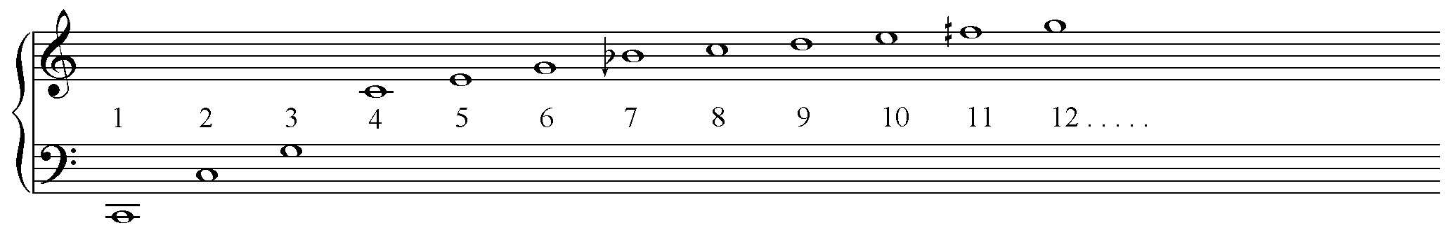
Music takes us deeper still.
Natural selection again: auditory scene analysis.
An implication is that
the harmonic series is another Platonic object,
part of the brain’s model-building repertoire
Websearch e-book ”lucidity principles”

Slide 41
Music takes us deeper still.
Natural selection again: auditory scene analysis.
An implication is that
the harmonic series is another Platonic object,
part of the brain’s model-building repertoire
(cross-cultural – indeed cross-species)
Websearch e-book ”lucidity principles”

Slide 42
Music takes us deeper still.
Natural selection again: auditory scene analysis.
An implication is that
the harmonic series is another Platonic object,
part of the brain’s model-building repertoire
(cross-cultural – indeed cross-species)
Websearch e-book ”lucidity principles”

Slide 43
Music takes us deeper still.
Natural selection again: auditory scene analysis.
An implication is that
the harmonic series is another Platonic object,
part of the brain’s model-building repertoire
(cross-cultural – indeed cross-species)
Websearch e-book ”lucidity principles”

Slide 44
Music takes us deeper still.
Natural selection again: auditory scene analysis.
An implication is that
the harmonic series is another Platonic object,
part of the brain’s model-building repertoire
(cross-cultural – indeed cross-species)
Websearch e-book ”lucidity principles”

Slide 45
Music takes us deeper still.
Natural selection again: auditory scene analysis.
An implication is that
the harmonic series is another Platonic object,
part of the brain’s model-building repertoire
(cross-cultural – indeed cross-species)
Websearch e-book ”lucidity principles”

Slide 46
Music takes us deeper still.
Natural selection again: auditory scene analysis.
An implication is that
the harmonic series is another Platonic object,
part of the brain’s model-building repertoire
(cross-cultural – indeed cross-species)
Websearch e-book ”lucidity principles”

Slide 47
Music takes us deeper still.
Natural selection again: auditory scene analysis.
An implication is that
the harmonic series is another Platonic object,
part of the brain’s model-building repertoire
(cross-cultural – indeed cross-species)
Websearch e-book ”lucidity principles”

Slide 48
Music takes us deeper still.
Natural selection again: auditory scene analysis.
An implication is that
the harmonic series is another Platonic object,
part of the brain’s model-building repertoire
(cross-cultural – indeed cross-species)
Websearch e-book ”lucidity principles”

Slide 49

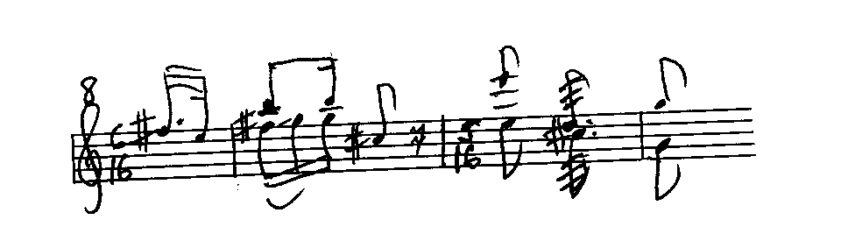
Tui song recorded in
Invercargill, New Zealand:
>
Recording by Les McPherson
Websearch e-book ”lucidity principles”

Slide 50
Also basic to our perceptual and cognitive processes:
the organic-change principle:
The unconscious brain is interested in – and likes to play with – patterns in which
some things change slightly, while others stay the same.
(Another abstract idea.) And it takes us from juvenile play toward
some of the deepest connections between music and mathematics.
Websearch e-book ”lucidity principles”

Slide 51
Music consists of
organically-changing sound patterns.
Websearch e-book ”lucidity principles”

Slide 52
Music consists of
organically-changing sound patterns.
Music and mathematics both stem from our
unconscious interest in abstract patterns for their own sake,
especially organically changing patterns – patterns we like to play with.
Websearch e-book ”lucidity principles”

Slide 53
Music consists of
organically-changing sound patterns.
Music and mathematics both stem from our
unconscious interest in abstract patterns for their own sake,
especially organically changing patterns – patterns we like to play with.
Mathematics is full of changing patterns (of numbers, shapes,
symmetry properties,…) but some things stay the same:
Websearch e-book ”lucidity principles”

Slide 54
Music consists of
organically-changing sound patterns.
Music and mathematics both stem from our
unconscious interest in abstract patterns for their own sake,
especially organically changing patterns – patterns we like to play with.
Mathematics is full of changing patterns (of numbers, shapes,
symmetry properties,…) but some things stay the same:
“conservation theorems”... “invariance properties”…
Websearch e-book ”lucidity principles”

Slide 55
Music consists of
organically-changing sound patterns.
Music and mathematics both stem from our
unconscious interest in abstract patterns for their own sake,
especially organically changing patterns – patterns we like to play with.
Mathematics is full of changing patterns (of numbers, shapes,
symmetry properties,…) but some things stay the same:
“conservation theorems”... “invariance properties”…
Mathematics is full of patterns that look dissimilar at first but
– when you go deeper, when you play with them enough –
are found to be similar, or intimately related, perhaps
within a still larger set of possibilities:
Websearch e-book ”lucidity principles”

Slide 56
Music consists of
organically-changing sound patterns.
Music and mathematics both stem from our
unconscious interest in abstract patterns for their own sake,
especially organically changing patterns – patterns we like to play with.
Mathematics is full of changing patterns (of numbers, shapes,
symmetry properties,…) but some things stay the same:
“conservation theorems”... “invariance properties”…
Mathematics is full of patterns that look dissimilar at first but
– when you go deeper, when you play with them enough –
are found to be similar, or intimately related, perhaps
within a still larger set of possibilities:
Websearch e-book ”lucidity principles”

Slide 57

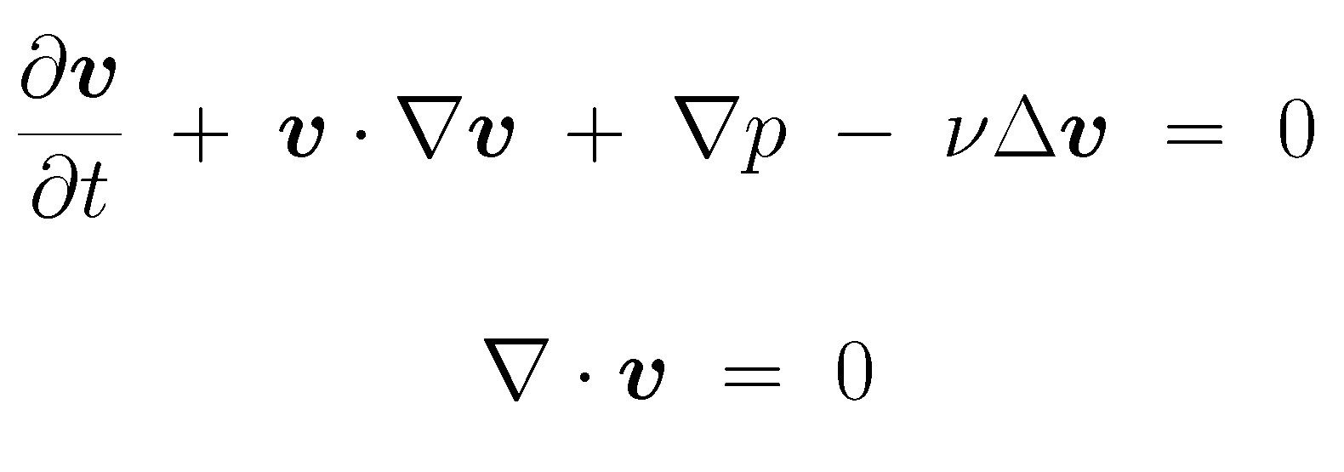
Here are two patterns that are intimately related:
Websearch e-book ”lucidity principles”

Slide 58
Here are two patterns that are intimately related:
Back to music:
Websearch e-book ”lucidity principles”

Slide 59
E.g. the way harmony works (websearch “musical hyperspace”):
Websearch e-book ”lucidity principles”

Slide 60
E.g. the way harmony works (websearch “musical hyperspace”):
Powerful, continuous harmonic motion uses organic change
– some things changing slightly while others stay the same –
where “slightly” now has two alternative meanings:
Websearch e-book ”lucidity principles”

Slide 61
E.g. the way harmony works (websearch “musical hyperspace”):
Powerful, continuous harmonic motion uses organic change
– some things changing slightly while others stay the same –
where “slightly” now has two alternative meanings:
”harmonically close”:
”melodically close”:
Websearch e-book ”lucidity principles”

Slide 62
E.g. the way harmony works (websearch “musical hyperspace”):
Powerful, continuous harmonic motion uses organic change
– some things changing slightly while others stay the same –
where “slightly” now has two alternative meanings:
”harmonically close”:
”melodically close”:
(And powerful chords are made of harmonic-series subsets. Debussy was the
first great composer to recognize all this – see Debussy and the Harmonic Series
by Sir Peter Platt.)
Websearch e-book ”lucidity principles”

Slide 63
E.g. the way harmony works (websearch “musical hyperspace”):
Powerful, continuous harmonic motion uses organic change
– some things changing slightly while others stay the same –
where “slightly” now has two alternative meanings:
”harmonically close”:
”melodically close”:
(And powerful chords are made of harmonic-series subsets. Debussy was the
first great composer to recognize all this – see Debussy and the Harmonic Series
by Sir Peter Platt.)
(Western music has two main pitch-templates, in slight tension – a rich artistic resource!!)
Websearch e-book ”lucidity principles”

Slide 64
One last point: music reminds us that the brain’s
unconscious model-fitting is done
in time as well as space
Websearch e-book ”lucidity principles”

Slide 65
One last point: music reminds us that the brain’s
unconscious model-fitting is done
in time as well as space
(or rather, in this case, musical hyperspace).
Websearch e-book ”lucidity principles”

Slide 66
One last point: music reminds us that the brain’s
unconscious model-fitting is done
in time as well as space
(or rather, in this case, musical hyperspace).
Therefore,
subjective time can differ from objective
(outside-world) time
because
Websearch e-book ”lucidity principles”

Slide 67
subjective, i.e., perceived, time is an internal-model property.
Websearch e-book ”lucidity principles”

Slide 68
subjective, i.e., perceived, time is an internal-model property.
(So it needn’t obey the usual laws of physics regarding causality.)
Websearch e-book ”lucidity principles”

Slide 69
subjective, i.e., perceived, time is an internal-model property.
(So it needn’t obey the usual laws of physics regarding causality.)
Example: acausality illusions
The perceived time of an event can precede the arrival
of sensory data defining the event.
Websearch e-book ”lucidity principles”

Slide 70
subjective, i.e., perceived, time is an internal-model property.
(So it needn’t obey the usual laws of physics regarding causality.)
Example: acausality illusions
The perceived time of an event can precede the arrival
of sensory data defining the event.
Basic to Western music are events called harmony changes:
Websearch e-book ”lucidity principles”

Slide 71
subjective, i.e., perceived, time is an internal-model property.
(So it needn’t obey the usual laws of physics regarding causality.)
Example: acausality illusions
The perceived time of an event can precede the arrival
of sensory data defining the event.
Basic to Western music are events called harmony changes:
Mozart K 545 again:
Websearch e-book ”lucidity principles”

Slide 72
subjective, i.e., perceived, time is an internal-model property.
(So it needn’t obey the usual laws of physics regarding causality.)
Example: acausality illusions
The perceived time of an event can precede the arrival
of sensory data defining the event.
Basic to Western music are events called harmony changes:
Mozart K 545 again:
Websearch e-book ”lucidity principles”

Slide 74
● Survival depends on perception
● Perception works by model-fitting (unconscious)
● Science works by model-fitting (partly conscious)
● Model-fitting uses unconscious mathematics
● Model-fitting builds on our unconscious interest in:
• Platonic objects
• Organically-changing patterns
– mathematics & music play with such objects and patterns
● Further aspects: complexity and multi-level thinking,.. . ... “self”,... “free will”,...
Websearch e-book ”lucidity principles” ”Ramachandran”

Slide 75
(No time for the following slides:)

Slide 76
Mozart K 545:
Not quite Mozart K 545:
Websearch e-book ”lucidity principles”

Slide 77
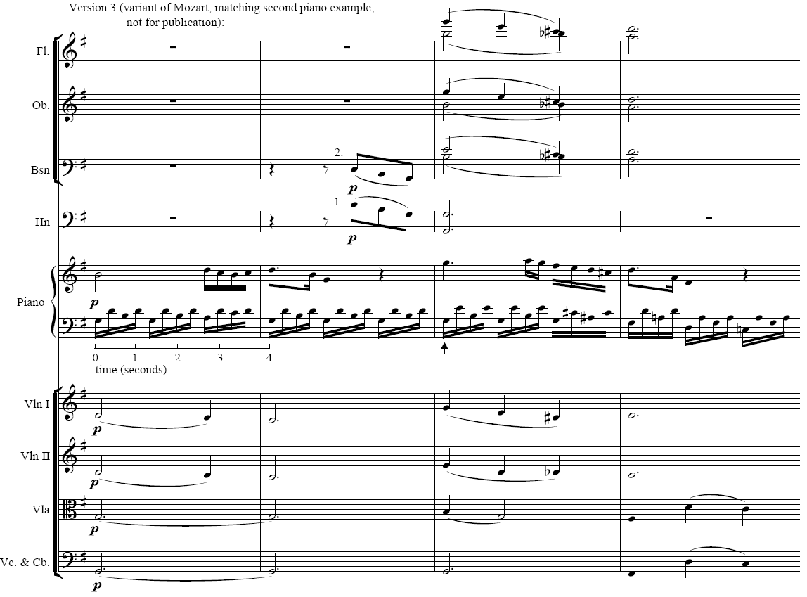

Slide 78
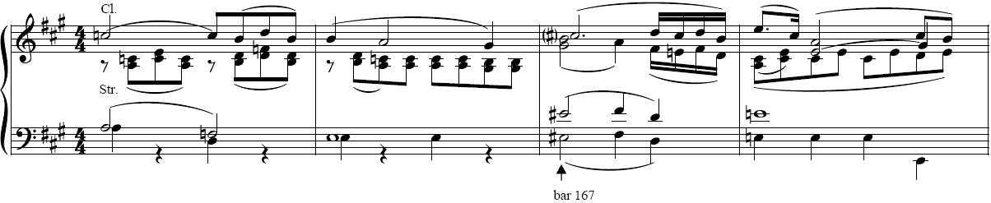
Hyperspace leaps – part of how the magic is done:
( )

Slide 79

Finally: the central idea or hypothesis that
perception works by model-fitting
deserves to be taken seriously for other reasons too, e.g.,
● The nature of “self ”: the brain is committee-like, yet has a single
internal “self-model” – continuously being fitted to the incoming data (visual,
auditory, tactile, and proprioceptive). (As distinct from “being conscious”!!)
● Acausality illusions include the perceived (subjective) times of making
decisions (cf. Grey Walter and Benjamin Libet experiments, free-will debates).
(The “perceived times of internal decisions must be later than, and perceived
times of outside-world events earlier than… physical events in the nervous
system. Only thus can the brain… represent both sets of times in its internal
model of the self in its surroundings at the… accuracies needed for survival.” )
For more on this, websearch ”lucidity principles” ”V. S. Ramachandran”

