Slide 1
FDSE Guest Lecture 8 Sept 2014
A tale of two paradigms,
with remarks on unconscious assumptions
(after the Bernhard Haurwitz Memorial Lecture)
Michael E. McIntyre,
Dept of Applied Mathematics & Theoretical Physics,
University of Cambridge, UK
For more detail, websearch ”lucidity principles”
then back to my home page at ”Encyclopedia”, ”staircase”, ”Rosenbluth”.

Slide 2
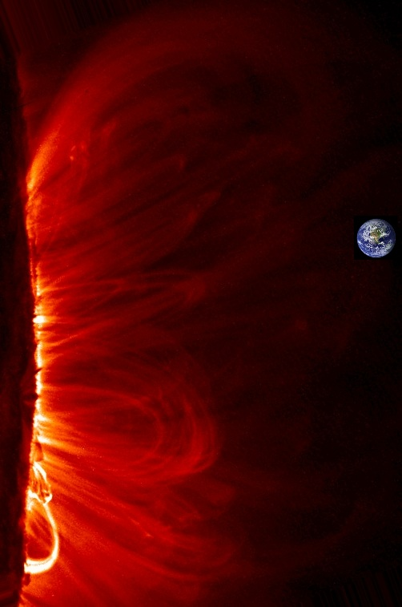
Our life support system
fluid dynamics on a grand scale…
And rotation and stable stratification are
important in many cases, including the Sun’s
interior…
For more detail, websearch ”lucidity principles”
then back to my home page at ”Encyclopedia”, ”Rosenbluth”, ”Haurwitz”.

Slide 3
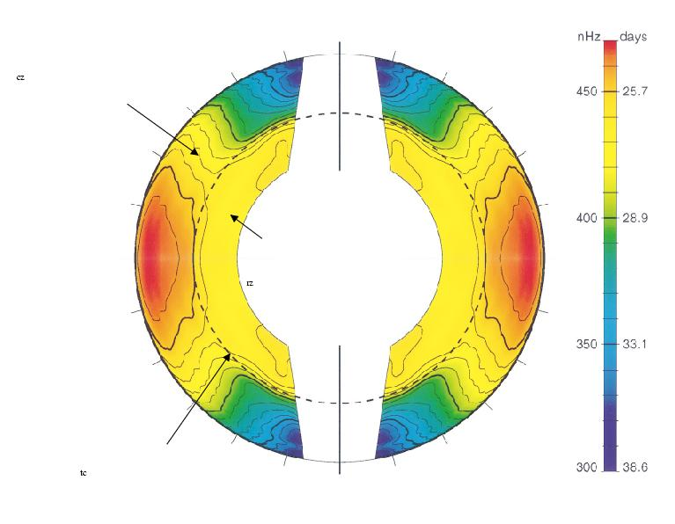
2πΩ/nHz
convection
zone
Wood & McI
(2011),
J. Fluid
Mech. 677
radiative interior –
no significant evidence
for departures from
solid rotation
(Princeton, May 2011)
For more detail, websearch ”lucidity principles”
then back to my home page at ”Encyclopedia”, ”Rosenbluth” , ”Haurwitz”.
tachocline
Schou et al ’98

Slide 4
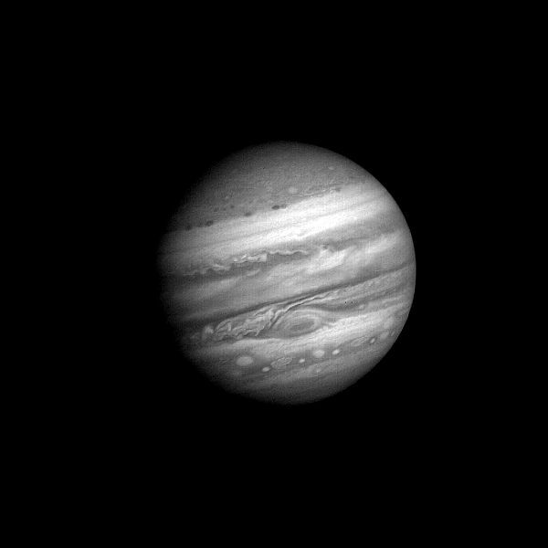
1979: Voyager 1 approaching (60 Jupiter days) – unearthly!
folded
filamentary
region
For more detail, websearch ”lucidity principles”
then back to my home page at ”Encyclopedia”, ”Rosenbluth” , ”Haurwitz”.

Slide 5
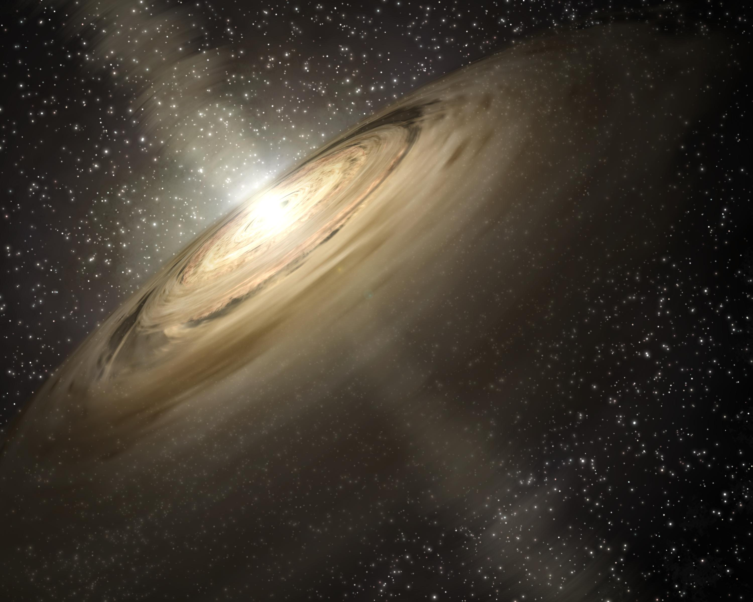
Protoplanetary accretion disks:
Artist’s impression – NASA/JPL-Caltech/T. Pyle (SSC)
For more detail, websearch ”lucidity principles”
then back to my home page at ”Encyclopedia”, ”staircase”, ”Rosenbluth”.

Slide 6
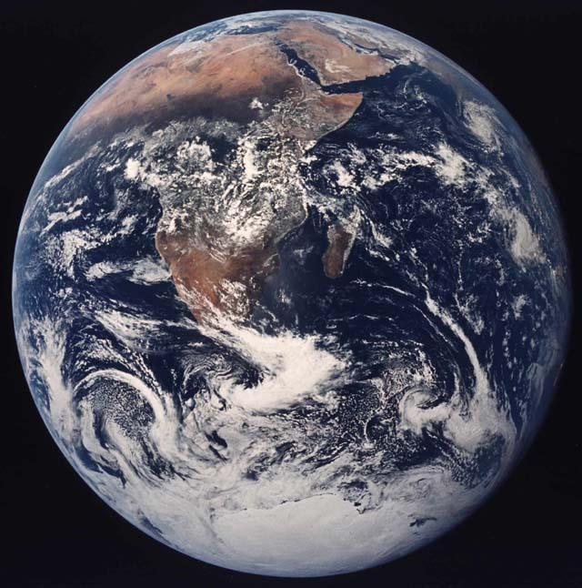
Today it hardly needs saying, following an
aphorism of V.I. Arnol’d, that
Rotating, stratified
fluid dynamics
cannot be
understood without
potential vorticity,
PV
(Disk people call
it “vortensity”)
Tokamaks too?
Here’s its most
beautiful definition:
For more detail, websearch ”lucidity principles”
then back to my home page at ”Encyclopedia”, ”staircase”, ”Rosenbluth”.

Slide 7
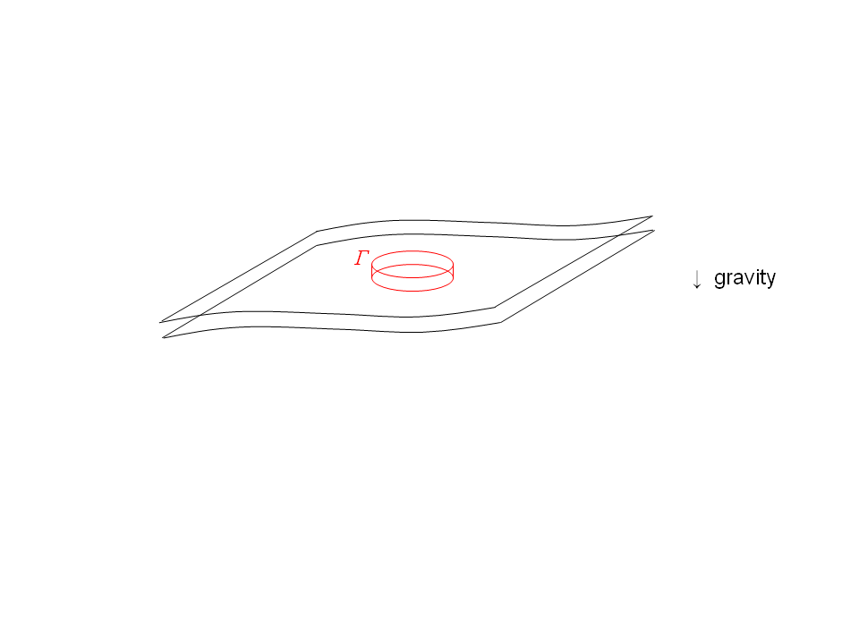

In both single-layer and multi-layer systems,
we can define the exact PV as the suitably normalized Kelvin circulation
of an infinitesimal material circuit Γ lying in a stratification surface.
“Suitably normalized”: multiply by mass of pillbox
between adjacent stratification surfaces:
Kelvin
circulation is
Corollary:
exact PV =
Note: (1) the PV is a material invariant for frictionless, adiabatic
fluid motion, under any scenario of stretching or tilting
of fluid elements and stratification surfaces.
So the PV is mixable along stratification surfaces (though not across!)
impermeability
theorem etc
For more detail, websearch ”lucidity principles”
then back to my home page at ”Encyclopedia”, ”Rosenbluth”, ”Haurwitz”.

Slide 8
In both single-layer and multi-layer systems,
we can define the exact PV as the suitably normalized Kelvin circulation
of an infinitesimal material circuit Γ lying in a stratification surface.
“Suitably normalized”: multiply by mass of pillbox
between adjacent stratification surfaces:
Kelvin
circulation is
Corollary:
exact PV =
Note: (1) the PV is a material invariant for frictionless, adiabatic
fluid motion, under any scenario of stretching or tilting
of fluid elements and stratification surfaces.
So the PV is mixable along stratification surfaces (though not across!)
And (2) the PV is invertible: the PV field has nearly all the dynamical
information. (Invertibility depends on the flow being balanced.)
impermeability
theorem etc
Note scale effect: small-scale PV anomalies → weak velocities.

Slide 9
In both single-layer and multi-layer systems,
we can define the exact PV as the suitably normalized Kelvin circulation
of an infinitesimal material circuit Γ lying in a stratification surface.
“Suitably normalized”: multiply by mass of pillbox
between adjacent stratification surfaces:
Kelvin
circulation is
Corollary:
exact PV =
Note: (1) the PV is a material invariant for frictionless, adiabatic
fluid motion, under any scenario of stretching or tilting
of fluid elements and stratification surfaces.
So the PV is mixable along stratification surfaces (though not across!)
And (2) the PV is invertible: the PV field has nearly all the dynamical
information. (Invertibility depends on the flow being balanced.)
impermeability
theorem etc
What do real PV fields look like? Here’s an example (nostalgic for me):

Slide 10
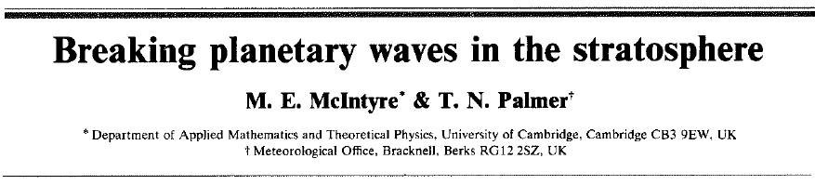
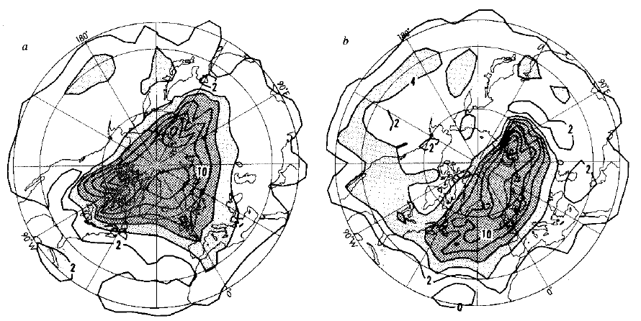
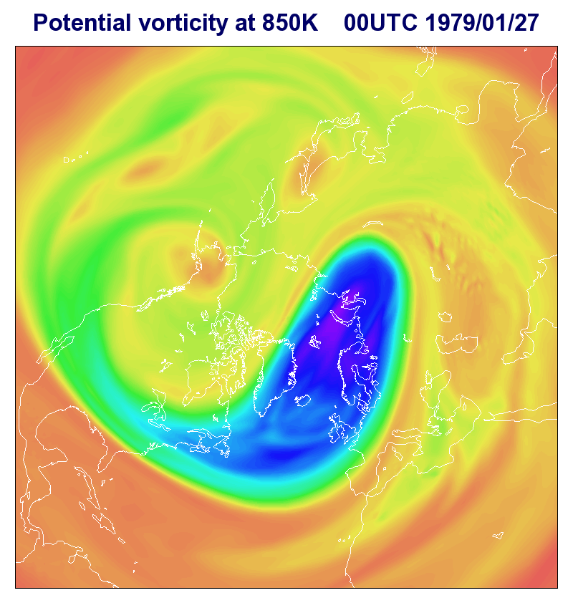
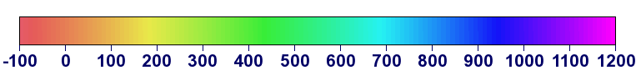
Courtesy Dr A J Simmons,
European Centre for Medium
Range Weather Forecasts:
McIntyre and Palmer (1983), revisited
PV on the 850K stratification surface:
turbulent
here
wavelike
here
Final state
PVU

Slide 11
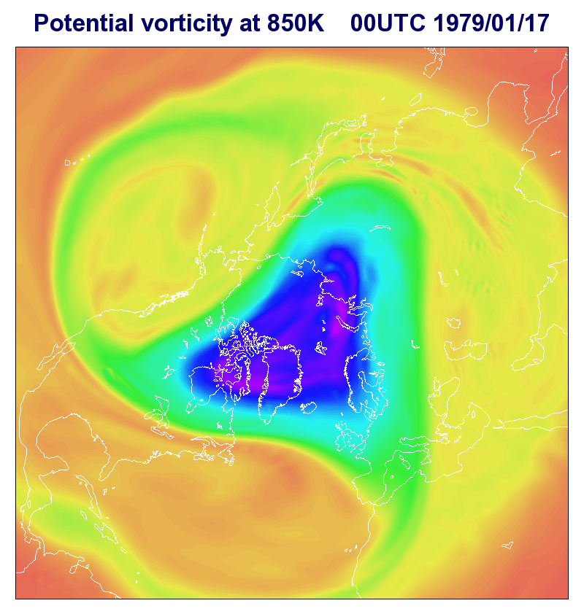
Courtesy Dr A J Simmons,
European Centre for Medium
Range Weather Forecasts:
PV at 850K,
mid-Jan. 1979
Inhomogeneous!
Quasi-elastic
“eddy-transport
barrier”
For more detail, websearch ”lucidity principles”
then back to my home page at ”Encyclopedia”, ”Rosenbluth”, ”Haurwitz”.

Slide 12
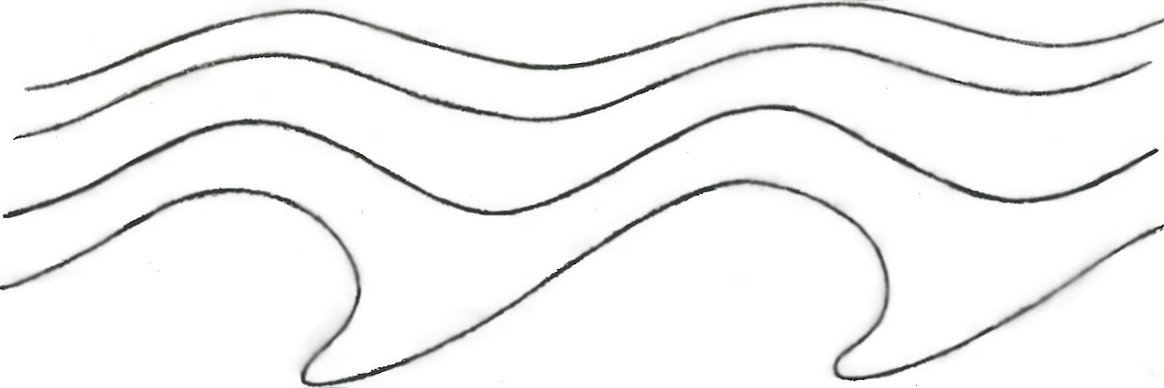
Yes, it’s turbulent – strongly nonlinear – but also highly inhomogeneous,
well outside the scope of homogeneous turbulence theory and its
extensions. In particular,
- the structure is completely missed by power spectra
(e.g. Armi and Flament 1985, J. Geophys. Res.)
Quasi-
elastic
“barrier”
- the structure has wavelike and turbulent regions that fit together
in a “wave-turbulence jigsaw”:
latitude
↑
PV contours undulate reversibly:
PV contours deform irreversibly:
(wave breaking → inhomogeneous PV mixing via scale effect)
→ longitude
NB: it’s impossible to make sense of the dynamics, even gross
angular-momentum budgets – including Starr’s “negative viscosity”
(anti-friction) – without recognizing this inhomogeneous jigsaw structure.
The simplest fully self-consistent model of the structure is the
Stewartson-Warn-Warn (1978) nonlinear critical-layer theory.
And the essence of it was first recognized by Dickinson (1969).

Slide 13
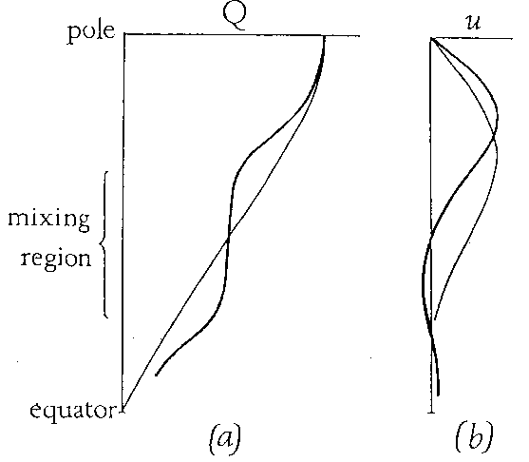
The wave-turbulence jigsaw structure is often associated with
jet-self-sharpening scenarios. (Negative viscosity or
anti-friction again.) The polar-night jet was the first
example for which this whole picture became clear:
___
PV
wavelike:
(quasi-linear)
turbulent:
(strongly nonlinear)
cf. movie!
The inhomogeneity of PV mixing means that
PV contours must bunch up on the borders of the
PV mixing regions. Then PV inversion automatically gives
sharp, strong jets (tighter “barriers” thanks to shear).
(Fig 5 from
my 1982
review,
J. Met. Soc.
Japan 60)
Historical note: the PV-mixing idea was not new even in 1982,
if you count the limiting case (nondivergent barotropic dynamics).
The idea goes back to the work of G. I. Taylor and others on turbulence –
thinking about momentum transport versus vorticity transport. Taylor
had already found an important clue in 1915, showing that one pattern
of vorticity transport can imply a different pattern of momentum transport:

Slide 14
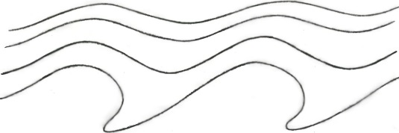
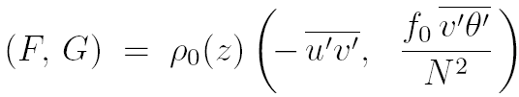
Taylor identity (G.I. Taylor 1915, Phil. Trans. Roy. Soc.)
– nonlinearly relates eddy fluxes of PV to
momentum-flux divergences:
Barotropic (any L_{D}): (+ form stress if topog)
3D baroclinic:
where
(“Eliassen-Palm flux”)
quasi-geostrophic PV
(Taylor-Charney-Stern-
Bretherton-Eady-Green identity)
form stress
(here θ′ = buoyancy-acceleration fluct’n)
NB: nonlinear relation: valid at any amplitude!! And valid
regardless of whether motion is free, forced, or self-excited.

Slide 15


Taylor identity (G.I. Taylor 1915, Phil. Trans. Roy. Soc.)
– nonlinearly relates eddy fluxes of PV to
momentum-flux divergences:
Barotropic (any L_{D}): (+ form stress if topog)
3D baroclinic:
where
(“Eliassen-Palm flux”)
quasi-geostrophic PV
(Taylor-Charney-Stern-
Bretherton-Eady-Green identity)
form stress
Corollary:
(here θ′ = buoyancy-acceleration fluct’n)
= 0 for isolated domain – once thought to prove PV mixing impossible
– but actually argues only against homogeneous PV mixing.
Here are 3 more reasons ” “ “ “ :

Slide 16
Three more reasons (beyond quasi-geostrophic ) why PV mixing
on stratification surfaces is usually inhomogeneous:
1. Stagnation effect: For spanning the globe, easy to prove that
homogeneous mixing has an absurd consequence. We have
where P = exact PV,
positive
on each . Homogeneous mixing (e.g., constant-diffusivity models)
→ P = 0 everywhere on : inverts to absolute stagnation!
2. Waveguide effect: Strong jets (PV contours bunched up) are Rossby
waveguides: dispersion relations favour wave breaking in jet flanks.
(Dispersion relations differ from those of homogeneous beta-turbulence theory)
3. PV Phillips effect: a generic positive-feedback effect:

Slide 17
O. M. Phillips (1972 Deep Sea Res). NB: Don’t need to assume Fickian diffusion.
a positive feedback
tending to make the mixing
spatially inhomogeneous.
The more inhomogeneous, the stronger
the feedback, bringing in the shear effects
(Juckes & M, Nature 1987).
“staircase” on my home page

Slide 18
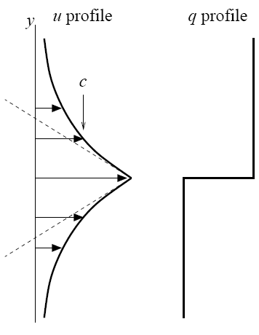


Waveguide effect:
Simplest quasi-geostrophic strong-jet model (Rosenbluth Lecture & refs.).
PV contours infinitely bunched up to make a perfect Rossby waveguide:
Dispersion relation differs from homogeneous:
u_{j}
Phase speed c lies within the
range of the jet velocity profile.
So simple kinematics favours Rossby-wave
breaking on the jet flanks. This is the key
message from the Rossby-wave critical-layer
theory – another way of seeing the feedback
from shear. Illustrates how a strong jet
sharpens itself when its Rossby waves are excited naturally.
Again note the jigsaw-like character of this scenario,
involving quasi-linear wave propagation and strongly
nonlinear turbulence in close symbiosis.
(slope jump is
proportional to PV
jump)
Strong support comes from numerical and laboratory experiments, e.g.,

Slide 19
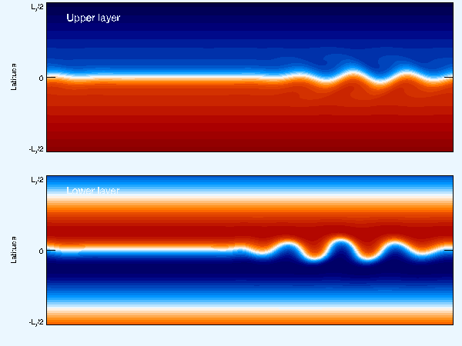
Scott and Dritschel (2012, J. Fluid Mech. 711, 576) – forced-dissipative
but clarifying how to reach the more “natural” low-excitation, low-dissipation
parameter regimes. Also
Esler, G., 2008, J. Fluid Mech. 599, 241 and Phys. Fluids 20, 116602:
Here the Taylor identity is satisfied via a form stress exerted from below:
Next is a classic lab experiment conveying the same message:

Slide 20
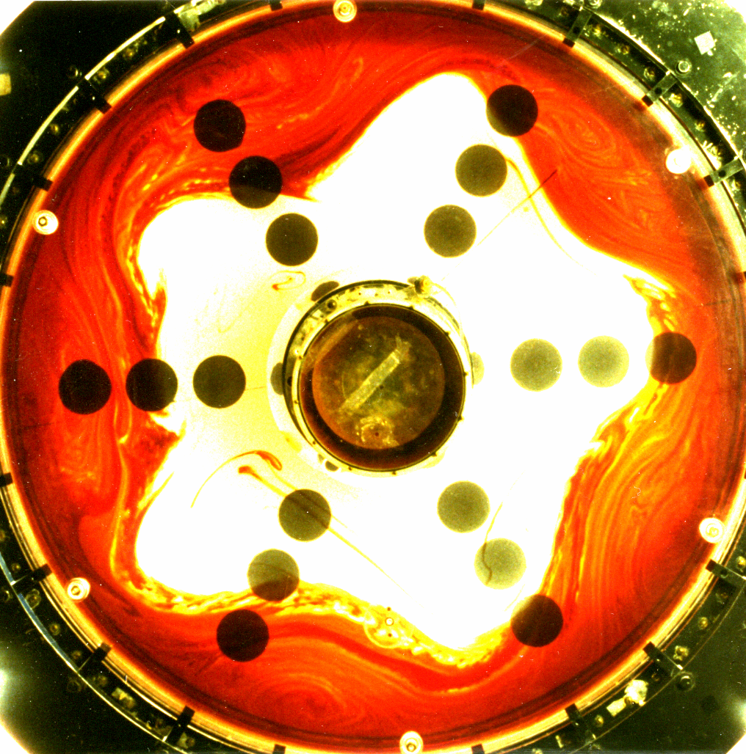
Sommeria,
Myers, and
Swinney,
Nature 1989
86.4 cm dia.;
3 revs/sec (!)
PV map and
dye map
near-identical.
Strong jet,
very tight
eddy-transport
barrier.
Dye put in
> 500 revs.
earlier.

Slide 21
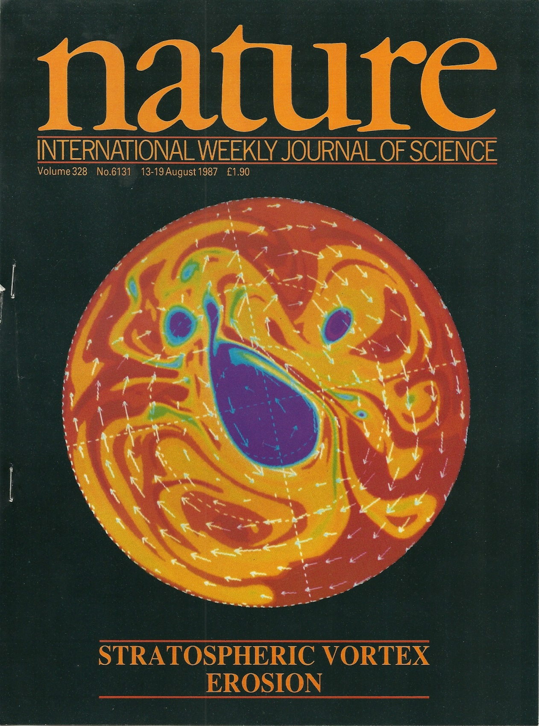
PV in a 2-D idealized “stratosphere”
(Juckes & McI 1987):
Polar-night jet strengthened and
sharpened by PV mixing, mainly
on its equatorward flank, this time,
again forming a strong jet and a
very tight eddy-transport barrier.
NB: “inverse cascades”
have no significant role
in any of these examples
– despite the variety of ways
in which the flows were excited.
Many other examples (e.g. nice
observational work in Huw Davies’
group. So here’s the bottom line:

Slide 22
Inhomogeneous PV mixing is so robust and so typical – mixing works so
much better than it ought (in part because of the PV-inversion scale effect –
and the arguments against homogeneous PV mixing are so powerful –
that we can reasonably talk about a paradigm shift
provided that we emphasize the word “inhomogeneous”.
And this inhomogeneous PV-mixing paradigm is one of the few
simple handles we have on the strongly nonlinear fluid behaviour.
It may also give a handle on strong nonlinearity in tokamaks – Rosenbluth Lecture
(Past obstacles? “Homogeneous” unconsciously assumed?
Mathematical temptation? Constant diffusivity too seductive?)
The paradigm is not, of course, the Answer to Everything:
● PV doesn’t always mix (e.g., vortex merging)
● Not all jets are strong jets (e.g., “ghost jets” in the Pacific Ocean)
● And there are, of course, other nonlinear mechanisms
that show up in different thought-experiments:
(??)
(??)

Slide 23

Jet dynamics – a complex conceptual landscape wth a 2-level hierarchy of ideas:
Horse & cart?
PV Phillips effect Taylor identity:
1. Generic ideas: PV invertibility – div (eddy momentum flux)
Nonlinear, forced/free/self-excited
2. Particular mechanisms:
(i) Rhines effect. Re weak jets generated by strong small-scale forcing – strong
enough to create active small-scale vortices that merge or cluster, producing an
inverse cascade that is arrested or slowed when eddy velocities ~ plane Rossby-
wave phase speeds. Wave-turbulence interaction is spatially homogeneous.
(ii) Repeated excit’n of passive Kelvin sheared disturbances by weak small-scale
forcing. (Kelvin 1887, Farrell-Ioannou, Marston, Srinivasan-Young: CE2, SSST)
(iii) Inhomogeneous PV mixing: re strong jets self-sharpened by Rossby-wave
breaking. Wave-turbulence interaction spatially inhomogeneous.
(iv) Vortex merging and cannibalism, ↔ inverse cascade (sort of)
(v) Monopole vortex migration (significant on Jupiter? Ingersoll et al. 2000)
(vi) Quasi-random-walk vortex migration (significant on Jupiter?)
(vii) PV-biased forcing: critical in the idealized Jupiter weather-layer model
being studied by Stephen Thomson and myself.
3. Additional point: DIMBO effect ...

Slide 24
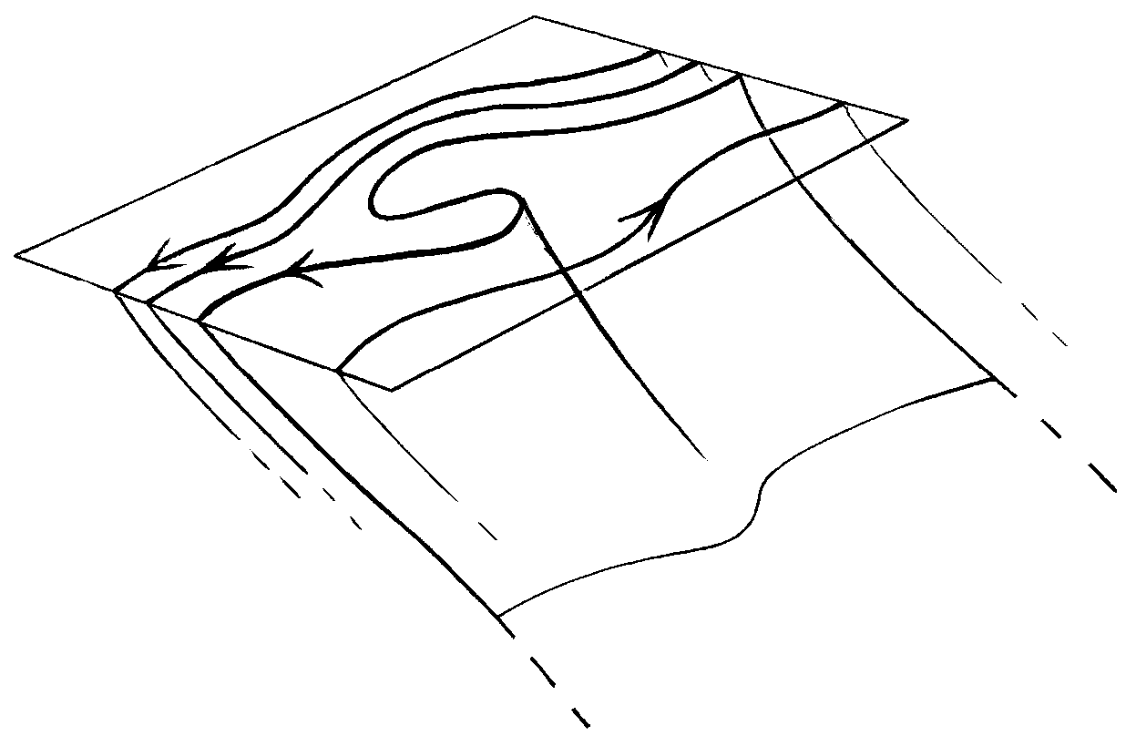
DIMBO = DIapycnal Mixing via Baroclinic Overturning
sea surface, ignoring
mixed layer
← L (mesoscale) →
isopycnal
surface
(to Antarctica)
DIMBO layer:
mesoscale eddies
mix diapycnally as well
as isopycnally
Statically unstable:
must convect.
Underneath:
mesoscale eddies
mix only isopycnally.
Diapycnal transport is
solely by inertia-gravity-wave
breaking, cabbeling, DD, spiralling
How deep is the DIMBO layer? Scale analysis and semigeostrophic PV inversion suggest
the “obvious” answer fL/N. Could ~ kilometre or two. Must often exceed mixed-layer depth.
Numerical experiments underway (John Taylor, Raff Ferrari, personal communication)
– watch this space!

Slide 25
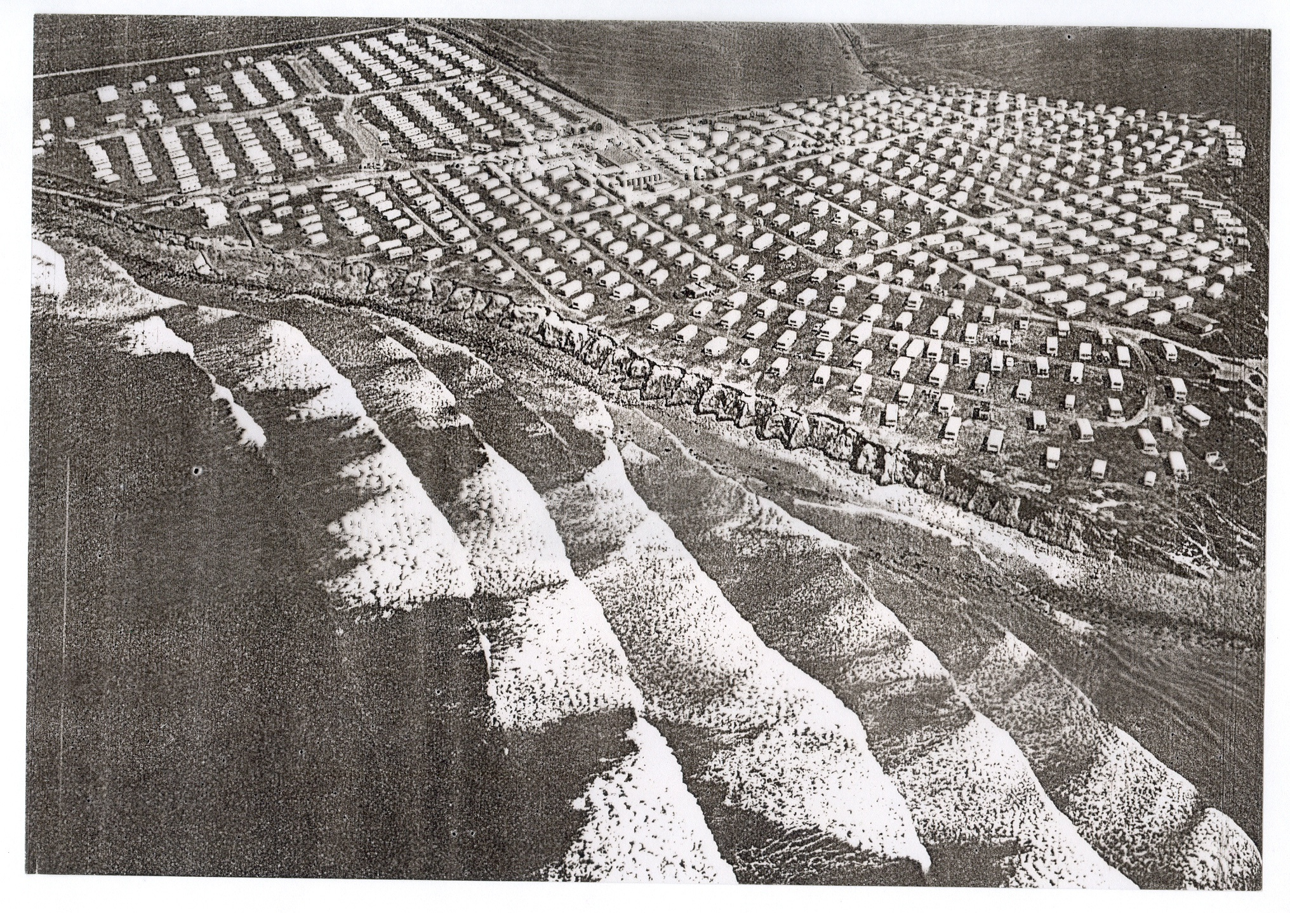
Big gear-shift to a
wider perspective:
(Not all the significant
waves are Rossby waves.)
(Aside: linear critical-layer theory
misleadingly says that all the action is at
the edge, where your toes only just get wet)

Slide 26
The inhomogeneous PV mixing paradigm overlaps with a wider
paradigm, that of the radiation-stress-dominated atmosphere
involving a number of different wave types.
Generalizing:
(including arrival
from elsewhere,
e.g. from below)
WAVE EXCITATION
wavelike:
turbulent:
WAVE DISSIPATION
Unlike turbulent momentum transport (eddy viscosity),
wave-induced “ “ can operate at long range.
Again there’s a long history over the past century…

Slide 27
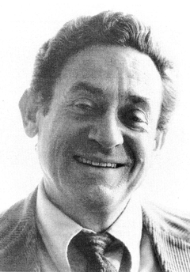

Understanding didn’t emerge until after V.P. Starr’s
1968 “negative viscosity” book, beginning with
←Jule Charney, Ernst Kleinschmidt, Bob Dickinson,→
and Aleksandr Mikhailovich Obukhov.
History long and tortuous – no “Einstein moment”.
Historical review: “staircase” on my home page.
Both Starr (1968) and E.N. Lorenz (1967) saw “negative viscosity” as one of the
great enigmas of atmospheric science. And there were two others at that time:
QBO, cold summer mesopause. All three were solved by the paradigm
change
“turbulent atmosphere” (frictional)
→
“radiation-stress-dominated atmosphere” (often anti-frictional)
The same paradigm change was critical to our solar tachocline breakthrough.
Remark: the generic role of wave propagation mechanisms illustrates one of the
grand themes of physics, the dynamical organization of fluctuations with
systematic mean effects. (e.g. bio-molecular motors!)
A simple non-Rossby-wave example is the Plumb-McEwan experiment (laboratory QBO):

Slide 28
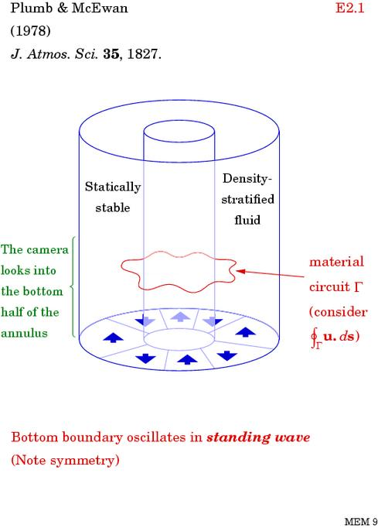
Here, “fluctuations”
are departures
from the zonal or
azimuthal mean.
cf. “nonacceleration
theorems”, “wave
breaking”, etc…
(The bottom-boundary
oscillations can be
more chaotic or
stochastic)
(Oscillation
frequencies allow
internal gravity wave
propagation.)

Slide 29
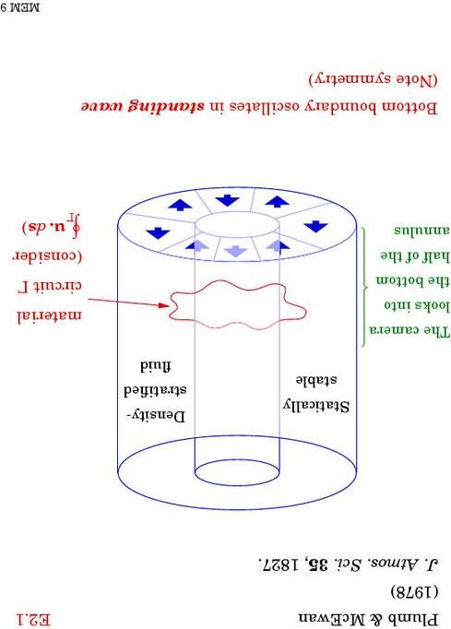
Kyoto University version:
I

Slide 30
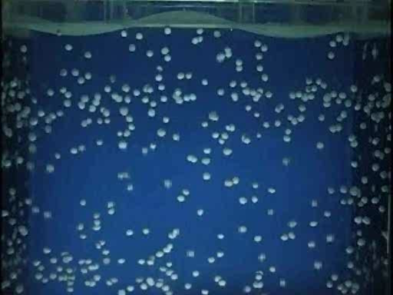
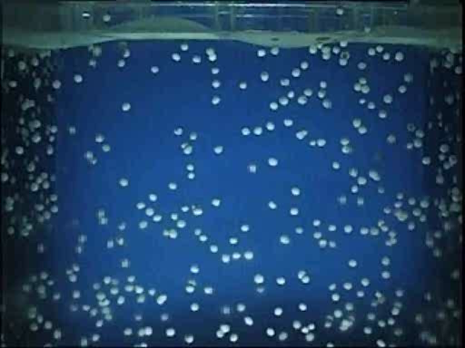
From the Kyoto University version of the Plumb-McEwan experiment:
www.gfd-dennou.org/library/gfd_exp/ or websearch QBO “Tech Tips”
Anti-frictional: an annulus of stratified fluid is driven away from solid rotation
by nothing more than the imposition of fluctuations at its top boundary.
In the real QBO, waves dissipate partly by breaking.– turbulent indeed!
But the key point is mean momentum transport is dynamically organized
by the waves – a long-range effect – and by their interplay with the
mean flow (Bühler 2009 & 2014, Waves and Mean Flows, Cambridge U.Press.)

Slide 31

The interplay with the mean flow involves the generic
sheared-disturbance kinematics already mentioned:
Thomson (Lord Kelvin) 1887
z
u

Slide 32
Here the “anti-frictional” effects are simple to understand
(motion essentially incompressible; wave mechanism
correlates vertical and horizontal velocity fluctuations):
z
> 0
u
The real QBO: fundamentally similar (tho’ details more complicated). Part of
the case for this is the Michelson-Morley principle (Wallace & Holton 1968).
The other enigma in 1968, when I was a postdoc at MIT, was

Slide 33

the enigma of the cold summer mesopause and its noctilucent, or polar-mesospheric, clouds:
Photo Georgii Grechko, from Salyut 6 in orbit

Slide 34
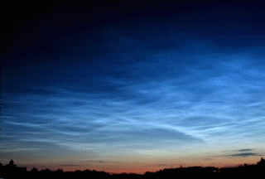
The sunniest place on earth is the coldest place on earth.
Not a radiative-photochemical mystery! Just long-range
momentum transport by gravity waves: an anti-frictional
force field driving a mean meridional circulation through a
mechanical “gyroscopic pumping” action.
This was not understood when I was a postdoc in 1968. Meridional
circulations of this kind were regarded as “thermally driven” – including
the stratospheric Brewer-Dobson circulation, and analogous
circulations inside solar-type stars.
(Aside: today’s understanding is still not complete:
websearch ”missing forces”, ” Einsteinian mismatch”)
Remark: “gyroscopic pumping” is essentially the same as Ekman pumping,
and astrophysical “orbital decay”. Any azimuthal force will do. So
WHY were these circulations regarded as “thermally driven”? This brings
me to a topic of great scientific importance: unconscious assumptions.

Slide 35
History reminds us how science is a struggle with unconscious assumptions;
and here’s another reminder (that we all make them):
For more detail, websearch ”lucidity principles”
then back to my home page at ”Encyclopedia”, ”staircase”, ”Rosenbluth”.

Slide 36
Paradigm changes often involve exposing unconscious assumptions that
are wrong. E.g.,
homogeneous-turbulence assumption, as already discussed
energetics assumption (counterexamples: Stewartson-Warn-Warn critical layer,
amplifier input and power-supply circuitry)
small-is-unimportant assumption (counterexample: amplifier input signal)
Remark: to make sense of the Pleistocene climate record, need to
recognize the climate system as a noisy amplifier, with complex
multi-timescale circuitry – some parts more sensitive than others.
A = B assumption: “an equation A = B means that B causes A.”
(As if it were a line of computer code.)
e.g., “pressure gradient
causes geostrophic
motion.”
You may laugh! But I’ve often encountered exactly this assumption, and in
more than one context.
For meridional circulations, A = B is the equation for temperature or
potential temperature in the mean-circulation model:
B = mean heating rate, A = (TEM residual) mean vertical velocity
times the static stability of the stable stratification.

Slide 37
The old idea that the right-hand side B can be regarded as prescribed,
and therefore the circulations as thermally driven is, indeed,
just an A = B assumption.
But hang on – what’s wrong with that? What’s wrong with a
thought-experiment in which one prescribes the heating rate?
Answer: some thought-experiments are better than others.
Think about pushing a plate along a dinner table. We can declare
that the friction force B is prescribed – but does that correspond
to a good thought-experiment (?)
The stratosphere and mesosphere – and the interiors of solar-type stars –
are all thermally-relaxing systems. So – as with the friction on the
dinner plate – it’s more insightful to regard the heating rate B as part of
the response to some forcing.
So “gyroscopic pumping” or “downward control” thought-experiments are better.

Slide 38
Summary: two paradigms with great explanatory power:
● The radiation-stress-dominated atmosphere
– cf. the old “turbulent stress-dominated…”. And, re Rossby-wave part,
● Inhomogeneous PV mixing – too good to be true?
No! It’s an observed reality – explaining, e,g,, the typical, ubiquitous
strong-jet and eddy-transport-barrier structures. Understandable via
the PV-inversion scale effect.
Old paradoxes resolved by recognizing the spatial inhomogeneity and
the wave or radiation-stress part of the jigsaw.
And – watch out for unconscious thought-experiments!
For more detail, websearch ”lucidity principles”
then back to my home page at ”Encyclopedia”, ”staircase”, ”Rosenbluth”.

Slide 39
(No time for the following slides:)

Slide 40
The sunniest place on earth is the coldest place on earth.
Not a radiative-photochemical mystery! Just long-range
momentum transport by gravity waves: an anti-frictional
force field driving a mean meridional circulation through a
mechanical “gyroscopic pumping” action.
This was not understood when I was a postdoc in 1968. Meridional
circulations of this kind were regarded as “thermally driven” – including
the stratospheric Brewer-Dobson circulation, and analogous
circulations inside solar-type stars.
(Aside: todays’ understanding is still not complete:
websearch ”missing forces”, ” Einsteinian mismatch”)
What do these circulations look like (in the terrestrial case)? A nostalgic reminder:

Slide 41
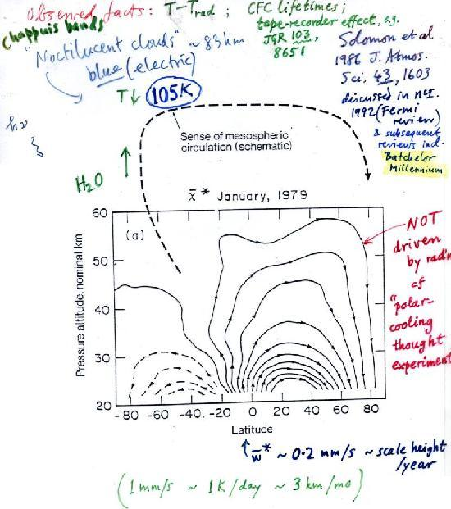
Independent
evidence of the
tropical upwelling
from “tape-recorder
effect”

Slide 42
Independent
evidence of the
tropical upwelling
from “tape-recorder
effect”

Slide 43
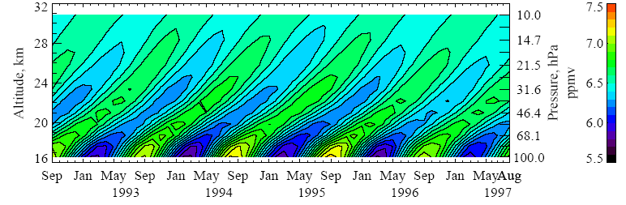
Evidence for the tape-recorder effect (Mote et al 1998, JGR 103, 8651):
HALOE “total hydrogen” concentration H₂O + 2 CH₄ (good passive tracer)
Why, then, were these circulations regarded as “thermally driven”?
Unconscious assumptions again!

Slide 44
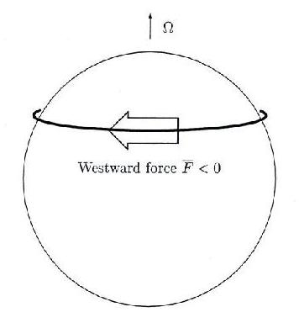
Gyroscopic pumping is easy to understand:
Rapidly-rotating system!
Low Rossby number,
Coriolis effects are strong.
Coriolis force turns
fluid poleward: a robust
and systematic mechanical
pumping effect. Another
example is Ekman pumping.
In the stratospheric case there is a
westward (i.e. retrograde) force due mainly to
breaking Rossby waves. That’s why the Brewer-Dobson circulation
is always poleward. In the Ekman case the force is due to friction,
(persistent)
Now recognized as crucial to the solar problem too: L. Mestel (2012) Stellar Magnetism (OUP)

