Slide 1
LASG, Beijing, 30 Sept 2016
Jetstreams, vortices, and the
Antarctic ozone hole
– and a tale of two paradigms in atmospheric science
Michael Edgeworth McIntyre
Dept of Applied Mathematics & Theoretical Physics,
University of Cambridge
Websearch ”lucidity principles” ”e-book”.

Slide 2
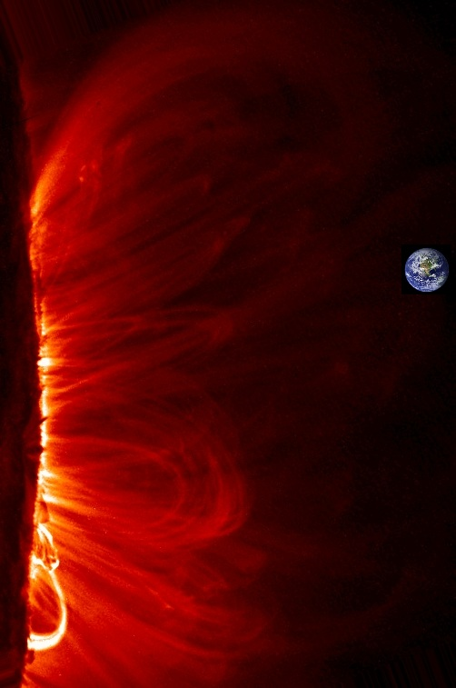
Our life support system
Websearch ”lucidity principles” ”e-book”.

Slide 3
Our life support system
fluid dynamics on a grand scale…
Websearch ”lucidity principles” ”e-book”.

Slide 4
Our life support system
fluid dynamics on a grand scale…
And rotation and stable stratification are
important in many cases.
Websearch ”lucidity principles” ”e-book”.

Slide 5
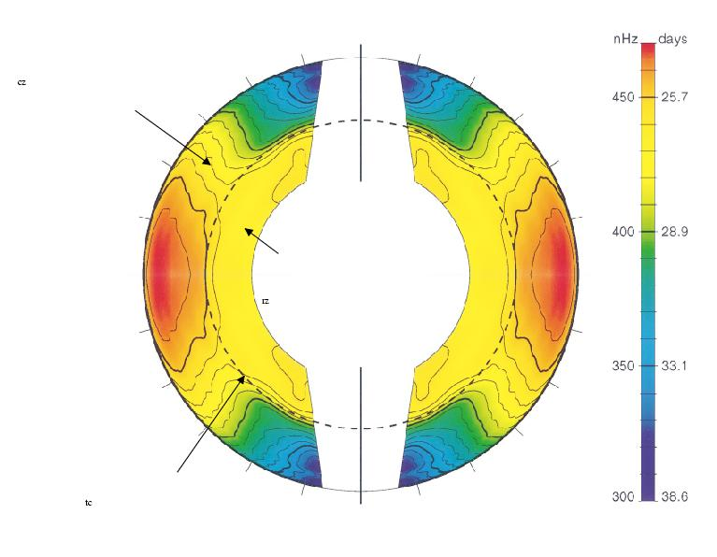
2πΩ/nHz
convection
zone
radiative interior
tachocline

Slide 6
2πΩ/nHz
convection
zone
radiative interior
Partial analogy with
terrestrial ozone layer
led to a breakthrough!
tachocline

Slide 7
2πΩ/nHz
convection
zone
radiative interior
Partial analogy with
terrestrial ozone layer
led to a breakthrough!
(work with Douglas Gough
and Toby Wood)
tachocline

Slide 8
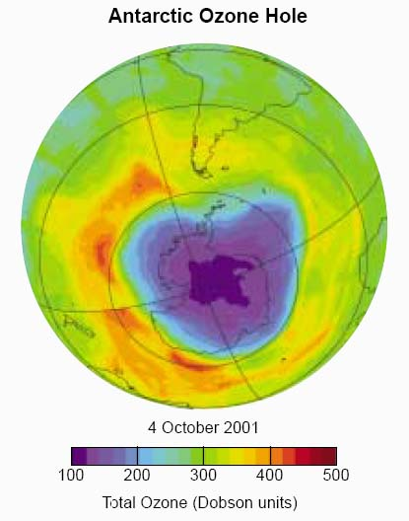
The edge of the
ozone hole is a
sharp boundary
between air masses
with different chemical
compositions (transport
barrier effect).

Slide 9
The edge is a wavy,
meandering jetstream
The edge of the
ozone hole is a
sharp boundary
between air masses
with different chemical
compositions (transport
barrier effect).

Slide 10
The whole structure is called
the stratospheric polar vortex.
The edge is a wavy,
meandering jetstream
The edge of the
ozone hole is a
sharp boundary
between air masses
with different chemical
compositions (transport
barrier effect).

Slide 11
The whole structure is called
the stratospheric polar vortex.
The edge is a wavy,
meandering jetstream
The edge of the
ozone hole is a
sharp boundary
between air masses
with different chemical
compositions (transport
barrier effect).
The velocity profile of the
jet is shaped, and sharpened,
by wave-induced forces, from the
waves disturbing the edge.
(Anti-frictional!)

Slide 12
The whole structure is called
the stratospheric polar vortex.
The edge is a wavy,
meandering jetstream
The edge of the
ozone hole is a
sharp boundary
between air masses
with different chemical
compositions (transport
barrier effect).
The velocity profile of the
jet is shaped, and sharpened,
by wave-induced forces, from the
waves disturbing the edge.
(Anti-frictional!)
‘Force’ is only one way to look at this.

Slide 13
The whole structure is called
the stratospheric polar vortex.
The edge is a wavy,
meandering jetstream
The edge of the
ozone hole is a
sharp boundary
between air masses
with different chemical
compositions (transport
barrier effect).
The velocity profile of the
jet is shaped, and sharpened,
by wave-induced forces, from the
waves disturbing the edge.
(Anti-frictional!)
‘Force’ is only one way to look at this.
Another is via ‘potential vorticity’.

Slide 14
The whole structure is called
the stratospheric polar vortex.
The edge is a wavy,
meandering jetstream
The edge of the
ozone hole is a
sharp boundary
between air masses
with different chemical
compositions (transport
barrier effect).
The velocity profile of the
jet is shaped, and sharpened,
by wave-induced forces, from the
waves disturbing the edge.
(Anti-frictional!)
‘Force’ is only one way to look at this.
Another is via ‘potential vorticity’.
(Feynman: ‘psychologically very different’)

Slide 15
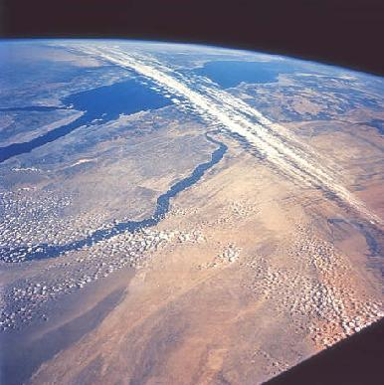
Other examples of jetstreams in the atmosphere-ocean system
include the great tropopause jets – sometimes marked by clouds, as here:
Websearch ”lucidity principles” ”e-book”.

Slide 16
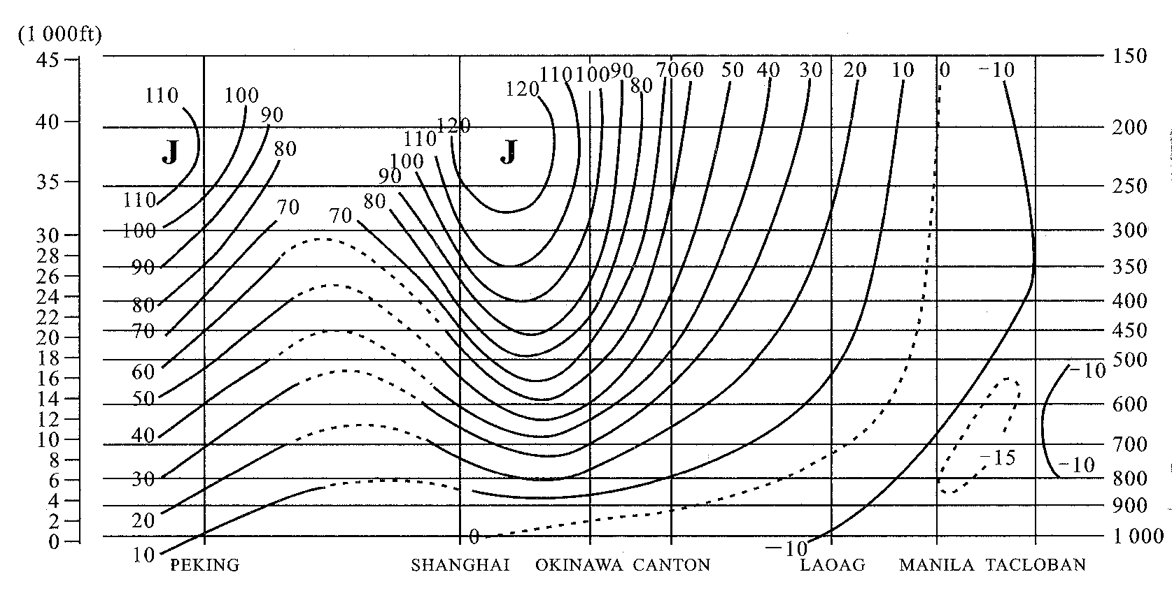
Yeh, T.C., 1950: The circulation of the high troposphere over China in the winter of 1945–1946.
Tellus 2, 173–183, Figure 8:
(mb)
40˚N
30˚N
27˚N
23˚N
18˚N
15˚N
11˚N
Websearch ”lucidity principles” ”e-book”.

Slide 17
Yeh, T.C., 1950: The circulation of the high troposphere over China in the winter of 1945–1946.
Tellus 2, 173–183, Figure 8:
> 120 mph, > 50 m/s
(mb)
40˚N
30˚N
27˚N
23˚N
18˚N
15˚N
11˚N
Websearch ”lucidity principles” ”e-book”.

Slide 18
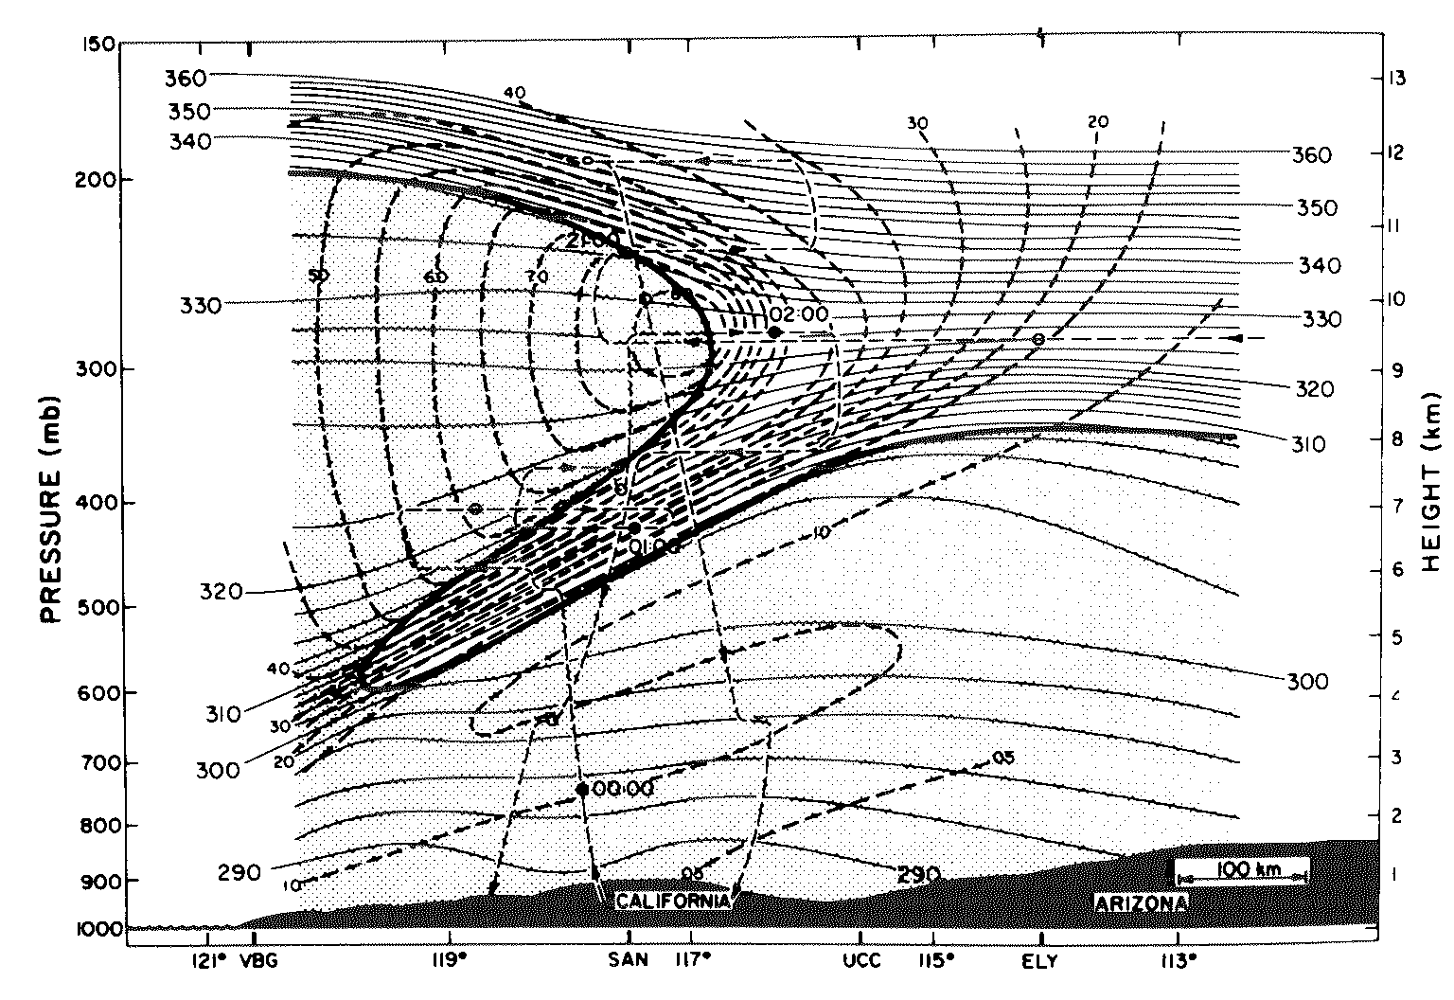
Section through a very strong tropopause jet, courtesy Mel Shapiro:
Websearch ”lucidity principles” ”e-book”.

Slide 19
Section through a very strong tropopause jet, courtesy Mel Shapiro:
Max wind speed ~ 200mph
Websearch ”lucidity principles” ”e-book”.

Slide 20

Section through a very strong tropopause jet, courtesy Mel Shapiro:
Max wind speed ~ 200mph
pot.
temp.
‘stratification
surfaces’
Websearch ”lucidity principles” ”e-book”.

Slide 21
Section through a very strong tropopause jet, courtesy Mel Shapiro:
Max wind speed ~ 200mph
pot.
temp.
‘stratification
surfaces’
Websearch ”lucidity principles” ”e-book”.

Slide 22
The colours mark
stratospheric
air (chemically
distinct):
Appenzeller et al 1996
J. Geophys. Res.
(using contour
advection)
320 K
Websearch ”lucidity principles” ”e-book”.

Slide 23
The colours mark
stratospheric
air (chemically
distinct):
Appenzeller et al 1996
J. Geophys. Res.
(using contour
advection)
320 K
This is an
approximately
circular
vortex:
Websearch ”lucidity principles” ”e-book”.

Slide 24
The colours mark
stratospheric
air (chemically
distinct):
Appenzeller et al 1996
J. Geophys. Res.
(using contour
advection)
320 K
This is an
approximately
circular
vortex:
Websearch ”lucidity principles” ”e-book”.

Slide 25
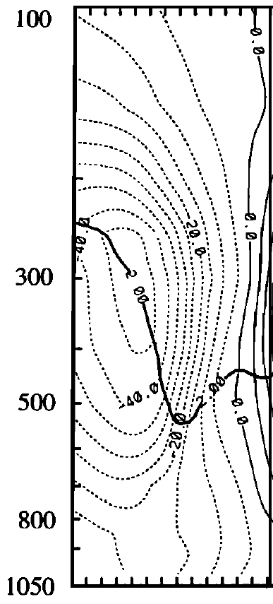
mb
(hPa)
mb
(hPa)
↔
↔
~1000 km
~1000 km
Appenzeller et al 1996,
J. Geophys. Res.
model calculation by A. J. Thorpe, in Hoskins et al. 1985 & 7,
Quart. J. Roy. Met. Soc ., 111 & 113
Websearch ”lucidity principles” ”e-book”.

Slide 26
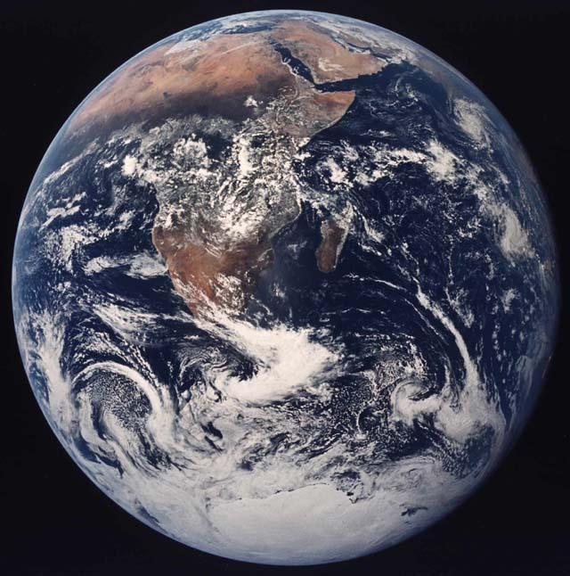
When I was a postdoc at MIT,
these jet and vortex structures
were part of a mysterious
‘zoology’.
Websearch ”lucidity principles” ”e-book”.

Slide 27
When I was a postdoc at MIT,
these jet and vortex structures
were part of a mysterious
‘zoology’. Recognition of the
central role of
potential vorticity
changed
all that.
Websearch ”lucidity principles” ”e-book”.

Slide 28
When I was a postdoc at MIT,
these jet and vortex structures
were part of a mysterious
‘zoology’. Recognition of the
central role of
potential vorticity
changed
all that.
Today it hardly needs saying, following an
aphorism of V.I. Arnol’d, that
Websearch ”lucidity principles” ”e-book”.

Slide 29
When I was a postdoc at MIT,
these jet and vortex structures
were part of a mysterious
‘zoology’. Recognition of the
central role of
potential vorticity
changed
all that.
Today it hardly needs saying, following an
aphorism of V.I. Arnol’d, that
Rotating, stratified
fluid dynamics
cannot be
understood without
potential vorticity,
PV.
Websearch ”lucidity principles” ”e-book”.

Slide 30
When I was a postdoc at MIT,
these jet and vortex structures
were part of a mysterious
‘zoology’. Recognition of the
central role of
potential vorticity
changed
all that.
Today it hardly needs saying, following an
aphorism of V.I. Arnol’d, that
Rotating, stratified
fluid dynamics
cannot be
understood without
potential vorticity,
PV.
Here’s its
most beautiful
definition:
Websearch ”lucidity principles” ”e-book”.

Slide 31
In both single-layer and multi-layer systems,
we can define the exact PV as the suitably normalized Kelvin circulation
of an infinitesimal material circuit Γ lying in a stratification surface.
Websearch ”lucidity principles” ”e-book”.

Slide 32
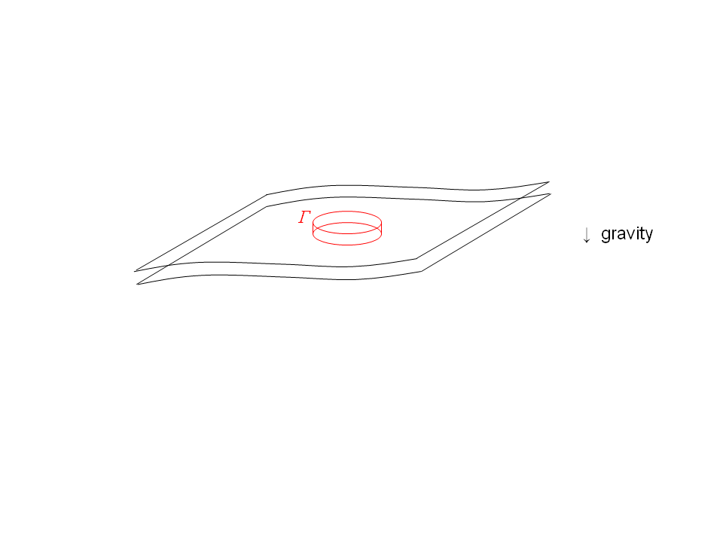
In both single-layer and multi-layer systems,
we can define the exact PV as the suitably normalized Kelvin circulation
of an infinitesimal material circuit Γ lying in a stratification surface.
“Suitably normalized”: multiply by mass of pillbox
between adjacent stratification surfaces:
Websearch ”lucidity principles” ”e-book”.

Slide 33
In both single-layer and multi-layer systems,
we can define the exact PV as the suitably normalized Kelvin circulation
of an infinitesimal material circuit Γ lying in a stratification surface.
“Suitably normalized”: multiply by mass of pillbox
between adjacent stratification surfaces:
Kelvin
circulation is
Websearch ”lucidity principles” ”e-book”.

Slide 34
In both single-layer and multi-layer systems,
we can define the exact PV as the suitably normalized Kelvin circulation
of an infinitesimal material circuit Γ lying in a stratification surface.
“Suitably normalized”: multiply by mass of pillbox
between adjacent stratification surfaces:
Kelvin
circulation is
Corollary:
exact PV =
Websearch ”lucidity principles” ”e-book”.

Slide 35
In both single-layer and multi-layer systems,
we can define the exact PV as the suitably normalized Kelvin circulation
of an infinitesimal material circuit Γ lying in a stratification surface.
“Suitably normalized”: multiply by mass of pillbox
between adjacent stratification surfaces:
Kelvin
circulation is
Corollary:
exact PV =
Note: (1) the PV is a material invariant for frictionless, adiabatic
fluid motion, under any scenario of stretching or tilting of fluid elements and
stratification surfaces. (Evolution eq’n with one time derivative.)
So the PV is mixable along stratification surfaces (though not across!)
Websearch ”lucidity principles” ”e-book”.

Slide 36
In both single-layer and multi-layer systems,
we can define the exact PV as the suitably normalized Kelvin circulation
of an infinitesimal material circuit Γ lying in a stratification surface.
“Suitably normalized”: multiply by mass of pillbox
between adjacent stratification surfaces:
Kelvin
circulation is
Corollary:
exact PV =
Note: (1) the PV is a material invariant for frictionless, adiabatic
fluid motion, under any scenario of stretching or tilting of fluid elements and
stratification surfaces. (Evolution eq’n with one time derivative.)
So the PV is mixable along stratification surfaces (though not across!)
Websearch ”lucidity principles” ”e-book”.

Slide 37
In both single-layer and multi-layer systems,
we can define the exact PV as the suitably normalized Kelvin circulation
of an infinitesimal material circuit Γ lying in a stratification surface.
“Suitably normalized”: multiply by mass of pillbox
between adjacent stratification surfaces:
Kelvin
circulation is
Corollary:
exact PV =
Note: (1) the PV is a material invariant for frictionless, adiabatic
fluid motion, under any scenario of stretching or tilting of fluid elements and
stratification surfaces. (Evolution eq’n with one time derivative.)
So the PV is mixable along stratification surfaces (though not across!)
Websearch ”lucidity principles” ”e-book”.

Slide 38
In both single-layer and multi-layer systems,
we can define the exact PV as the suitably normalized Kelvin circulation
of an infinitesimal material circuit Γ lying in a stratification surface.
“Suitably normalized”: multiply by mass of pillbox
between adjacent stratification surfaces:
Kelvin
circulation is
Corollary:
exact PV =
Note: (1) the PV is a material invariant for frictionless, adiabatic
fluid motion, under any scenario of stretching or tilting of fluid elements and
stratification surfaces. (Evolution eq’n with one time derivative.)
So the PV is mixable along stratification surfaces (though not across!)
impermeability
theorem etc
Websearch ”lucidity principles” ”e-book”.

Slide 39
In both single-layer and multi-layer systems,
we can define the exact PV as the suitably normalized Kelvin circulation
of an infinitesimal material circuit Γ lying in a stratification surface.
“Suitably normalized”: multiply by mass of pillbox
between adjacent stratification surfaces:
Kelvin
circulation is
Corollary:
exact PV =
Note: (1) the PV is a material invariant for frictionless, adiabatic
fluid motion, under any scenario of stretching or tilting of fluid elements and
stratification surfaces. (Evolution eq’n with one time derivative.)
So the PV is mixable along stratification surfaces (though not across!)
And (2) the PV is invertible: the PV field has nearly all the dynamical
information. (Invertibility depends on the flow being balanced.)
impermeability
theorem etc

Slide 40
Rossby-wave mechanism

Slide 41
Rossby-wave mechanism
PV denoted
Q here

Slide 42
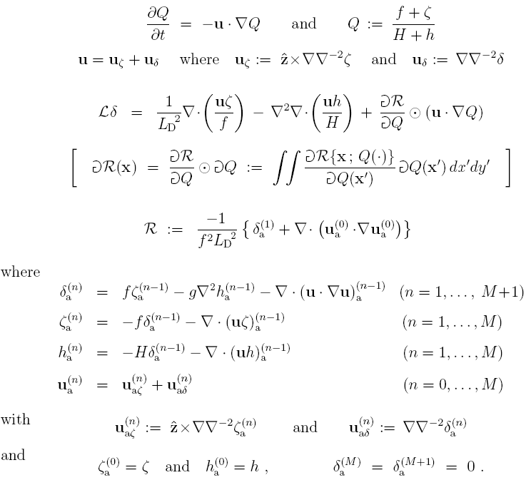
Hyperbalance model:
PV
inversion
operator:
nonlocal

Slide 43
Hyperbalance model:
PV
inversion
operator:
nonlocal
(one time derivative!)

Slide 44
In both single-layer and multi-layer systems,
we can define the exact PV as the suitably normalized Kelvin circulation
of an infinitesimal material circuit Γ lying in a stratification surface.
“Suitably normalized”: multiply by mass of pillbox
between adjacent stratification surfaces:
Kelvin
circulation is
Corollary:
exact PV =
Note: (1) the PV is a material invariant for frictionless, adiabatic
fluid motion, under any scenario of stretching or tilting of fluid elements and
stratification surfaces. (Evolution eq’n with one time derivative.)
So the PV is mixable along stratification surfaces (though not across!)
And (2) the PV is invertible: the PV field has nearly all the dynamical
information. (Invertibility depends on the flow being balanced.)
impermeability
theorem etc

Slide 45
In both single-layer and multi-layer systems,
we can define the exact PV as the suitably normalized Kelvin circulation
of an infinitesimal material circuit Γ lying in a stratification surface.
“Suitably normalized”: multiply by mass of pillbox
between adjacent stratification surfaces:
Kelvin
circulation is
Corollary:
exact PV =
Note: (1) the PV is a material invariant for frictionless, adiabatic
fluid motion, under any scenario of stretching or tilting of fluid elements and
stratification surfaces. (Evolution eq’n with one time derivative.)
So the PV is mixable along stratification surfaces (though not across!)
And (2) the PV is invertible: the PV field has nearly all the dynamical
information. (Invertibility depends on the flow being balanced.)
impermeability
theorem etc
Note scale effect: small-scale PV anomalies → weak velocities.

Slide 46
In both single-layer and multi-layer systems,
we can define the exact PV as the suitably normalized Kelvin circulation
of an infinitesimal material circuit Γ lying in a stratification surface.
“Suitably normalized”: multiply by mass of pillbox
between adjacent stratification surfaces:
Kelvin
circulation is
Corollary:
exact PV =
Note: (1) the PV is a material invariant for frictionless, adiabatic
fluid motion, under any scenario of stretching or tilting of fluid elements and
stratification surfaces. (Evolution eq’n with one time derivative.)
So the PV is mixable along stratification surfaces (though not across!)
And (2) the PV is invertible: the PV field has nearly all the dynamical
information. (Invertibility depends on the flow being balanced.)
impermeability
theorem etc
What do realistic PV fields look like? Here’s an example (nostalgic for me):

Slide 47
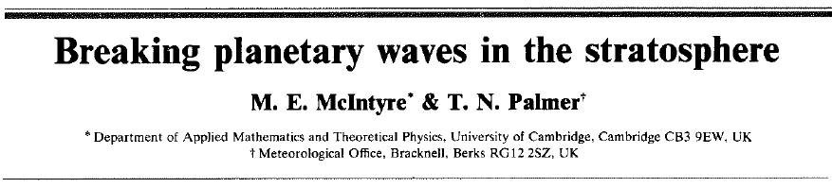
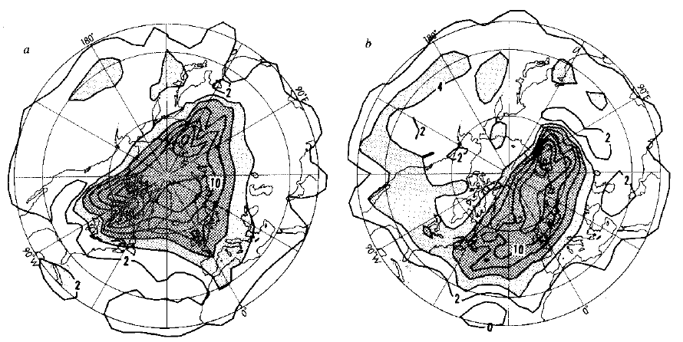
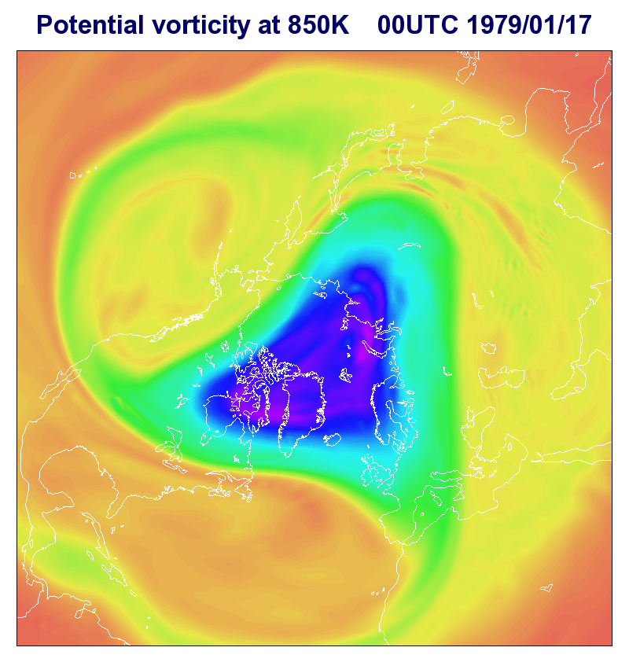
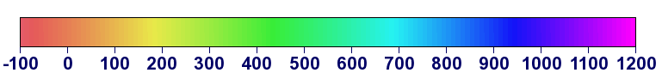
Courtesy Dr A J Simmons,
European Centre for Medium
Range Weather Forecasts:
McIntyre and Palmer (1983), revisited
Initial state
PVU
Websearch ”lucidity principles” ”e-book”.

Slide 48
Courtesy Dr A J Simmons,
European Centre for Medium
Range Weather Forecasts:
McIntyre and Palmer (1983), revisited
Initial state
Nature, 1983
PVU
Websearch ”lucidity principles” ”e-book”.

Slide 49
Courtesy Dr A J Simmons,
European Centre for Medium
Range Weather Forecasts:
McIntyre and Palmer (1983), revisited
The World’s Largest Breaking Waves: PV on the 850K stratification surface:
Initial state
Nature, 1983
PVU
Websearch ”lucidity principles” ”e-book”.

Slide 50
Courtesy Dr A J Simmons,
European Centre for Medium
Range Weather Forecasts:
McIntyre and Palmer (1983), revisited
The World’s Largest Breaking Waves: PV on the 850K stratification surface:
We called it
“a blurred
view of reality
seen through
knobbly glass”
Initial state
Nature, 1983
PVU
Websearch ”lucidity principles” ”e-book”.

Slide 51
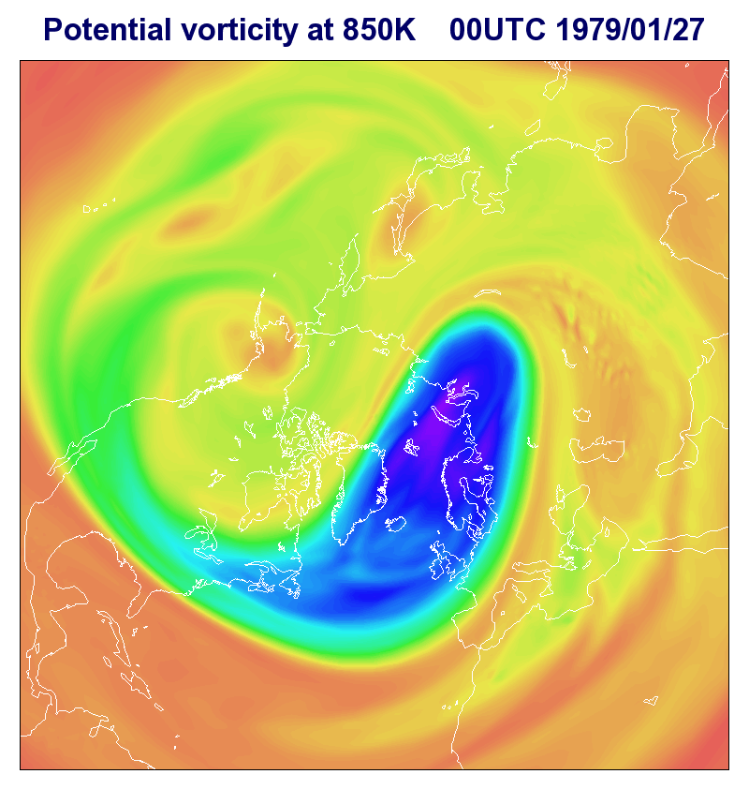
Courtesy Dr A J Simmons,
European Centre for Medium
Range Weather Forecasts:
McIntyre and Palmer (1983), revisited
The World’s Largest Breaking Waves: PV on the 850K stratification surface:
We called it
“a blurred
view of reality
seen through
knobbly glass”
Final state
Nature, 1983
PVU
Websearch ”lucidity principles” ”e-book”.

Slide 52
Courtesy Dr A J Simmons,
European Centre for Medium
Range Weather Forecasts:
McIntyre and Palmer (1983), revisited
The World’s Largest Breaking Waves: PV on the 850K stratification surface:
turbulent
here
We called it
“a blurred
view of reality
seen through
knobbly glass”
Final state
Nature, 1983
PVU
Websearch ”lucidity principles” ”e-book”.

Slide 53
Courtesy Dr A J Simmons,
European Centre for Medium
Range Weather Forecasts:
McIntyre and Palmer (1983), revisited
The World’s Largest Breaking Waves: PV on the 850K stratification surface:
turbulent
here
wavelike
here
We called it
“a blurred
view of reality
seen through
knobbly glass”
Final state
Nature, 1983
PVU
Websearch ”lucidity principles” ”e-book”.

Slide 54
Courtesy Dr A J Simmons,
European Centre for Medium
Range Weather Forecasts:
PV at 850K,
mid-Jan. 1979
Inhomogeneous!
Quasi-elastic
“eddy-transport
barrier”
Websearch ”lucidity principles” ”e-book”.

Slide 55
Yes, it’s turbulent – strongly nonlinear – but also highly inhomogeneous,
well outside the scope of homogeneous turbulence theory and its
extensions.
Websearch ”lucidity principles” ”e-book”.

Slide 56
Yes, it’s turbulent – strongly nonlinear – but also highly inhomogeneous,
well outside the scope of homogeneous turbulence theory and its
extensions. In particular,
- the structure is completely missed by power spectra
(e.g. Armi and Flament 1985, J. Geophys. Res.)
Websearch ”lucidity principles” ”e-book”.

Slide 57
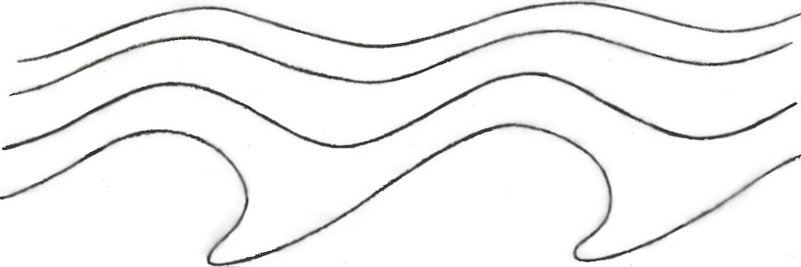
Yes, it’s turbulent – strongly nonlinear – but also highly inhomogeneous,
well outside the scope of homogeneous turbulence theory and its
extensions. In particular,
- the structure is completely missed by power spectra
(e.g. Armi and Flament 1985, J. Geophys. Res.)
- the structure has wavelike and turbulent regions that fit together
in a “wave-turbulence jigsaw”:
latitude
↑
PV contours undulate reversibly:
PV contours deform irreversibly:
→ longitude
Websearch ”lucidity principles” ”e-book”.

Slide 58
Yes, it’s turbulent – strongly nonlinear – but also highly inhomogeneous,
well outside the scope of homogeneous turbulence theory and its
extensions. In particular,
- the structure is completely missed by power spectra
(e.g. Armi and Flament 1985, J. Geophys. Res.)
Quasi-
elastic
“barrier”
- the structure has wavelike and turbulent regions that fit together
in a “wave-turbulence jigsaw”:
latitude
↑
PV contours undulate reversibly:
PV contours deform irreversibly:
→ longitude
Websearch ”lucidity principles” ”e-book”.

Slide 59
Yes, it’s turbulent – strongly nonlinear – but also highly inhomogeneous,
well outside the scope of homogeneous turbulence theory and its
extensions. In particular,
- the structure is completely missed by power spectra
(e.g. Armi and Flament 1985, J. Geophys. Res.)
Quasi-
elastic
“barrier”
- the structure has wavelike and turbulent regions that fit together
in a “wave-turbulence jigsaw”:
latitude
↑
PV contours undulate reversibly:
PV contours deform irreversibly:
(wave breaking → inhomogeneous PV mixing via scale effect)
→ longitude
Websearch ”lucidity principles” ”e-book”.

Slide 60
Yes, it’s turbulent – strongly nonlinear – but also highly inhomogeneous,
well outside the scope of homogeneous turbulence theory and its
extensions. In particular,
- the structure is completely missed by power spectra
(e.g. Armi and Flament 1985, J. Geophys. Res.)
Quasi-
elastic
“barrier”
- the structure has wavelike and turbulent regions that fit together
in a “wave-turbulence jigsaw”:
latitude
↑
PV contours undulate reversibly:
PV contours deform irreversibly:
(wave breaking → inhomogeneous PV mixing via scale effect)
→ longitude
NB: it’s impossible to make sense of the dynamics, even gross
angular-momentum budgets – including Starr’s “negative viscosity”
(anti-friction) – without recognizing this inhomogeneous jigsaw structure.
(Historical review: “staircase” on my home page.)
Websearch ”lucidity principles” ”e-book”.

Slide 61
Yes, it’s turbulent – strongly nonlinear – but also highly inhomogeneous,
well outside the scope of homogeneous turbulence theory and its
extensions. In particular,
- the structure is completely missed by power spectra
(e.g. Armi and Flament 1985, J. Geophys. Res.)
Quasi-
elastic
“barrier”
- the structure has wavelike and turbulent regions that fit together
in a “wave-turbulence jigsaw”:
latitude
↑
PV contours undulate reversibly:
PV contours deform irreversibly:
(wave breaking → inhomogeneous PV mixing via scale effect)
→ longitude
NB: it’s impossible to make sense of the dynamics, even gross
angular-momentum budgets – including Starr’s “negative viscosity”
(anti-friction) – without recognizing this inhomogeneous jigsaw structure.
(Historical review: “staircase” on my home page.)
The simplest fully self-consistent model of the structure is the
Stewartson-Warn-Warn (1978) nonlinear critical-layer theory.
And the essence of it was first recognized by Bob Dickinson (1969).

Slide 62
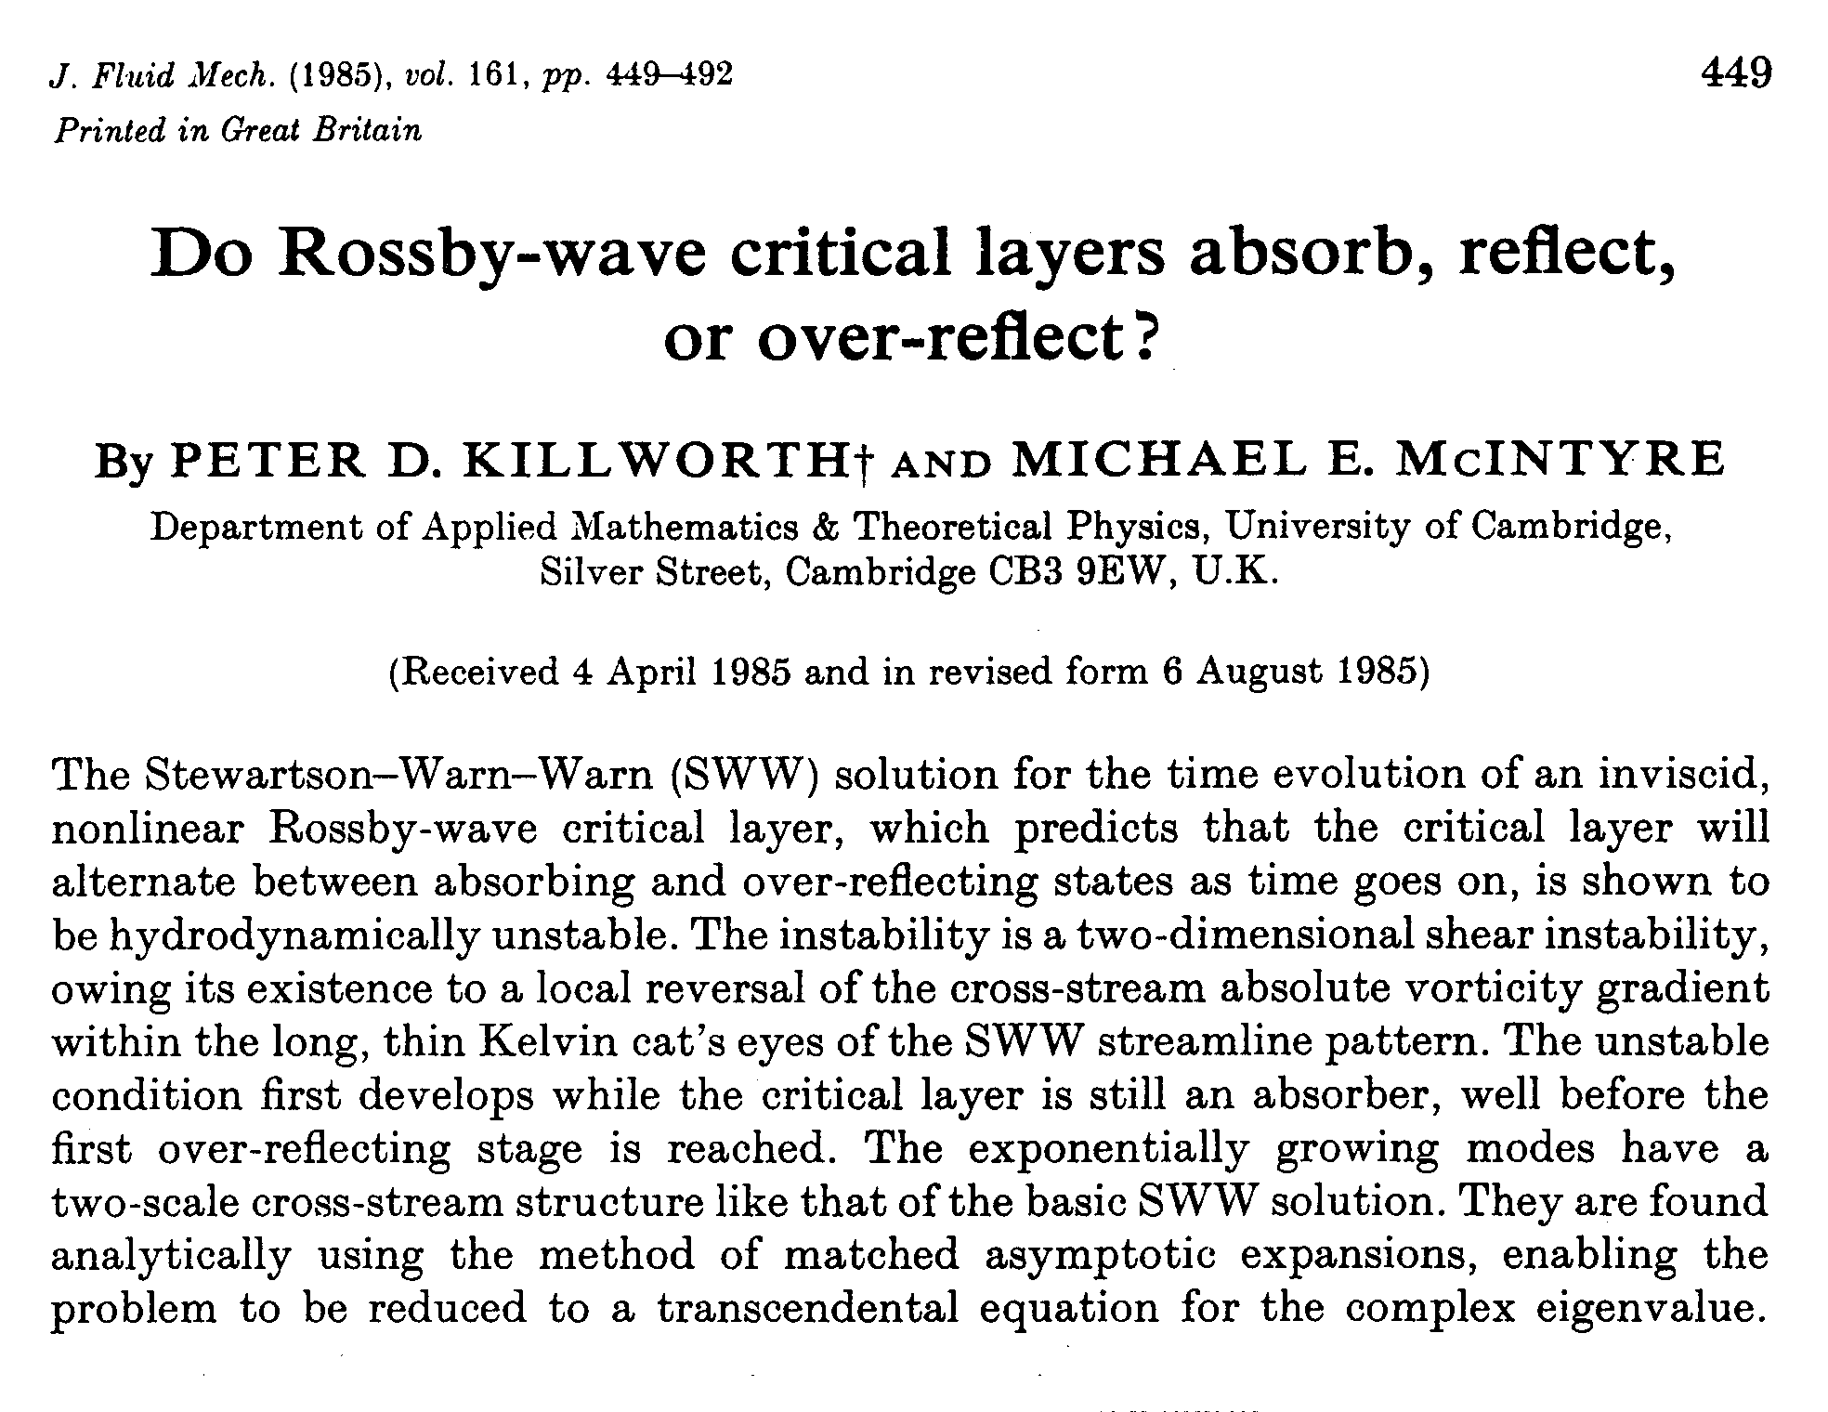
…

Slide 63
…

Slide 64
The wave-turbulence jigsaw structure is often associated with
jet-self-sharpening scenarios. (Negative viscosity or
anti-friction again.)
Websearch ”lucidity principles” ”e-book”.

Slide 65
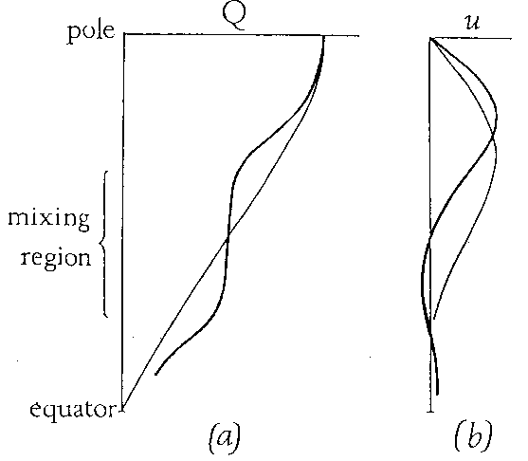
The wave-turbulence jigsaw structure is often associated with
jet-self-sharpening scenarios. (Negative viscosity or
anti-friction again.) The polar-night jet was the first
example for which this whole picture became clear:
___
PV
wavelike:
(quasi-linear)
turbulent:
(strongly nonlinear)
(Fig 5 from
my 1982
review,
J. Met. Soc.
Japan 60)
Websearch ”lucidity principles” ”e-book”.

Slide 66
The wave-turbulence jigsaw structure is often associated with
jet-self-sharpening scenarios. (Negative viscosity or
anti-friction again.) The polar-night jet was the first
example for which this whole picture became clear:
___
PV
wavelike:
(quasi-linear)
turbulent:
(strongly nonlinear)
cf. movie!
(Fig 5 from
my 1982
review,
J. Met. Soc.
Japan 60)
Websearch ”lucidity principles” ”e-book”.

Slide 67
The wave-turbulence jigsaw structure is often associated with
jet-self-sharpening scenarios. (Negative viscosity or
anti-friction again.) The polar-night jet was the first
example for which this whole picture became clear:
___
PV
wavelike:
(quasi-linear)
turbulent:
(strongly nonlinear)
cf. movie!
The inhomogeneity of PV mixing means that
PV contours must bunch up on the borders of the
PV mixing regions..
(Fig 5 from
my 1982
review,
J. Met. Soc.
Japan 60)
Websearch ”lucidity principles” ”e-book”.

Slide 68
The wave-turbulence jigsaw structure is often associated with
jet-self-sharpening scenarios. (Negative viscosity or
anti-friction again.) The polar-night jet was the first
example for which this whole picture became clear:
___
PV
wavelike:
(quasi-linear)
turbulent:
(strongly nonlinear)
cf. movie!
The inhomogeneity of PV mixing means that
PV contours must bunch up on the borders of the
PV mixing regions. Then PV inversion automatically gives
sharp, strong jets (tighter “barriers” thanks to shear).
(Fig 5 from
my 1982
review,
J. Met. Soc.
Japan 60)
Websearch ”lucidity principles” ”e-book”.

Slide 69
The wave-turbulence jigsaw structure is often associated with
jet-self-sharpening scenarios. (Negative viscosity or
anti-friction again.) The polar-night jet was the first
example for which this whole picture became clear:
___
PV
wavelike:
(quasi-linear)
turbulent:
(strongly nonlinear)
cf. movie!
The inhomogeneity of PV mixing means that
PV contours must bunch up on the borders of the
PV mixing regions. Then PV inversion automatically gives
sharp, strong jets (tighter “barriers” thanks to shear).
(Fig 5 from
my 1982
review,
J. Met. Soc.
Japan 60)
Historical note: the PV-mixing idea was not new even in 1982,
if you count the limiting case (nondivergent barotropic dynamics).
Websearch ”lucidity principles” ”e-book”.

Slide 70
The wave-turbulence jigsaw structure is often associated with
jet-self-sharpening scenarios. (Negative viscosity or
anti-friction again.) The polar-night jet was the first
example for which this whole picture became clear:
___
PV
wavelike:
(quasi-linear)
turbulent:
(strongly nonlinear)
cf. movie!
The inhomogeneity of PV mixing means that
PV contours must bunch up on the borders of the
PV mixing regions. Then PV inversion automatically gives
sharp, strong jets (tighter “barriers” thanks to shear).
(Fig 5 from
my 1982
review,
J. Met. Soc.
Japan 60)
Historical note: the PV-mixing idea was not new even in 1982,
if you count the limiting case (nondivergent barotropic dynamics).
The idea goes back to the work of G. I. Taylor and others on turbulence –
thinking about momentum transport versus vorticity transport.
Websearch ”lucidity principles” ”e-book”.

Slide 71
The wave-turbulence jigsaw structure is often associated with
jet-self-sharpening scenarios. (Negative viscosity or
anti-friction again.) The polar-night jet was the first
example for which this whole picture became clear:
___
PV
wavelike:
(quasi-linear)
turbulent:
(strongly nonlinear)
cf. movie!
The inhomogeneity of PV mixing means that
PV contours must bunch up on the borders of the
PV mixing regions. Then PV inversion automatically gives
sharp, strong jets (tighter “barriers” thanks to shear).
(Fig 5 from
my 1982
review,
J. Met. Soc.
Japan 60)
Historical note: the PV-mixing idea was not new even in 1982,
if you count the limiting case (nondivergent barotropic dynamics).
The idea goes back to the work of G. I. Taylor and others on turbulence –
thinking about momentum transport versus vorticity transport. Taylor
had already found an important clue in 1915, showing that one pattern
of vorticity transport can imply a different pattern of momentum transport:

Slide 72
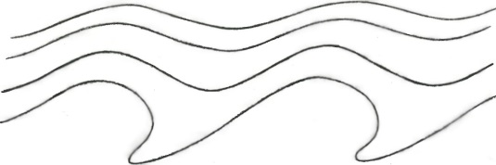
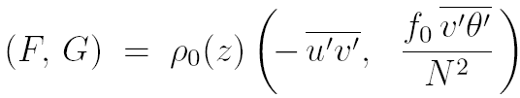
Taylor identity (G.I. Taylor 1915, Phil. Trans. Roy. Soc.)
– nonlinearly relates eddy fluxes of PV to
momentum-flux divergences:
Barotropic (any L_{D}): (+ form stress if topog)
3D baroclinic:
where
(“Eliassen-Palm flux”)
(Taylor-Charney-Stern-
Bretherton-Eady-Green identity)

Slide 73
Taylor identity (G.I. Taylor 1915, Phil. Trans. Roy. Soc.)
– nonlinearly relates eddy fluxes of PV to
momentum-flux divergences:
Barotropic (any L_{D}): (+ form stress if topog)
3D baroclinic:
where
(“Eliassen-Palm flux”)
quasi-geostrophic PV
(Taylor-Charney-Stern-
Bretherton-Eady-Green identity)

Slide 74
Taylor identity (G.I. Taylor 1915, Phil. Trans. Roy. Soc.)
– nonlinearly relates eddy fluxes of PV to
momentum-flux divergences:
Barotropic (any L_{D}): (+ form stress if topog)
3D baroclinic:
where
(“Eliassen-Palm flux”)
quasi-geostrophic PV
(Taylor-Charney-Stern-
Bretherton-Eady-Green identity)

Slide 75
Taylor identity (G.I. Taylor 1915, Phil. Trans. Roy. Soc.)
– nonlinearly relates eddy fluxes of PV to
momentum-flux divergences:
Barotropic (any L_{D}): (+ form stress if topog)
3D baroclinic:
where
(“Eliassen-Palm flux”)
quasi-geostrophic PV
(Taylor-Charney-Stern-
Bretherton-Eady-Green identity)
form stress
(here θ′ = buoyancy-acceleration fluct’n)

Slide 76
Taylor identity (G.I. Taylor 1915, Phil. Trans. Roy. Soc.)
– nonlinearly relates eddy fluxes of PV to
momentum-flux divergences:
Barotropic (any L_{D}): (+ form stress if topog)
3D baroclinic:
where
(“Eliassen-Palm flux”)
quasi-geostrophic PV
(Taylor-Charney-Stern-
Bretherton-Eady-Green identity)
form stress
(here θ′ = buoyancy-acceleration fluct’n)
NB: nonlinear relation: valid at any amplitude!! And valid
regardless of whether motion is free, forced, or self-excited.

Slide 77


Taylor identity (G.I. Taylor 1915, Phil. Trans. Roy. Soc.)
– nonlinearly relates eddy fluxes of PV to
momentum-flux divergences:
Barotropic (any L_{D}): (+ form stress if topog)
3D baroclinic:
where
(“Eliassen-Palm flux”)
quasi-geostrophic PV
(Taylor-Charney-Stern-
Bretherton-Eady-Green identity)
form stress
Corollary:
(here θ′ = buoyancy-acceleration fluct’n)
= 0 for isolated domain – once thought to prove PV mixing impossible
– but actually argues only against homogeneous PV mixing.

Slide 78
Taylor identity (G.I. Taylor 1915, Phil. Trans. Roy. Soc.)
– nonlinearly relates eddy fluxes of PV to
momentum-flux divergences:
Barotropic (any L_{D}): (+ form stress if topog)
3D baroclinic:
where
(“Eliassen-Palm flux”)
quasi-geostrophic PV
(Taylor-Charney-Stern-
Bretherton-Eady-Green identity)
form stress
Corollary:
(here θ′ = buoyancy-acceleration fluct’n)
= 0 for isolated domain – once thought to prove PV mixing impossible
– but actually argues only against homogeneous PV mixing.
Here are 3 more reasons ” “ “ “ :

Slide 79
Three more reasons (beyond quasi-geostrophic ) why PV mixing
on stratification surfaces is usually inhomogeneous:

Slide 80
Three more reasons (beyond quasi-geostrophic ) why PV mixing
on stratification surfaces is usually inhomogeneous:
1. Stagnation effect: For spanning the globe, easy to prove that
homogeneous mixing has an absurd consequence. We have
where P = exact PV,
positive
on each . Homogeneous mixing (e.g., constant-diffusivity models)
→ P = 0 everywhere on : inverts to absolute stagnation!

Slide 81
Three more reasons (beyond quasi-geostrophic ) why PV mixing
on stratification surfaces is usually inhomogeneous:
1. Stagnation effect: For spanning the globe, easy to prove that
homogeneous mixing has an absurd consequence. We have
where P = exact PV,
positive
on each . Homogeneous mixing (e.g., constant-diffusivity models)
→ P = 0 everywhere on : inverts to absolute stagnation!
2. Waveguide effect: Strong jets (PV contours bunched up) are Rossby
waveguides: dispersion relations favour wave breaking in jet flanks.

Slide 82
Three more reasons (beyond quasi-geostrophic ) why PV mixing
on stratification surfaces is usually inhomogeneous:
1. Stagnation effect: For spanning the globe, easy to prove that
homogeneous mixing has an absurd consequence. We have
where P = exact PV,
positive
on each . Homogeneous mixing (e.g., constant-diffusivity models)
→ P = 0 everywhere on : inverts to absolute stagnation!
2. Waveguide effect: Strong jets (PV contours bunched up) are Rossby
waveguides: dispersion relations favour wave breaking in jet flanks.
(Dispersion relations differ from those of homogeneous beta-turbulence theory)

Slide 83
Three more reasons (beyond quasi-geostrophic ) why PV mixing
on stratification surfaces is usually inhomogeneous:
1. Stagnation effect: For spanning the globe, easy to prove that
homogeneous mixing has an absurd consequence. We have
where P = exact PV,
positive
on each . Homogeneous mixing (e.g., constant-diffusivity models)
→ P = 0 everywhere on : inverts to absolute stagnation!
2. Waveguide effect: Strong jets (PV contours bunched up) are Rossby
waveguides: dispersion relations favour wave breaking in jet flanks.
(Dispersion relations differ from those of homogeneous beta-turbulence theory)
3. PV Phillips effect: a generic positive-feedback effect:

Slide 84
O. M. Phillips (1972 Deep Sea Res).
“staircase” on my home page

Slide 85
O. M. Phillips (1972 Deep Sea Res)
“staircase” on my home page

Slide 86
O. M. Phillips (1972 Deep Sea Res). NB: Don’t need to assume Fickian diffusion.
“staircase” on my home page

Slide 87
O. M. Phillips (1972 Deep Sea Res). NB: Don’t need to assume Fickian diffusion.
“staircase” on my home page

Slide 88
O. M. Phillips (1972 Deep Sea Res). NB: Don’t need to assume Fickian diffusion.
a positive feedback
tending to make the mixing
spatially inhomogeneous.
“staircase” on my home page

Slide 89
O. M. Phillips (1972 Deep Sea Res). NB: Don’t need to assume Fickian diffusion.
a positive feedback
tending to make the mixing
spatially inhomogeneous.
The more inhomogeneous, the stronger
the feedback, bringing in the shear effects
(Juckes & M, Nature 1987).
“staircase” on my home page

Slide 90
Waveguide effect:
Simplest quasi-geostrophic strong-jet model (Rosenbluth Lecture & refs.).
PV contours infinitely bunched up to make a perfect Rossby waveguide:
“staircase” on my home page

Slide 91
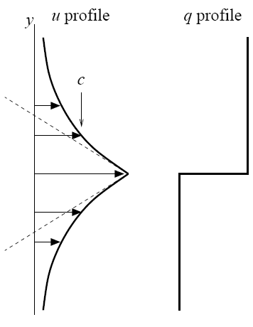
Waveguide effect:
Simplest quasi-geostrophic strong-jet model (Rosenbluth Lecture & refs.).
PV contours infinitely bunched up to make a perfect Rossby waveguide:
u_{j}
(slope jump is
proportional to PV
jump)
“staircase” on my home page

Slide 92

Waveguide effect:
Simplest quasi-geostrophic strong-jet model (Rosenbluth Lecture & refs.).
PV contours infinitely bunched up to make a perfect Rossby waveguide:
Dispersion relation differs from homogeneous:
u_{j}
(slope jump is
proportional to PV
jump)
“staircase” on my home page

Slide 93
Waveguide effect:
Simplest quasi-geostrophic strong-jet model (Rosenbluth Lecture & refs.).
PV contours infinitely bunched up to make a perfect Rossby waveguide:
Dispersion relation differs from homogeneous:
u_{j}
Phase speed c lies within the
range of the jet velocity profile.
(slope jump is
proportional to PV
jump)
“staircase” on my home page

Slide 94

Waveguide effect:
Simplest quasi-geostrophic strong-jet model (Rosenbluth Lecture & refs.).
PV contours infinitely bunched up to make a perfect Rossby waveguide:
Dispersion relation differs from homogeneous:
u_{j}
Phase speed c lies within the
range of the jet velocity profile.
So simple kinematics favours Rossby-wave
breaking on the jet flanks.
(slope jump is
proportional to PV
jump)
“staircase” on my home page

Slide 95
Waveguide effect:
Simplest quasi-geostrophic strong-jet model (Rosenbluth Lecture & refs.).
PV contours infinitely bunched up to make a perfect Rossby waveguide:
Dispersion relation differs from homogeneous:
u_{j}
Phase speed c lies within the
range of the jet velocity profile.
So simple kinematics favours Rossby-wave
breaking on the jet flanks. This is the key
message from the Rossby-wave critical-layer
theory – another way of seeing the feedback
from shear.
(slope jump is
proportional to PV
jump)
“staircase” on my home page

Slide 96
Waveguide effect:
Simplest quasi-geostrophic strong-jet model (Rosenbluth Lecture & refs.).
PV contours infinitely bunched up to make a perfect Rossby waveguide:
Dispersion relation differs from homogeneous:
u_{j}
Phase speed c lies within the
range of the jet velocity profile.
So simple kinematics favours Rossby-wave
breaking on the jet flanks. This is the key
message from the Rossby-wave critical-layer
theory – another way of seeing the feedback
from shear. Illustrates how a strong jet
sharpens itself when its Rossby waves are excited naturally.
(slope jump is
proportional to PV
jump)
“staircase” on my home page

Slide 97
Waveguide effect:
Simplest quasi-geostrophic strong-jet model (Rosenbluth Lecture & refs.).
PV contours infinitely bunched up to make a perfect Rossby waveguide:
Dispersion relation differs from homogeneous:
u_{j}
Phase speed c lies within the
range of the jet velocity profile.
So simple kinematics favours Rossby-wave
breaking on the jet flanks. This is the key
message from the Rossby-wave critical-layer
theory – another way of seeing the feedback
from shear. Illustrates how a strong jet
sharpens itself when its Rossby waves are excited naturally.
Again note the jigsaw-like character of this scenario,
involving quasi-linear wave propagation and strongly
nonlinear turbulence in close symbiosis.
(slope jump is
proportional to PV
jump)
“staircase” on my home page

Slide 98
Waveguide effect:
Simplest quasi-geostrophic strong-jet model (Rosenbluth Lecture & refs.).
PV contours infinitely bunched up to make a perfect Rossby waveguide:
Dispersion relation differs from homogeneous:
u_{j}
Phase speed c lies within the
range of the jet velocity profile.
So simple kinematics favours Rossby-wave
breaking on the jet flanks. This is the key
message from the Rossby-wave critical-layer
theory – another way of seeing the feedback
from shear. Illustrates how a strong jet
sharpens itself when its Rossby waves are excited naturally.
Again note the jigsaw-like character of this scenario,
involving quasi-linear wave propagation and strongly
nonlinear turbulence in close symbiosis.
(slope jump is
proportional to PV
jump)
Strong support comes from numerical and laboratory experiments, e.g.,

Slide 99
Scott and Dritschel (2012, J. Fluid Mech. 711, 576) – forced-dissipative
but clarifying how to reach the more “natural” low-excitation, low-dissipation
parameter regimes.

Slide 100
Scott and Dritschel (2012, J. Fluid Mech. 711, 576) – forced-dissipative
but clarifying how to reach the more “natural” low-excitation, low-dissipation
parameter regimes. Also
Esler, G., 2008, J. Fluid Mech. 599, 241 and Phys. Fluids 20, 116602:

Slide 101
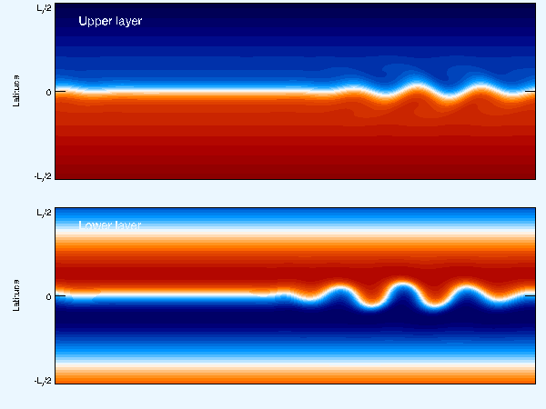
Scott and Dritschel (2012, J. Fluid Mech. 711, 576) – forced-dissipative
but clarifying how to reach the more “natural” low-excitation, low-dissipation
parameter regimes. Also
Esler, G., 2008, J. Fluid Mech. 599, 241 and Phys. Fluids 20, 116602:
Here the Taylor identity is satisfied via a form stress exerted from below:
Next is a classic lab experiment conveying the same message:

Slide 102
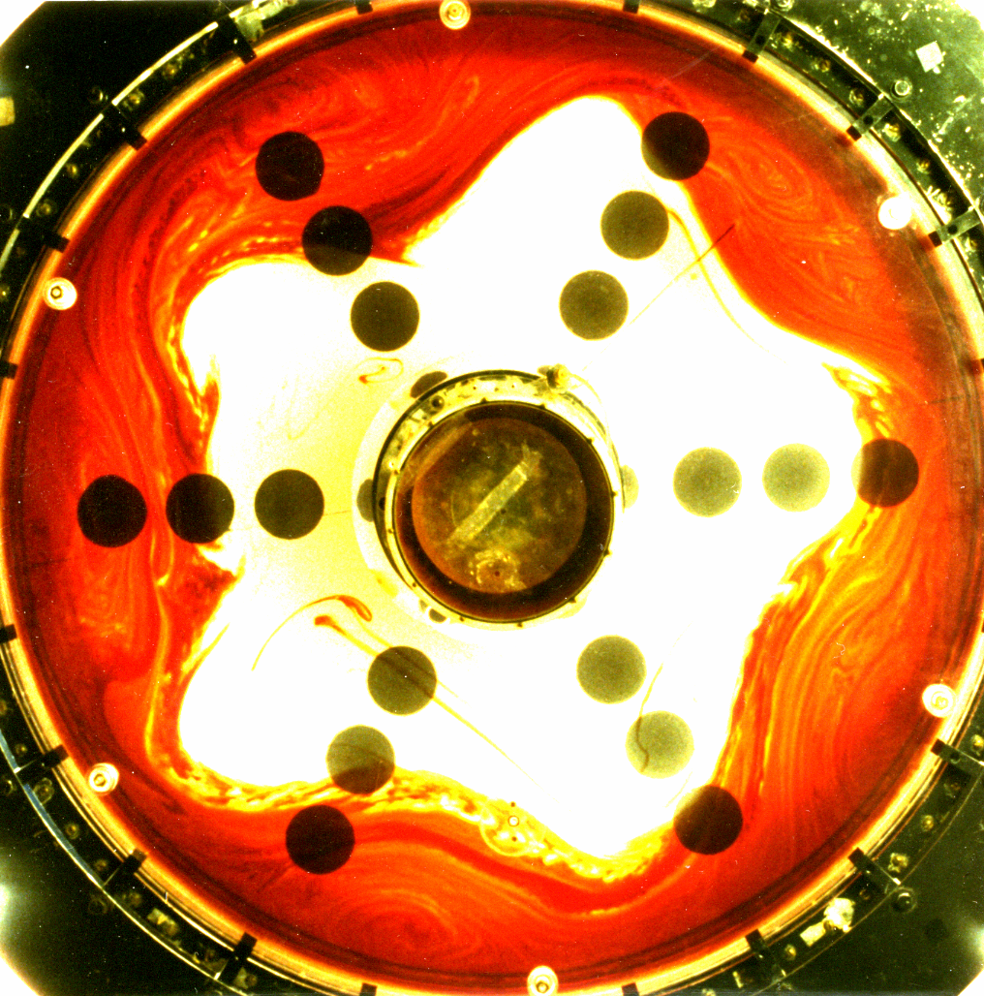
Sommeria,
Myers, and
Swinney,
Nature 1989
86.4 cm dia.;
3 revs/sec (!)

Slide 103
Sommeria,
Myers, and
Swinney,
Nature 1989
86.4 cm dia.;
3 revs/sec (!)
PV map and
dye map
near-identical.

Slide 104
Sommeria,
Myers, and
Swinney,
Nature 1989
86.4 cm dia.;
3 revs/sec (!)
PV map and
dye map
near-identical.
Strong jet,
very tight
eddy-transport
barrier.

Slide 105
Sommeria,
Myers, and
Swinney,
Nature 1989
86.4 cm dia.;
3 revs/sec (!)
PV map and
dye map
near-identical.
Strong jet,
very tight
eddy-transport
barrier.
Dye put in
> 500 revs.
earlier.

Slide 106
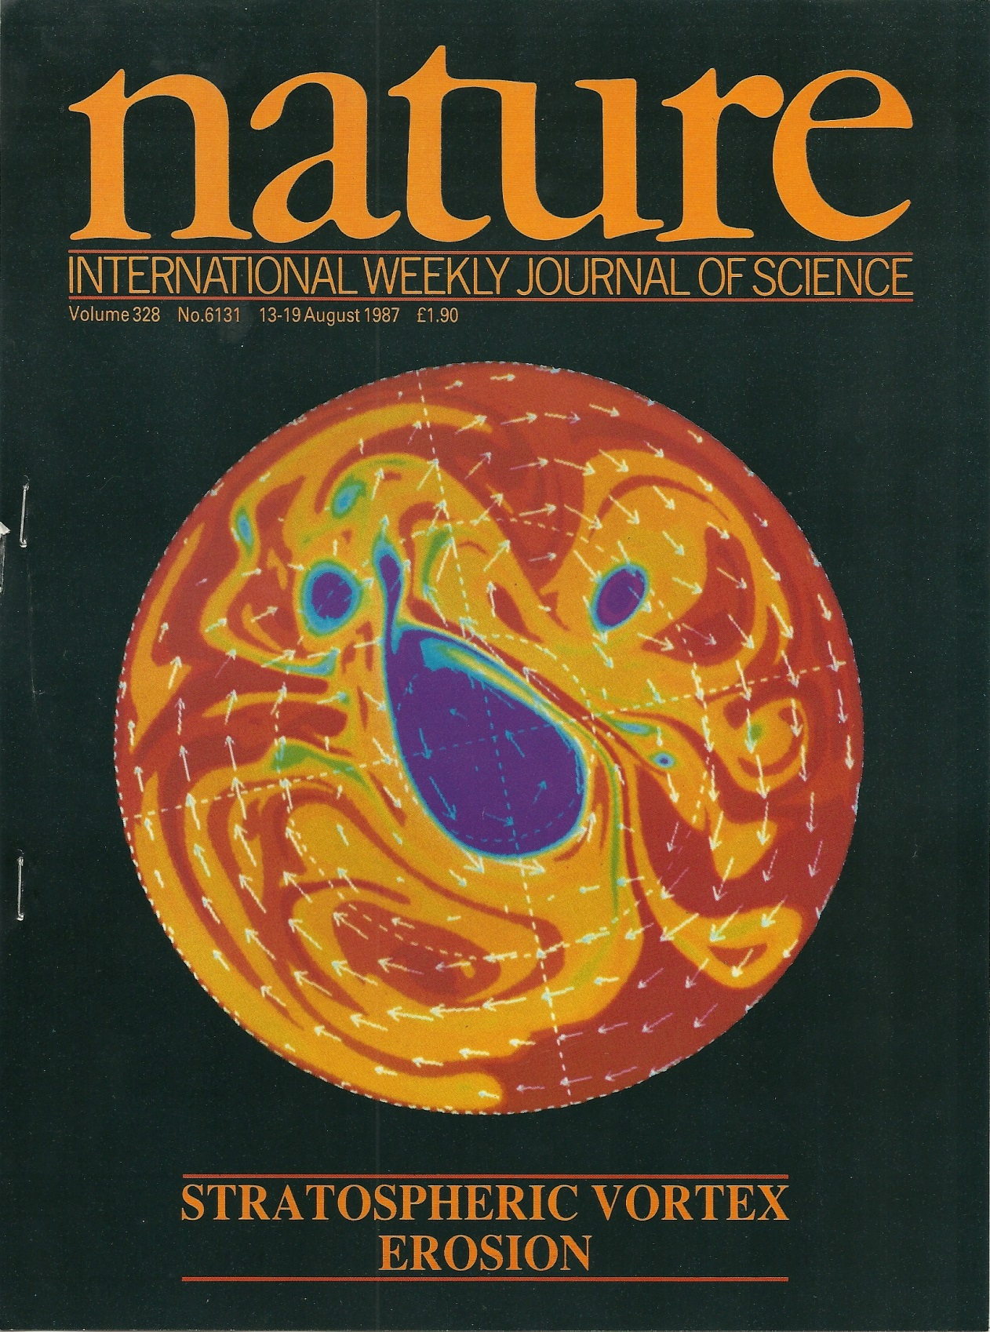
PV in a 2-D idealized “stratosphere”
(Juckes & McI 1987):

Slide 107
PV in a 2-D idealized “stratosphere”
(Juckes & McI 1987):
Polar-night jet strengthened and
sharpened by PV mixing, mainly
on its equatorward flank, this time,
again forming a strong jet and a
very tight eddy-transport barrier.

Slide 108
PV in a 2-D idealized “stratosphere”
(Juckes & McI 1987):
Polar-night jet strengthened and
sharpened by PV mixing, mainly
on its equatorward flank, this time,
again forming a strong jet and a
very tight eddy-transport barrier.
NB: “inverse cascades”
have no significant role
in any of these examples
– despite the variety of ways
in which the flows were excited.

Slide 109
PV in a 2-D idealized “stratosphere”
(Juckes & McI 1987):
Polar-night jet strengthened and
sharpened by PV mixing, mainly
on its equatorward flank, this time,
again forming a strong jet and a
very tight eddy-transport barrier.
NB: “inverse cascades”
have no significant role
in any of these examples
– despite the variety of ways
in which the flows were excited.
Many other examples (e.g. nice
observational work in Huw Davies’
group. So here’s the bottom line:

Slide 110
Inhomogeneous PV mixing is so robust and so typical – mixing works so
much better than it ought (in part because of the PV-inversion scale effect –
and the arguments against homogeneous PV mixing are so powerful –

Slide 111
Inhomogeneous PV mixing is so robust and so typical – mixing works so
much better than it ought (in part because of the PV-inversion scale effect –
and the arguments against homogeneous PV mixing are so powerful –
that we can reasonably talk about a paradigm shift
provided that we emphasize the word “inhomogeneous”.

Slide 112
Inhomogeneous PV mixing is so robust and so typical – mixing works so
much better than it ought (in part because of the PV-inversion scale effect –
and the arguments against homogeneous PV mixing are so powerful –
that we can reasonably talk about a paradigm shift
provided that we emphasize the word “inhomogeneous”.
(cf. the old
‘turbulent
momentum-
mixing’
paradigm)

Slide 113
Inhomogeneous PV mixing is so robust and so typical – mixing works so
much better than it ought (in part because of the PV-inversion scale effect –
and the arguments against homogeneous PV mixing are so powerful –
that we can reasonably talk about a paradigm shift
provided that we emphasize the word “inhomogeneous”.
And this inhomogeneous PV-mixing paradigm is one of the few
simple handles we have on the strongly nonlinear fluid behaviour.
(cf. the old
‘turbulent
momentum-
mixing’
paradigm)

Slide 114
Inhomogeneous PV mixing is so robust and so typical – mixing works so
much better than it ought (in part because of the PV-inversion scale effect –
and the arguments against homogeneous PV mixing are so powerful –
that we can reasonably talk about a paradigm shift
provided that we emphasize the word “inhomogeneous”.
And this inhomogeneous PV-mixing paradigm is one of the few
simple handles we have on the strongly nonlinear fluid behaviour.
It may also give a handle on strong nonlinearity in tokamaks – Rosenbluth Lecture
(cf. the old
‘turbulent
momentum-
mixing’
paradigm)
(??)
(??)

Slide 115
Inhomogeneous PV mixing is so robust and so typical – mixing works so
much better than it ought (in part because of the PV-inversion scale effect –
and the arguments against homogeneous PV mixing are so powerful –
that we can reasonably talk about a paradigm shift
provided that we emphasize the word “inhomogeneous”.
And this inhomogeneous PV-mixing paradigm is one of the few
simple handles we have on the strongly nonlinear fluid behaviour.
It may also give a handle on strong nonlinearity in tokamaks – Rosenbluth Lecture
(Past obstacles? “Homogeneous” unconsciously assumed?
Mathematical temptation? Constant diffusivity too seductive?)
(cf. the old
‘turbulent
momentum-
mixing’
paradigm)
(??)
(??)

Slide 116
Inhomogeneous PV mixing is so robust and so typical – mixing works so
much better than it ought (in part because of the PV-inversion scale effect –
and the arguments against homogeneous PV mixing are so powerful –
that we can reasonably talk about a paradigm shift
provided that we emphasize the word “inhomogeneous”.
And this inhomogeneous PV-mixing paradigm is one of the few
simple handles we have on the strongly nonlinear fluid behaviour.
It may also give a handle on strong nonlinearity in tokamaks – Rosenbluth Lecture
(Past obstacles? “Homogeneous” unconsciously assumed?
Mathematical temptation? Constant diffusivity too seductive?)
The paradigm is not, of course, the Answer to Everything:
● PV doesn’t always mix (e.g., vortex merging)
● Not all jets are strong jets (e.g., “ghost jets” in the Pacific Ocean)
● And there are, of course, other nonlinear mechanisms
that show up in different thought-experiments:
(cf. the old
‘turbulent
momentum-
mixing’
paradigm)
(??)
(??)

Slide 117

Jet dynamics – a complex conceptual landscape wth a 2-level hierarchy of ideas:
Horse & cart?
PV Phillips effect Taylor identity:
1. Generic ideas: PV invertibility – div (eddy momentum flux)
Nonlinear, forced/free/self-excited
2. Particular mechanisms:
(i) Rhines effect. Re weak jets generated by strong small-scale forcing – strong
enough to create active small-scale vortices that merge or cluster, producing an
inverse cascade that is arrested or slowed when eddy velocities ~ plane Rossby-
wave phase speeds. Wave-turbulence interaction is spatially homogeneous.
(ii) Repeated excit’n of passive Kelvin sheared disturbances by weak small-scale
forcing. (Kelvin 1887, Farrell-Ioannou, Marston, Srinivasan-Young: CE2, SSST)
(iii) Inhomogeneous PV mixing: re strong jets self-sharpened by Rossby-wave
breaking. Wave-turbulence interaction spatially inhomogeneous.
(iv) Vortex merging and cannibalism, ↔ inverse cascade (sort of)
(v) Monopole vortex migration (probably significant on Jupiter)
(vi) Quasi-random-walk vortex migration (ditto)
(vii) PV-biased forcing (ditto): (v) – (vii) and (iii) all critical in the idealized Jupiter
weather-layer model studied by Stephen Thomson and myself, JAS 73, 1119
3. Additional point: DIMBO effect ...

Slide 118
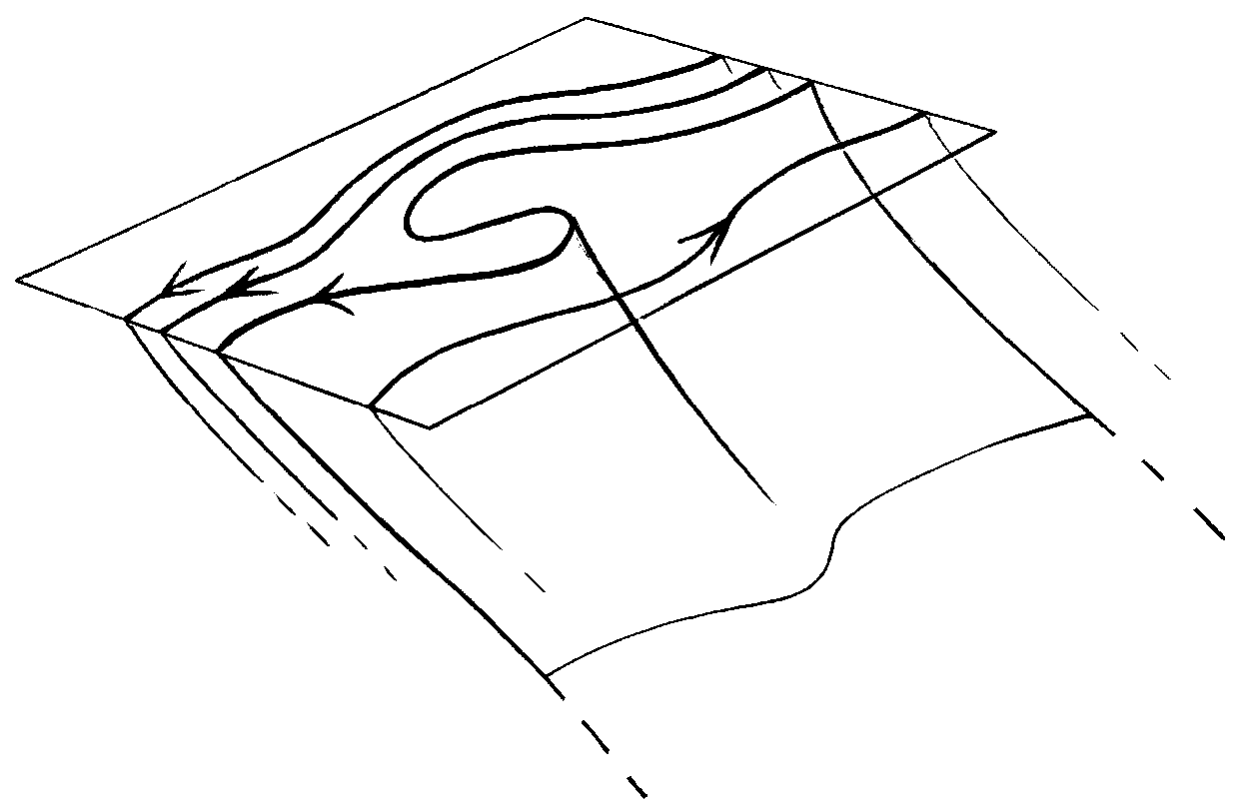
DIMBO = DIapycnal Mixing via Baroclinic Overturning
sea surface, ignoring
mixed layer
← L (mesoscale) →
isopycnal
surface
(to Antarctica)
DIMBO layer:
mesoscale eddies
mix diapycnally as well
as isopycnally
Underneath:
mesoscale eddies
mix only isopycnally.
Diapycnal transport is
solely by inertia-gravity-wave
breaking, cabbeling, DD, spiralling
How deep is the DIMBO layer? Scale analysis and semigeostrophic PV inversion suggest
the “obvious” answer fL/N. Could ~ kilometre or two. Must often exceed mixed-layer depth.
Numerical experiments underway (John Taylor, Raff Ferrari, personal communication)
– watch this space!

Slide 119
DIMBO = DIapycnal Mixing via Baroclinic Overturning
sea surface, ignoring
mixed layer
← L (mesoscale) →
isopycnal
surface
(to Antarctica)
DIMBO layer:
mesoscale eddies
mix diapycnally as well
as isopycnally
Statically unstable:
must convect.
Underneath:
mesoscale eddies
mix only isopycnally.
Diapycnal transport is
solely by inertia-gravity-wave
breaking, cabbeling, DD, spiralling
How deep is the DIMBO layer? Scale analysis and semigeostrophic PV inversion suggest
the “obvious” answer fL/N. Could ~ kilometre or two. Must often exceed mixed-layer depth.
Numerical experiments underway (John Taylor, Raff Ferrari, personal communication)
– watch this space!

Slide 120
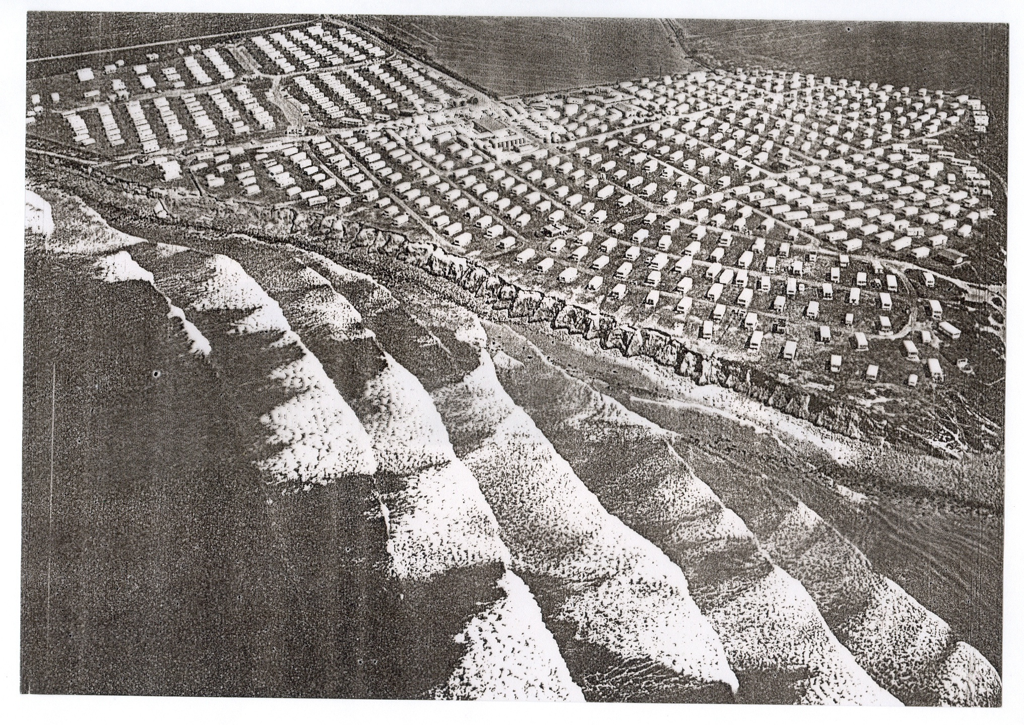
Now widening
the perspective:
(Not all the significant
waves are Rossby waves.)

Slide 121
Now widening
the perspective:
(Not all the significant
waves are Rossby waves.
Other wave types can exert forces
and reshape mean flows.)

Slide 122
Now widening
the perspective:
(Not all the significant
waves are Rossby waves.
Other wave types can exert forces
and reshape mean flows.)
(Aside: linear critical-layer theory
misleadingly says that all the action is at
the edge, where your toes only just get wet)

Slide 123
The ability of waves to exert forces, including mean forces
that can shape or reshape the profile of a jetstream
or mean current, is an extremely general, and highly robust,
property of waves in fluids. Here’s another example

Slide 124
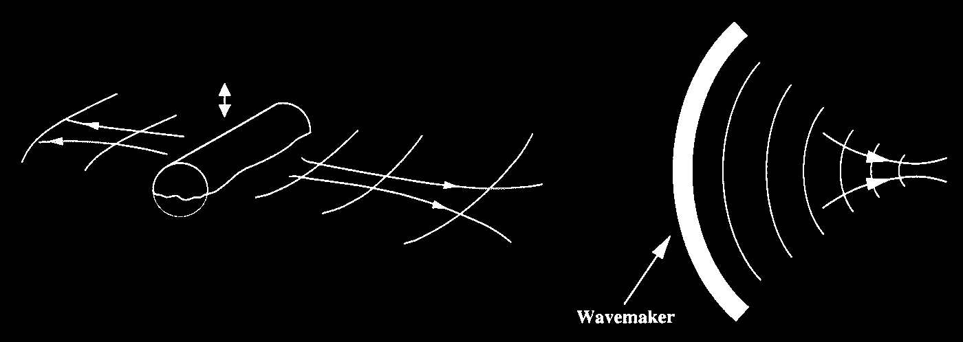
The ability of waves to exert forces, including mean forces
that can shape or reshape the profile of a jetstream
or mean current, is an extremely general, and highly robust,
property of waves in fluids. Here’s another example
(live demonstration):

Slide 126
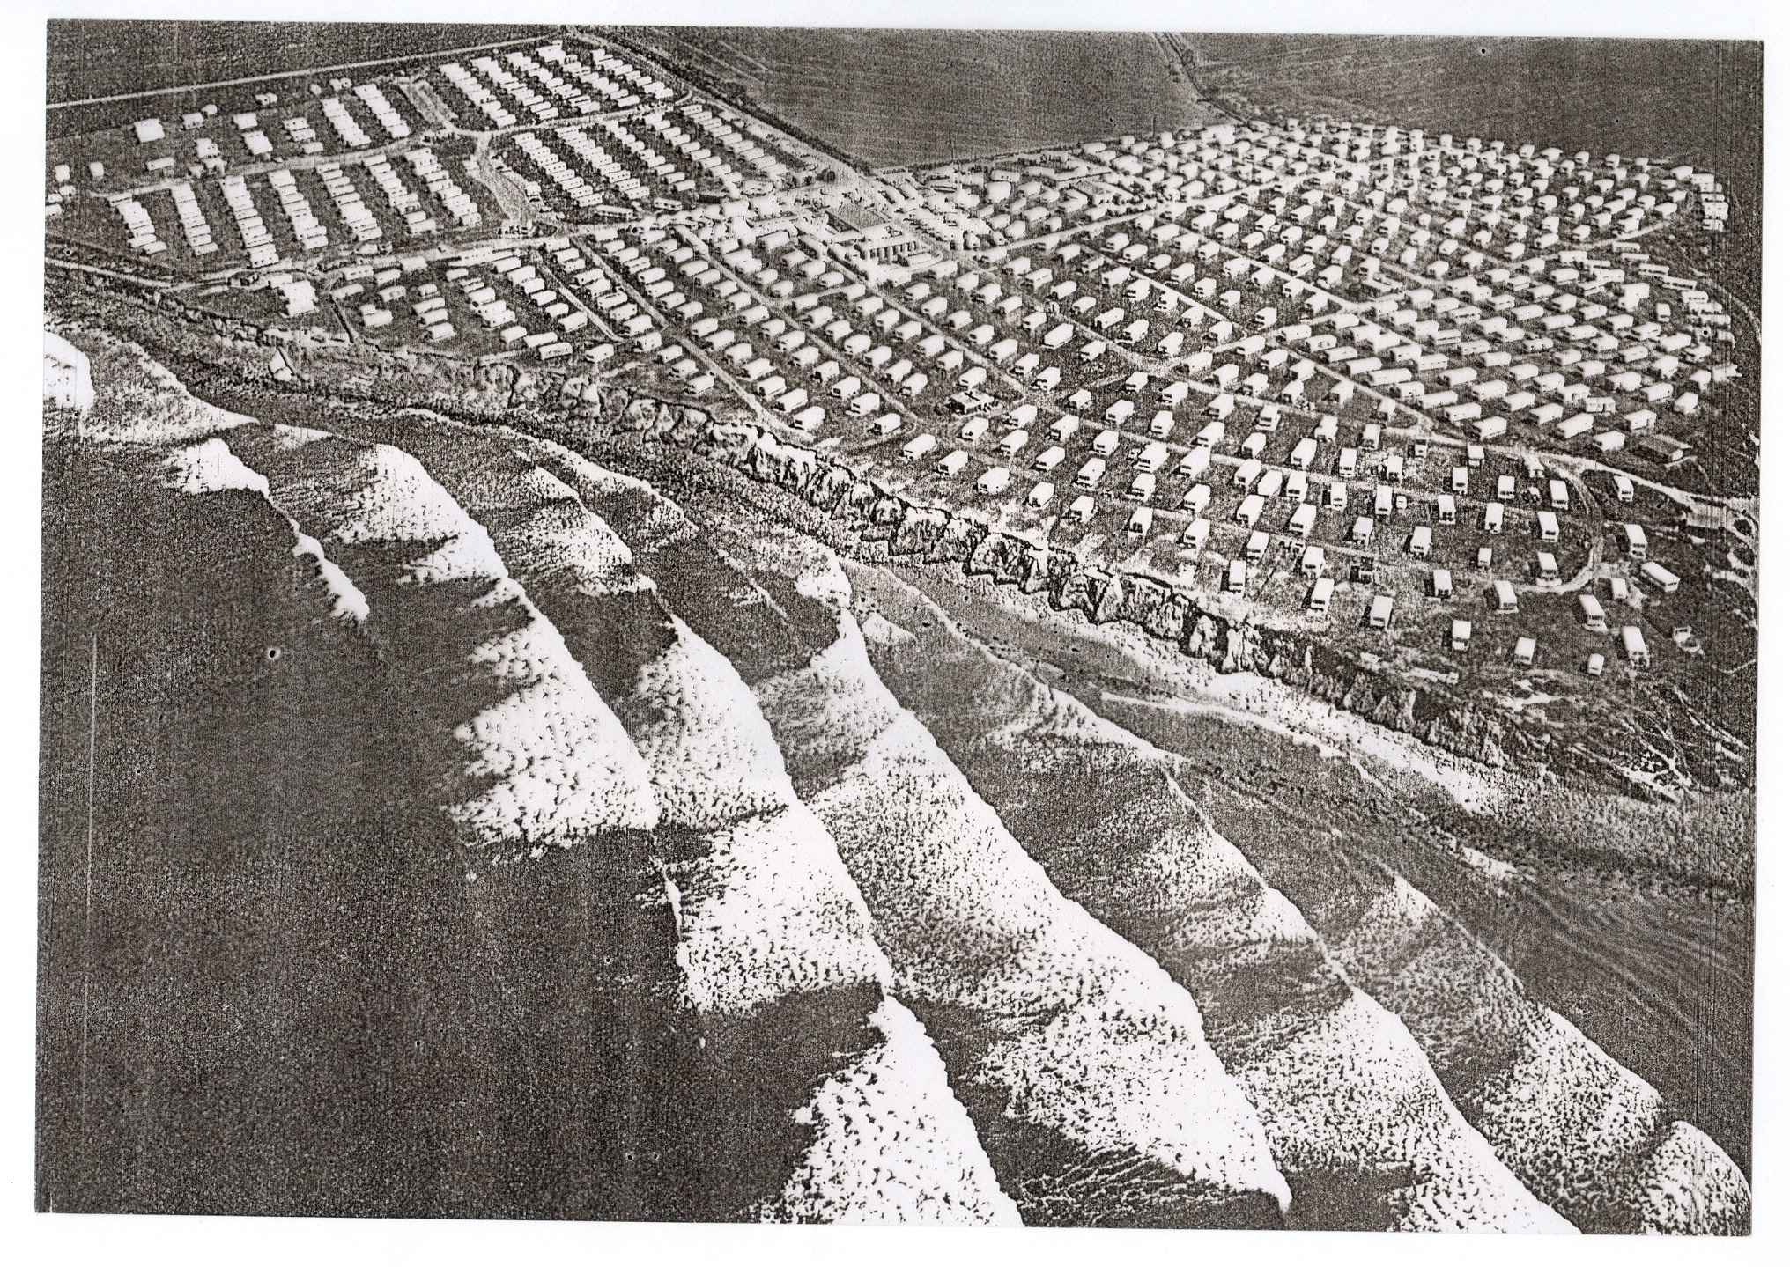
Essentially similar is the generation of longshore currents and rip currents by breaking ocean-beach waves – and sediment transport, sand bars, etc – multi-timescale...

Slide 127
In fact, the inhomogeneous PV mixing paradigm overlaps with a wider
paradigm, that of the radiation-stress-dominated atmosphere
involving a number of different wave types.
Generalizing:
WAVE EXCITATION
wavelike:
turbulent:
WAVE DISSIPATION
Websearch ”lucidity principles” ”e-book”.

Slide 128
In fact, the inhomogeneous PV mixing paradigm overlaps with a wider
paradigm, that of the radiation-stress-dominated atmosphere
involving a number of different wave types.
Generalizing:
(including arrival
from elsewhere,
e.g. from below)
WAVE EXCITATION
wavelike:
turbulent:
WAVE DISSIPATION
Websearch ”lucidity principles” ”e-book”.

Slide 129
In fact, the inhomogeneous PV mixing paradigm overlaps with a wider
paradigm, that of the radiation-stress-dominated atmosphere
involving a number of different wave types.
Generalizing:
(including arrival
from elsewhere,
e.g. from below)
WAVE EXCITATION
wavelike:
turbulent:
WAVE DISSIPATION
Unlike turbulent momentum transport (eddy viscosity),
wave-induced “ “ can operate at long range.
Websearch ”lucidity principles” ”e-book”.

Slide 130
In fact, the inhomogeneous PV mixing paradigm overlaps with a wider
paradigm, that of the radiation-stress-dominated atmosphere
involving a number of different wave types.
Generalizing:
(including arrival
from elsewhere,
e.g. from below)
WAVE EXCITATION
wavelike:
turbulent:
WAVE DISSIPATION
Unlike turbulent momentum transport (eddy viscosity),
wave-induced “ “ can operate at long range.
There’s a long history over the past century…
Websearch ”lucidity principles” ”e-book”.

Slide 131
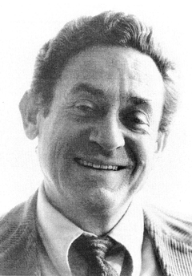
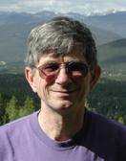
Understanding didn’t emerge until after V.P. Starr’s
1968 “negative viscosity” book. Early steps:
←Jule Charney, Ernst Kleinschmidt, Bob Dickinson,→
Aleksandr Mikhailovich Obukhov, Duzheng Ye,
Norman Phillips,...
History long and tortuous – no “Einstein moment”.

Slide 132
Understanding didn’t emerge until after V.P. Starr’s
1968 “negative viscosity” book. Early steps:
←Jule Charney, Ernst Kleinschmidt, Bob Dickinson,→
Aleksandr Mikhailovich Obukhov, Duzheng Ye,
Norman Phillips,...
History long and tortuous – no “Einstein moment”.
Historical review: “staircase” on my home page.

Slide 133
Understanding didn’t emerge until after V.P. Starr’s
1968 “negative viscosity” book. Early steps:
←Jule Charney, Ernst Kleinschmidt, Bob Dickinson,→
Aleksandr Mikhailovich Obukhov, Duzheng Ye,
Norman Phillips,...
History long and tortuous – no “Einstein moment”.
Historical review: “staircase” on my home page.
Both Starr (1968) and E.N. Lorenz (1967) saw “negative viscosity” as one of the
great enigmas of atmospheric science.

Slide 134
Understanding didn’t emerge until after V.P. Starr’s
1968 “negative viscosity” book. Early steps:
←Jule Charney, Ernst Kleinschmidt, Bob Dickinson,→
Aleksandr Mikhailovich Obukhov, Duzheng Ye,
Norman Phillips,...
History long and tortuous – no “Einstein moment”.
Historical review: “staircase” on my home page.
Both Starr (1968) and E.N. Lorenz (1967) saw “negative viscosity” as one of the
great enigmas of atmospheric science. And there were two others at that time:
QBO, cold summer mesopause.

Slide 135
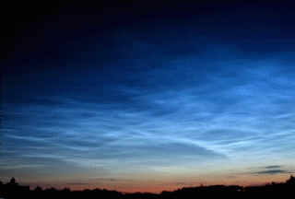
The sunniest place on earth is the coldest place on earth.
→ noctilucent clouds (at ~ 83km)

Slide 136
Understanding didn’t emerge until after V.P. Starr’s
1968 “negative viscosity” book. Early steps:
←Jule Charney, Ernst Kleinschmidt, Bob Dickinson,→
Aleksandr Mikhailovich Obukhov, Duzheng Ye,
Norman Phillips,...
History long and tortuous – no “Einstein moment”.
Historical review: “staircase” on my home page.
Both Starr (1968) and E.N. Lorenz (1967) saw “negative viscosity” as one of the
great enigmas of atmospheric science. And there were two others at that time:
QBO, cold summer mesopause.

Slide 137
Understanding didn’t emerge until after V.P. Starr’s
1968 “negative viscosity” book. Early steps:
←Jule Charney, Ernst Kleinschmidt, Bob Dickinson,→
Aleksandr Mikhailovich Obukhov, Duzheng Ye,
Norman Phillips,...
History long and tortuous – no “Einstein moment”.
Historical review: “staircase” on my home page.
Both Starr (1968) and E.N. Lorenz (1967) saw “negative viscosity” as one of the
great enigmas of atmospheric science. And there were two others at that time:
QBO, cold summer mesopause. All three were solved by the paradigm
change
“turbulent atmosphere” (frictional)
→
“radiation-stress-dominated atmosphere” (often anti-frictional)

Slide 138
Understanding didn’t emerge until after V.P. Starr’s
1968 “negative viscosity” book. Early steps:
←Jule Charney, Ernst Kleinschmidt, Bob Dickinson,→
Aleksandr Mikhailovich Obukhov, Duzheng Ye,
Norman Phillips,...
History long and tortuous – no “Einstein moment”.
Historical review: “staircase” on my home page.
Both Starr (1968) and E.N. Lorenz (1967) saw “negative viscosity” as one of the
great enigmas of atmospheric science. And there were two others at that time:
QBO, cold summer mesopause. All three were solved by the paradigm
change
“turbulent atmosphere” (frictional)
→
“radiation-stress-dominated atmosphere” (often anti-frictional)
The same paradigm change was critical to our solar tachocline breakthrough.

Slide 139
Understanding didn’t emerge until after V.P. Starr’s
1968 “negative viscosity” book. Early steps:
←Jule Charney, Ernst Kleinschmidt, Bob Dickinson,→
Aleksandr Mikhailovich Obukhov, Duzheng Ye,
Norman Phillips,...
History long and tortuous – no “Einstein moment”.
Historical review: “staircase” on my home page.
Both Starr (1968) and E.N. Lorenz (1967) saw “negative viscosity” as one of the
great enigmas of atmospheric science. And there were two others at that time:
QBO, cold summer mesopause. All three were solved by the paradigm
change
“turbulent atmosphere” (frictional)
→
“radiation-stress-dominated atmosphere” (often anti-frictional)
The same paradigm change was critical to our solar tachocline breakthrough.
Remark: the generic role of wave propagation mechanisms illustrates one of the
grand themes of physics, the dynamical organization of fluctuations with
systematic mean effects.

Slide 140
Understanding didn’t emerge until after V.P. Starr’s
1968 “negative viscosity” book. Early steps:
←Jule Charney, Ernst Kleinschmidt, Bob Dickinson,→
Aleksandr Mikhailovich Obukhov, Duzheng Ye,
Norman Phillips,...
History long and tortuous – no “Einstein moment”.
Historical review: “staircase” on my home page.
Both Starr (1968) and E.N. Lorenz (1967) saw “negative viscosity” as one of the
great enigmas of atmospheric science. And there were two others at that time:
QBO, cold summer mesopause. All three were solved by the paradigm
change
“turbulent atmosphere” (frictional)
→
“radiation-stress-dominated atmosphere” (often anti-frictional)
The same paradigm change was critical to our solar tachocline breakthrough.
Remark: the generic role of wave propagation mechanisms illustrates one of the
grand themes of physics, the dynamical organization of fluctuations with
systematic mean effects. (e.g. bio-molecular motors!)

Slide 141
Understanding didn’t emerge until after V.P. Starr’s
1968 “negative viscosity” book. Early steps:
←Jule Charney, Ernst Kleinschmidt, Bob Dickinson,→
Aleksandr Mikhailovich Obukhov, Duzheng Ye,
Norman Phillips,...
History long and tortuous – no “Einstein moment”.
Historical review: “staircase” on my home page.
Both Starr (1968) and E.N. Lorenz (1967) saw “negative viscosity” as one of the
great enigmas of atmospheric science. And there were two others at that time:
QBO, cold summer mesopause. All three were solved by the paradigm
change
“turbulent atmosphere” (frictional)
→
“radiation-stress-dominated atmosphere” (often anti-frictional)
The same paradigm change was critical to our solar tachocline breakthrough.
Remark: the generic role of wave propagation mechanisms illustrates one of the
grand themes of physics, the dynamical organization of fluctuations with
systematic mean effects. (e.g. bio-molecular motors!)
A simple non-Rossby-wave example is the Plumb-McEwan experiment (laboratory QBO):

Slide 142
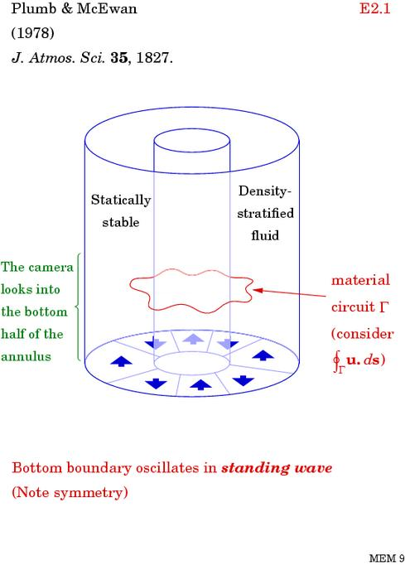
Here, “fluctuations”
are departures
from the zonal or
azimuthal mean.

Slide 143
Here, “fluctuations”
are departures
from the zonal or
azimuthal mean.
cf. “nonacceleration
theorems”, “wave
breaking”, etc…
(The bottom-boundary
oscillations can be
more chaotic or
stochastic)
(Oscillation
frequencies allow
internal gravity wave
propagation.)

Slide 144
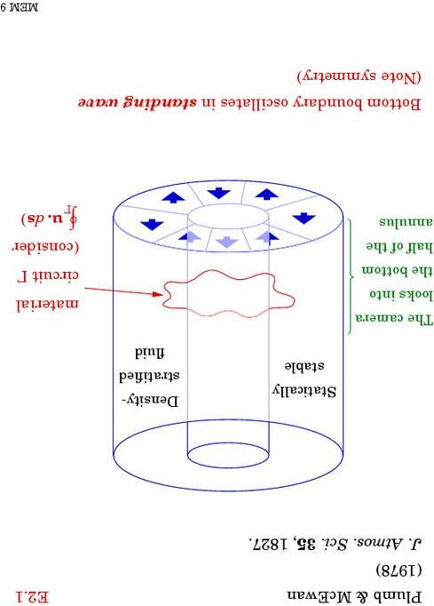
Kyoto University version:
I

Slide 145
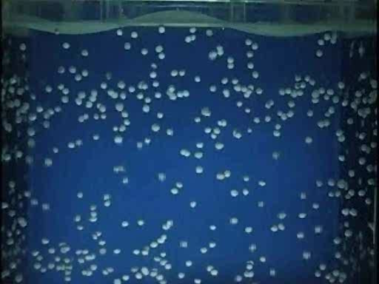
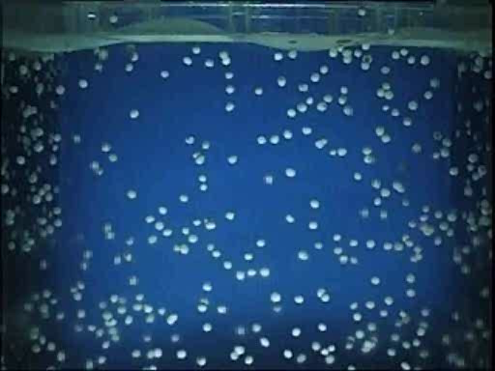
From the Kyoto University version of the Plumb-McEwan experiment:
www.gfd-dennou.org/library/gfd_exp/ or websearch QBO “Tech Tips”
Anti-frictional: an annulus of stratified fluid is driven away from solid rotation
by nothing more than the imposition of fluctuations at its top boundary.
In the real QBO, waves dissipate partly by breaking.– turbulent indeed!
But the key point is mean momentum transport is dynamically organized
by the waves – a long-range effect – and by their interplay with the
mean flow (Bühler 2009 & 2014, Waves and Mean Flows, Cambridge U.Press.)

Slide 146
From the Kyoto University version of the Plumb-McEwan experiment:
www.gfd-dennou.org/library/gfd_exp/ or websearch QBO “Tech Tips”
Anti-frictional: an annulus of stratified fluid is driven away from solid rotation
by nothing more than the imposition of fluctuations at its top boundary.
In the real QBO, waves dissipate partly by breaking.– turbulent indeed!
But the key point is mean momentum transport is dynamically organized
by the waves – a long-range effect – and by their interplay with the
mean flow (Bühler 2009 & 2014, Waves and Mean Flows, Cambridge U.Press.)
Wave-induced momentum transport also drives extratropical mean circulations:

Slide 147
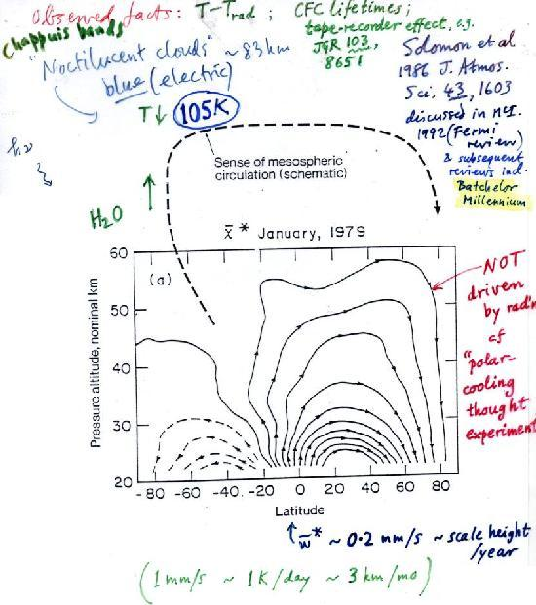

Slide 148
Sunnniest place
on earth!
(Gyroscopic pumping
by breaking gravity
waves)

Slide 149
Sunnniest place
on earth!
(Gyroscopic pumping
by breaking gravity
waves)

Slide 150
Sunnniest place
on earth!
(Gyroscopic pumping
by breaking gravity
waves)
Brewer-Dobson
circulation:
(gyroscopic pumping
by breaking Rossby
waves)

Slide 151
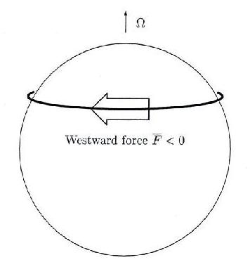
Gyroscopic pumping is easy to understand:
Rapidly-rotating system!
Low Rossby number,
Coriolis effects are strong.
(persistent)

Slide 152
Gyroscopic pumping is easy to understand:
Rapidly-rotating system!
Low Rossby number,
Coriolis effects are strong.
Coriolis force turns
fluid poleward: a robust
and systematic mechanical
pumping effect. Another
example is Ekman pumping.
(persistent)

Slide 153
Gyroscopic pumping is easy to understand:
Rapidly-rotating system!
Low Rossby number,
Coriolis effects are strong.
Coriolis force turns
fluid poleward: a robust
and systematic mechanical
pumping effect. Another
example is Ekman pumping.
In the stratospheric case
the force is due mainly to
breaking Rossby waves. That’s why the Brewer-Dobson circulation
is always poleward. In the Ekman case the force is due to friction,
(persistent)

Slide 154
Gyroscopic pumping is easy to understand:
Rapidly-rotating system!
Low Rossby number,
Coriolis effects are strong.
Coriolis force turns
fluid poleward: a robust
and systematic mechanical
pumping effect. Another
example is Ekman pumping.
In the stratospheric case
the force is due mainly to
breaking Rossby waves. That’s why the Brewer-Dobson circulation
is always poleward. In the Ekman case the force is due to friction,
(persistent)
Now recognized as crucial to the solar problem too: L. Mestel (2012) Stellar Magnetism (OUP)

Slide 155
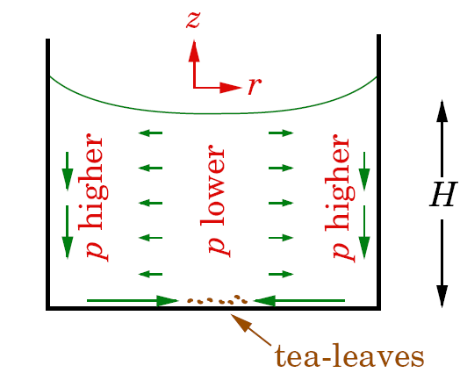
(Einstein’s)
Experimental demo uses a rotating mass of fluid in a glass container.

Slide 156
(Einstein’s)
Experimental demo uses a rotating mass of fluid in a glass container.

Slide 157
(Einstein’s)
Experimental demo uses a rotating mass of fluid in a glass container.
The retrograde force from boundary friction produces gyroscopic pumping –
in this case called “Ekman” pumping – of fluid toward the rotation axis.

Slide 158
(Einstein’s)
Experimental demo uses a rotating mass of fluid in a glass container.
The retrograde force from boundary friction produces gyroscopic pumping –
in this case called “Ekman” pumping – of fluid toward the rotation axis.
Because of axisymmetry, the dynamics is almost the same as that of
orbital decay – as with the inward drift of dust in a protoplanetary
accretion disk. The dust feels a persistent retrograde force from the
(sub-Keplerian) gas, and is inexorably pushed inward.

Slide 160
Gyroscopic pumping” was not understood when I was a postdoc in 1968.
The meridional circulations were regarded as “thermally driven” – not only
the stratospheric and mesospheric circulations, but also
circulations inside solar-type stars.

Slide 161
Gyroscopic pumping” was not understood when I was a postdoc in 1968.
The meridional circulations were regarded as “thermally driven” – not only
the stratospheric and mesospheric circulations, but also
circulations inside solar-type stars.
(Aside: today’s understanding is still not complete:
websearch ”missing forces”, ” Einsteinian mismatch”.)

Slide 162
Gyroscopic pumping” was not understood when I was a postdoc in 1968.
The meridional circulations were regarded as “thermally driven” – not only
the stratospheric and mesospheric circulations, but also
circulations inside solar-type stars.
(Aside: today’s understanding is still not complete:
websearch ”missing forces”, ” Einsteinian mismatch”.)
As already mentioned, “gyroscopic pumping” is essentially the same as
Ekman pumping,

Slide 163
Gyroscopic pumping” was not understood when I was a postdoc in 1968.
The meridional circulations were regarded as “thermally driven” – not only
the stratospheric and mesospheric circulations, but also
circulations inside solar-type stars.
(Aside: today’s understanding is still not complete:
websearch ”missing forces”, ” Einsteinian mismatch”.)
As already mentioned, “gyroscopic pumping” is essentially the same as
Ekman pumping, also astrophysical “orbital decay” due to an azimuthal force.

Slide 164
Gyroscopic pumping” was not understood when I was a postdoc in 1968.
The meridional circulations were regarded as “thermally driven” – not only
the stratospheric and mesospheric circulations, but also
circulations inside solar-type stars.
(Aside: today’s understanding is still not complete:
websearch ”missing forces”, ” Einsteinian mismatch”.)
As already mentioned, “gyroscopic pumping” is essentially the same as
Ekman pumping, also astrophysical “orbital decay” due to an azimuthal force.
So WHY were these circulations regarded as “thermally driven”?

Slide 165
Gyroscopic pumping” was not understood when I was a postdoc in 1968.
The meridional circulations were regarded as “thermally driven” – not only
the stratospheric and mesospheric circulations, but also
circulations inside solar-type stars.
(Aside: today’s understanding is still not complete:
websearch ”missing forces”, ” Einsteinian mismatch”.)
As already mentioned, “gyroscopic pumping” is essentially the same as
Ekman pumping, also astrophysical “orbital decay” due to an azimuthal force.
So WHY were these circulations regarded as “thermally driven”?
Well, it’s yet another story of unconscious assumptions:

Slide 166
History reminds us how science is a struggle with unconscious assumptions;
Websearch ”lucidity principles” ”e-book”.

Slide 167

History reminds us how science is a struggle with unconscious assumptions;
and here’s another reminder (that we all make them):
(We unconsciously assume a particular three-dimensional motion.)
If movie fails, go to http://www.atm.damtp.cam.ac.uk/people/mem/
Websearch ”lucidity principles” ”e-book”.

Slide 168
Paradigm changes often involve exposing unconscious assumptions that
are wrong. E.g.,
Websearch ”lucidity principles” ”e-book”.

Slide 169
Paradigm changes often involve exposing unconscious assumptions that
are wrong. E.g.,
homogeneous-turbulence assumption, as already discussed
Websearch ”lucidity principles” ”e-book”.

Slide 170
Paradigm changes often involve exposing unconscious assumptions that
are wrong. E.g.,
homogeneous-turbulence assumption, as already discussed
energetics assumption (counterexamples: Stewartson-Warn-Warn critical layer,
amplifier input and power-supply circuitry)
Websearch ”lucidity principles” ”e-book”.

Slide 171
Paradigm changes often involve exposing unconscious assumptions that
are wrong. E.g.,
homogeneous-turbulence assumption, as already discussed
energetics assumption (counterexamples: Stewartson-Warn-Warn critical layer,
amplifier input and power-supply circuitry)
small-is-unimportant assumption (counterexample: amplifier input signal)
Websearch ”lucidity principles” ”e-book”.

Slide 172
Paradigm changes often involve exposing unconscious assumptions that
are wrong. E.g.,
homogeneous-turbulence assumption, as already discussed
energetics assumption (counterexamples: Stewartson-Warn-Warn critical layer,
amplifier input and power-supply circuitry)
small-is-unimportant assumption (counterexample: amplifier input signal)
Remark: to make sense of the Pleistocene climate record, need to
recognize the climate system as a noisy amplifier,
Websearch ”lucidity principles” ”e-book”.

Slide 173
Paradigm changes often involve exposing unconscious assumptions that
are wrong. E.g.,
homogeneous-turbulence assumption, as already discussed
energetics assumption (counterexamples: Stewartson-Warn-Warn critical layer,
amplifier input and power-supply circuitry)
small-is-unimportant assumption (counterexample: amplifier input signal)
Remark: to make sense of the Pleistocene climate record, need to
recognize the climate system as a noisy amplifier, with complex
multi-timescale circuitry –
Websearch ”lucidity principles” ”e-book”.

Slide 174
Paradigm changes often involve exposing unconscious assumptions that
are wrong. E.g.,
homogeneous-turbulence assumption, as already discussed
energetics assumption (counterexamples: Stewartson-Warn-Warn critical layer,
amplifier input and power-supply circuitry)
small-is-unimportant assumption (counterexample: amplifier input signal)
Remark: to make sense of the Pleistocene climate record, need to
recognize the climate system as a noisy amplifier, with complex
multi-timescale circuitry – some parts more sensitive than others.
Websearch ”lucidity principles” ”e-book”.

Slide 175
Paradigm changes often involve exposing unconscious assumptions that
are wrong. E.g.,
homogeneous-turbulence assumption, as already discussed
energetics assumption (counterexamples: Stewartson-Warn-Warn critical layer,
amplifier input and power-supply circuitry)
small-is-unimportant assumption (counterexample: amplifier input signal)
Remark: to make sense of the Pleistocene climate record, need to
recognize the climate system as a noisy amplifier, with complex
multi-timescale circuitry – some parts more sensitive than others.
A = B assumption: “an equation A = B means that B causes A.”
Websearch ”lucidity principles” ”e-book”.

Slide 176
Paradigm changes often involve exposing unconscious assumptions that
are wrong. E.g.,
homogeneous-turbulence assumption, as already discussed
energetics assumption (counterexamples: Stewartson-Warn-Warn critical layer,
amplifier input and power-supply circuitry)
small-is-unimportant assumption (counterexample: amplifier input signal)
Remark: to make sense of the Pleistocene climate record, need to
recognize the climate system as a noisy amplifier, with complex
multi-timescale circuitry – some parts more sensitive than others.
A = B assumption: “an equation A = B means that B causes A.”
Websearch ”lucidity principles” ”e-book”.

Slide 177
Paradigm changes often involve exposing unconscious assumptions that
are wrong. E.g.,
homogeneous-turbulence assumption, as already discussed
energetics assumption (counterexamples: Stewartson-Warn-Warn critical layer,
amplifier input and power-supply circuitry)
small-is-unimportant assumption (counterexample: amplifier input signal)
Remark: to make sense of the Pleistocene climate record, need to
recognize the climate system as a noisy amplifier, with complex
multi-timescale circuitry – some parts more sensitive than others.
A = B assumption: “an equation A = B means that B causes A.”
(As if it were a line of computer code.)
Websearch ”lucidity principles” ”e-book”.

Slide 178
Paradigm changes often involve exposing unconscious assumptions that
are wrong. E.g.,
homogeneous-turbulence assumption, as already discussed
energetics assumption (counterexamples: Stewartson-Warn-Warn critical layer,
amplifier input and power-supply circuitry)
small-is-unimportant assumption (counterexample: amplifier input signal)
Remark: to make sense of the Pleistocene climate record, need to
recognize the climate system as a noisy amplifier, with complex
multi-timescale circuitry – some parts more sensitive than others.
A = B assumption: “an equation A = B means that B causes A.”
(As if it were a line of computer code.)
You may laugh! But I’ve often encountered exactly this assumption,...
Websearch ”lucidity principles” ”e-book”.

Slide 179
Paradigm changes often involve exposing unconscious assumptions that
are wrong. E.g.,
homogeneous-turbulence assumption, as already discussed
energetics assumption (counterexamples: Stewartson-Warn-Warn critical layer,
amplifier input and power-supply circuitry)
small-is-unimportant assumption (counterexample: amplifier input signal)
Remark: to make sense of the Pleistocene climate record, need to
recognize the climate system as a noisy amplifier, with complex
multi-timescale circuitry – some parts more sensitive than others.
A = B assumption: “an equation A = B means that B causes A.”
(As if it were a line of computer code.)
You may laugh! But I’ve often encountered exactly this assumption, and in
more than one context...
Websearch ”lucidity principles” ”e-book”.

Slide 180
Paradigm changes often involve exposing unconscious assumptions that
are wrong. E.g.,
homogeneous-turbulence assumption, as already discussed
energetics assumption (counterexamples: Stewartson-Warn-Warn critical layer,
amplifier input and power-supply circuitry)
small-is-unimportant assumption (counterexample: amplifier input signal)
Remark: to make sense of the Pleistocene climate record, need to
recognize the climate system as a noisy amplifier, with complex
multi-timescale circuitry – some parts more sensitive than others.
A = B assumption: “an equation A = B means that B causes A.”
(As if it were a line of computer code.)
e.g., “pressure gradient
causes geostrophic
motion.”
You may laugh! But I’ve often encountered exactly this assumption, and in
more than one context...
Websearch ”lucidity principles” ”e-book”.

Slide 181
Paradigm changes often involve exposing unconscious assumptions that
are wrong. E.g.,
homogeneous-turbulence assumption, as already discussed
energetics assumption (counterexamples: Stewartson-Warn-Warn critical layer,
amplifier input and power-supply circuitry)
small-is-unimportant assumption (counterexample: amplifier input signal)
Remark: to make sense of the Pleistocene climate record, need to
recognize the climate system as a noisy amplifier, with complex
multi-timescale circuitry – some parts more sensitive than others.
A = B assumption: “an equation A = B means that B causes A.”
(As if it were a line of computer code.)
e.g., “pressure gradient
causes geostrophic
motion.”
You may laugh! But I’ve often encountered exactly this assumption, and in
more than one context...
For meridional circulations, A = B is the equation for temperature or
potential temperature in the mean-circulation model:
B = mean heating rate, A = (TEM residual) mean vertical velocity
times the static stability of the stable stratification.

Slide 182
The old idea that the right-hand side B can be regarded as prescribed,
and therefore the circulations as thermally caused or driven is, indeed,
just an A = B assumption.

Slide 183
The old idea that the right-hand side B can be regarded as prescribed,
and therefore the circulations as thermally caused or driven is, indeed,
just an A = B assumption.
But hang on – what’s wrong with that? What’s wrong with a
thought-experiment in which one prescribes the heating rate?

Slide 184
The old idea that the right-hand side B can be regarded as prescribed,
and therefore the circulations as thermally caused or driven is, indeed,
just an A = B assumption.
But hang on – what’s wrong with that? What’s wrong with a
thought-experiment in which one prescribes the heating rate?
Answer: some thought-experiments are better than others.

Slide 185
The old idea that the right-hand side B can be regarded as prescribed,
and therefore the circulations as thermally caused or driven is, indeed,
just an A = B assumption.
But hang on – what’s wrong with that? What’s wrong with a
thought-experiment in which one prescribes the heating rate?
Answer: some thought-experiments are better than others.
Think about pushing a plate along a dinner table. We can declare
that the friction force B is prescribed – but does that correspond to
a good thought-experiment?

Slide 186
The old idea that the right-hand side B can be regarded as prescribed,
and therefore the circulations as thermally caused or driven is, indeed,
just an A = B assumption.
But hang on – what’s wrong with that? What’s wrong with a
thought-experiment in which one prescribes the heating rate?
Answer: some thought-experiments are better than others.
Think about pushing a plate along a dinner table. We can declare
that the friction force B is prescribed – but does that correspond to
a good thought-experiment? Of course not! You exert a given force.

Slide 187
The old idea that the right-hand side B can be regarded as prescribed,
and therefore the circulations as thermally caused or driven is, indeed,
just an A = B assumption.
But hang on – what’s wrong with that? What’s wrong with a
thought-experiment in which one prescribes the heating rate?
Answer: some thought-experiments are better than others.
Think about pushing a plate along a dinner table. We can declare
that the friction force B is prescribed – but does that correspond to
a good thought-experiment? Of course not! You exert a given force.
The stratosphere and mesosphere – and the interiors of solar-type stars –
are all thermally-relaxing systems.

Slide 188
The old idea that the right-hand side B can be regarded as prescribed,
and therefore the circulations as thermally caused or driven is, indeed,
just an A = B assumption.
But hang on – what’s wrong with that? What’s wrong with a
thought-experiment in which one prescribes the heating rate?
Answer: some thought-experiments are better than others.
Think about pushing a plate along a dinner table. We can declare
that the friction force B is prescribed – but does that correspond to
a good thought-experiment? Of course not! You exert a given force.
The stratosphere and mesosphere – and the interiors of solar-type stars –
are all thermally-relaxing systems. So – as with the friction on the
dinner plate – it’s more insightful to regard the heating rate B as part of
the response to some forcing.

Slide 189
The old idea that the right-hand side B can be regarded as prescribed,
and therefore the circulations as thermally caused or driven is, indeed,
just an A = B assumption.
But hang on – what’s wrong with that? What’s wrong with a
thought-experiment in which one prescribes the heating rate?
Answer: some thought-experiments are better than others.
Think about pushing a plate along a dinner table. We can declare
that the friction force B is prescribed – but does that correspond to
a good thought-experiment? Of course not! You exert a given force.
The stratosphere and mesosphere – and the interiors of solar-type stars –
are all thermally-relaxing systems. So – as with the friction on the
dinner plate – it’s more insightful to regard the heating rate B as part of
the response to some forcing.
So “gyroscopic pumping” or “downward control” thought-experiments are better.

Slide 190
Main points about PV dynamics:
● PV is mixable along stratification surfaces.
● The PV invertibility principle says: the PV field contains nearly all the
dynamical information.
● How much dynamical information depends on accuracy of the
balance condition used – slow quasi-manifold, velocity field slaved
to mass field (fully nonlocal function, for greatest accuracy).
● Corollary: the dynamics has only a single time derivative.
● The PV invertibility principle + the inhomogeneity of PV mixing help
explain the atmosphere’s jet/vortex ‘zoology’.
● Re unconscious assumptions: A = B doesn’t mean ‘B causes A’
or ‘B drives A’.
Websearch ”lucidity principles” ”e-book”.

Slide 191
And finally: two paradigms with great explanatory power:
● The radiation-stress-dominated atmosphere
– cf. the old “turbulent stress-dominated…”. And, re the vortical or Rossby-wave part,
● Inhomogeneous PV mixing – too good to be true?
No! It’s an observed reality – explaining, e,g,, the typical, ubiquitous
strong-jet and eddy-transport-barrier structures. Understandable via
the PV-inversion scale effect.
Old paradoxes resolved by recognizing the spatial inhomogeneity and
the wave or radiation-stress part of the jigsaw.
And – watch out for unconscious thought-experiments, and the word “driven” !!
Websearch ”lucidity principles” ”carbon dioxide”
then ”e-book”, ”staircase”, ”Rosenbluth”, ”Encyclopedia” on home page.

Slide 192
(No time for the following slides:)

Slide 193
Independent
evidence of the
tropical upwelling
from “tape-recorder
effect”

Slide 194
Independent
evidence of the
tropical upwelling
from “tape-recorder
effect”

Slide 195
Independent
evidence of the
tropical upwelling
from “tape-recorder
effect”

Slide 196
Independent
evidence of the
tropical upwelling
from “tape-recorder
effect”

Slide 197
Timescales:
~ years aloft,
decades below.
Independent
evidence of the
tropical upwelling
from “tape-recorder
effect”

Slide 198
Timescales:
~ years aloft,
decades below.
“mean”: definition
is critical!
Independent
evidence of the
tropical upwelling
from “tape-recorder
effect”

Slide 199
Timescales:
~ years aloft,
decades below.
“mean”: definition
is critical!
Independent
evidence of the
tropical upwelling
from “tape-recorder
effect”

Slide 200
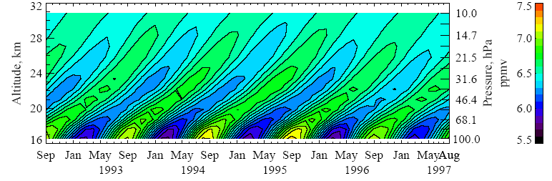
Evidence for the tape-recorder effect (Mote et al 1998, JGR 103, 8651):
HALOE “total hydrogen” concentration H₂O + 2 CH₄ (good passive tracer)
Why, then, were these circulations regarded as “thermally driven”?
Unconscious assumptions again!

