Slide 1
The solar tachocline: a big open question
Oxford July 2018: meeting for John Papaloizou
Is the high-latitude, sub-convective
tachocline invisible?
Michael Edgeworth McIntyre
DAMTP, University of Cambridge, UK
_______________________________________________________________________________________________________________________________________________________
Reprints & corrigenda: websearch ”lucidity principles” then back to home page, string ”tachocline”

Slide 2
The solar tachocline: a big open question
Oxford July 2018: meeting for John Papaloizou
Is the high-latitude, sub-convective
tachocline invisible?
Michael Edgeworth McIntyre
DAMTP, University of Cambridge, UK
_______________________________________________________________________________________________________________________________________________________
Reprints & corrigenda: websearch ”lucidity principles” then back to home page, string ”tachocline”

Slide 3
The solar tachocline: a big open question
Oxford July 2018: meeting for John Papaloizou
(stably stratified)
Is the high-latitude, sub-convective
tachocline invisible?
Michael Edgeworth McIntyre
DAMTP, University of Cambridge, UK
_______________________________________________________________________________________________________________________________________________________
Reprints & corrigenda: websearch ”lucidity principles” then back to home page, string ”tachocline”

Slide 4
The solar tachocline: a big open question
Oxford July 2018: meeting for John Papaloizou
(stably stratified)
Is the high-latitude, sub-convective
tachocline invisible?
I proposed that it is invisible in 2007 (see my chapter in The Solar
Tachocline, ed. Hughes, Rosner & Weiss (paperback) – “M07”
hereafter – q.v. for scientific background, and typical numbers.
See also Wood & McI. (2011), J. Fluid Mech., 677, 445. However,
_______________________________________________________________________________________________________________________________________________________
Reprints & corrigenda: websearch ”lucidity principles” then back to home page, string ”tachocline”

Slide 5
The solar tachocline: a big open question
Oxford July 2018: meeting for John Papaloizou
(stably stratified)
Is the high-latitude, sub-convective
tachocline invisible?
I proposed that it is invisible in 2007 (see my chapter in The Solar
Tachocline, ed. Hughes, Rosner & Weiss (paperback) – “M07”
hereafter – q.v. for scientific background, and typical numbers.
See also Wood & McI. (2011), J. Fluid Mech., 677, 445. However,
another big open question not addressed there but raised in 2011
by me at Douglas Gough’s Gargano meeting: is the Sun’s
internal magnetic field aligned with the rotation axis?
_______________________________________________________________________________________________________________________________________________________
Reprints & corrigenda: websearch ”lucidity principles” then back to home page, string ”tachocline”

Slide 6
The solar tachocline: a big open question
Oxford July 2018: meeting for John Papaloizou
(stably stratified)
Is the high-latitude, sub-convective
tachocline invisible?
I proposed that it is invisible in 2007 (see my chapter in The Solar
Tachocline, ed. Hughes, Rosner & Weiss (paperback) – “M07”
hereafter – q.v. for scientific background, and typical numbers.
See also Wood & McI. (2011), J. Fluid Mech., 677, 445. However,
another big open question not addressed there but raised in 2011
by me at Douglas Gough’s Gargano meeting: is the Sun’s
internal magnetic field aligned with the rotation axis?
First a bit of the background (beyond old controversies):
_______________________________________________________________________________________________________________________________________________________
Reprints & corrigenda: websearch ”lucidity principles” then back to home page, string ”tachocline”

Slide 7
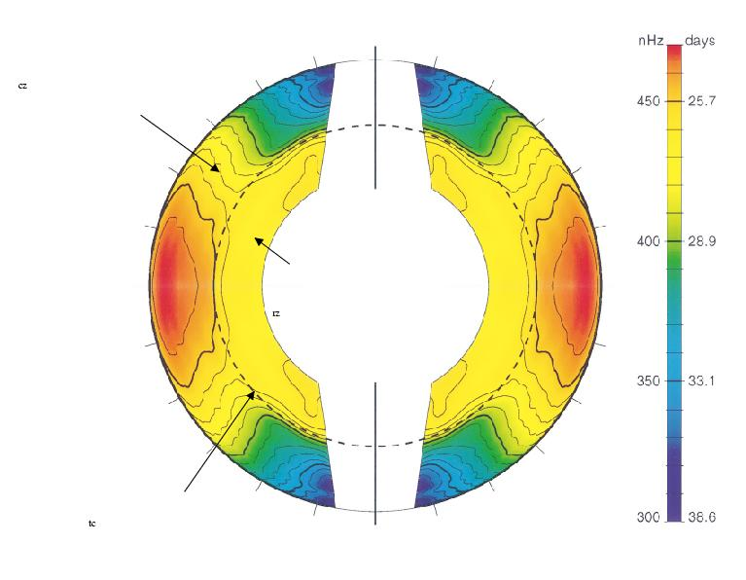
2πΩ/nHz
convection
zone
radiative interior – still
no significant evidence
for departures from
solid rotation
tachocline

Slide 8
2πΩ/nHz
convection
zone
radiative interior – still
no significant evidence
for departures from
solid rotation
tachocline

Slide 9
shellular solid rotation
2πΩ/nHz
convection
zone
radiative interior – still
no significant evidence
for departures from
solid rotation
tachocline

Slide 10
shellular solid rotation
(Occam’s razor)
2πΩ/nHz
convection
zone
radiative interior – still
no significant evidence
for departures from
solid rotation
tachocline

Slide 11
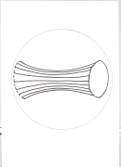
Scientific background:
“downward
spreading”
Re nonmagnetic processes,
(a) HSZ (Haynes-Spiegel-Zahn) burrowing is a robust process in any thermally-
relaxing, stratified rotating system (Pr « 1). Concept of “gyroscopic pumping”.
I

Slide 12
Scientific background:
“downward
spreading”
Re nonmagnetic processes,
(a) HSZ (Haynes-Spiegel-Zahn) burrowing is a robust process in any thermally-
relaxing, stratified rotating system (Pr « 1). Concept of “gyroscopic pumping”.
I

Slide 13
Scientific background:
“downward
spreading”
Re nonmagnetic processes,
(a) HSZ (Haynes-Spiegel-Zahn) burrowing is a robust process in any thermally-
relaxing, stratified rotating system (Pr « 1). Concept of “gyroscopic pumping”.
(b) Neither gravity waves nor NMST (nonmagnetic stratified turbulence) are
naturally able to enforce interior solid rotation.
I

Slide 14
Scientific background:
“downward
spreading”
Re nonmagnetic processes,
(a) HSZ (Haynes-Spiegel-Zahn) burrowing is a robust process in any thermally-
relaxing, stratified rotating system (Pr « 1). Concept of “gyroscopic pumping”.
(b) Neither gravity waves nor NMST (nonmagnetic stratified turbulence) are
naturally able to enforce interior solid rotation.
2. So reasonable to assume interior MUST be magnetic (McI.1994, GM98).
Interior dipoles are the longest-lived; so focus on the 3 possible types of
dipole scenario. With rotation axis upward,
O upright dipole: simplest geometry but polar confinement layers needed
O equatorial-plane dipole: polar CLs needless
O slanted dipole: polar CLs needless
I
I
I
I

Slide 15
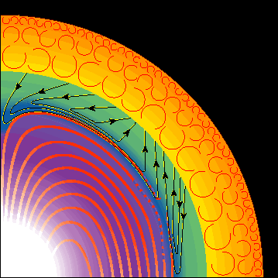
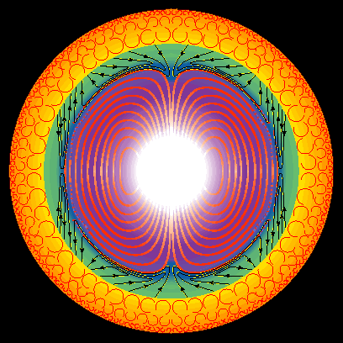
Scientific background:
“downward
spreading”
Re nonmagnetic processes,
(a) HSZ (Haynes-Spiegel-Zahn) burrowing is a robust process in any thermally-
relaxing, stratified rotating system (Pr « 1). Concept of “gyroscopic pumping”.
(b) Neither gravity waves nor NMST (nonmagnetic stratified turbulence) are
naturally able to enforce interior solid rotation.
2. So reasonable to assume interior MUST be magnetic (McI.1994, GM98).
Interior dipoles are the longest-lived; so focus on the 3 possible types of
dipole scenario. With rotation axis upward,
O upright dipole: simplest geometry but polar confinement layers needed
O equatorial-plane dipole: polar CLs needless
O slanted dipole: polar CLs needless
I
I
I
Upright dipole , as originally assumed in GM98
Courtesy Richard Sword

Slide 16
Scientific background:
“downward
spreading”
Re nonmagnetic processes,
(a) HSZ (Haynes-Spiegel-Zahn) burrowing is a robust process in any thermally-
relaxing, stratified rotating system (Pr « 1). Concept of “gyroscopic pumping”.
(b) Neither gravity waves nor NMST (nonmagnetic stratified turbulence) are
naturally able to enforce interior solid rotation.
2. So reasonable to assume interior MUST be magnetic (McI.1994, GM98).
Interior dipoles are the longest-lived; so focus on the 3 possible types of
dipole scenario. With rotation axis upward,
O upright dipole: simplest geometry but polar confinement layers needed
O equatorial-plane dipole: polar CLs needless
O slanted dipole: polar CLs needless
I
I
I
Upright dipole , as originally assumed in GM98
Note polar downwelling
Courtesy Richard Sword

Slide 17

Scientific background:
“downward
spreading”
Re nonmagnetic processes,
(a) HSZ (Haynes-Spiegel-Zahn) burrowing is a robust process in any thermally-
relaxing, stratified rotating system (Pr « 1). Concept of “gyroscopic pumping”.
(b) Neither gravity waves nor NMST (nonmagnetic stratified turbulence) are
naturally able to enforce interior solid rotation.
2. So reasonable to assume interior MUST be magnetic (McI.1994, GM98).
Interior dipoles are the longest-lived; so focus on the 3 possible types of
dipole scenario. With rotation axis upward,
O upright dipole: simplest geometry but polar confinement layers needed
O equatorial-plane dipole: polar CLs needless
O slanted dipole: polar CLs needless
I
I
I
Upright dipole , as originally assumed in GM98
Note polar downwelling (but no “polar pit”).
Courtesy Richard Sword

Slide 18
Scientific background:
“downward
spreading”
Re nonmagnetic processes,
(a) HSZ (Haynes-Spiegel-Zahn) burrowing is a robust process in any thermally-
relaxing, stratified rotating system (Pr « 1). Concept of “gyroscopic pumping”.
(b) Neither gravity waves nor NMST (nonmagnetic stratified turbulence) are
naturally able to enforce interior solid rotation.
2. So reasonable to assume interior MUST be magnetic (McI.1994, GM98).
Interior dipoles are the longest-lived; so focus on the 3 possible types of
dipole scenario. With rotation axis upward,
O upright dipole: simplest geometry but polar confinement layers needed
O equatorial-plane dipole: polar CLs needless
O slanted dipole: polar CLs needless
I
I
I
Upright dipole , as originally assumed in GM98
Note polar downwelling (but no “polar pit”).
11-year sign flips impossible.
Courtesy Richard Sword

Slide 19
Scientific background:
“downward
spreading”
Re nonmagnetic processes,
(a) HSZ (Haynes-Spiegel-Zahn) burrowing is a robust process in any thermally-
relaxing, stratified rotating system (Pr « 1). Concept of “gyroscopic pumping”.
(b) Neither gravity waves nor NMST (nonmagnetic stratified turbulence) are
naturally able to enforce interior solid rotation.
2. So reasonable to assume interior MUST be magnetic (McI.1994, GM98).
Interior dipoles are the longest-lived; so focus on the 3 possible types of
dipole scenario. With rotation axis upward,
O upright dipole: simplest geometry but polar confinement layers needed
O equatorial-plane dipole: polar CLs needless
O slanted dipole: polar CLs needless
I
I
I
Upright dipole , as originally assumed in GM98
Note polar downwelling (but no “polar pit”).
11-year sign flips impossible. So interior B weak:
Courtesy Richard Sword

Slide 20
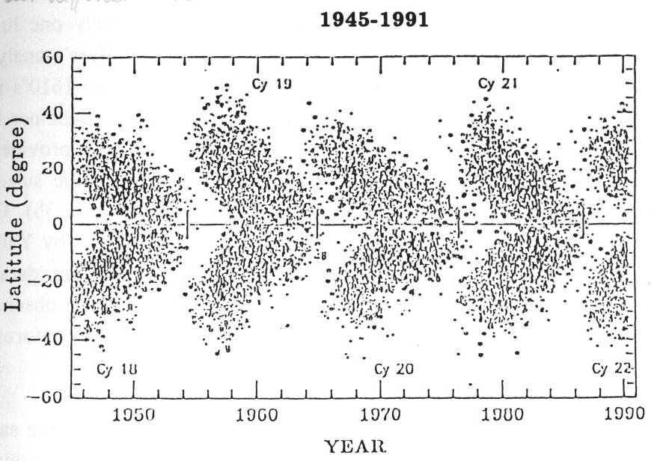
Ribes and Nesme-Ribes 1993, A&A:

Slide 21
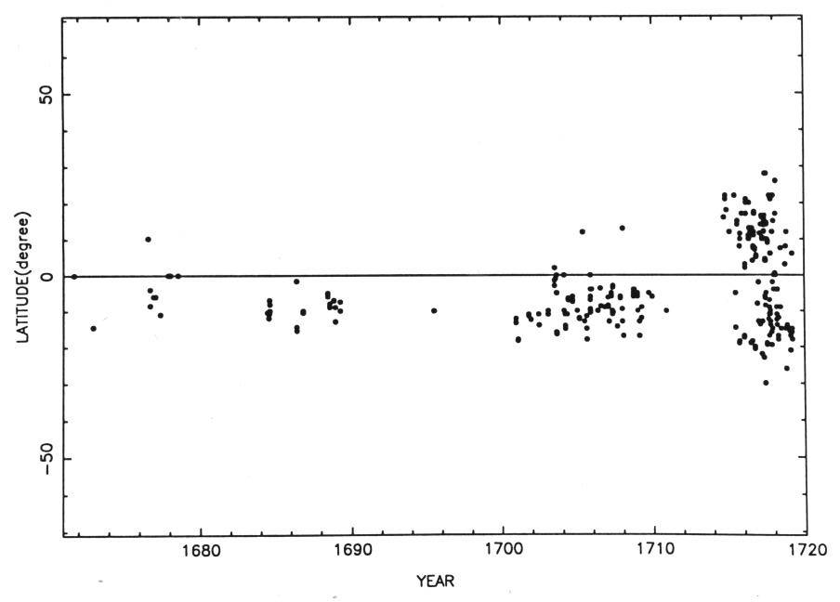
Ribes and Nesme-Ribes 1993, A&A:
Maunder Minimum, 1645–1705
(cycle -9 to cycle -4)
|

Slide 22
Ribes and Nesme-Ribes 1993, A&A:
Maunder Minimum, 1645–1705
(cycle -9 to cycle -4)
|
Note bias in the form of a north-south asymmetry:
could be due to the weak internal B

Slide 23
Ribes and Nesme-Ribes 1993, A&A:
Maunder Minimum, 1645–1705
(cycle -9 to cycle -4)
|
Note bias in the form of a north-south asymmetry:
could be due to the weak internal B
In the upright case, the first consistent
model of field confinement was that of Wood & McI (2011),
J. Fluid Mech. 677, 445:

Slide 24
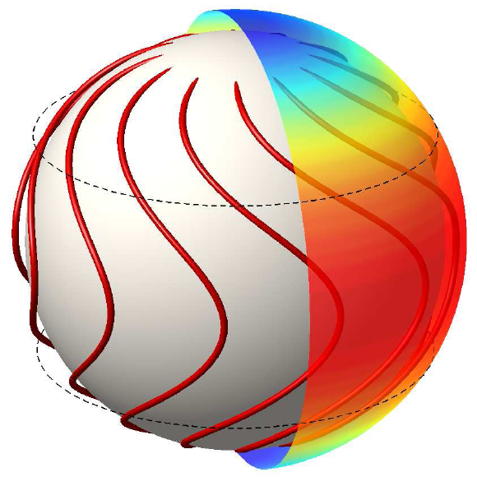
I
Schematic from WM11 (Wood & McI. 2011, “Polar confinement..” (JFM 677,445)
Lines of time-average B join up through interior “applecore” region:
radiative
interior
tachocline {

Slide 25
I
Schematic from WM11 (Wood & McI. 2011, “Polar confinement..” (JFM 677,445)
Lines of time-average B join up through interior “applecore” region:
radiative
interior
tachocline {
Need toroidal
stabilization
(Braithwaite &
Spruit 2004)

Slide 26
I
Schematic from WM11 (Wood & McI. 2011, “Polar confinement..” (JFM 677,445)
Lines of time-average B join up through interior “applecore” region:
radiative
interior
tachocline {

Slide 27
I
Schematic from WM11 (Wood & McI. 2011, “Polar confinement..” (JFM 677,445)
Lines of time-average B join up through interior “applecore” region:
Assume (throughout ):
1. Turbulent magnetic flux pumping (TMFP)
from the convection zone’s overshoot layer
can hold B close to horizontal within
the tachocline – away from the
applecore axis at least.
radiative
interior
I
I
I
tachocline {

Slide 28
I
Schematic from WM11 (Wood & McI. 2011, “Polar confinement..” (JFM 677,445)
Lines of time-average B join up through interior “applecore” region:
Assume (throughout ):
1. Turbulent magnetic flux pumping (TMFP)
from the convection zone’s overshoot layer
can hold B close to horizontal within
the tachocline – away from the
applecore axis at least.
2. Windup within the tachocline is
limited by a magnetic eddy diffusivity η_{E}
arising from all the fast eddy processes
(<< 10⁵yr): overshoot, small-scale
MHD instabilities, and the solar cycle
itself. NB: expect η_{E} and windup to be
strongly latitude-dependent.
radiative
interior
I
I
I
tachocline {

Slide 29
I
Schematic from WM11 (Wood & McI. 2011, “Polar confinement..” (JFM 677,445)
Lines of time-average B join up through interior “applecore” region:
Assume (throughout ):
1. Turbulent magnetic flux pumping (TMFP)
from the convection zone’s overshoot layer
can hold B close to horizontal within
the tachocline – away from the
applecore axis at least.
2. Windup within the tachocline is
limited by a magnetic eddy diffusivity η_{E}
arising from all the fast eddy processes
(<< 10⁵yr): overshoot, small-scale
MHD instabilities, and the solar cycle
itself. NB: expect η_{E} and windup to be
strongly latitude-dependent.
radiative
interior
I
I
I
tachocline {
aka “turbulent
resistivity” β

Slide 30
I
Schematic from WM11 (Wood & McI. 2011, “Polar confinement..” (JFM 677,445)
Lines of time-average B join up through interior “applecore” region:
Assume (throughout ):
1. Turbulent magnetic flux pumping (TMFP)
from the convection zone’s overshoot layer
can hold B close to horizontal within
the tachocline – away from the
applecore axis at least.
2. Windup within the tachocline is
limited by a magnetic eddy diffusivity η_{E}
arising from all the fast eddy processes
(<< 10⁵yr): overshoot, small-scale
MHD instabilities, and the solar cycle
itself. NB: expect η_{E} and windup to be
strongly latitude-dependent.
(Aside – all these scenarios, upright and
slanting, naturally provide the coupling
needed for primordial spindown…)
radiative
interior
I
I
I
tachocline {
aka “turbulent
resistivity” β

Slide 31
I
Schematic from WM11 (Wood & McI. 2011, “Polar confinement..” (JFM 677,445)
Lines of time-average B join up through interior “applecore” region:
Assume (throughout ):
1. Turbulent magnetic flux pumping (TMFP)
from the convection zone’s overshoot layer
can hold B close to horizontal within
the tachocline – away from the
applecore axis at least.
2. Windup within the tachocline is
limited by a magnetic eddy diffusivity η_{E}
arising from all the fast eddy processes
(<< 10⁵yr): overshoot, small-scale
MHD instabilities, and the solar cycle
itself. NB: expect η_{E} and windup to be
strongly latitude-dependent.
Key implication – details in WM11:
Any such time-average B can provide the
persistent poleward angular-momentum transport
across all latitudes required to stop HSZ burrowing
over the Sun’s lifetime, thus keeping the tachocline thin, and allowing a He layer to form.
radiative
interior
I
I
I
tachocline {
aka “turbulent
resistivity” β

Slide 32
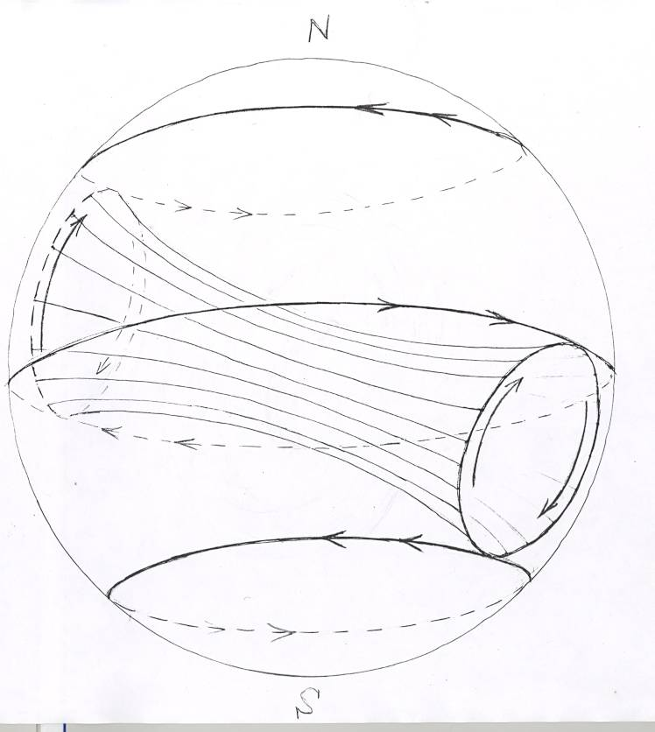
A slanting poloidal “applecore”
can provide the needed a.m.
transport equally well.
View from below:
radiative
interior
only
I

Slide 33
A slanting poloidal “applecore”
can provide the needed a.m.
transport equally well.
View from below:
radiative
interior
only
I

Slide 34
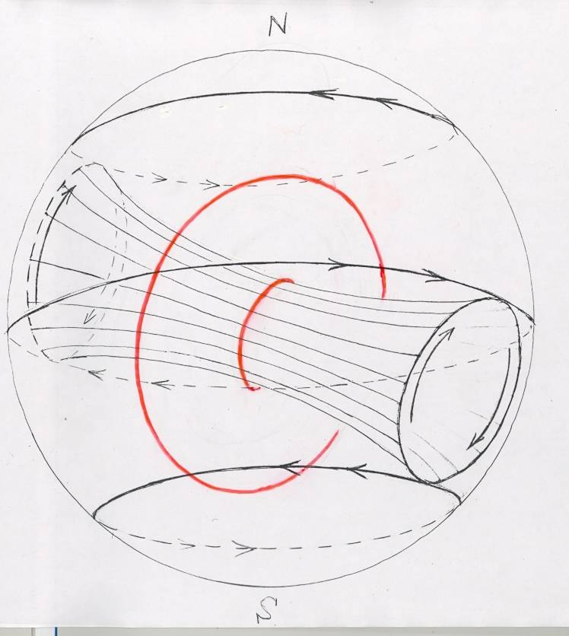
A slanting poloidal “applecore”
can provide the needed a.m.
transport equally well.
View from below:
(Toroidal stabilization
needed, as always.)
radiative
interior
only
I

Slide 35
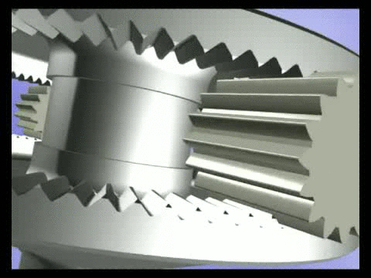
A slanting poloidal “applecore”
can provide the needed a.m.
transport equally well.
View from below:
(Toroidal stabilization
needed, as always.)
Interior Ferraro motion?
Probably “gearbox-like”
radiative
interior
only
I
courtesy Rich Wood & Spiral Bevel Corp.

Slide 36
A slanting poloidal “applecore”
can provide the needed a.m.
transport equally well.
View from below:
(Toroidal stabilization
needed, as always.)
– or
“friction-wheel-like”.
radiative
interior
only
I

Slide 37
A slanting poloidal “applecore”
can provide the needed a.m.
transport equally well.
View from below:
(Toroidal stabilization
needed, as always.)
– or
“friction-wheel-like”.
(Tough problem: “friction” is a strong function of latitude,
as with the tachocline’s MHD instabilities.)
radiative
interior
only
I

Slide 38
A slanting poloidal “applecore”
can provide the needed a.m.
transport equally well.
View from below:
(Toroidal stabilization
needed, as always.)
– or
“friction-wheel-like”.
Even tougher, and more pertinent here:
what’s the stable axis inclination, or inclinations?
radiative
interior
only
I

Slide 39
radiative
interior
only
I
A slanting poloidal “applecore”
can provide the needed a.m.
transport equally well.
View from below:
(Toroidal stabilization
needed, as always.)
– or
“friction-wheel-like”.
Even tougher, and more pertinent here:
what’s the stable axis inclination, or inclinations?
Here I missed a key point, later made by Douglas Gough:

Slide 40
See Gough (2012), Geophys. Astrophys. Fluid Dyn., 106, 429,
also (2017), Solar Phys. 292, 70:
If gyroscopically-pumped polar downwelling W is credible
(and indeed I’d say it’s arguably robust) then, because
such downwelling cannot penetrate the He settling layer,
there must be persistent, systematic equatorward flow
within the tachocline, across the higher latitudes at least.
Over the Sun’s lifetime, this is likely to have advected
the ends of the applecore to middle or low latitudes –
the Maunder Minimum bias suggests probably not as far
as the equator, favouring the “slanting” scenario –
I
also now favoured by geomagnetic evidence (Gough 2017).
The new results in this talk show how M07’s “invisible sub-tachocline”
polar-cap scenario is then modified, starting as follows:

Slide 41



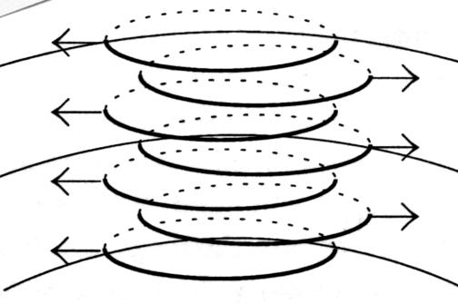




Helioseimology suggests that the shear of the polar-cap tachocline straddles
the bottom of the convection zone (Christensen-Dalsgaard & Thompson (2007),
in the Tachocline Book, & refs including Basu & Antia (2003).
TST (Tayler-Spruit turbulence) must switch on within the
underlying stratified layers. (This is a vertical-shear-driven dynamo turbulence.)
(TST can be driven by a relatively small . Even if the underlying stratified layers
span only ~ 10% of the total , TST would inevitably switch on there.)
Cartoon from Spruit 2002, A&A 381, 923:
Vertically (tho’ not horizontally) scale-separated. Eddies have plenty of headroom
over a wide range of plausible conditions.
Note constancy as well as large magnitude of eddy viscosity (solar treacle).
Horizontal field fluctuations are nearly out of phase, suggesting horizontal turbulent
Maxwell stresses smaller than their formal order of magnitude.

Slide 42



M07 scenario:
= nonzero mean magnetic field
pole
latitude 50-60˚N
Convective overshoot layer
Tayler-Spruit-turbulence layer (TSTL)
(solar treacle, shear invisible)
z (vertical distance)
r (co-latitudinal distance)
Confinement layer
Helium settling layer
≠ 0;
const.

Slide 43
M07 scenario:
= nonzero mean magnetic field
pole
latitude 50-60˚N
Convective overshoot layer
Tayler-Spruit-turbulence layer (TSTL)
(solar treacle, shear invisible)
z (vertical distance)
Viscous stress constant in z
until TST switches off here, for
lack of headroom
r (co-latitudinal distance)
Confinement layer
Helium settling layer
≠ 0;
const.

Slide 44


New scenario:
= nonzero mean magnetic field
pole
latitude 50-60˚N
Convective overshoot layer
Tayler-Spruit-turbulence layer (TSTL)
(solar treacle, shear probably invisible)
z (vertical distance)
r (co-latitudinal distance,
)
Helium settling layer
;
const.

Slide 45
New scenario:
= nonzero mean magnetic field
pole
latitude 50-60˚N
Convective overshoot layer
B horizontal and confined only by TMFP
Tayler-Spruit-turbulence layer (TSTL)
(solar treacle, shear probably invisible)
z (vertical distance)
r (co-latitudinal distance,
)
Helium settling layer
;
const.

Slide 46
New scenario:
= nonzero mean magnetic field
pole
latitude 50-60˚N
Convective overshoot layer
B horizontal and confined only by TMFP
Tayler-Spruit-turbulence layer (TSTL)
(solar treacle, shear probably invisible)
z (vertical distance)
Viscous stress hands torque over
to horizontal Maxwell stresses, and
goes smoothly to zero as bottom
approached, switching off the TST
by depriving it of shear.
r (co-latitudinal distance,
)
Helium settling layer
;
const.

Slide 47
New scenario:
= nonzero mean magnetic field
pole
latitude 50-60˚N
Convective overshoot layer
B horizontal and confined only by TMFP
Tayler-Spruit-turbulence layer (TSTL)
(solar treacle, shear probably invisible)
z (vertical distance)
Viscous stress hands torque over
to horizontal Maxwell stresses, and
goes smoothly to zero as bottom
approached, switching off the TST
by depriving it of shear.
Consider the simplest model that
can describe such a handover:
r (co-latitudinal distance,
)
Helium settling layer
;
const.

Slide 48




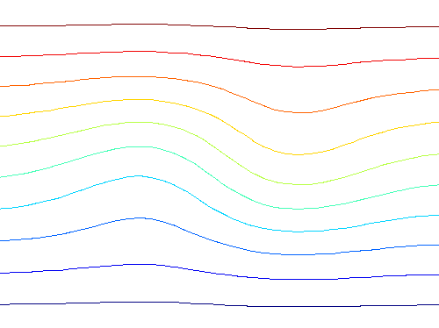


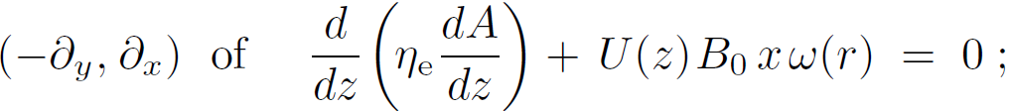

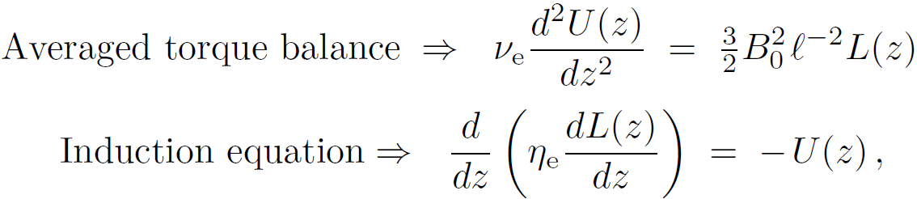




dimensionless
,
(horizontal and unidirectional)
Then the linearized induction eqn is
Depth scale of TSTL :
– cf.

Slide 49



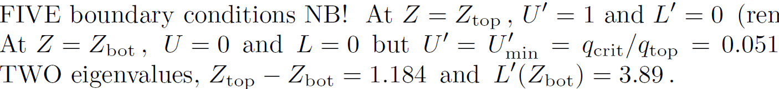

cf. M07 (!)
– cf.
Dimensionless equations are
(torque balance)
(induction eqn)
(normalized shear stress)
(in the above case)
Main weakness: windup usually too strong for the induction eqn to be linearized, so
(layer a bit deeper, field a bit weaker)

Slide 50
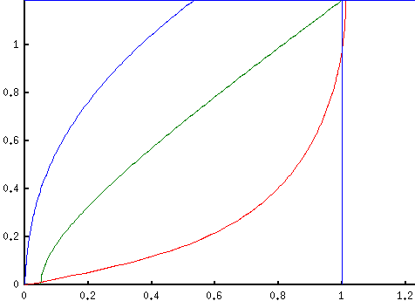





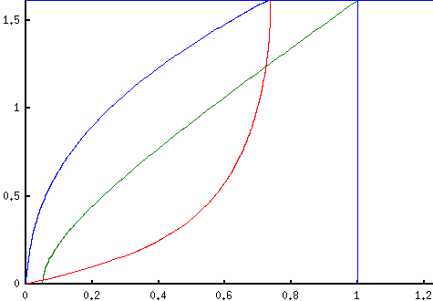
Without linear damping:
–
(Lorentz
torque)
TST switched off here, just above top of He layer →
critical shear
With linear damping,
mimicing stronger windup:
Dimensionless depth increases
from 1.2 to 1.6. But qualitative
structure robust!
(Lorentz
torque)
TST switched off here, just above top of He layer →

Slide 51




Conclusions – focusing on model properties that seem qualitatively robust:
1. TSTL must exist if tachocline overlaps top of even slightly, ca. 1/20 or more
2. Such overlap exists for ; ;
across TSTL invisible except near top end of range (also TSTL depth too small).
3. TSTL robustly excludes MMCs; dominates the downward-transmitted stress.
4. TSTL depth (1-4 Mm) & vertical structure fixed by TST props. incl. scale sep. & by,
(i) at top of TSTL, the applied shear stress (W determines it), and TMFP;
at bot. of TSTL, stress = 0, = 0, TST switched off, = 0 (no twist);
(iii) within TSTL, . and balance horizontal processes (mean-field twisting,
horizontal reconnection à la classic flux expulsion, horizontal Maxwell stresses
both mean and turbulent, importing prograde angular momentum).
5. He mixing is perfect down to bottom of TSTL, i.e. to top of He settling layer; eddy
mixing times ~ 100’s years, instantaneous! So again have a sharp tachopause.
Aside: need gravity-wave breaking to reduce in He settling layer as
found by Christensen-Dalsgaard, Gough & Knudstrup (2018).
6. Challenges for further progress (good numerics can win here): horizontal windup
is likely to be strong; horizontal turbulent transfers NOT simple-diffusive!
_______________________________________________________________________________________________________________________________________________________
Reprints & corrigenda: websearch ”lucidity principles” then back to home page, string ”tachocline”

Slide 56
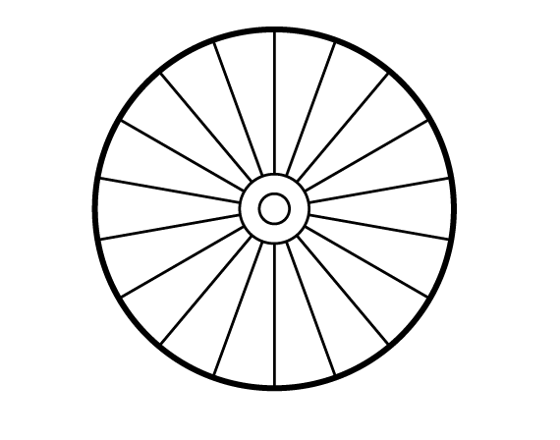
Test text, testing transrency

Slide 57
Roadmap/conclusions:
Re nonmagnetic processes,
(a) HSZ (Haynes-Spiegel-Zahn) burrowing is a robust process in any thermally-
relaxing, stratified rotating system. Concept of “gyroscopic pumping”.
(b) Neither gravity waves nor NMST (nonmagnetic stratified turbulence) are
naturally able to enforce interior solid rotation. (Note post-Starr history!!!!)
2. So reasonable to assume interior must be magnetic (McI.1994, GM98).
Interior dipoles are the longest-lived; so focus on the 3 possible types of
dipole scenario. With rotation axis upward,
O upright dipole: simplest geometry but polar confinement layers needed
O equatorial-plane dipole: simplest dynamics (?), PCLs needless
O slanted dipole: gearbox-like dynamics (?), PCLs needless
3. Open questions include migration of dipole axis inclination. Which angles are
stable? E.g., would solar-cycle jiggling push axis into, or out of, the equatorial
plane? Might axis be pinned to the zero-shear latitude ~ 30°? Shear distortion?
4. All these scenarios involve HSZ burrowing being held in check by the interior
dipole. Burrowing tendency is strengthened by rotational stiffness in the
early Sun. Suggests not a “polar pit” but a “lithium frying pan”.
I
I
I

Slide 58
Roadmap/conclusions:
“downward
spreading”
Re nonmagnetic processes,
(a) HSZ (Haynes-Spiegel-Zahn) burrowing is a robust process in any thermally-
relaxing, stratified rotating system. Concept of “gyroscopic pumping”.
(b) Neither gravity waves nor NMST (nonmagnetic stratified turbulence) are
naturally able to enforce interior solid rotation. (Note post-Starr history!!!!)
2. So reasonable to assume interior must be magnetic (McI.1994, GM98).
Interior dipoles are the longest-lived; so focus on the 3 possible types of
dipole scenario. With rotation axis upward,
O upright dipole: simplest geometry but polar confinement layers needed
O equatorial-plane dipole: simplest dynamics (?), PCLs needless
O slanted dipole: gearbox-like dynamics (?), PCLs needless
3. Open questions include migration of dipole axis inclination. Which angles are
stable? E.g., would solar-cycle jiggling push axis into, or out of, the equatorial
plane? Might axis be pinned to the zero-shear latitude ~ 30°? Shear distortion?
4. All these scenarios involve HSZ burrowing being held in check by the interior
dipole. Burrowing tendency is strengthened by rotational stiffness in the
early Sun. Suggests not a “polar pit” but a “lithium frying pan”.
I
I
I

Slide 59
Roadmap/conclusions:
“downward
spreading”
Re nonmagnetic processes,
(a) HSZ (Haynes-Spiegel-Zahn) burrowing is a robust process in any thermally-
relaxing, stratified rotating system. Concept of “gyroscopic pumping”.
(b) Neither gravity waves nor NMST (nonmagnetic stratified turbulence) are
naturally able to enforce interior solid rotation. (Note post-Starr history!!!!)
2. So reasonable to assume interior must be magnetic (McI.1994, GM98).
Interior dipoles are the longest-lived; so focus on the 3 possible types of
dipole scenario. With rotation axis upward,
O upright dipole: simplest geometry but polar confinement layers needed
O equatorial-plane dipole: simplest dynamics (?), PCLs needless
O slanted dipole: gearbox-like dynamics (?), PCLs needless
3. Open questions include migration of dipole axis inclination. Which angles are
stable? E.g., would solar-cycle jiggling push axis into, or out of, the equatorial
plane? Might axis be pinned to the zero-shear latitude ~ 30°? Shear distortion?
4. All these scenarios involve HSZ burrowing being held in check by the interior
dipole. Burrowing tendency is strengthened by rotational stiffness in the
early Sun. Suggests not a “polar pit” but a “lithium frying pan”.
I
I
I

Slide 60
Re burrowing and gyroscopic pumping:
A much-studied example is the Brewer-Dobson circulation (MMC)
in the terrestrial stratosphere. The stratosphere is a
thermally-relaxing, stratified rotating system – where
“stratified” means “stably stratified”.
Countless observational and modelling studies – many in connection
with the ozone-layer problem – have led to a secure understanding of
the dynamics.

Slide 61
So I hope everyone is, or will soon be, persuaded
(a) that NMST is overwhelmingly unlikely to produce a
horizontal eddy viscosity,
(b) that gravity waves from the convection zone are
overwhelmingly unlikely to produce interior solid rotation,
and
(c) that it’s therefore reasonable to assume, as
Douglas Gough and I did, that a global-scale
magnetic field in the Sun’s interior is inevitable.

Slide 62
So I hope everyone is, or will soon be, persuaded
(a) that NMST is overwhelmingly unlikely to produce a
horizontal eddy viscosity,
(b) that gravity waves from the convection zone are
overwhelmingly unlikely to produce interior solid rotation,
and
(c) that it’s therefore reasonable to assume, as
Douglas Gough and I did, that a global-scale
magnetic field in the Sun’s interior is inevitable.
(Have I been flogging a dead horse all these years?)

Slide 63
So I hope everyone is, or will soon be, persuaded
(a) that NMST is overwhelmingly unlikely to produce a
horizontal eddy viscosity,
(b) that gravity waves from the convection zone are
overwhelmingly unlikely to produce interior solid rotation,
and
(c) that it’s therefore reasonable to assume, as
Douglas Gough and I did, that a global-scale
magnetic field in the Sun’s interior is inevitable.
(Have I been flogging a dead horse all these years? Was Fausto
winding me up??)

Slide 64
So I hope everyone is, or will soon be, persuaded
(a) that NMST is overwhelmingly unlikely to produce a
horizontal eddy viscosity,
(b) that gravity waves from the convection zone are
overwhelmingly unlikely to produce interior solid rotation,
and
(c) that it’s therefore reasonable to assume, as
Douglas Gough and I did, that a global-scale
magnetic field in the Sun’s interior is inevitable.
(Have I been flogging a dead horse all these years? Was Fausto
winding me up?? Anyway, Spiegel & Zahn sounded serious!)

Slide 65
Roadmap/conclusions (so far):
“downward
spreading”
Re nonmagnetic processes,
(a) HSZ (Haynes-Spiegel-Zahn) burrowing is a robust process in any thermally-
relaxing, stratified rotating system. Concept of “gyroscopic pumping”.
(b) Neither gravity waves nor NMST (nonmagnetic stratified turbulence) are
naturally able to enforce interior solid rotation. (Note post-Starr history!!!!)
2. So reasonable to assume interior must be magnetic (McI.1994, GM98).
Interior dipoles are the longest-lived; so focus on the 3 possible types of
dipole scenario. With rotation axis upward,
O upright dipole: simplest geometry but polar confinement layers needed
O equatorial-plane dipole: simplest dynamics (?), PCLs needless
O slanted dipole: gearbox-like dynamics (?), PCLs needless
3. Open questions include migration of dipole axis inclination. Which angles are
stable? E.g., would solar-cycle jiggling push axis into, or out of, the equatorial
plane? Might axis be pinned to the zero-shear latitude ~ 30°? Shear distortion?
All these scenarios involve HSZ burrowing being held in check by the interior
dipole. Burrowing tendency is strengthened by rotational stiffness in the
early Sun. Suggests promising new approach to the Li/Be problem.
I
I
I
I

Slide 66
Roadmap/conclusions (so far):
“downward
spreading”
Re nonmagnetic processes,
(a) HSZ (Haynes-Spiegel-Zahn) burrowing is a robust process in any thermally-
relaxing, stratified rotating system. Concept of “gyroscopic pumping”.
(b) Neither gravity waves nor NMST (nonmagnetic stratified turbulence) are
naturally able to enforce interior solid rotation. (Note post-Starr history!!!!)
2. So reasonable to assume interior must be magnetic (McI.1994, GM98).
Interior dipoles are the longest-lived; so focus on the 3 possible types of
dipole scenario. With rotation axis upward,
O upright dipole: simplest geometry but polar confinement layers needed
O equatorial-plane dipole: simplest dynamics (?), PCLs needless
O slanted dipole: gearbox-like dynamics (?), PCLs needless
I
I
I
Upright dipole first.
Courtesy Richard Sword

Slide 67
Roadmap/conclusions (so far):
“downward
spreading”
Re nonmagnetic processes,
(a) HSZ (Haynes-Spiegel-Zahn) burrowing is a robust process in any thermally-
relaxing, stratified rotating system. Concept of “gyroscopic pumping”.
(b) Neither gravity waves nor NMST (nonmagnetic stratified turbulence) are
naturally able to enforce interior solid rotation. (Note post-Starr history!!!!)
2. So reasonable to assume interior must be magnetic (McI.1994, GM98).
Interior dipoles are the longest-lived; so focus on the 3 possible types of
dipole scenario. With rotation axis upward,
O upright dipole: simplest geometry but polar confinement layers needed
O equatorial-plane dipole: simplest dynamics (?), PCLs needless
O slanted dipole: gearbox-like dynamics (?), PCLs needless
I
I
I
By the way, does
anyone remember
the “polar pit”?
Upright dipole first.
Courtesy Richard Sword

Slide 68
Roadmap/conclusions (so far):
“downward
spreading”
Re nonmagnetic processes,
(a) HSZ (Haynes-Spiegel-Zahn) burrowing is a robust process in any thermally-
relaxing, stratified rotating system. Concept of “gyroscopic pumping”.
(b) Neither gravity waves nor NMST (nonmagnetic stratified turbulence) are
naturally able to enforce interior solid rotation. (Note post-Starr history!!!!)
2. So reasonable to assume interior must be magnetic (McI.1994, GM98).
Interior dipoles are the longest-lived; so focus on the 3 possible types of
dipole scenario. With rotation axis upward,
O upright dipole: simplest geometry but polar confinement layers needed
O equatorial-plane dipole: simplest dynamics (?), PCLs needless
O slanted dipole: gearbox-like dynamics (?), PCLs needless
I
I
I
It was such a great idea! (For burning lithium.)
Upright dipole first.
Courtesy Richard Sword

Slide 69
Roadmap/conclusions (so far):
“downward
spreading”
Re nonmagnetic processes,
(a) HSZ (Haynes-Spiegel-Zahn) burrowing is a robust process in any thermally-
relaxing, stratified rotating system. Concept of “gyroscopic pumping”.
(b) Neither gravity waves nor NMST (nonmagnetic stratified turbulence) are
naturally able to enforce interior solid rotation. (Note post-Starr history!!!!)
2. So reasonable to assume interior must be magnetic (McI.1994, GM98).
Interior dipoles are the longest-lived; so focus on the 3 possible types of
dipole scenario. With rotation axis upward,
O upright dipole: simplest geometry but polar confinement layers needed
O equatorial-plane dipole: simplest dynamics (?), PCLs needless
O slanted dipole: gearbox-like dynamics (?), PCLs needless
I
I
I
But even if you don’t buy confinement layers,
the helium settling layer is enough to preclude
such “pits”…
Upright dipole first.
Courtesy Richard Sword

Slide 70
Roadmap/conclusions (so far):
“downward
spreading”
Re nonmagnetic processes,
(a) HSZ (Haynes-Spiegel-Zahn) burrowing is a robust process in any thermally-
relaxing, stratified rotating system. Concept of “gyroscopic pumping”.
(b) Neither gravity waves nor NMST (nonmagnetic stratified turbulence) are
naturally able to enforce interior solid rotation. (Note post-Starr history!!!!)
2. So reasonable to assume interior must be magnetic (McI.1994, GM98).
Interior dipoles are the longest-lived; so focus on the 3 possible types of
dipole scenario. With rotation axis upward,
O upright dipole: simplest geometry but polar confinement layers needed
O equatorial-plane dipole: simplest dynamics (?), PCLs needless
O slanted dipole: gearbox-like dynamics (?), PCLs needless
I
I
I
Upright dipole first.
Courtesy Richard Sword

Slide 71
Roadmap/conclusions (so far):
“downward
spreading”
Re nonmagnetic processes,
(a) HSZ (Haynes-Spiegel-Zahn) burrowing is a robust process in any thermally-
relaxing, stratified rotating system. Concept of “gyroscopic pumping”.
(b) Neither gravity waves nor NMST (nonmagnetic stratified turbulence) are
naturally able to enforce interior solid rotation. (Note post-Starr history!!!!)
2. So reasonable to assume interior must be magnetic (McI.1994, GM98).
Interior dipoles are the longest-lived; so focus on the 3 possible types of
dipole scenario. With rotation axis upward,
O upright dipole: simplest geometry but polar confinement layers needed
O equatorial-plane dipole: simplest dynamics (?), PCLs needless
O slanted dipole: gearbox-like dynamics (?), PCLs needless
I
I
I
Upright dipole first. Its steadiness “disagrees”
with solar cycle reversals; but remember the
Maunder Minimum…
Courtesy Richard Sword

Slide 72
I
How else might we prevent this?
One way was proposed and demonstrated mathematically
in Wood & McI 2007 (WM07), by exhibiting exact solutions
of the nonlinear Boussinesq MHD equations in a
realistic parameter regime. Refined in WM11.
radiative
interior

Slide 73
I
How else might we prevent this?
One way was proposed and demonstrated mathematically
in Wood & McI 2007 (WM07), by exhibiting exact solutions
of the nonlinear Boussinesq MHD equations in a
realistic parameter regime. Refined in WM11.
These nonlinear solutions describe a family
of “magnetic confinement layers”
able to function as “corks in the
confinement bottle” (Mestel 2011,
Stellar Magnetism, 2nd edn, Oxford).
radiative
interior

Slide 74
I
How else might we prevent this?
One way was proposed and demonstrated mathematically
in Wood & McI 2007 (WM07), by exhibiting exact solutions
of the nonlinear Boussinesq MHD equations in a
realistic parameter regime. Refined in WM11.
These nonlinear solutions describe a family
of “magnetic confinement layers”
able to function as “corks in the
confinement bottle” (Mestel 2011,
Stellar Magnetism, 2nd edn, Oxford).
They rely on the weak but persistent
polar downwelling that’s gyroscopically
pumped by Reynolds and Maxwell stress
divergences in the overlying turbulent
layers – the convection zone and the bulk
of the tachocline. (Le Chatelier/Lenz etc.)
WM11 discusses a subset of the family whose
pattern of angular momentum transport fits in with this
interior-dipole picture. Need zero torque on the applecore. (CLs are “air bearings”).
radiative
interior

Slide 75
I
Zooming in…

Slide 76
I
Zooming in…
(the confinement layers are
really thin – far thinner than
the bulk of the tachocline –
fraction of a Mm)

Slide 77
I
and
expanding
vertically

Slide 78
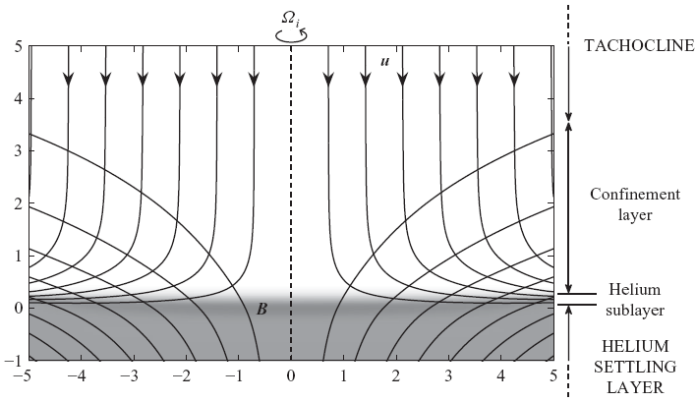
I
and
expanding
vertically

Slide 79
(fully nonlinear solution;
WM 2011, J. Fluid Mech)
I
and
expanding
vertically

Slide 80
I
the CL may
even be laminar
and
expanding
vertically

Slide 81
I
NB: HSZ burrowing
is held in check by B.
Early Sun has a stronger
burrowing tendency:
promise re Li/Be:
“Li frying pan”.

Slide 82
I
I
Slanted-dipole scenarios
hold same promise re Li/Be:
HSZ burrowing still
held in check by B; and the
early Sun still has a stronger
burrowing tendency (because of
its much faster rotation).
So can still have a lithium frying pan.

Slide 83
Consider non-upright dipoles, briefly:
I
A dipole whose axis lies in the equatorial
plane is another way to hold the interior
in solid rotation. And no confinement layers
are needed!
A slanting dipole doesn’t need CLs either.
Both cases raise some questions not yet
answered (as far as I know), especially in
the slanting case:
I

Slide 84
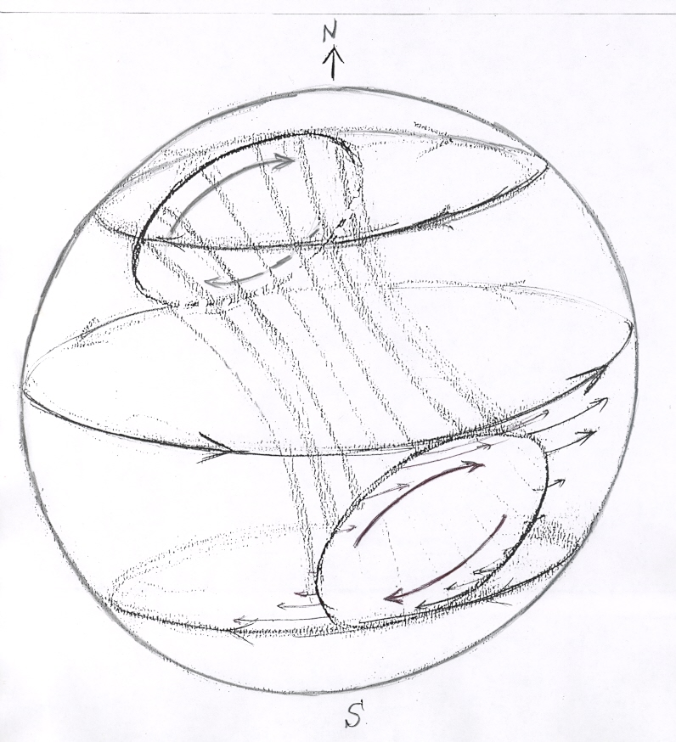
A slanting poloidal “applecore”
will pick up the tachocline’s
differential rotation.
View from above:
radiative
interior
only
I

Slide 85
A slanting poloidal “applecore”
will pick up the tachocline’s
differential rotation.
View from above:
radiative
interior
only
I
Azimuthal shearing
keeps applecore
mostly confined

Slide 86
A slanting poloidal “applecore”
will pick up the tachocline’s
differential rotation.
View from above:
radiative
interior
only
I
Slanted/distorted
“generalized Ferraro motion”.
This would be well below helioseismic
detectability (D. O. Gough, pers. comm.)
Azimuthal shearing
keeps applecore
mostly confined

Slide 88
A slanting poloidal “applecore”
will pick up the tachocline’s
differential rotation.
View from below:
(Toroidal stabilization
needed, as always.)
– or better,
“friction-wheel-like”.
Even tougher: what’s the stable axis inclination,
or inclinations?
radiative
interior
only
I

Slide 89
A slanting poloidal “applecore”
will pick up the tachocline’s
differential rotation.
View from below:
(Toroidal stabilization
needed, as always.)
– or better,
“friction-wheel-like”.
Even tougher: what’s the stable axis inclination,
or inclinations? E.g. could there be a “pinning effect”
at the latitude of zero tachocline shear?
radiative
interior
only
I

Slide 90
A slanting poloidal “applecore”
will pick up the tachocline’s
differential rotation.
View from below:
(Toroidal stabilization
needed, as always.)
– or better,
“friction-wheel-like”.
Even tougher: what’s the stable axis inclination,
or inclinations? E.g. could there be a “pinning effect”
at the latitude of zero tachocline shear? What governs
axis-tilt migration? Shear distortion of applecore?
radiative
interior
only
I

Slide 91
Conclusions (as before):
Re nonmagnetic processes,
(a) HSZ (Haynes-Spiegel-Zahn) burrowing is a robust process in any thermally-
relaxing, stratified rotating system. Concept of “gyroscopic pumping”.
(b) Neither gravity waves nor NMST (nonmagnetic stratified turbulence) are
naturally able to enforce interior solid rotation. (Note post-Starr history!!!!)
2. So reasonable to assume interior must be magnetic (McI.1994, GM98).
Interior dipoles are the longest-lived; so focus on the 3 possible types of
dipole scenario. With rotation axis upward,
O upright dipole: simplest geometry but polar confinement layers needed
O equatorial-plane dipole: simplest dynamics (?), PCLs needless
O slanted dipole: gearbox-like dynamics (?), PCLs needless
3. Open questions include migration of dipole axis inclination. Which angles are
stable? E.g., would solar-cycle jiggling push axis into, or out of, the equatorial
plane? Might axis be pinned to the zero-shear latitude ~ 30°? Shear distortion?
4. All these scenarios involve HSZ burrowing being held in check by the interior
dipole. Burrowing tendency is strengthened by rotational stiffness in the
early Sun. Suggests not a “polar pit” but a “lithium frying pan”.
I
I
I

Slide 92
I
To do all the above, the time-average B
must be prevented from diffusing out like this
(à la Brun-Zahn & Garaud).
Such an “unconfined” configuration would
lock the applecore into retrograde motion.
NB: TMFP seems well demonstrated by
3D numerics when B horizontal and
pressure scale height finite (recent papers
by Brummel, Tobias, Weiss, Wood,...)
Much more dubious when B vertical.
(Mean-field theory is of questionable
applicability, if only because of steep
vertical gradients in overshoot layer:
no scale separation.)
radiative
interior
tachocline {

Slide 93
I
… one further question about the upright dipole:
How would an unconfined applecore
ever get confined? Wouldn’t it just rotate retrogradely
with the polar convection zone?
Then perhaps no high-latitude tachocline,
with the convection zone rotating as
retrogradely as it wants to, implying
• no unbalanced retrograde stress divgce
• no gyroscopic pumping
• no polar downwelling.
But wait: in the interior, such a
retrograde applecore will be eaten into
by horizontal (“barotropic”) shear instabilities
from the surroundings. Applecore feels prograde
torque and speeds up; tachocline reappears; B
lines are sheared azimuthally, gyroscopic pumping
switches back on! (B no longer curl-free, so TMFP might be more effective too.)
radiative
interior

Slide 94
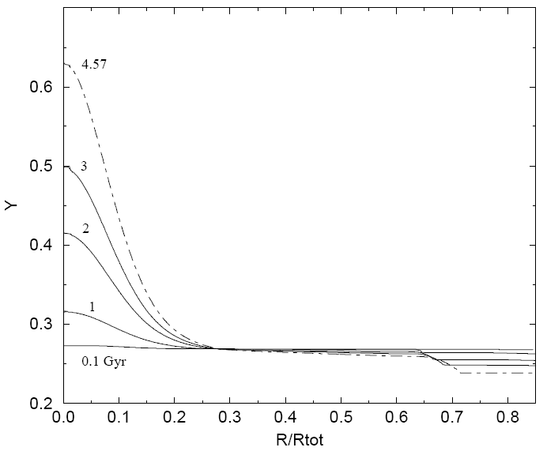
Ciacio, degl'Innocenti & Ricci (1997) A&A Suppl. Ser. 123, 449

Slide 95
The Plumb-McEwan experiment: This is a laboratory counterpart of the QBO (the quasi-biennial oscillation of the east-west winds in the equatorial lower stratosphere).
The flow in a stratified, non-rotating annulus is driven away from solid rotation (anti-friction again) by nothing but the imposition of fluctuations at an upper or lower boundary. These are organized by the gravity-wave propagation mechanism:

Slide 96
The Plumb-McEwan experiment: This is a laboratory counterpart of the QBO (the quasi-biennial oscillation of the east-west winds in the equatorial lower stratosphere).
The flow in a stratified, non-rotating annulus is driven away from solid rotation (anti-friction again) by nothing but the imposition of fluctuations at an upper or lower boundary. These are organized by the gravity-wave propagation mechanism:

Slide 97
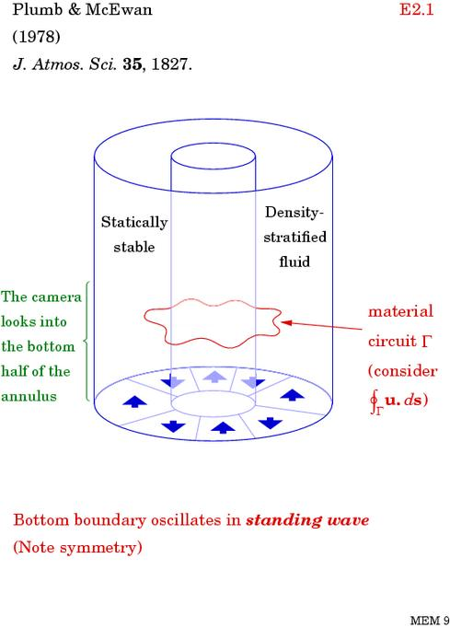

Slide 98
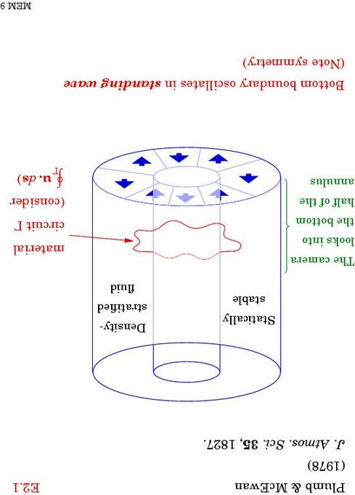
Experiment easier with the apparatus upside down:
I

Slide 99
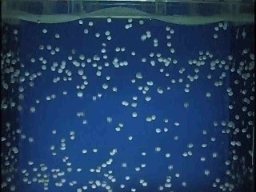
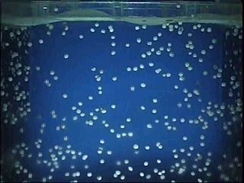
This is the Kyoto University version of the
Plumb-McEwan experiment:
www.gfd-dennou.org/library/gfd_exp/ or
websearch QBO “Tech Tips”

Slide 100
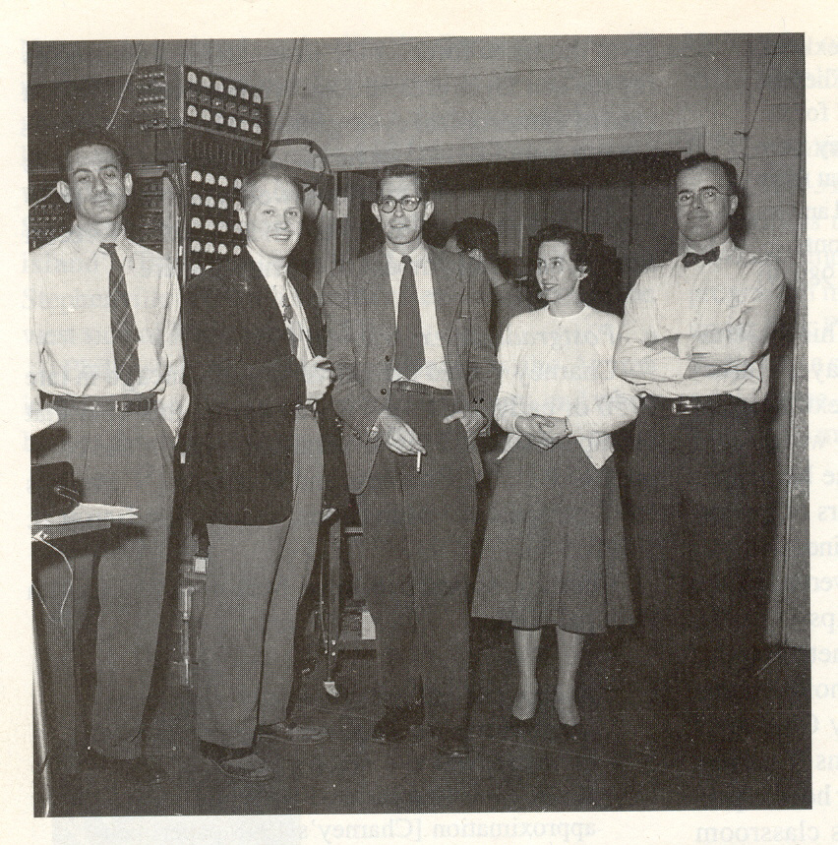
A bit more history – for still more see
www.atm.damtp.cam.ac.uk/people/mem#jupiter1
Jule Charney, Norm Phillips, G. Lewis, N. Gilbarg, G. Platzman
MANIAC (Princeton, Inst for Advanced Studies)

Slide 101
A bit more history – for still more see
www.atm.damtp.cam.ac.uk/people/mem#jupiter1
Jule Charney, Norm Phillips, G. Lewis, N. Gilbarg, G. Platzman
MANIAC (Princeton, Inst for Advanced Studies)

Slide 102
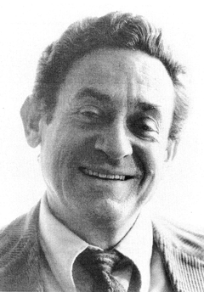

Jule Charney as I knew him, probably ca. 1975, and Bob Dickinson a bit later
www.nap.edu/readingroom/books/biomems/jcharney.html
with thanks to Thomas Peter

Slide 103
Further widening the perspective: ANY fluctuations about a mean are liable to feel the atmosphere’s, or the ocean’s, wave propagation mechanisms
and thereby get organized, with significant mean effects including systematic momentum transport, which can be both antifrictional and long-range.
Three examples among many:
the Plumb-McEwan experiment;
(2) The Antarctic ozone hole;
(3) the stratospheric Brewer-Dobson circulation, which also illustrates gyroscopic pumping.

Slide 104
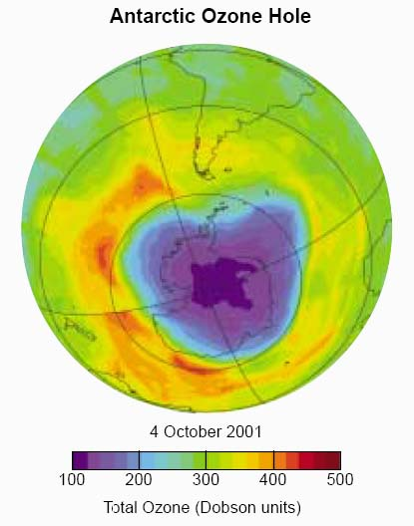
The ozone hole with
its jet & sharp edge
well illustrates the
eddy-transport barrier
phenomenon, which
arises from (post-Starr!):
the mixability of PV
PV invertibility.
(PV = potential vorticity.)
Vortex edge behaves
quasi-elastically – via
Rossby-wave
propagation mechanism

Slide 105
The ozone hole with
its jet & sharp edge
well illustrates the
eddy-transport barrier
phenomenon, which
arises from (post-Starr!):
the mixability of PV
PV invertibility.
(PV = potential vorticity.)
Vortex edge behaves
quasi-elastically – via
Rossby-wave
propagation mechanism
(google “Some dynamics that
is significant for chemistry”)

Slide 106
The ozone hole with
its jet & sharp edge
well illustrates the
eddy-transport barrier
phenomenon, which
arises from (post-Starr!):
the mixability of PV
PV invertibility.
(PV = potential vorticity.)
Vortex edge behaves
quasi-elastically – via
Rossby-wave
propagation mechanism
(google “Some dynamics that
is significant for chemistry”)

Slide 107
The ozone hole with
its jet & sharp edge
well illustrates the
eddy-transport barrier
phenomenon, which
arises from (post-Starr!):
the mixability of PV
PV invertibility.
(PV = potential vorticity.)
Vortex edge behaves
quasi-elastically – via
Rossby-wave
propagation mechanism
(google “Some dynamics that
is significant for chemistry”)
Here’s a model experiment
on a straightened-out jet:

Slide 108
A shallow-water model stratosphere shows qualitatively the same features, though in more detail (W. A. Norton 1994, J. Atmos. Sci). Sequence 3.rm Sequence 3.mov
Note: different map projection (polar stereographic).
Note the quasi-elastic behaviour of the vortex edge, which acts as an eddy-transport barrier.

Slide 109
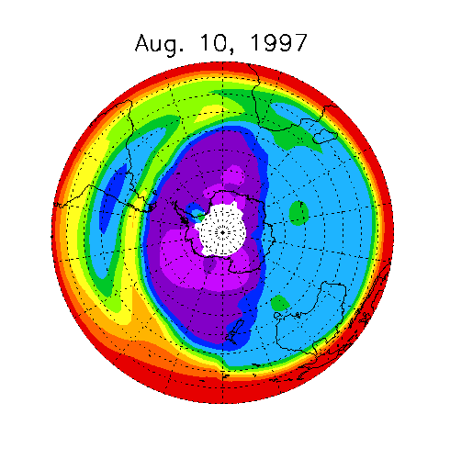
The gyroscopic pump in action:
CRISTA
N₂O in upper
stratosphere,
courtesy
Martin
Riese
For a tutorial on the dynamics,
websearch “dynamics that is significant for chemistry”

Slide 110
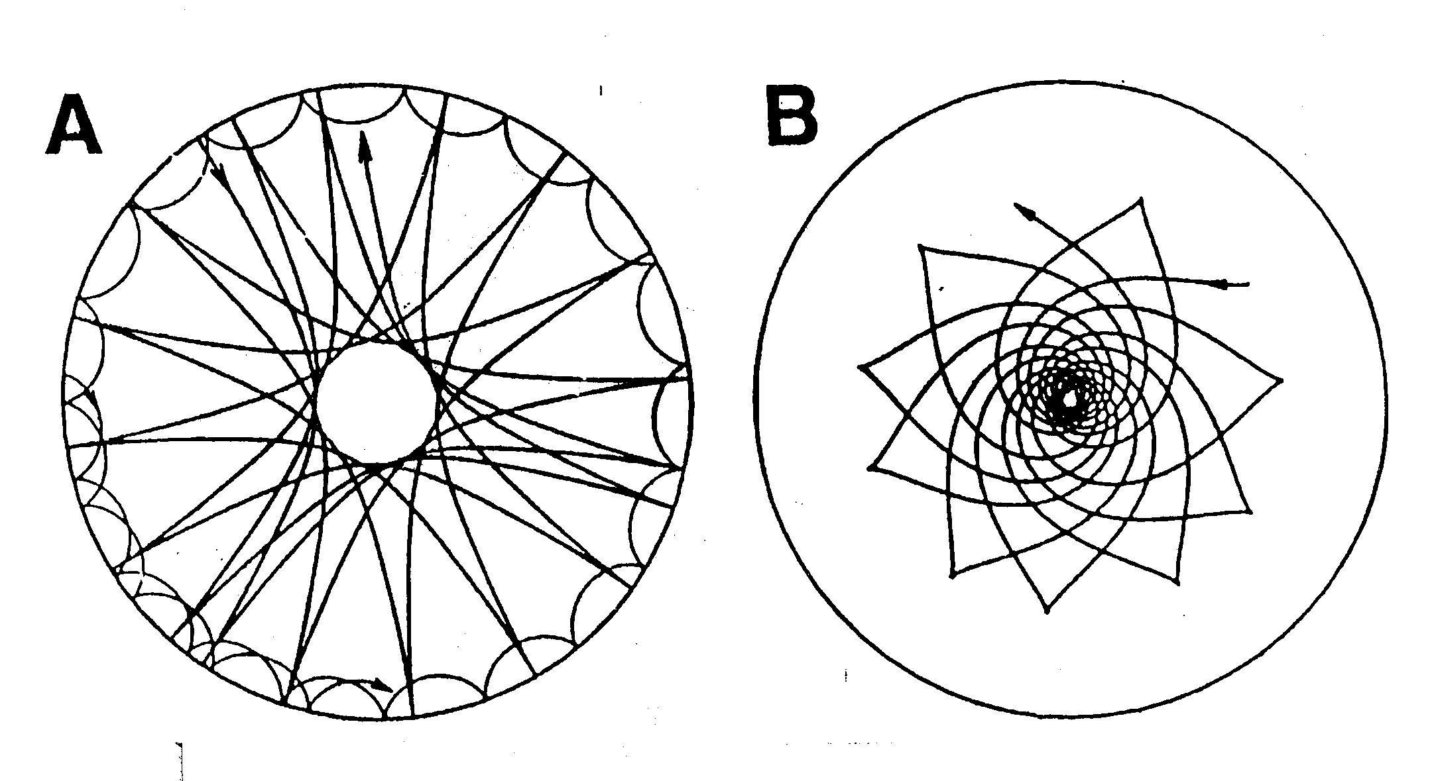
acoustic waves: gravity waves:

Slide 111
Hill et al 1996,
Science 272:

Slide 112
Hill et al 1996,
Science 272:
Error bars
are multiplied
by 200…

Slide 113
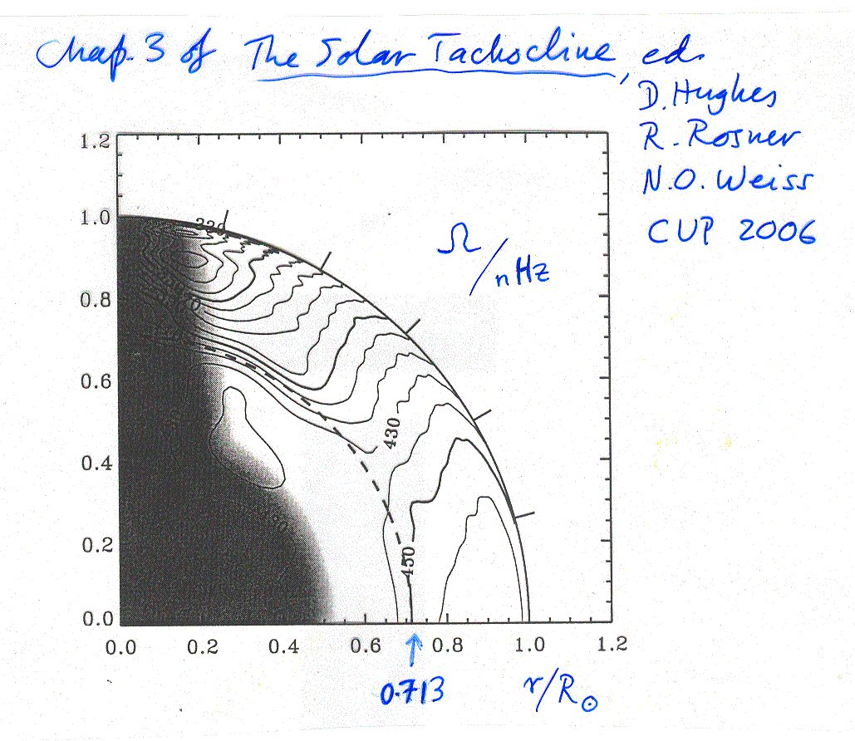
/7

Slide 114
Spiegel and Zahn 1992 proposal not viable, because of the
PV-conserving, anti-frictional properties of stratified turbulence
(layerwise-2D turbulence)
Remedy proposed by Gough & McI. 1998: Nature 394, 755:
Field-free!
(plus toroidal
component
to stabilize)
GM98 also argued for the inevitability, not merely the
possibility, of the interior magnetic field, (a) to stop HSZ
burrowing, and (b) to constrain rotation in interior..

Slide 115
A&A 2006
Colours: angular velocity
Contours: poloidal magnetic field

Slide 116
Stabilizing toroidal component must be comparable in magnitude
to poloidal cpt (Braithwaite & Spruit 2004, Nature 431, 819):

Slide 117
However – high-latitude descent can’t be field-free,
because of Spruit-Tayler dynamo (Spruit 2002, A&A):
Tayler
(stratification-
constrained)
pinch/kink
instability
Dynamo loop closed by vertical shear, e.g. of shellular
solid rotation. Stable stratification → motion nearly horizontal

Slide 118
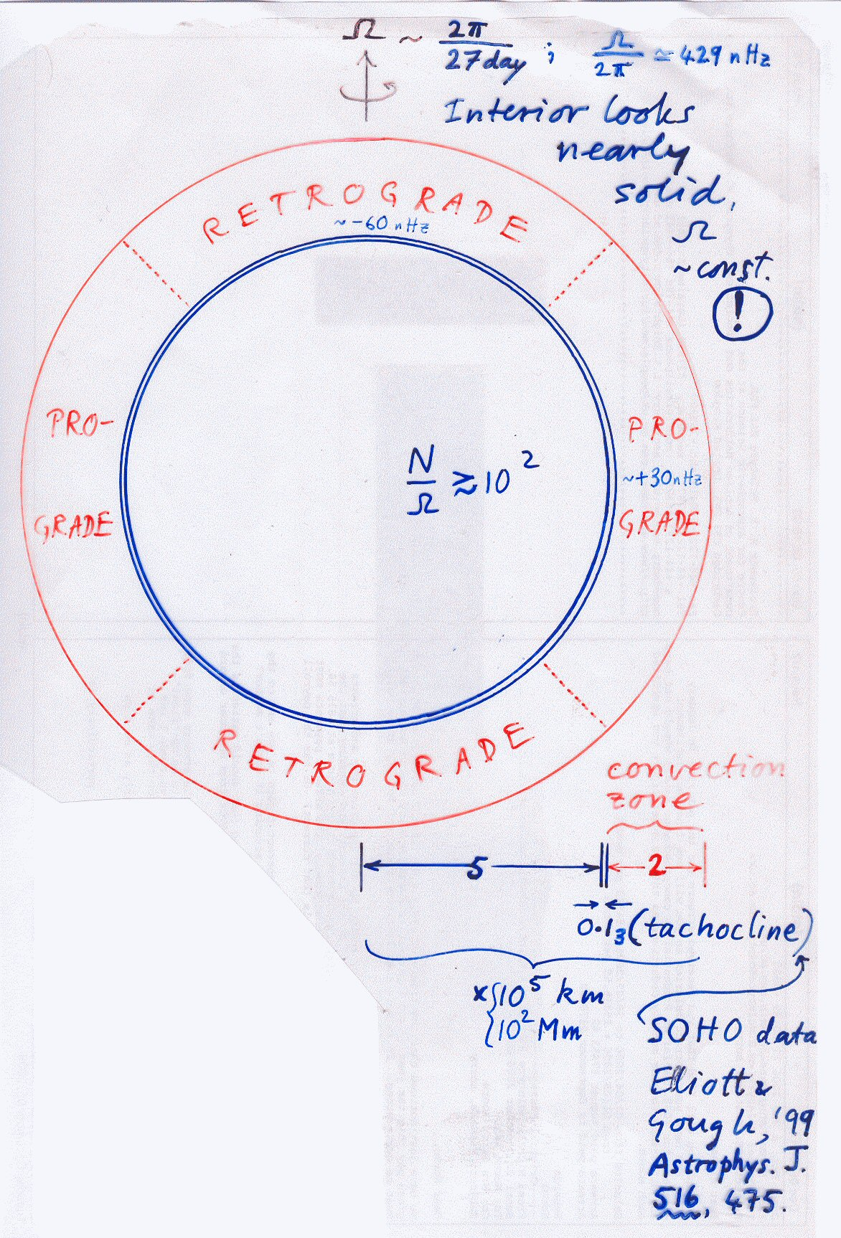

Slide 119
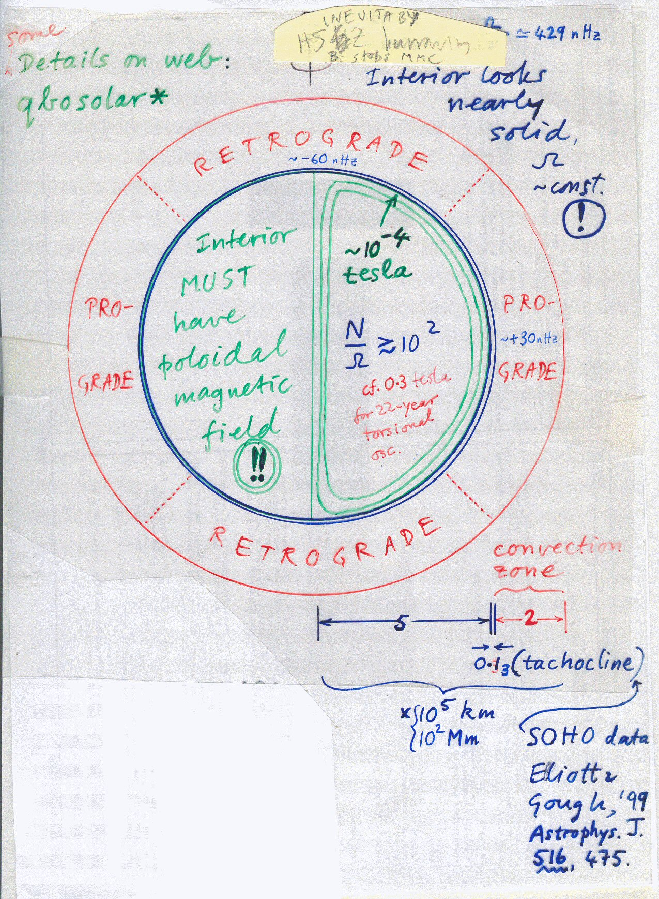

Slide 120
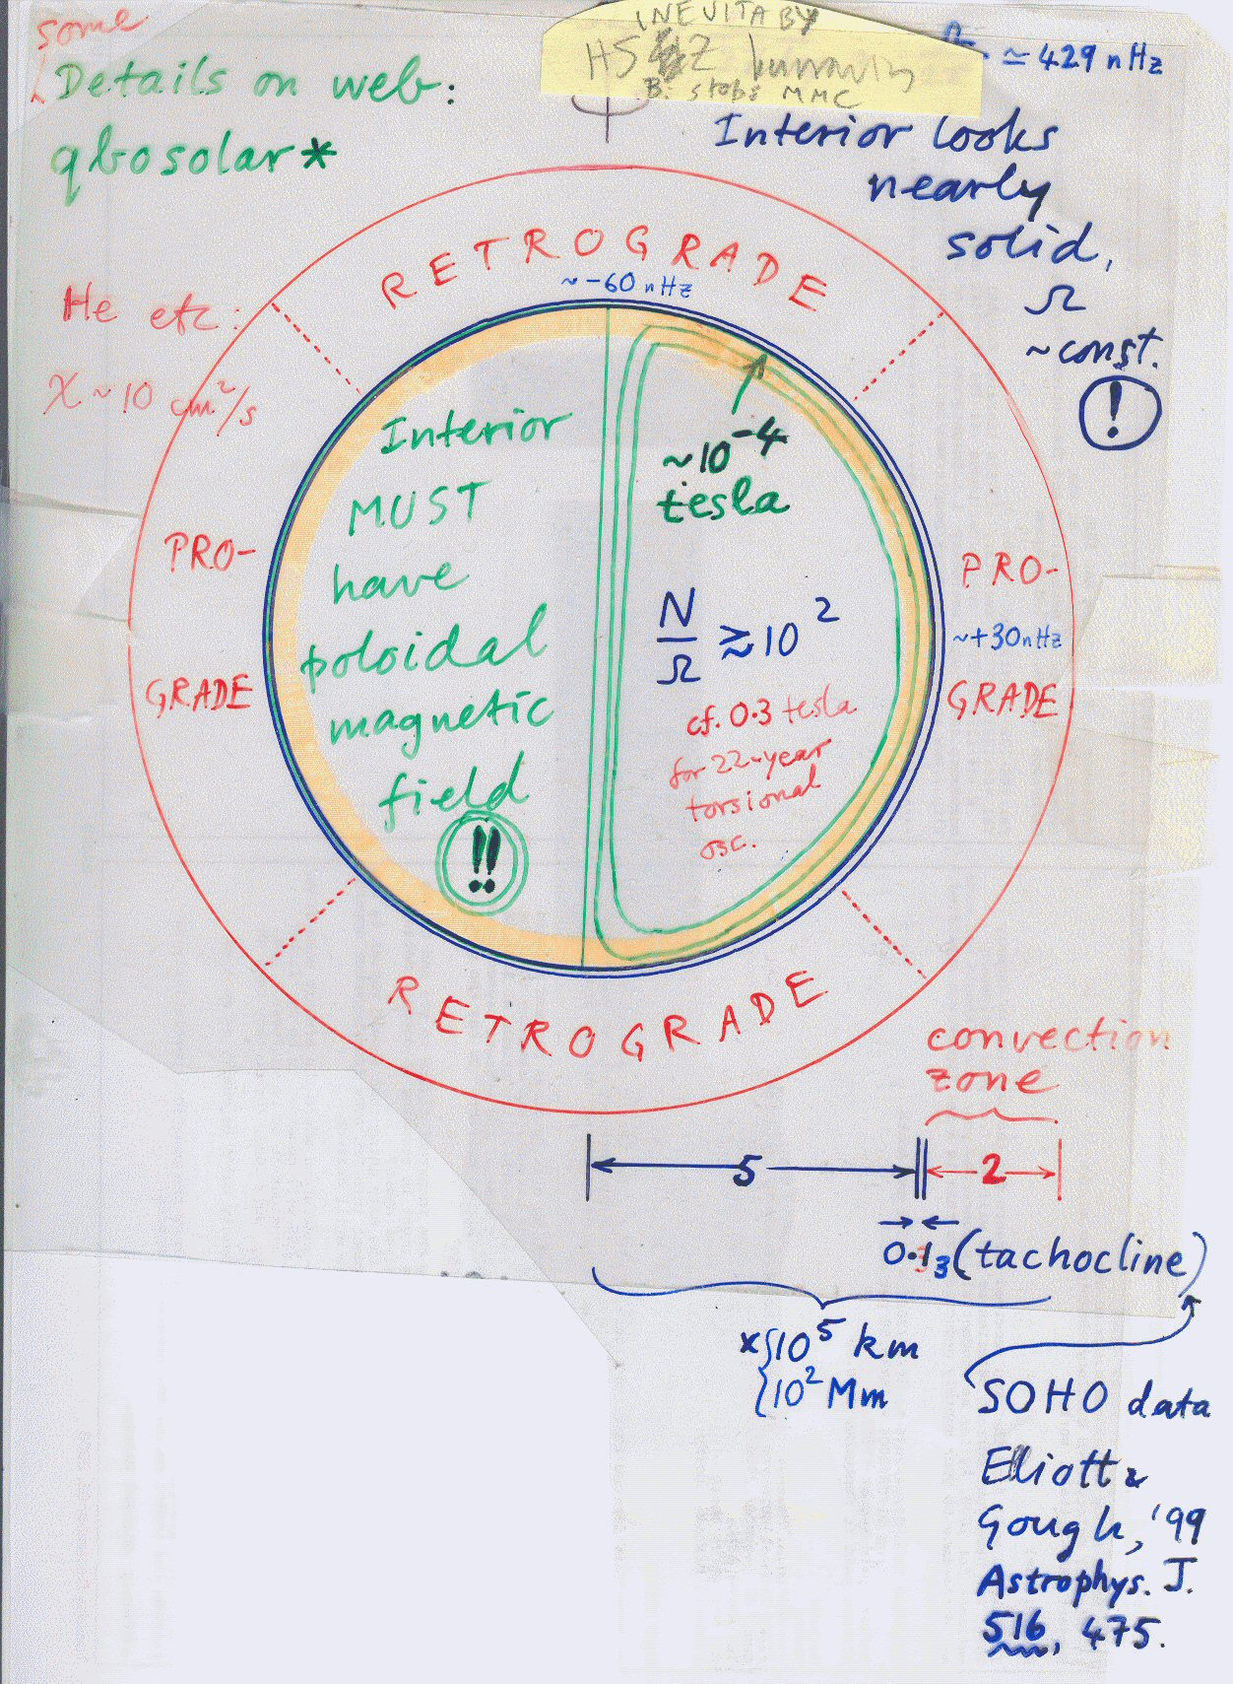

Slide 121
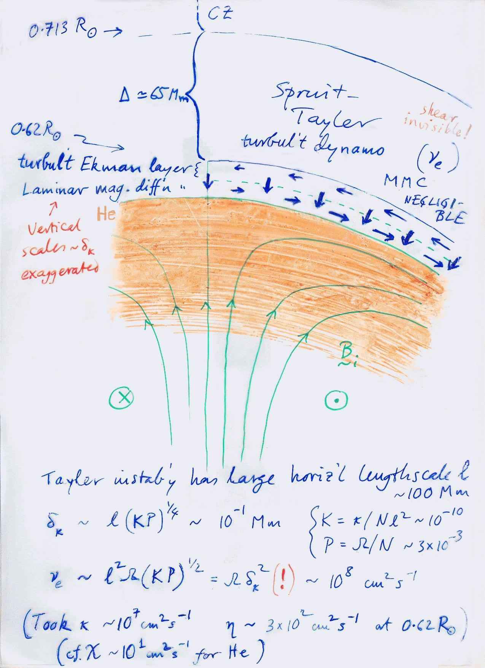
greatly

Slide 122
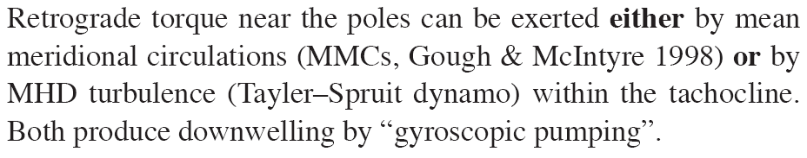

Slide 123
(& maybe MRI too,
Parfrey-Menou ’07)
Define vertical coord.
z = R – R_{helium}
Self-consistent model
in polar-cap approx’n→

Slide 124
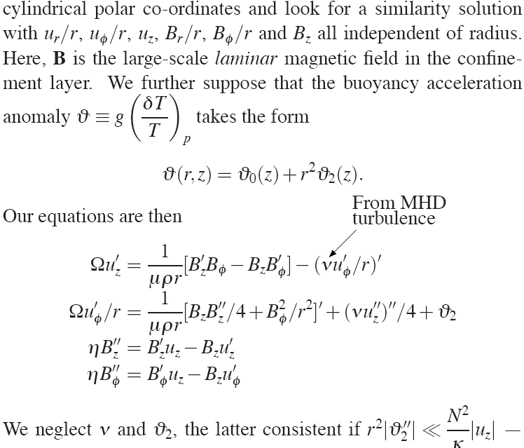
–
–

Slide 125
–
–
(Wood-McI 2007, AIP Proc)

Slide 126
–
–
(Wood-McI 2007, AIP Proc)
microscopic
viscosity is minuscule
~ 30 cm²/s

Slide 127
(Wood-McI 2007, AIP Proc)

Slide 128
(Wood-McI 2007, AIP Proc)

Slide 129
←Tayler-Spruit

Slide 130
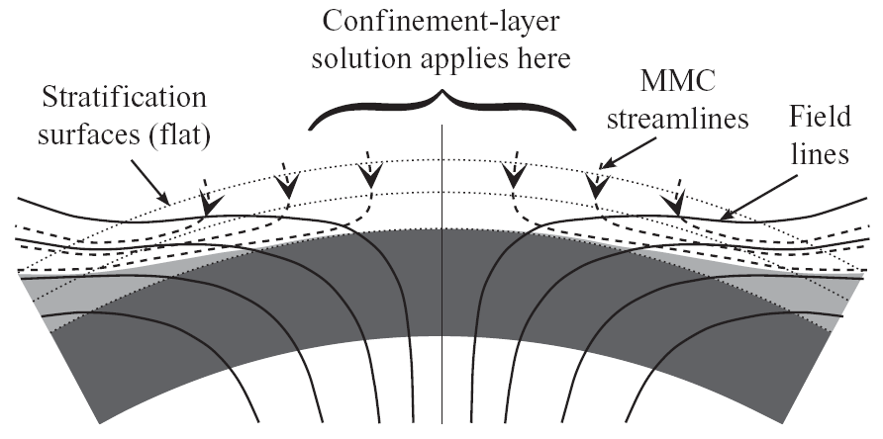

Slide 131
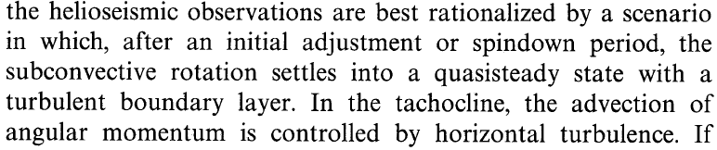
Spiegel and Zahn 1992: Astron. Astrophys. 265, 106
We conclude that

Slide 132
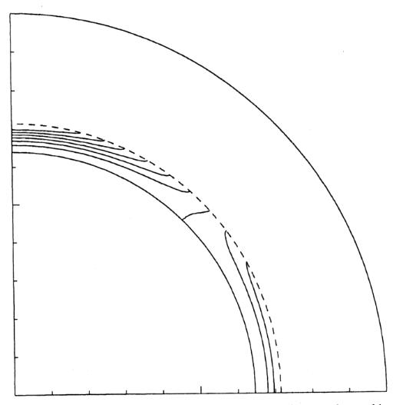
Spiegel and Zahn 1992, Astron. Astrophys

Slide 133
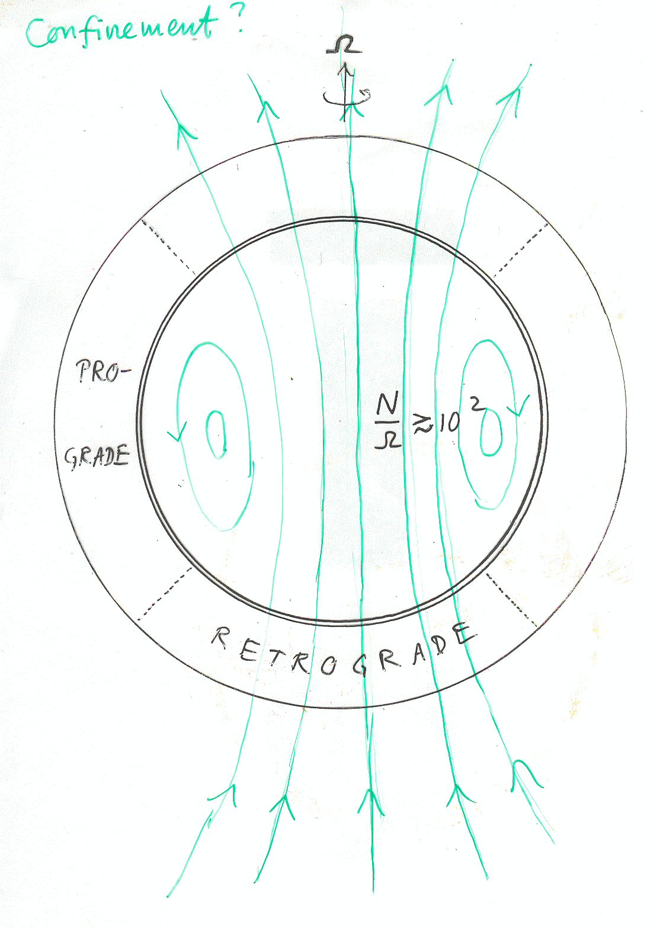
High-latitude
descent needed
to confine the field
– stop it diffusing
out like this:

Slide 134
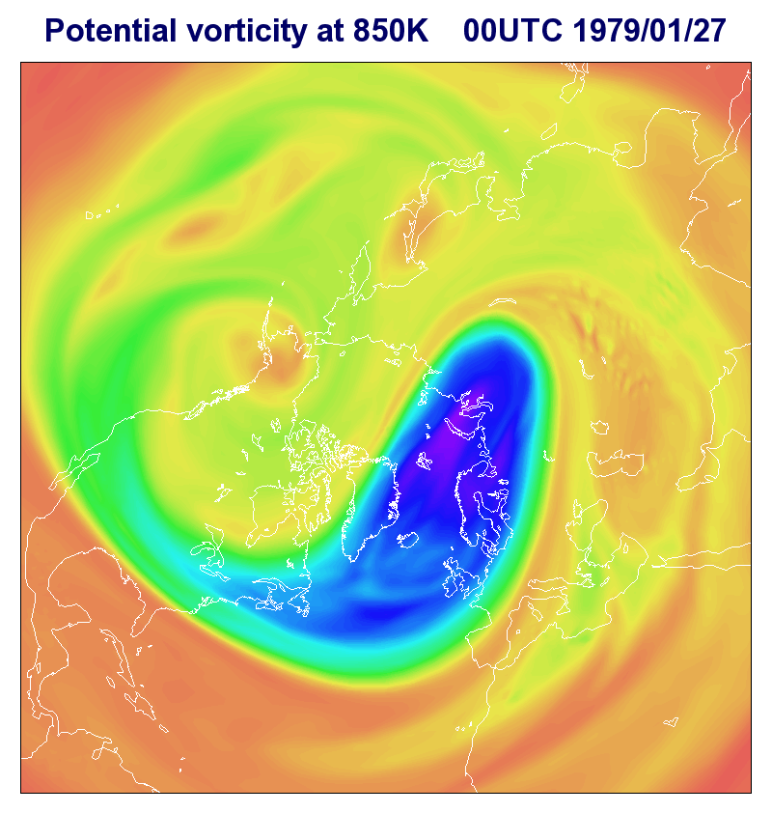

Slide 135
I
To do all the above, the time-average B
must be prevented from diffusing out like this
(à la Brun-Zahn & Garaud).
Such an “unconfined” configuration would
lock the applecore into retrograde motion.
NB: TMFP seems well demonstrated by
3D numerics when B horizontal (Brummel,
Tobias, Weiss,…). More dubious when
B vertical. FWIW, std.mean-field theory
predicts eddy-diffusive rate of change
of B equal to − curl (η_{E} J), giving a
pumping term V x J with V = − grad η_{E}.
This has no traction on a curl-free B, J=0.
However, mean-field scale sep’n dubious,
and in any case makes varied predictions
(γ-effect, curl(½ grad η_{E} x B); and perhaps
more importantly the numerics suggest that
non-Boussinesq effects are significant. My strong
intuitive feeling (FWIW) is that TMFP is less effective
near the poles – but the jury will probably be out for some time!
radiative
interior
tachocline {

Slide 139
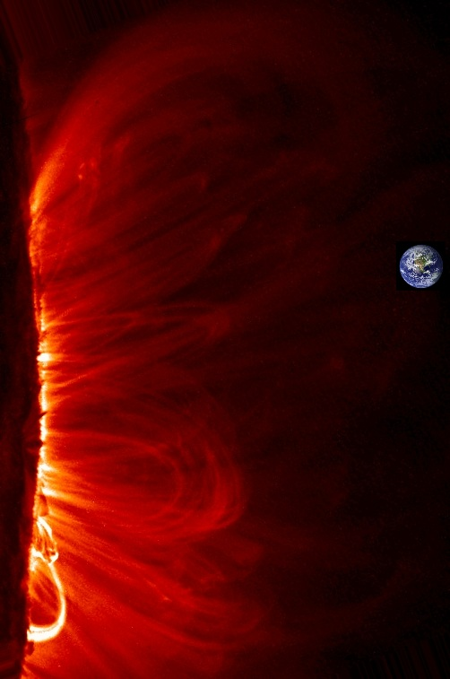
Our life support system

Slide 140
Our life support system
– how well do we understand it?

Slide 141
Our life support system
– how well do we understand it?
(scientifically, that is)
(cf. James Gleick on Feynman)

Slide 142
Our life support system
– how well do we understand it?
(scientifically, that is)
(cf. James Gleick on Feynman)
One answer: quite a lot better as a result of
the discovery of the Antarctic ozone hole and the
interdisciplinary research efforts that
followed – resulting in some of the most
thoroughly checked scientific understanding
there’s ever been on a global environmental issue.

Slide 143
Our life support system
– how well do we understand it?
(scientifically, that is)
(cf. James Gleick on Feynman)
One answer: quite a lot better as a result of
the discovery of the Antarctic ozone hole and the
interdisciplinary research efforts that
followed – resulting in some of the most
thoroughly checked scientific understanding
there’s ever been on a global environmental issue.
(I was closely involved in understanding the fluid dynamics...)

Slide 144
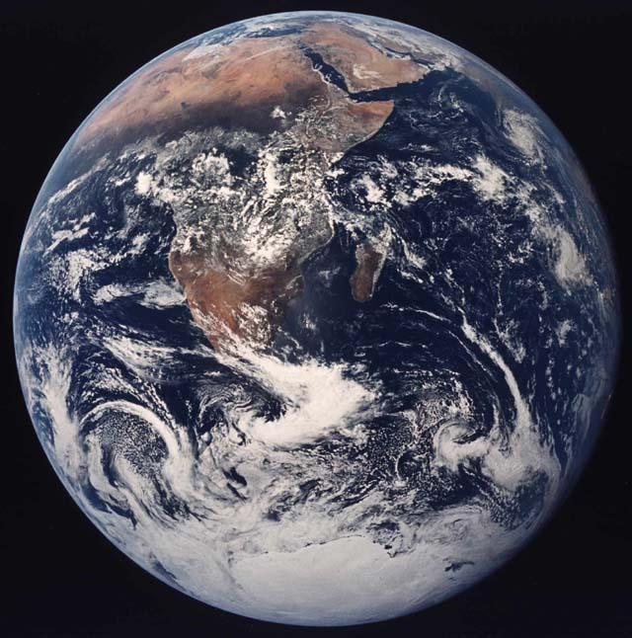
Much of my work has been on the dynamics of stratified,
rotating fluid systems like the Earth’s atmosphere-ocean
system, and the Sun’s interior.
This is only a small
– though important –
part of the whole
ozone-climate problem,
let alone the
life-support problem

Slide 145
Much of my work has been on the dynamics of stratified,
rotating fluid systems like the Earth’s atmosphere-ocean
system, and the Sun’s interior.
This is only a small
– though important –
part of the whole
ozone-climate problem,
let alone the
life-support problem
Rotation crucial…
gyroscopic effects,
“ballerina effect”, etc…

Slide 146
Much of my work has been on the dynamics of stratified,
rotating fluid systems like the Earth’s atmosphere-ocean
system, and the Sun’s interior.
This is only a small
– though important –
part of the whole
ozone-climate problem,
let alone the
life-support problem
Rotation crucial…
gyroscopic effects,
“ballerina effect”, etc…

Slide 147
Much of my work has been on the dynamics of stratified,
rotating fluid systems like the Earth’s atmosphere-ocean
system, and the Sun’s interior.
This is only a small
– though important –
part of the whole
ozone-climate problem,
let alone the
life-support problem
Rotation crucial…
gyroscopic effects,
“ballerina effect”, etc…
Other such fluid systems include

Slide 148
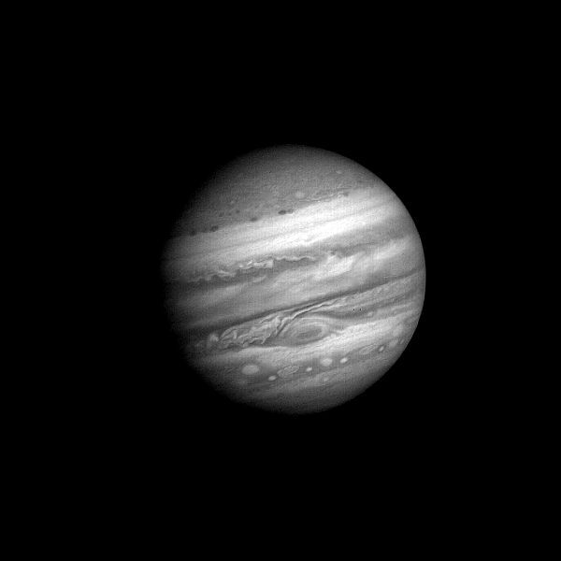
this one
Voyager 1 approaching (60 Jupiter days)
NASA/JPL

Slide 149
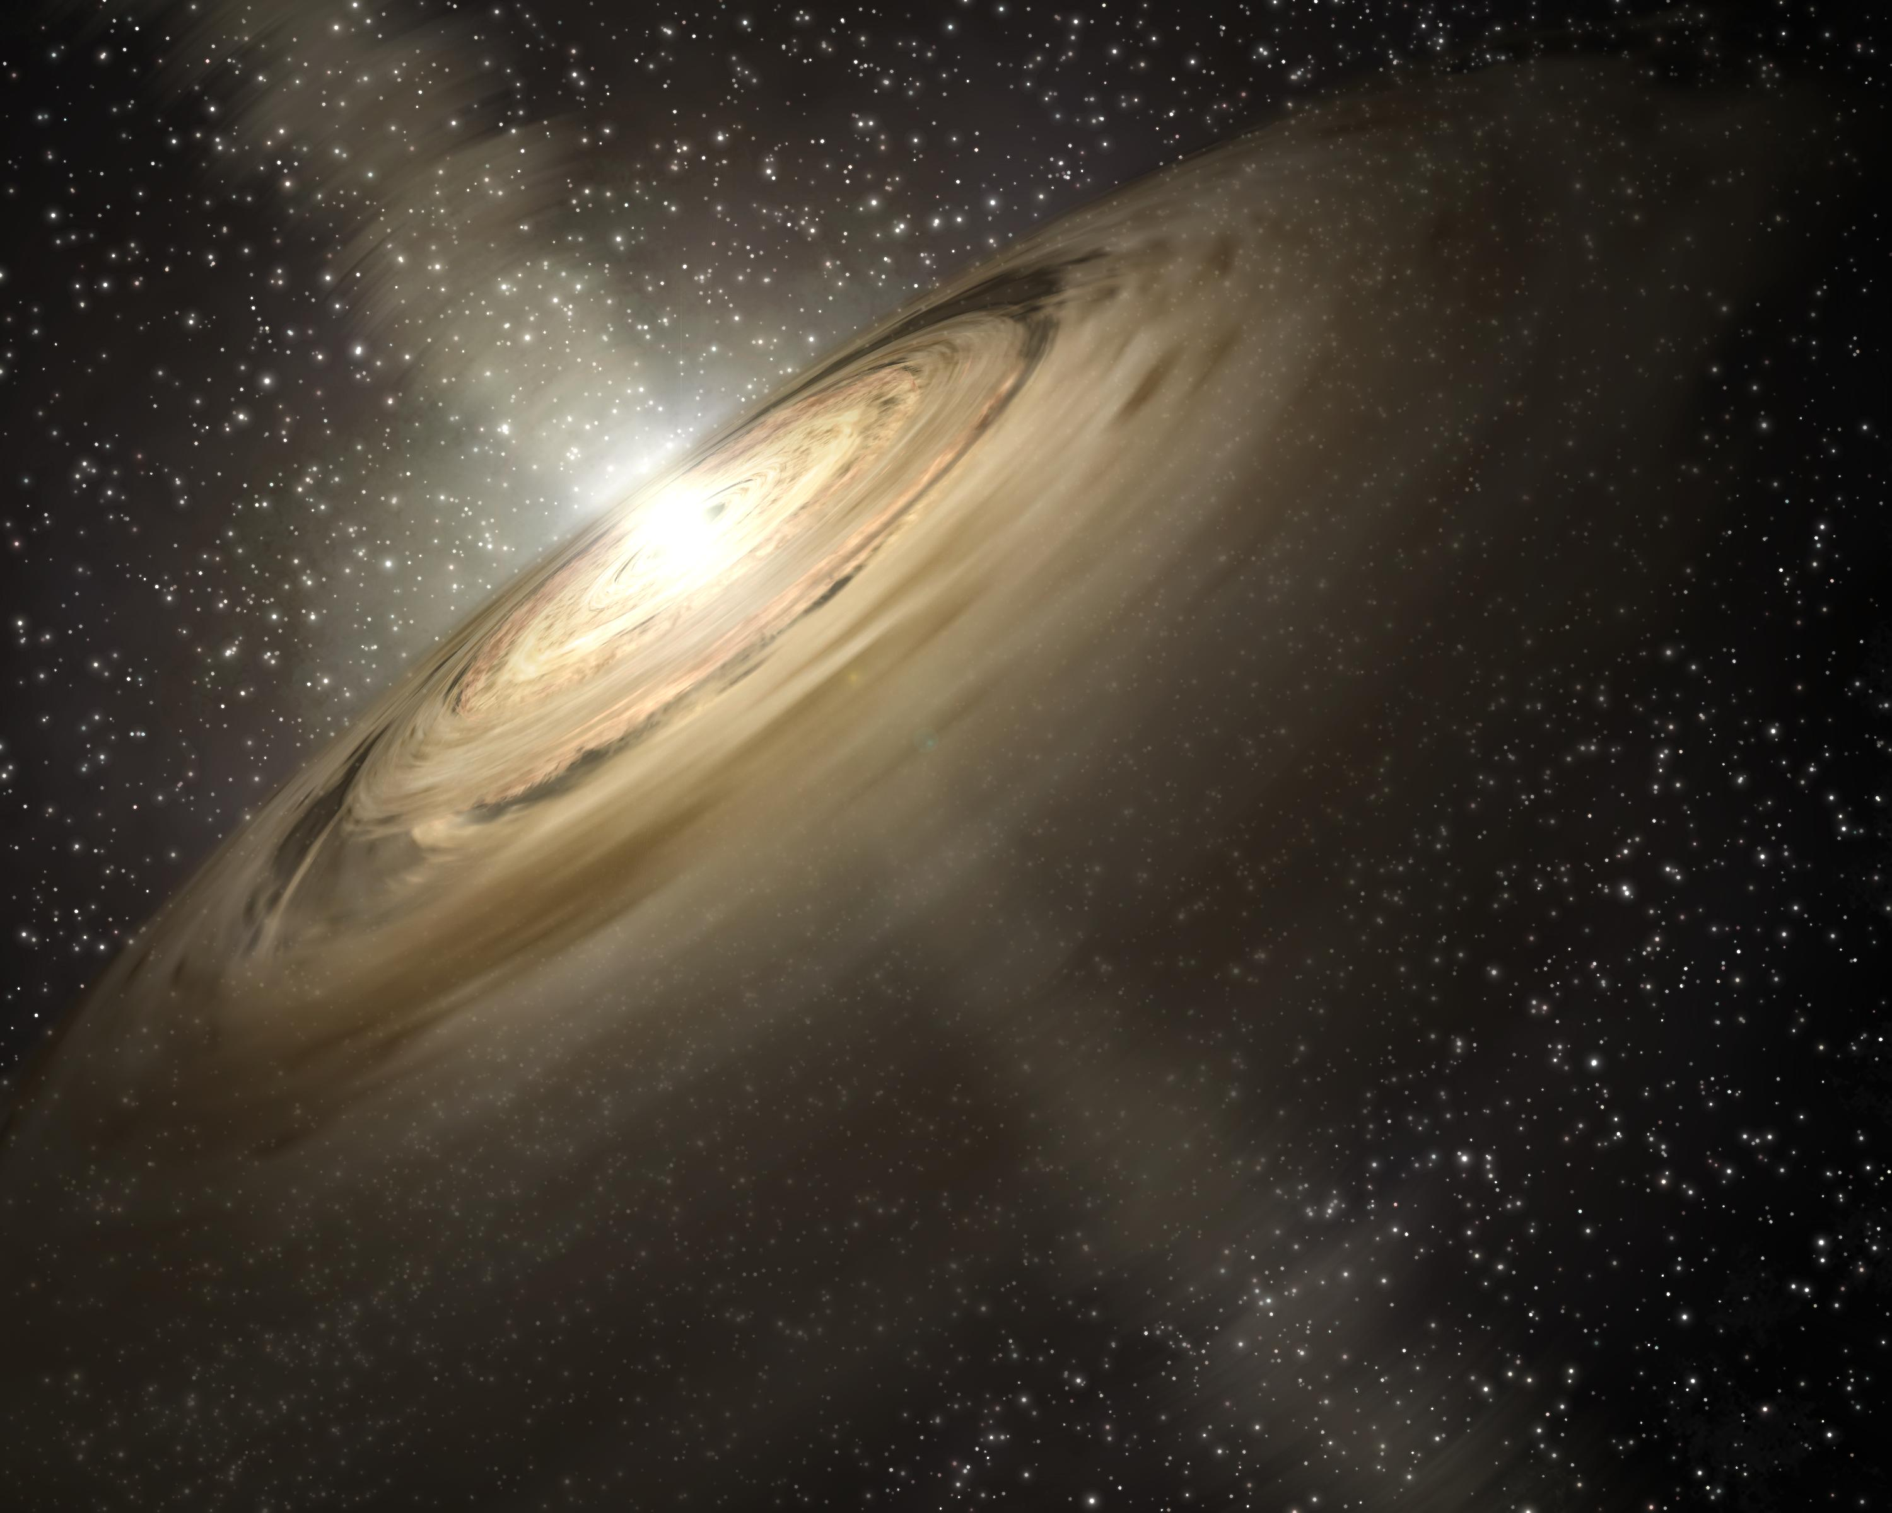
and this one – a protoplanetary accretion disk
Artist’s impression – NASA/JPL-Caltech/T. Pyle (SSC)

Slide 150
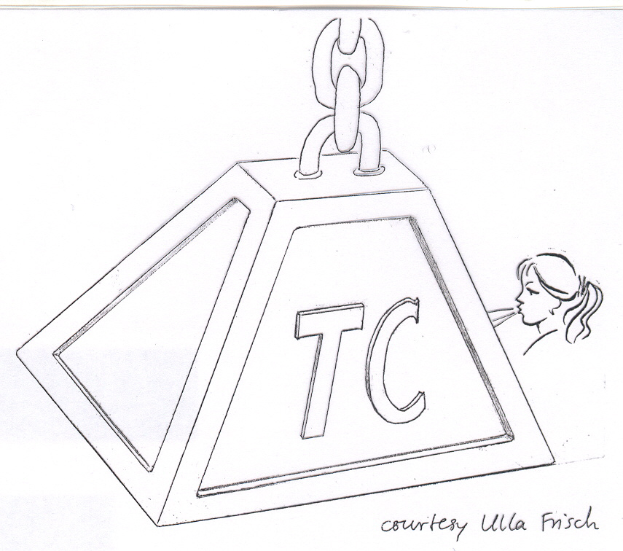
“Thermal-wind” balance is
likely to be robust throughout
most of the tachocline
(polar confinement layers
excepted)

Slide 151
Recall GM98’s schematic MMC: could it
be enough to pin the axis?
more like
“Li frying pan”
than “pit”

Slide 152
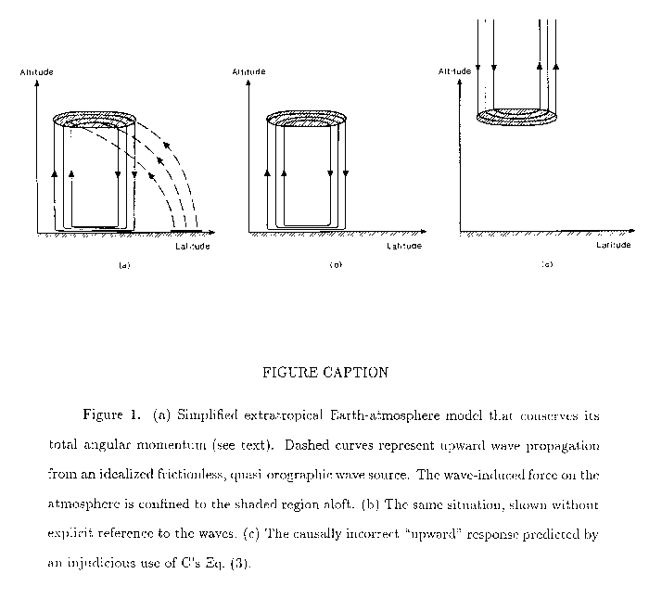
“Terrestrial” cases with a lower boundary
(Haynes, P. H., et al., 1991):
YES:
NO:
Zonal force
applied here

Slide 153
Prelude: What are these things called “models”?
(mathematical, conceptual, numerical, experimental…..
conscious and unconscious………….)

Slide 154

Kobe Lecture

Slide 155
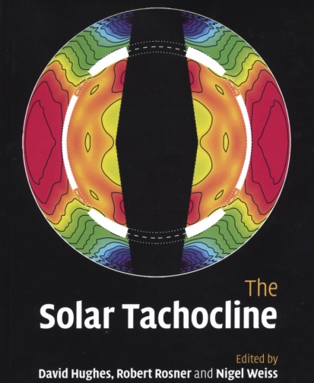



“downward
spreading”
NB:
I
I

Slide 156
I
Schematic from WM11 (Wood & McI. 2011, “Polar confinement..” (JFM 677,445)
Lines of time-average B join up through interior “applecore” region:
Assume (throughout ):
1. Turbulent magnetic flux pumping (TMFP)
from the convection zone’s overshoot layer
can hold B close to horizontal within
the tachocline – away from the
applecore axis at least.
2. Windup within the tachocline is
limited by a magnetic eddy diffusivity η_{E}
arising from all the fast eddy processes
(<< 10⁵yr): overshoot, small-scale
MHD instabilities, and the solar cycle
itself. NB: expect η_{E} and windup to be
strongly latitude-dependent.
Key implication – details in WM11:
Any such time-average B can provide the
persistent poleward angular-momentum transport
across all latitudes required to stop HSZ burrowing,
to keep the tachocline thin, and to prevent a retrograde applecore.
radiative
interior
I
I
I
tachocline {
aka “turbulent
resistivity” β

